Slide 1
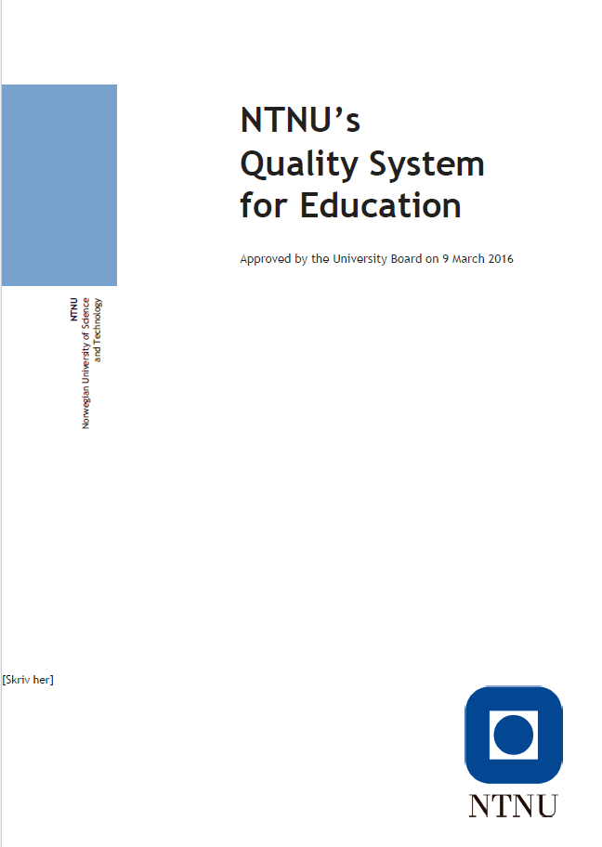
NTNU’s quality system for education

Slide 2
NTNU’s quality system for education
NTNU’s system for quality of education describes the goals of the quality processes and defines roles, responsibilities, tasks and follow-up processes
The aim is to develop the quality of education at all levels – bachelor’s, master’s and PhD – and to ensure the quality of processes and activities that influence education quality
Quality improvement work is intended to help students achieve the learning outcomes that have been defined for courses and programmes of study, and to ensure that education at NTNU is characterized by quality at a high international level, in academic and pedagogical terms

Slide 3
The quality system covers:
Portfolio quality
Programme quality
Course quality

Slide 4
Requirements for evaluation of courses, programmes and portfolios
Course evaluation During each course, the course coordinator must carry out an evaluation. All course evaluations must include a student evaluation, normally based on the reference group method. At least every third time the course is completed, the course coordinator must actively ask for feedback from all the students in the course to ensure that the information base is representative.
Evaluation of study programmes Every year, the study programme coordinator must conduct an evaluation of the study programme focused on the inner quality of the programme. The study programme coordinator must prepare a report on the programme. At least every five years, the Dean must ensure that a periodic evaluation of the programmes of study is conducted with input from students, the working world and external parties at the national or international level.
Development of the academic portfolio Measures from the course evaluations and the annual programme evaluations are implemented in the annual process for planning of studies. Based on the periodic evaluations of programmes of study, phasing out or change of existing programmes must be considered. “Requirements for studies” and accompanying guides describe the process, requirements for procedures and content.
Notes:
Development of the academic portfolio
Actions from the course evaluations and the annual programme evaluations are implemented in the annual process for planning of studies.
Based on the periodic evaluations of programmes of study, phasing out or change of existing programmes must be considered. “Requirements for studies” and accompanying guides describe the process, requirements for procedures and content.
When new programmes of study are established, the requirements specified in ‘Requirements for studies’ and accompanying guides must be met. How the new programme contributes to fulfilling NTNU’s strategy is one of the aspects that must be highlighted.
The Board considers the overall academic portfolio as an agenda item in June, and decides on changes in the academic portfolio in October. Admission capacity is determined by the Board in November/December.

Slide 5
Roles in NTNU’s quality system for education
Board
Rector
Dean
Study Programme Coordinator
Head of Department
Course Coordinator
Teaching staff
Student
Committee

Slide 6
NTNU’s quality system for education – tasks
The Dean must ensure all programmes of study have a study programme coordinator and a programme council, as well as sufficient resources for the management of the programme and quality improvement work. At least every five years, the Dean must ensure that a periodic evaluation of the programmes of study is conducted.
The Study Programme Coordinator must conduct an programme evaluation every year and prepare a report on the programme. The Study Programme Coordinator has an advisory role and must contribute to developing the learning environment as well as the academic and pedagogical quality of the programme of study.
The Study Programme Coordinator chairs the council for the programme of study and reports to the responsible line manager.

Slide 7
NTNU’s quality system for education – tasks
The Head of Department must ensure that quality assurance of the department’s courses is implemented in accordance with the requirements and that the quality processes are documented and included in the annual quality reporting process. The Head of Department approves plans of action and follows these up through resource allocation and personnel management.
The Course Coordinator is responsible for planning, coordination and implementation of the course, so that the relationship between teaching, learning activities and assessment is appropriate and helps students to achieve the learning outcome for the course. The Course Coordinator must follow up the plan of action as decided by the Head of Department.

Slide 8
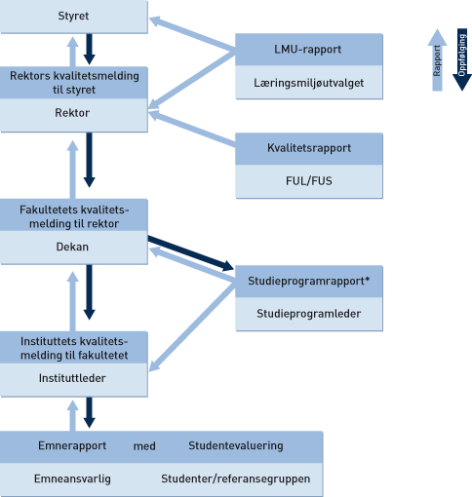
Process for reporting and follow-up
*The study programme coordinator reports to the Dean or to the Head of Department, depending on how the tasks related to quality assurance of the programme have been delegated. Where the study programme coordinator reports to the Head of Department, follow-up can also be done by the Head of Department

Slide 9
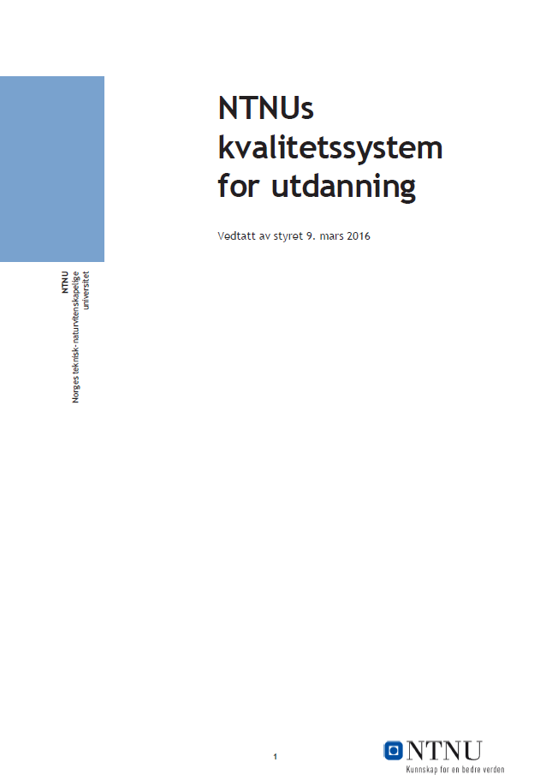
Database of course and study programme reports

Slide 10
Speak up – report problems

Slide 11
NTNU’s strategy: Knowledge for a better world
"
NTNU’s quality system aims to contribute to an education characterized by quality at a high international level, in academic and pedagogical terms

Slide 12
Further information
About education quality at NTNU:
http://www.ntnu.no/utdanningskvalitet/
Description of the system on Innsida https://innsida.ntnu.no/wiki/-/wiki/English/Quality+assurance+of+education
“Speak Up” page for reporting problems https://innsida.ntnu.no/avvik
Database of course and programme reports: https://spfarm.ntnu.no/system/doq/default.aspx

