Slide 1
KASPER for Study Programme Coordinators
Knowledge for a better world
Study programme evaluation and study plan revision in KASPER
Notes:
Welcome to the course “KASPER for study program coordinators”. Does anybody here have any experience using KASPER?
//If the answer is no: “That’s alright. In that case, we hope that this will be informative and that it will help you feel comfortable using KASPER.”
//If the answer is yes: “Great! In that case, I hope that this course will build on the knowledge that you already have and that you might learn something new anyway.”
//The goal here is to break the ice and start a discussion.

Slide 2
Agenda
Evaluating Study Programmes
Getting started
How to use Teams
Database/attachments
Tasks
Writing the report
The report portal
Break?
2. Revising Study Plans
Information and content texts
Significant changes
Tasks
Break?
3. Tool for Study Programme Components
How to navigate
Editing paths
Editing course groups
Notes:
Here is our plan for today. The material is divided into three main parts.
First, we will talk about how to carry out the study programme evaluation in Microsoft Teams. This includes how to find the Team and how it works. We will discuss how to use the database, tasks, and the report template. Finally, we will have a quick look at the Study Quality Portal, where the reports are archived.
Part two will be about the study plan revision process. Here we will look at how the study plan is displayed in KASPER, and how the different revision tool s work.
One of these tools is complicated enough that we have separated it into its own part. This is the tool for revising the study programme components, i.e., the course groups that make up the study.
Although this presentation is meant to stand on its own, and includes screen grabs illustrating everything we talk about, from experience we would recommend you clicking through KASPER while following the presentation. This makes it much easier to grasp the whole thing.

Slide 3
Evaluating Study Programmes
This part of the course builds on information from the wiki KASPER – Evaluate study programme
Notes:
Study program evaluations are continuous processes that are carried out throughout the entire school year. The evaluation is led by the study program coordinator and program administrators in cooperation with a study program council. The process happens primarily in Microsoft Teams.
The evaluation is concerned with systematically developing the study program and thereby increasing the study’s quality. This evaluation forms the basis for the study plan revision.
Information about study program evaluations can also be found on the wiki page entitled KASPER – Evaluate study program.7
NB: We will be moving away from using Teams to evaluate study programmes. The process will not change significantly, except that it will take place in the web browser, where the rest of KASPER is located. The screenshots in this presentation will be updated as soon as this change has been implemented.

Slide 4
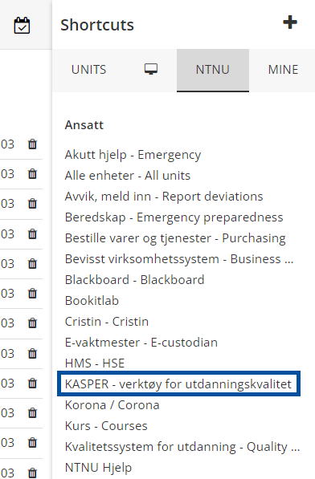
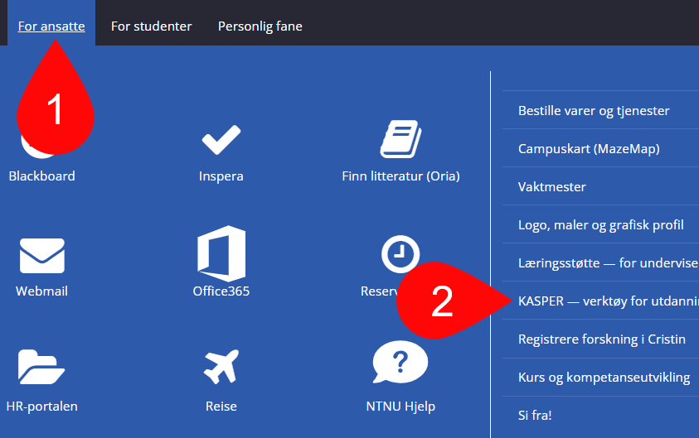
Getting Started
Log on to the KASPER start page
There are several links to it at Innsida
Click the section called «Studieprogramleder» [Study programme coordinator]
*https://studntnu.sharepoint.com/sites/studieplanlegging
Notes:
Most people who participate in the study programme evaluation will be added to the evaluation team when the faculty performs the administrative preparations for the study year. The team will then appear in their app, and a mail will be sent out about it. Thus, it is often not necessary to log onto KASPER to start the process.
That said, we will quickly look at how to get started from KASPER anyhow.
There are links to the KASPER start pages several places at Innsida, through the “For employees” tab, and under “Shortcuts – NTNU”. There is also a link from the KASPER-wiki main page: https://i.ntnu.no/wiki/-/wiki/English/KASPER+-+Study+programme+management+system
You log in with your FEIDE-user (NTNU-user). At the start page you have three options. Let's click into «Studieprogramleder» [Study Programme Coordinator].

Slide 5
Evaluate Study Programme
Click «Evaluere studieprogram» [Evaluate study programme]
Click the study programme you wish to evaluate
This redirects you to Teams
Notes:
This page leads to the KASPER tools concerning the study programme. Select “Evaluere studieprogram” [Evaluate study programme] to view a list of your evaluation teams. As mentioned previously, these will have been created by the faculty administration when starting the process, and you should already have access to them in your Teams app. The main thing this page provides is a simple overview with links to all the teams.
Click the study programme you wish to evaluate. You will be redirected to the Teams app, either in the browser or on your desktop.

Slide 6
The Evaluation Team
The evaluation team will appear at the bottom of your Teams list, titled by the study programme acronym
The study programme coordinator and the programme administrator are added as «Owners» of the team,
The study programme council are added as members
At the start of a new year, you may need to revise the member list
Adding external participants, students, etc.
Removing expired members
Notes:
When you are added to a new team it will appear at the bottom of your Teams list, titled by the study programme acronym. The Study programme coordinator and program administrator will be listed as “Owners” of the team, which means they have administration rights for it. The study programme council will be added as normal members.
Even though most members are added automatically you may need to revise the members list at the start of the evaluation, as the team is reused every year. This means removing expired members and adding new ones outside the programme council. This could be students, teachers or external participants. NB: To add someone they must have an NTNU/FEIDE user.
Should you wish to change who the program administrator is, or who is in the programme council, you need to speak to the faculty administrator, so they can make the necessary changes in KASPER.

Slide 7
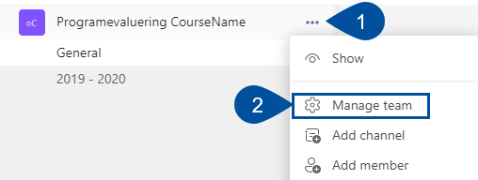
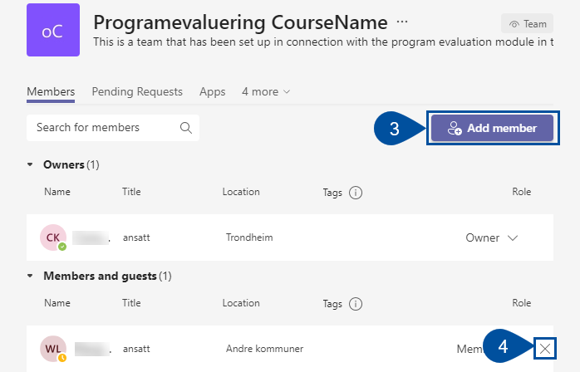
Managing Members
Click the three dots next to the team's name (1)
Click “Manage team” (2)
Add members by clicking “Add member” (3) and search by name
Remove members by clicking the ”X” next to the person’s name (4)
Notes:
You can revise the members list by clicking the three dots next to the team's name, clicking “Manage team” and then searching for the person you wish to add by name. To remove members, we click on the “X” next to the member.

Slide 8
Teams Channels
The team will have a “General” channel, which will not be used, and separate channels for each academic year (2020-2021, etc.)
These yearly channels are used in the evaluation process
Notes:
Every study program evaluation team has several “channels”. One is called “General”, is standard in all teams and typically not used for evaluation purposes.
For every academic year, a separate channel will be created, which contains the tools used for the program evaluation. Every channel is built up of a series of tabs, which we will look at now.

Slide 9
Teams Channel Tabs
Discussion forum
Share relevant files
Report basis
Home Pages
Messages/Assignments
Writing tools
Notes:
The evaluation channels have six tabs: Posts, Files, “Datagrunnlag” [Database], ”Studiebarometeret” [the study barometer], ”Oppgaver” {Tasks] , and “Rapport” [Report]. We will run though all of them one by one.

Slide 10
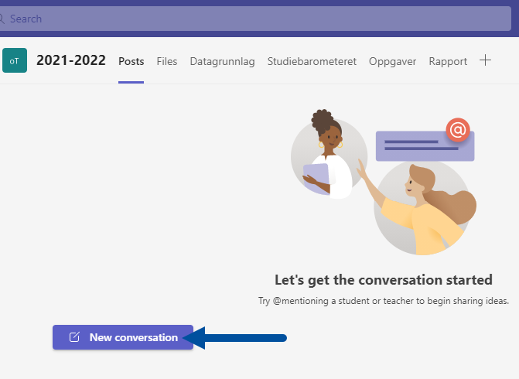
Posts
Use the posts tab to have conversations with the team members, discussing proposed changes, etc.
Expand the toolbar to find more formatting options (1)
Click the paper plane icon to send (2)
Notes:
When you click a channel, you will enter the posts tab by default. This is a conversation planform where all the members of the team may start conversations and post comments. You can discuss things like changes that should be implemented in the program, or tasks that should be added.
Click the purple “New conversation” button to start a thread. This opens a box to write in, with a toolbar below. Here you may add attachments, images, videos, and so on to your post. You can expand the toolbar to include more formatting options by clicking the “A” at the far left. Click the paper plane icon on the bottom right (2) to publish the post.

Slide 11
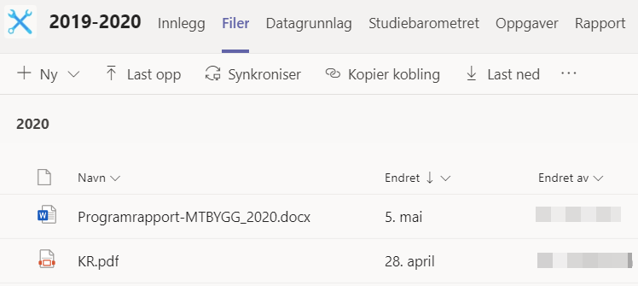
Files
Use this tab to share relevant files – everything is saved to the cloud
All members may up- and download files, or created documents directly into the folder
Notes:
The files tab is a save folder where participants can share relevant files.
You can up- and download files to and from your computer or created documents directly in the folder by clicking “+New”. Everything in saved to the cloud. Documents in this folder can be worked on directly in the team, or their respective apps on the computer, and will be continuously saved as long as you are connected to the internet.
The documents saved here are available to all members of the team during the evaluation. If you have a document that should attached to the published report, this must be uploaded in the report tab (more about this later).

Slide 12
Datagrunnlag [Database]
All documents, statistics, etc., that support the evaluation
This tab lists all the courses included in the programme, with links to their reports. Use the search bar at the top to find a specific course (1)
To the right there are links to some relevant web pages. You may add your own by clickin “Legg til lenke til datagrunnlag” [Add a link to the database] (2)
Notes:
The database is an umbrella term that includes all documents, statistics, etc., that are used to support the evaluation. This tab provides a list of all courses in the programme, with links to their course reports, as well as a list of links to other web pages that may be of use. Use the search bar to the left to locate specific courses (1).
To the right you ay add your own links to relevant documents or web pages (2). This may be other programme reports, admission numbers, completion statistics, etc. Links you add here will be included in the published report.
NB: Previously you could also attach files to the report through this tab. By popular demand, this feature has been moved to the report tab, but all the texts referencing this has not been updated yet.

Slide 13
Studiebarometeret [Student surveys]
Direct link to the Studiebarometer’s web page
Functions as a web browser with limited nagivation
Notes:
This tab is a direct link to the Studiebarometer’s web page. This tab works sort of like a normal web page, except it has no navigation buttons to move back and forth between pages.

Slide 14
Oppgaver [Tasks]
Tasks are messages, assignments, reminders, etc., that suggest some action or change to be done
All members of the team may create tasks
The owners (study programme coordinator and program administrator) chooses to accept or dismiss tasks
Accepted tasks are linked to KASPER and may be used in future study plan revisions
Notes:
This function exists to create messages, assignment, reminders, etc., that suggest things to focus on during the evaluation. This could for instance be suggesting changes to be made to the assessment forms used for a course, or the descriptions of learning outcomes.
All team members may create tasks, but you as study programme coordinator have the choice to accept or dismiss them. Accepted tasks will be linked to KASPER and may be used in future study plan revisions.

Slide 15
New Tasks
- Click “Ny” [New]
- Fill in a title, description, make someone responsible, and set a deadline
Notes:
This is what the tasks tab looks like when you open it. To add a new task to the list, click “Ny” [New]. Fill in a title, a description, choose if a specific person should be responsible for the task, and, if applicable, a deadline. When you’re finished, click “Lagre” [Save].

Slide 16
Tasks Toolbar
Select an existing task to make more options appear in the toolbar
“Ny” [New] (1) to create a new task (as we just saw)
“Detaljer” [Details] (2) to change a task’s characteristics
“Slett” [Delete] (3) to delete a task from the list
“Aksepter” [Accept] (4) a suggested task if you think it is applicable to the process
If not, use “Avvis” [Dismiss] (5) to strike out the tab, but leave it visible in the list
Notes:
You can see the toolbar by selecting a task under “Oppgaver som hører til denne evaluering” [Tasks that belong to this evaluation].
We already explained this on the previous slide.
Click “Detaljer” [Details] to change a task’s characteristics and to update its status. This opens the same panel as when creating a new task.
Click “Slett” [Delete] to delete the task. This will make it disappear from the list.
As a study program coordinator, you can click “Aksepter” [Accept] to accept a suggested task. This saves it to KASPER.
Click “Avvis” [Dismiss] if you do not think the task is needed but wish to keep it visible. It will appear stricken out in the list.

Slide 17
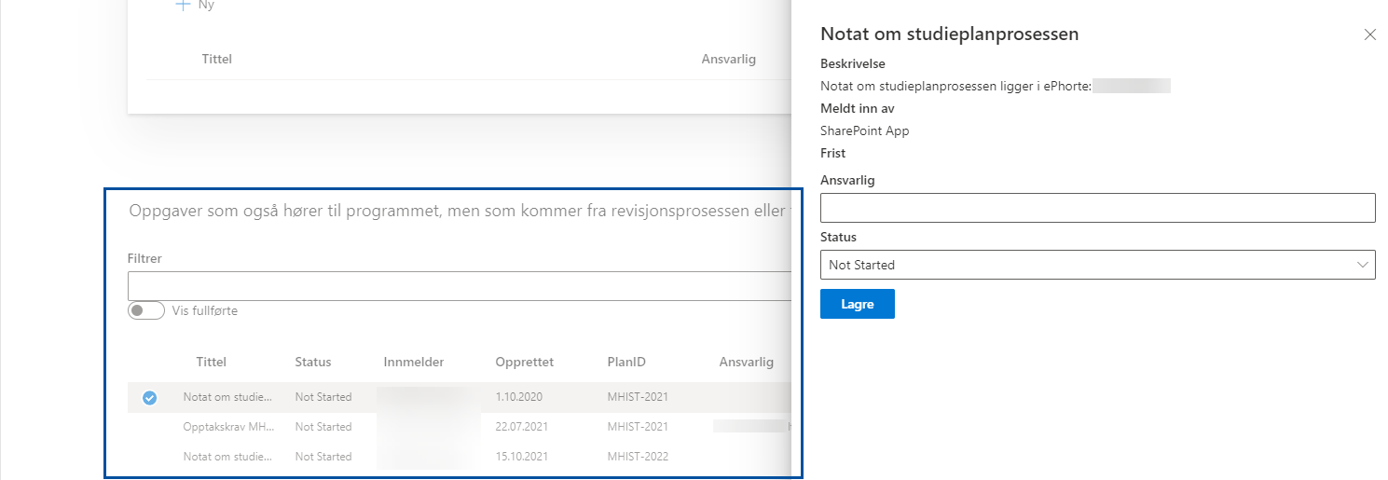
Previous Tasks
This lists tasks created in previous evaluations
Use the toggle to display completed tasks
Select tasks to change their status
Notes:
This lists tasks from earlier evaluations that were not completed. They are listed with title, status, creator, date, PlanID (the program code and year), and the person who was assigned responsibility for the task. Use the toggle to also display completed tasks.
You can change the status of a task that comes from an earlier evaluation in Teams by clicking the task, and then updating the status.
Are there any questions about tasks?

Slide 18
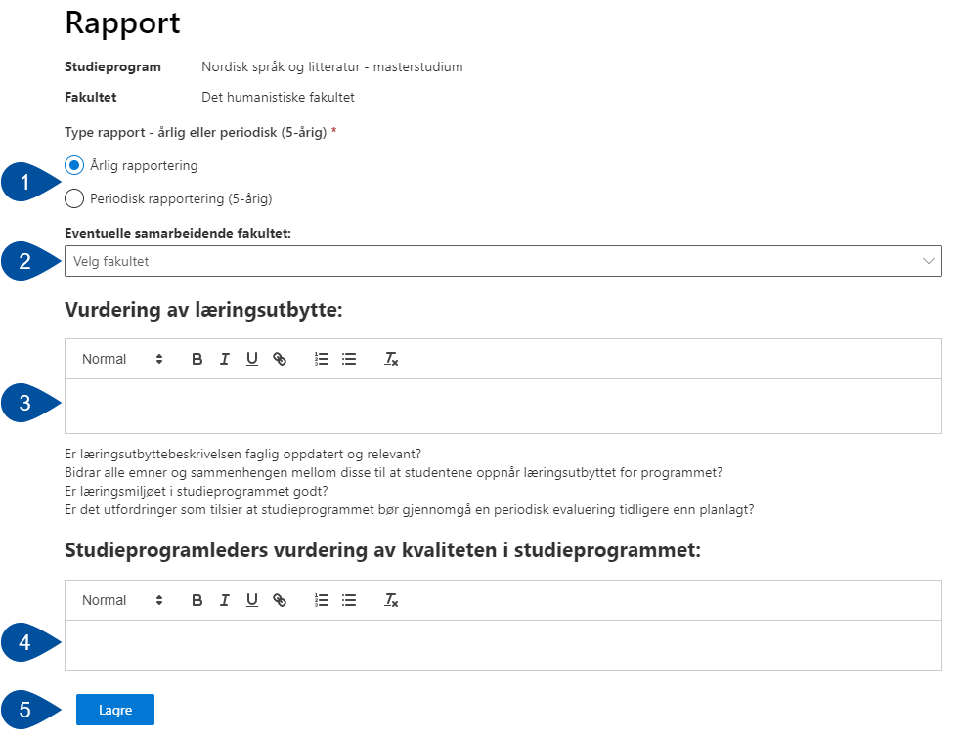
The Report Tab
Choose between “Årlig” [Yearly] or “Periodisk” [Periodic] report (1). The periodic report is larger and performed every 5 years
If applicable, add other participating faculties
Fill inn the textboxes. The template for yearly reports have two boxes (3 og 4), but the periodic may have several more
Below the last textbox is the “Lagre” [Save] button
The study programme coordinator will see a “Publiser” [Publish] button next to save.
At the bottom of the page, you can upload documents to the report database
Notes:
This tab includes a report template to fill in. The whole team can cooperate on writing the report, but only the study programme coordinator and program administrator can do the final publishing.
You start by selecting if you are writing the report for a yearly or periodic evaluation (1). The latter is a bigger evaluation, performed every five years, that requires more work and may include more people than the yearly.
If applicable, you may select other participating faculties from the drop-down menu (2).
A yearly report will have two textboxes to fill inn, “Vurdering av læringsutbytte” [Assessment of learning outcomes] (3) and “Studieprogramleders vurdering av kvaliteten i studieprogrammet” [Study program coordinator’s assessment of study program quality] (4). The template for periodic evaluation will have several more boxes.
Below the last textbox there is “Lagre” [Save] button (5). The study programme coordinator and programme administrator will also see a “Publiser” [Publish] button.
At the bottom of the page, you can upload documents to the programmes database.
Any questions before we move on to where the published report ends up?

Slide 19
Studiekvalitetsportalen [Study Quality Portal]
https://innsida.ntnu.no/studiekvalitetsportalen/
Change to English interface if needed (1)
Click “Study programme reports” to access the search menu (2)
Notes:
Let’s now take a quick look to the Study Quality Portal, or the “Studiekvalitetsportal”. This is where published course reports and study program reports end up. You can find the portal by going directly to this URL or by searching “Studiekvalitetsportal” in Innsida.
You can change the language to English by clicking the toggle in the top right corner. Note that this only changes the language of the portal interface, not the language of the actual reports.
Click “Study programme reports” to access the search menu (2)

Slide 20
Study Programme Reports
Use the search bar
Scroll through the list
Filter reports by faculty
Notes:
Here you will see a list of all study programs that have published their study program reports. You can search for reports using the study programme code, or whole name. Use the filter in the top right to only show reports for specific faculties.

Slide 21
Study Programme Reports
On the right side:
Information about the study programme
Contact information
Database attachments and links
On the left side:
The report text as filled in the template boxes
Notes:
This is what a published report looks like. To the right you will see some information about the study programme, contact info about the writers, and any attachments and links from the database. To the left is the report text, as filled in the template boxes.

Slide 22
Revise Study Plans
This part of the course builds on information from the wiki KASPER – Revise study plan
Notes:
[Ask the group if there are any more questions to that first section of the presentation. Check the time and assess/ask if the anyone need a break before continuing.]

Slide 23
Study Plan Revision
The study programme coordinator is responsible for revisions and works with the study programme council and other contributors
The revision is made each year based on an evaluation from the previous academic year
Notes:
The study program coordinator is responsible for the study plan revision, but they work closely with the study program council and other administrative or academic resources. The revision is carried out every year, and changes are based on the study programme evaluation.
The revision begins with the faculty administrator preparing the revision in KASPER. The study program coordinator will receive an email notification when it is done.

Slide 24
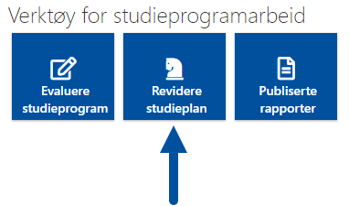
Study Plan Revision
Click “Revidere studieplan” [Revise study plan] under “Verktøy for studieprogramarbeid” [Study Programme Tools]
Click the study plan you wish to revise.
The status "Til revisjon" means that the administrative preparation is completed, and the study plan is ready for revision.
Notes:
We start by going back to the KASPER page concerning study programmes. In the previous part of this presentation, we went into “Evaluere studieprogram”. Now let’s go into “Revidere studieplan” [Revise study plan].
The page that opens will have a list of all study programmes for which you are the coordinator. The “Status” column shows you which stage in the process a plan is at. Plans with the status “Til revisjon” [In revision] are ready to revise. Click the one you wish to revise.

Slide 25
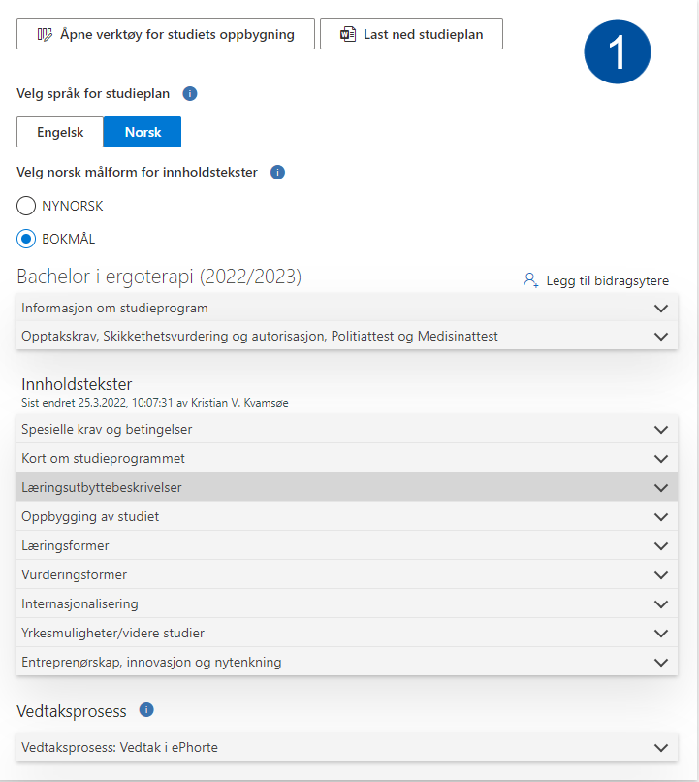
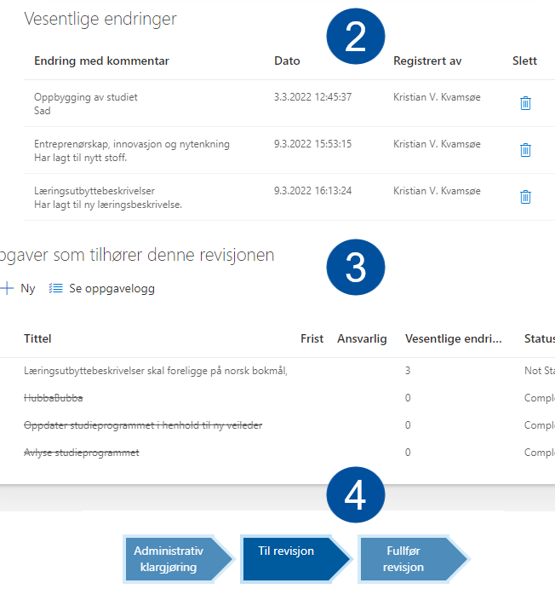
Revision Workspace
Information about the study programme, study programme components, and study plan contents (1)
“Vesentlige endringer” [Significant changes] (2): a summary of the most important changes being made
“Oppgaver som tilhører den revisjonen” [Revision tasks] (3): The study programmes follow-up plan
The arrows at the bottom show you how far the revision process has come
Notes:
The workspace for study plan revision looks like this, only the sections are oriented vertically on the actual page. You use this space to revise the textual descriptions of the study programme, as well as the study programme components. For revising course descriptions, EpN is used.
This page consists of four main sections:
The top section (1) contains information about the study programme, revisable content texts, and a link to “Verktøy for studiets oppbygning”, where course groups are revised. This section is where the largest part of the revision is performed. As you can see in the image, there are several small, blue encircled “i”-s. Click these to open help texts that may guide your usage of the page.
The next section is called “Vesentlige endringer” [Significant changes] (2). This section summarizes the larger changes made to the study plan. We will return to how and what changes are registered as “significant” later in this presentation.
Under the heading "Oppgaver som hører til denne revisjonen" [Tasks for this revision process] (3) tasks, assignments, messages and such are created and listed. These make up what we call the Study Programme's "oppfølgingsplan" [Follow-up Plan]. These are the equivalent to the tasks mentioned in the evaluation part of this presentation, used for keeping track of suggested revisions. Relevant tasks created during the study programme evaluation in Teams will appear here.
At the bottom (4) some arrows show you at which step of the process the plan is now. While revising, the arrow called “Til revisjon” [In revision] is highlighted.

Slide 26
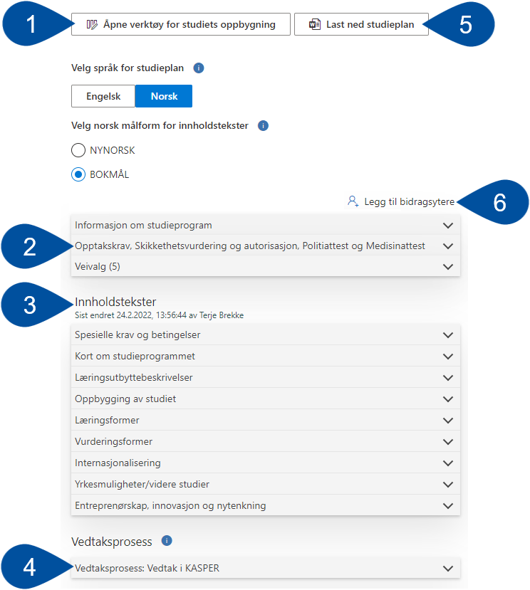
1. Study Plan Contents
Open tool for study programme components
Information about the study programme, admission requirements etc., and paths
Content texts
Approval process, summaries and comments
Download study plan
Add contributors
Notes:
This image shows you the main components of the first section. All of them are not necessarily visible at the same time but will appear when applicable.
At the top left there is a link to "Verktøy for studiets oppbygning" [Tool for study programme components] (1). This is where you edit the courses and course groups that make up the program is made up of. Since this tool is separated from the rest of this workspace and has quite a lot of features to go through, we will go through after all the other features on this page.
In the first grouping of drop-down boxes (2), you find "Informasjon om studieprogram" [Information about the study program], "Opptakskrav, sikkerhetsvurdering og autorisasjon, Politiattest og Medisinattest" [Admission requirements, Security clearance, Police certificate of conduct, and medical certificate], and "Veivalg" [Study Paths].
The first two drop-downs contain basic information about the study programme. Most of this info may not be edited here in KASPER.
Under Study Paths there are links to specific study profiles, places, and specializations included in the study programme
In the next grouping of drop-downs contains the study plan's main "Innholdstekster" [Content texts] (3). These contain the information that define the study plan and is published to NTNU's website. The content of each drop-down is revised in separate editors, in a process we will go through later in this presentation.
The drop-down called "Vedtaksprosess" [Approval process] (4) specifies whether the plan will be approved through ePhorte or KASPER. It will also list eventual summaries of the study coordinator's and faculty's recommendations, and comments made to the approved study plan.
"Last ned studieplan" [Download study plan] (5). Clicking the button will provide you some display options, for instance if you want all changes, course groups, and summaries to be visible in the downloaded document.
The button called "Legg til bidragsytere" [Add contributors] (6) is only visible to study programme coordinators and administrators and is used give additional people the access to participate in the revision process. These can be lecturers, course coordinators, or other professional resources.
We will now take a closer look at each of these functions.

Slide 27
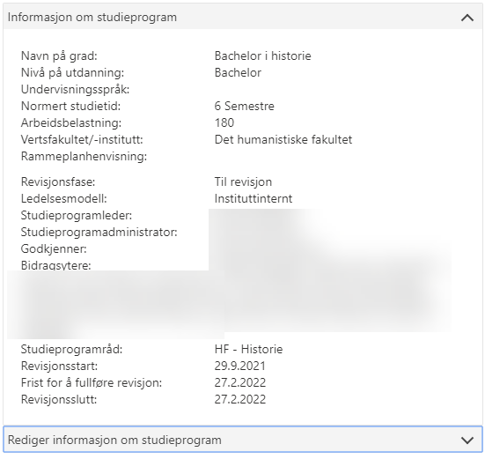
1.1.1 Study Programme Information
General information about the study programme
Imported from FS and the administrative preparation in KASPER
This information is not revisable here
Notes:
When you open the first of the drop-down menus you will find some general information about the study programme. This information comes partially from FS, partially from KASPER, and is not to be revised on this page. If you find some information that needs changing here, speak to your institute’s KASPER-contact.

Slide 28
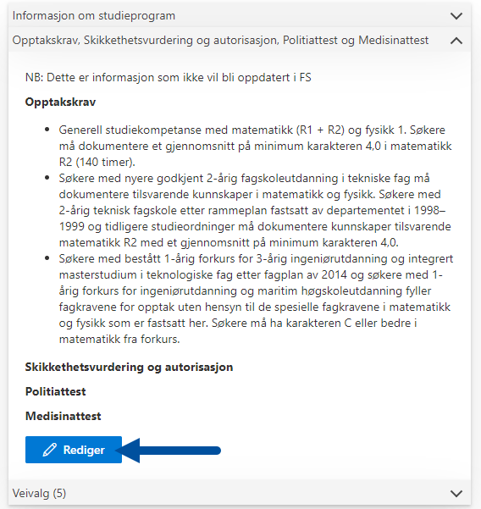
1.1.2 Admission Requirements and more
Here you may edit information about admission requirements, security clearance and certificates of conduct and health
This info is not synced back to FS
Click «Rediger» [Edit] to open the editing workspace
Notes:
In the next drop-down you will find some information that may be revised in KASPER. This includes admission requirements, security clearance, and certificates of conduct and health. However, this information will not be synced back to FS.

Slide 29
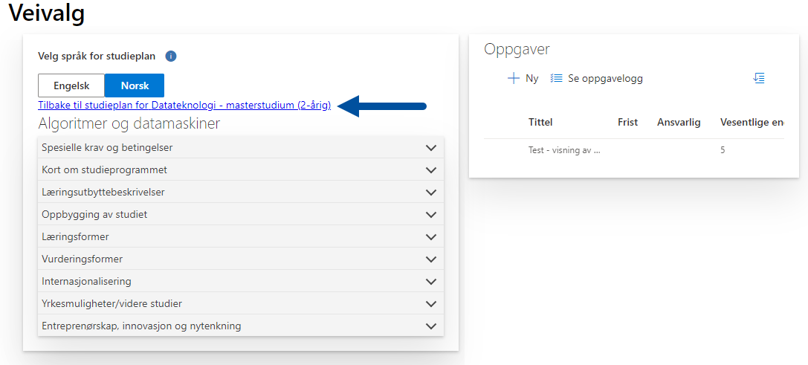
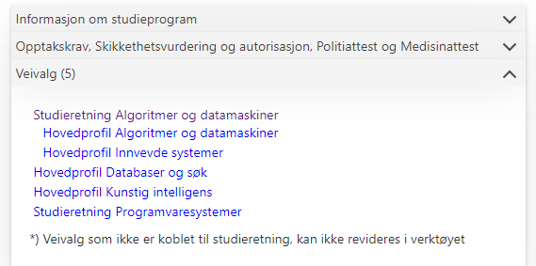
1.1.3 Paths
Study programmes may contain different paths, fields of study, specializations etc.
In this drop-down menu there are links to the different paths. Here you may edit content texts and create tasks for each path
Notes:
Study programmes may contain several different paths, fields of study, specializations etc. These will be listed in this drop-down menu.
Click the link to open a specific path and find its content texts and tasks. You may edit these in the same way you do for the main study plan. To return to the main study plan, click the link at the top (see arrow).

Slide 30
1.2.1 Content texts
Texts describing the study programme
These texts are published on NTNU’s website
Open a drop-down menu to see the text for a given heading
Click “Rediger” [Edit] to open the editing workspace
Notes:
The content texts make up the descriptions of the study programme that are published on NTNU’s website. Open the drop-down menu to see the text for a given heading. Click “Rediger” [Edit] to open the workspace for editing in a new window.

Slide 31
1.2.2 Edit content texts
Workspace for editing content texts
Editing to the left (1) and guiding texts to the right (2)
“Historisk tekst” [Text history] is a color-coded change log
Use the toggle (3) to select if the changes you are making are significant or not
“Lagre og lukk” [Save and close] (4)
Notes:
This is what the workspace for editing texts in the study plan looks like. It looks about the same for all content texts, with some minor differing details. The left side is used to write new or edit old texts. The toolbar at the top of each textbox provides some formatting option (1).
For most content texts there are two tabs to the right (2). Under “Informasjon” [Information] you will find some guiding texts to assist your editing. These texts come from the NTNU guidelines for designing study programmes (Studieplanveilederen).
“Historisk tekst” [Text history] is a changelog that shows you how the texts have been edited since the previous revision. New texts are color-coded green, while deleted text is red with a line struck through.
At the bottom left you can see a toggle for “Vesentlig endring” [Significant changes] (3). Toggle this off if the changes you are making are not “significant”, i.e., just restructuring, fixing typos/grammatical errors, etc.
When saving your work (4), if the changes are significant, you will be asked to write a summary of the changes, and potentially connect them to a task. We will look more closely at this a little later.
This workspace looks slightly different for the content text called “Læringsutbyttebeskrivelser” [Descriptions of learning outcomes], so we will look at that in the next slide.

Slide 32
1.2.3 Descriptions of learning outcomes
The content text “Læringsutbyttebeskrivelser” [Descriptions of learning outcomes] has different tabs of guiding information
“Emneliste” [Course list] (1) shows you course descriptions from the previous year
“Veileder” [Guide] (2) shows you NKR’s* definitions of what the term “learning outcomes” means
*The Norwegian Qualifications Framework for Lifelong Learning
Notes:
When editing “Læringsutbyttebeskrivelser” [Descriptions of learning outcomes] you will see two other tabs in addition to the previously mentioned texts history.
“Emneliste” [Course list] (1) shows you course descriptions from the previous year, for all courses in the study plan. NB: These texts will not be automatically updated if any changes to the descriptions are made in EpN during this revision.
The “Veileder” [Guide] (2) tab has information from The Norwegian Qualifications Framework for Lifelong Learning, establishing how they define the term “learning outcomes”.

Slide 33
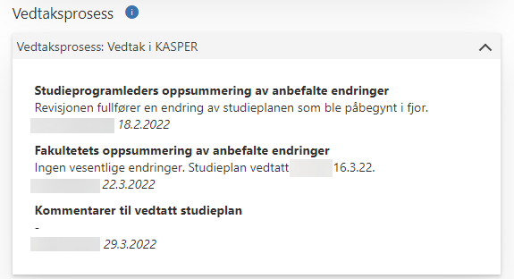
1.3 Approval process and summaries
Specifies if the plan is approved through ePhorte or KASPER
List the study programme coordinator and faculty’s summaries of recommended changes
Notes:
In the drop-down called «Vedtaksprosess» [Approval process], you will find whether the plan is approved through ePhorte or KASPER. You will also find the study programme coordinator and faculty’s summaries of recommended changes, as well as comments to the approved study plan.

Slide 34
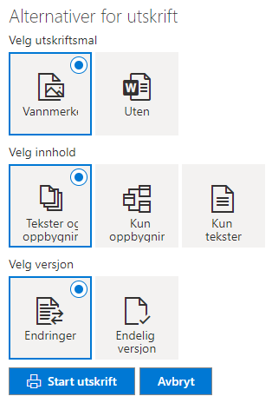
1.4 Download the study plan
Generates a document with all the information in the plan
Click “Last ned studieplan” [Download study plan] (1)
Select printing options, and click “Start utskrift” [Begin print] to download the document
Notes:
This function lets you generate a document containing all the texts and components of the study plan, which you can download and/or print.
If you click “Velg utskrift” [Chose print version] (1) you will be presented with some formatting options, like if you want only the content texts, or if the course groups should be included. When you have decided on the formatting, click “Start utskrift” [Begin print]. This generates the document, which you can choose to download or print.
If you choose the option to display “Endringer” [Changes], the document will have a page where the significant changes are summarized, and the course groups will have their changes color-coded.

Slide 35
1.5 Add Contributors
Only visible to the study programme coordinator and program administrator
Use this button to add additional contributors to the study plan revision
This could include course coordinators, lecturers, or other academic resources
Notes:
This button is only visible for the Study programme coordinator and program administrator.
Contributors are all the people who will make any form of contribution during the revision process. This can include lecturers, course coordinators, and so on. To add a person, click “Legg til bidragsytere” (“add contributors”). A new window will pop up where you can search for people by name. When you have located everyone you wish to add, click “Lagre” (“save”).
Note that any person who is added in this way will only be included as a contributor for the current revision. On the other hand, should you want to add someone as contributors for a longer period, ask your faculty administrator to add them during the administrative preparation in KASPER.

Slide 36
2. Significant changes
When editing contents of the plan, a distinction is made between two types of changes
Simple, editorial changes include fixing typos/grammar, restructuring the text without changing the contents, etc.
“Significant changes” are changes that are consequential enough that they should be logged in the system
Toggle significant changes on or off (1) before you save and close (2)
Notes:
When editing content texts, we draw a line between simple, editorial changes like fixing typos, grammar, or restructuring a text without changing its contents. Changes that are big and/or consequential enough that they should be logged are called “Vesentlige endringer” [Significant changes].
By default, KASPER will register changes you make as significant, unless you toggle it off (1) before you save and close (2).

Slide 37
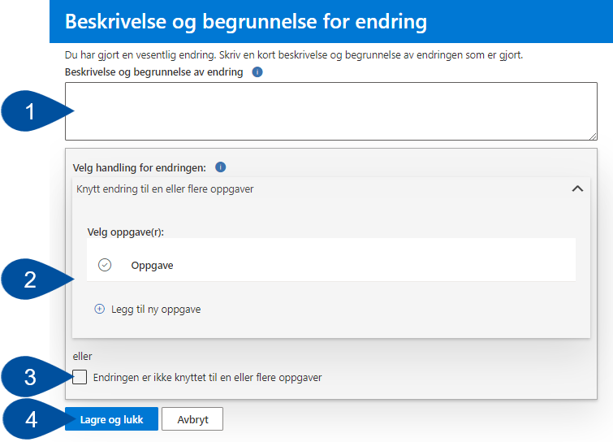
2.1 Connecting significant changes to tasks
When saving your changes this box will pop up
Fill inn a short summary of the changes (1)
Connect the changes to an existing task, or create a new one (2)
Or else tick the box below (3)
Save and close again (4)
Notes:
When you are editing content texts and save some significant changes, this dialogue box will pop up, asking you to do two things.
First write a summary of the changes made (1).
Next you may connect the changes to one or more existing tasks, if applicable. (2). You may also create a new task to connect to the change. The idea here is to be able to trace significant changes back to the suggestions made at different parts of the evaluation and revision process. If you do not wish to connect the change to a task, tick the box below (3).
When finished, click “Lagre og lukk” [Save and close] again (3).

Slide 38
2.2 List of significant changes
When significant changes are saved, they are listed in the section below the content texts
Here you can see which content text the change is made in (see arrow), and the summary that was written
You can also see who made the change, and when
Notes:
All significant changes will be listed in the section below the content texts. These will be listed with the following information: “Endring med kommentar” [Change and comment], “Dato” [Date], “Registrert av” [Registered by], and a delete button at the far right.
Under “Endring med kommentar” you will see which content text the change was made in, as well as the summary that was written.

Slide 39
3. Tasks
Click “+Ny” [New] to create new tasks
Select a task to display more options in the toolbar
Click “Detaljer” [Details] (2) to edit the contents of an existing task
Clicking “Fullfør” [Complete] (3) changes the task’s status and strikes it out
Use “Se oppgavelogg” [View task log] (4) to view tasks from previous evaluations
You can sort the list by status (5)
Notes:
As we have seen before in this presentation, tasks may be assignments, messages, reminders, etc., that suggest things to revise. In this list you will find tasks that were accepted in the latest study programme evaluation. You may also add new tasks and make changes to the details in the old ones.
Click “+Ny” [New] (1) to add new tasks.
If you select an existing task more buttons will become visible in the toolbar. Click “Detaljer” [Details] (2) to edit the contents of a task.
Clicking “Fullfør” [Complete] (3) will change the task’s status and strike it out.
If you wish to view completed tasks from previous revisions, click “Se oppgavelogg” [View task log] (4).
If needed, you may sort the tasks by status (5).

Slide 40
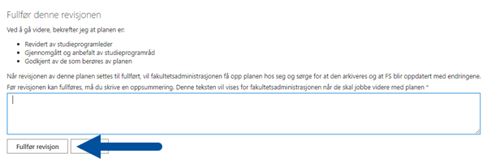
4. Process arrows
The dark blue arrow indicates the current step of the process
When finishing the revision, click the arrow called “Fullfør revisjon” [Complete revision]
You will be prompted to write a summary of the revision, and confirming that the plan has been checked and approved by all relevant parties
Notes:
At the bottom of the page there will be three process arrows, indicating at which part of the process the plan is at the moment. When finishing the revision, the study programme coordinator or program administrator may click the arrow called “Fullfør revisjon” [Complete revision].
This will trigger a dialogue box to pop up. Here you must write summary of the revisions made to the plan and confirm that the plan has been checked and approved by all relevant parties. Finally, you click “Fullfør revision” again.

Slide 41
4.1 Study programme coordinator’s summary
The summary you write will be posted under the content texts on the study plan page
Notes:
This is how the summary you write will appear on the study plan page, under the content texts in the main section.

Slide 42
Tool for study programme components
This part of the course builds on information from the wiki KASPER – Tools for study programme components
Notes:
Now we will take a step back and look at the tool for study programme components, which we skipped over earlier in the presentation.
[Ask if there are any questions to what we just went through. Check how much time has passed and decide/ask if the participants need a break before we move on.]

Slide 43
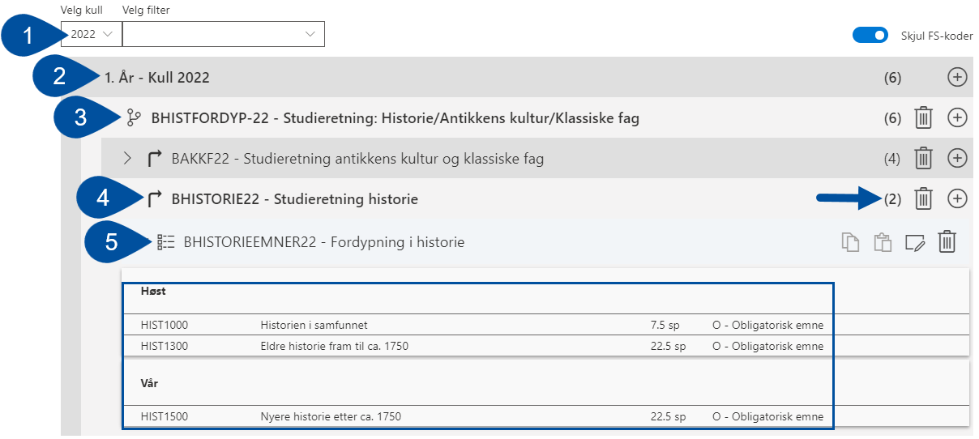
Tool for study programme components
Used for revising the course groups that make up the study plan
Navigate the menu by selecting “Kull” [Class] (1), “År” [Year] (2), path, field or place of study (3 & 4), and finally the course group (5)
The numbers to the right (arrow) show you how many course a path contains
Notes:
The tool for study programme components is used to revise the course groups that make up the study. In this tool you may add, edit, and delete courses and course groups from the plan. This tools is however only for planning, and the changes made here are not final. They can be seen as suggestions that must be approved, and then implemented in EpN and FS.
You open the tool by clicking “Åpne verktøy for studiets oppbygning” [Open tool for study programme components] at the very bottom of the content text section. The tool will open on its own page.
When looking at a study plan in the tool, it will be divided into several drop-down levels. Start by selecting which “Kull” [Class] you wish to look at (1). Then find the study year (2) and the specific field of study, place of study or other specializations (3 and 4). Finally, you may open a course group, where the courses are sorted by semester (5).
The numbers you can see to the right on each row shows you how many course groups there are in each drop-down menu.

Slide 44
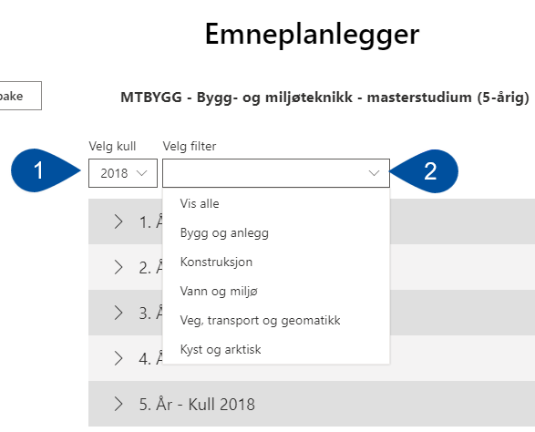
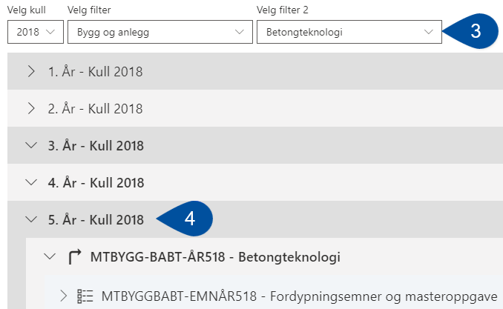
Filtering by study profiles
You may use some filters to make the course groups easier to navigate
After having selected the class (1) you may choose to filter by fields of study (2)
If the field of study has further specializations, a filter will appear for these (3)
When the filters are applied, only the course groups that fit will appear when you open a year (4)
Notes:
For study programmes with many fields of study and specializations, this course group menu may become cluttered. To help this there are some filters you can use, which makes it so only the course group that fit the filters will appear.
When having selected the class (1) the drop-down menu called “Velg filter” [Choose filter] will appear (2), if the programme has more than one field of study.
For fields of study that include further specialization, another drop-down will appear, named “Velg filter 2” (3).
When you have decided on the filters, only course groups that fit them will appear when you open a year (4).

Slide 45
Editing course groups
When you have located the field of study or course group you wish to work with, you have the following features:
Add new course group
Copy changes
Paste changes
Edit course group
Delete course group
NB: Copy/paste only works for course groups that were identical at the start of the revision
Changes made here will be color-coded green (new), red (deleted) or yellow (edited)
Notes:
When you have located the course group you wish to work with, you can see the courses listed with course code, course name, study points, and course type. All changes you make here will be color coded. New courses/groups will be colored green, deleted ones will be red with a line struck through, and courses/groups that have been edited will be yellow.
At the top right of this menu there are clickable icons for the following features:
“Add course group” (1): Use this to create a new, empty course group you can design from scratch. If the plan you are looking at has several paths/fields of study/places of study, this same icon will let you add new paths where possible.
“Copy changes” (2): Use this to copy all the changes that have been made in a course group in the current revision.
“Paste changes” (3): Use this to paste those same changes into a course group in another path/field of study. NB: The two groups you are copy/pasting between must have been identical at the start of the current revision.
“Edit course group” (4): Use this to edit the properties of the group, including name and contents.
“Delete course group” (5): Use this to delete entire course groups. Deleting an existing course group will not make it disappear, but color-code it red, and strike a line through its heading. The delete icon will then change to an “Undo” icon (arrow curving to the left) for this group.
NB: The undo-function does not work for new course groups created during the current revision. These will disappear completely.

Slide 46
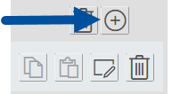
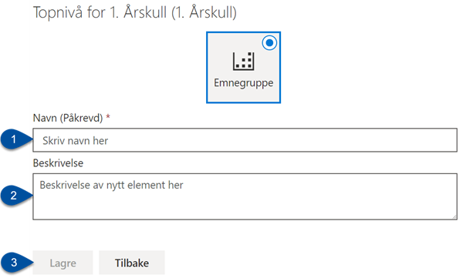
Adding course groups
When you click “Add course group” a window will appear to the right
Here you fill in “Navn” [Name] (1) and, optionally, a “Beskrivelse” [Description] (2)
Then click “Lagre” [Save]
Notes:
To create a new course group, click the plus icon we showed you on the previous slide. This will make a window appear to the right, where you must fill in a “Navn” [Name] (1) , and optionally a “Beskrivelse” [Description] (2). You finish by clicking “Lagre” [Save] (3). The course group will now appear in the list, and you may start adding courses.

Slide 47
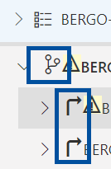
Adding paths
You may add paths, fields of study, etc., in about the same way you do course groups
Find the specific row and click the same plus-icon
The new path must have a name (1) and can not be empty. Thus, you also need to name a new course group (2)
As usual, click “Lagre” [Save] when you finish (3)
Notes:
If the study programme has more than one path, field or place of study, you can add more in almost the same way as you would course groups. Find the specific row for the path or field of study. Paths are symbolized by forked road. Under a path the fields of study are symbolized by arrows turning right. To add a new path etc., click the plus-icon on the corresponding row.
In the window that pops up you need to give the new path a “Navn” [Name] (1), and potentially a description. The new path can no be empty, so you will also need to create and name a course group (2). When you finish, click “Lagre” [Save] (3).

Slide 48
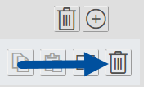
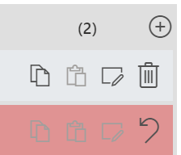
Deleting course groups/paths
You may delete whole course groups/paths/etc. by clicking the delete icon (trash-can) in the given row
Deleted items will be color-coded red, and the delete icon becomes an undo icon (arrow curving left)
NB: You can not undo the deletion of groups/path that were created during the current revision. These will disappear completely
Notes:
You may delete whole course groups/paths/etc. by clicking the delete icon (trash-can) in the given row. Deleted items will be color-coded red, and the delete icon becomes an undo icon (arrow curving left).
NB: You will not be able to undo the deletion of groups or paths that were created during the current revision. These will disappear completely.

Slide 49
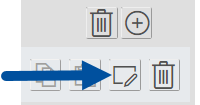
Editing course group contents
Click the edit group icon
A new window will open, where the courses are listed
Select a course to display all the editing options in the toolbar
Notes:
To edit the contents of a course group, click the edit group icon. This opens a new window, where are all the courses in the group are listed. At first the only button in the toolbar is “+Ny” [+New]. Select a course to display all the editing options.

Slide 50
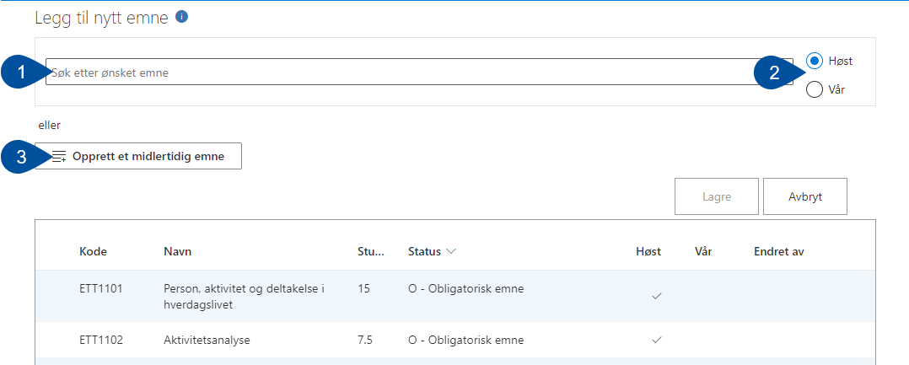
Adding courses to the group
Click “+Ny” [+New]
You may search for existing courses to add (1)
Select which semester the course is normally held (2)
Or else you can add a temporary course (3)
Notes:
Click “+Ny” [+New].
In the window that opens you can use the search bar to look for existing courses to add. Before searching, make sure which semester the course is usually held (2). If the course you want to add does not already exist in the system, you may add a temporary course (3). We will explain this feature in more detail later.

Slide 51
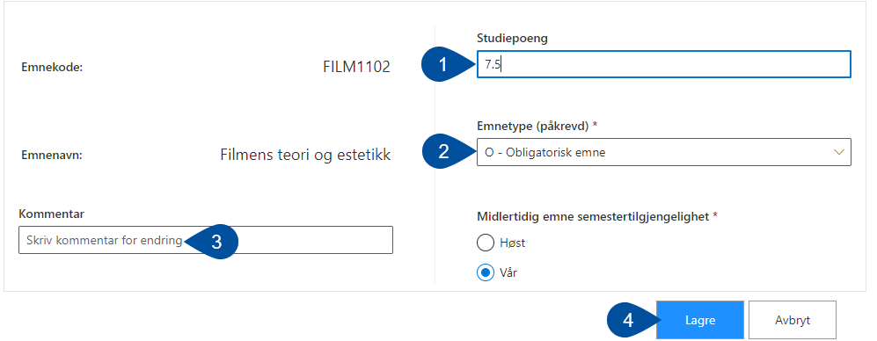
Adding an existing course
If needed, you may edit the number of study points (1) and the course type (2)
Optionally you may write a short comment on the change (3) and finally click “Lagre” [Save] (4)
New courses will be color-coded green
Notes:
When you select an existing course to add to a course, you will be presented with a few options before saving. You can choose to edit the number of study points the course is worth (1) and the course type (2). Optionally you may write a short comment explaining the changes (3), before finally clicking “Lagre” [Save] (4).
After saving a course you will be sent back to the course group, where the newly added course will be color-coded green.

Slide 52
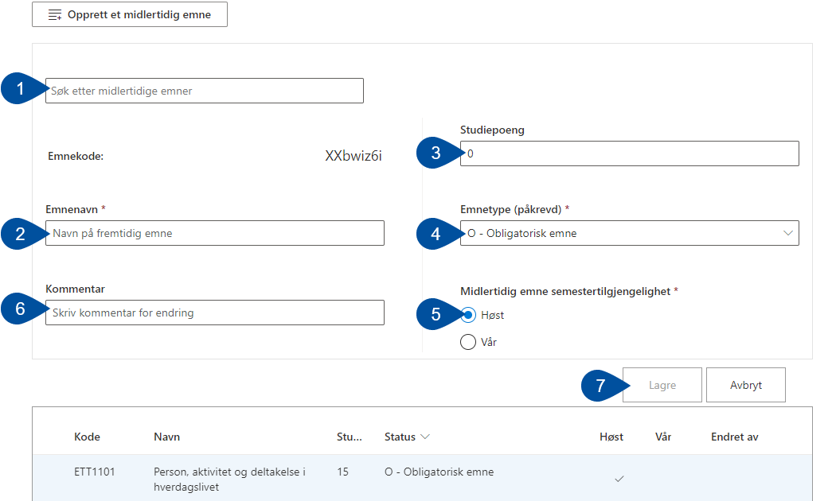
Adding a temporary (“dummy”) course
Temporary courses are place holders for courses that are coming to the study plan, but have not yet been created in EpN
They are reusable, which means you can search for and add previously created dummies (1)
When creating a new one, fill inn a course name (2), number of study points (3), course type (4), which semester the course starts (5) and (optionally) a comment (6)
As usual, click “Lagre” [Save] at the end (5)
Notes:
If you want to add a course to the study plan that has not yet been created in EpN, you can add it as a temporary course. This function creates a “dummy” course as a placeholder indicating that a “real” course will be coming.
When you click “Opprett et midlertidig emne” [Create temporary course] the window that opens will provide several options. Firstly, you can use the search bar to check if someone already created the temporary course you are thinking of. If not, you fill in a “Emnenavn” [Course name] (2), a number of “Studiepoeng” [Study points] (3), “Emnetype” [Course type] (4), “Semestertilgjengelighet” [Semester availability] (5), and an optional “Kommentar” [Comment] (6). As usual, click “Lagre” [Save] (7) when you finish.

Slide 53
Editing courses
Select the course you wish to edit (1) and click “Rediger” [Edit] (2)
The only course property you may change here in KASPER is the course type (3)
Write a comment if necessary (4) and click save (5)
Edited courses will be color-coded yellow
To make other changes, a new course must be created instead
Notes:
Select the course you wish to edit (1) and click “Rediger” [Edit] (2).
The only change you can make here is the course type (3). Write a comment if necessary (4) and click save (5). Should you wish to make bigger changes to a course, a new one must be created instead.
An edited course will be color-coded yellow, and display what change was made.

Slide 54
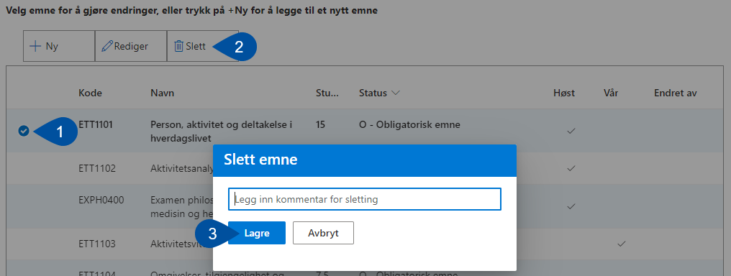
Deleting courses
Select the course you wish to delete (1) and click “Slett” [Delete] (2)
A dialogue box will pop up, asking you to write a short comment explaining why the course is deleted. Click “Lagre” [Save] (3) when you finish
Deleted courses will be color-coded red, and have its texts struck out
Unless this was a new course added in the current revision, you can undo the deletion (see arrow)
Notes:
Select the course you wish to delete (1) and click “Slett” [Delete] (2).
A dialogue box will pop up, asking you to write a short comment explaining why the course is deleted. Click “Lagre” [Save] (3) when you finish.
A deleted course will be color-coded red and have its texts struck out. For this course the delete button is now an undo button.
NB: Like with course groups, this does not apply if you delete a course that was added during the current revision.

Slide 55
Copy changes between course groups
If you have identical course groups in several paths you can copy the changes made in one to another
Click the “Copy changes” icon
Navigate to the course groups you want to paste the changes to, and click the “Paste changes” icon
Notes:
For paths that use the same course groups you can copy and paste the changes you make in one into another, which means you do not have to do the same exact changes over and over.
After having edited one group, click the “Copy changes” icon. Navigate to the group into which you want to paste the changes, and click the “Paste changes” icon.

Slide 56
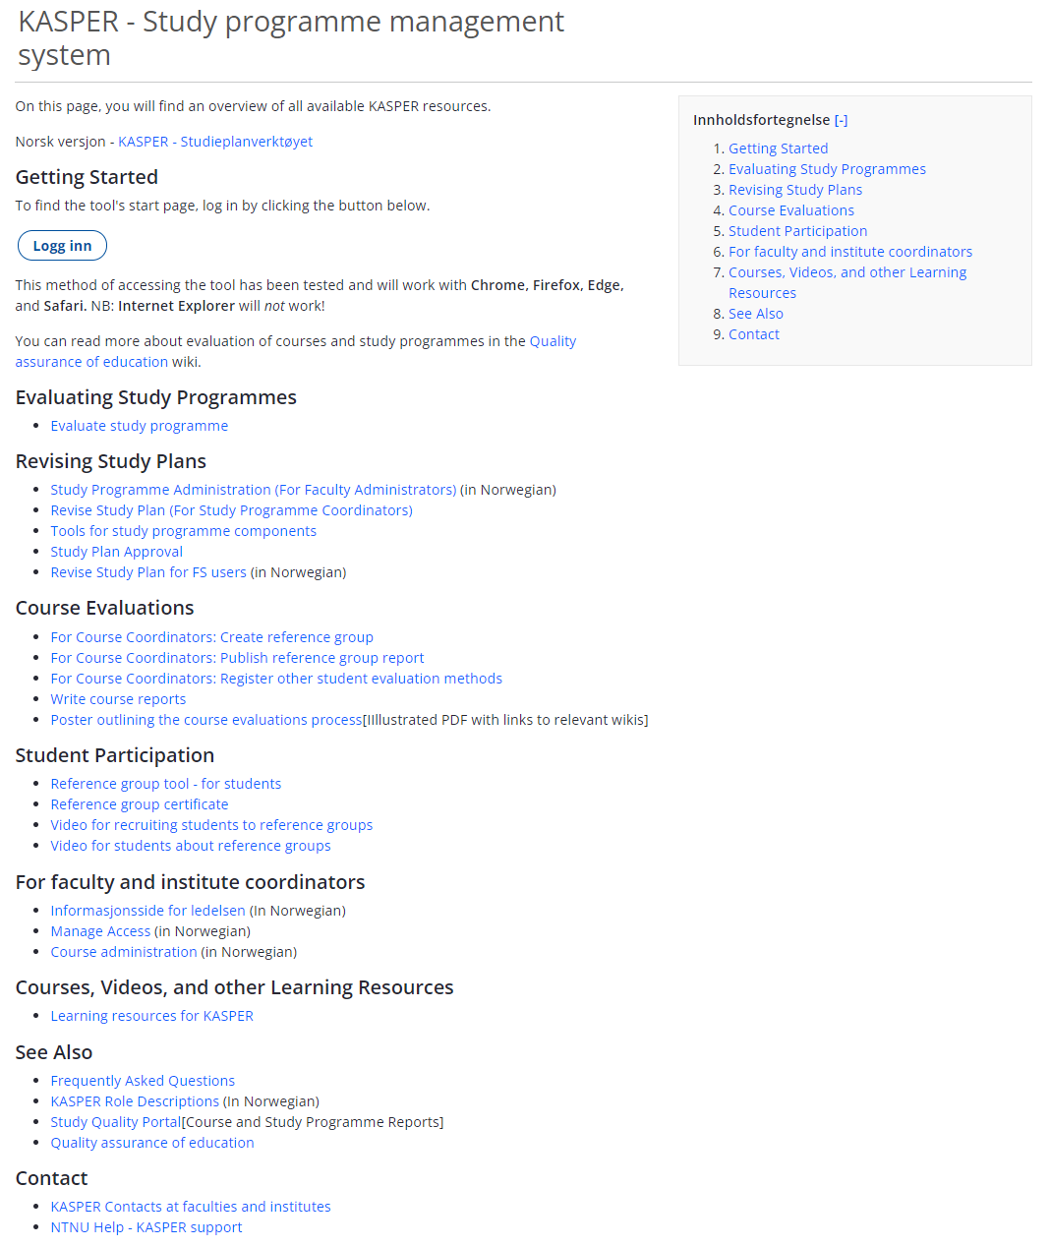
Where to get support when needed
We have a page displaying wikis about all aspects of KASPER:
KASPER – Study Programme Management Tool
Talk to the KASPER contact person for your institute or faculty. You can find your nearest contact in this wiki:
KASPER Contacts
For bigger problems/bug reports
NTNU Help – KASPER-Support
Notes:
If you have any questions about the revision process or KASPER, you can use the wiki overview for KASPER. Here you will find wikis for every topic in the tool, along with a list of institute contacts, who will be your primary contact in questions regarding KASPER.
If you are unsure as to who your institute contact is, you can find this information on the KASPER – contact person wiki.
Any final questions before we call it a day?

