Slide 1
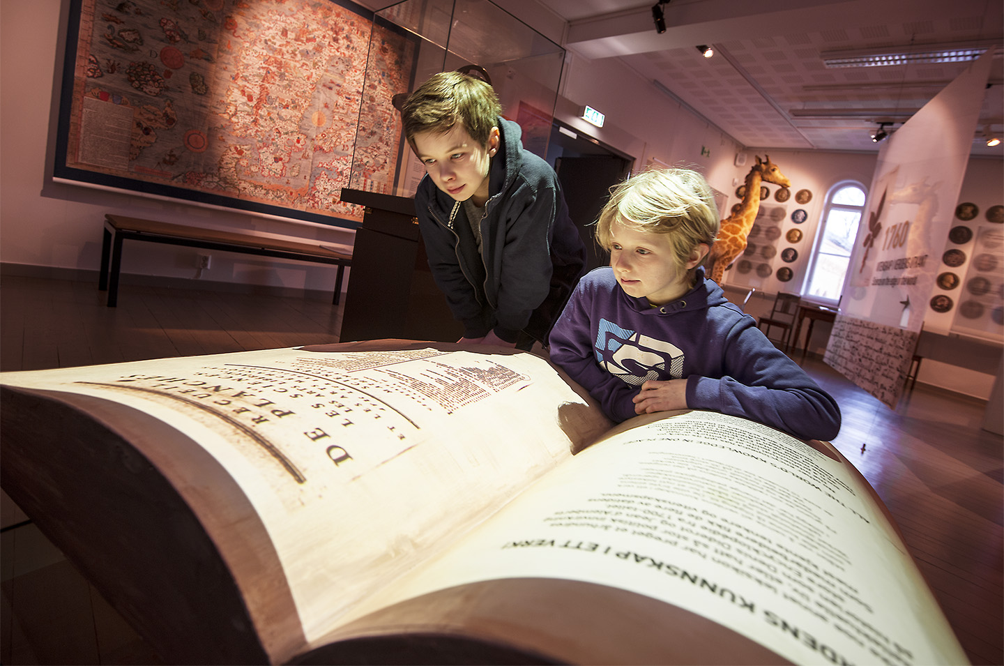
Foto: Åge Hojem/NTNU Vitenskapsmuseet

Slide 3
The NTNU University Museum is one of six university museums in Norway and forms part of the Norwegian University of Science and Technology, NTNU. The NTNU University Museum is one of the faculties at the University and consists of four departments. The Museum’s history goes back over 250 years to the establishment of Norway’s first scientific institution: Royal Norwegian Society of Sciences and Letters (DKNVS), founded in 1760. The following year, the society published Norway’s first scientific journal.

Slide 4
The Museum has four academic Departments:
The National Laboratory of Age Determination
Department of
Natural History
Department of
Archaeology and
Cultural History
Department of
Public Outreach
and Exhibitions

Slide 5
NTNU University Museum is split between two campuses:
Kalvskinnet campus, in the centre of Trondheim, with the Museum’s exhibitions, collections, Museum Administration, and three of its departments.
The National Laboratory for Age Determination is located at Gløshaugen campus
The Museum’s Department of Natural History also manages two botanical gardens:
Ringve Botanical Garden at Lade, Trondheim
Kongsvoll Alpine Garden at Dovre

Slide 6
Visions
The NTNU University Museum embraces the world
NTNU – Knowledge for a better world

Slide 7
Our mission
The NTNU University Museum is to develop and share knowledge about the natural environment and culture, and is to safeguard and preserve its scientific collections, making them available for research, curation and outreach activities.

Slide 8
Our vision for 2016
NTNU University Museum is an active producer of knowledge for the sustainable management of culture and the natural environment, at a high international level.
NTNU University Museum is a leading national resource for knowledge dissemination and research communication, and highly visible in the public debate.
NTNU University Museum’s scientific collections are secure and made available for research, management and the public.

Slide 9
Ringve Botanical Gardens offer attractive and well-functioning university gardens.
Kalvskinnet is a district that attracts attention and provides a display window for NTNU
Notes:
Second part of our vision for 2016

Slide 10
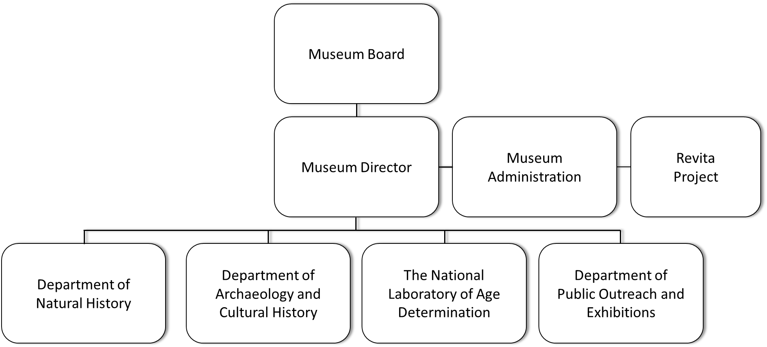
Organisation

Slide 11
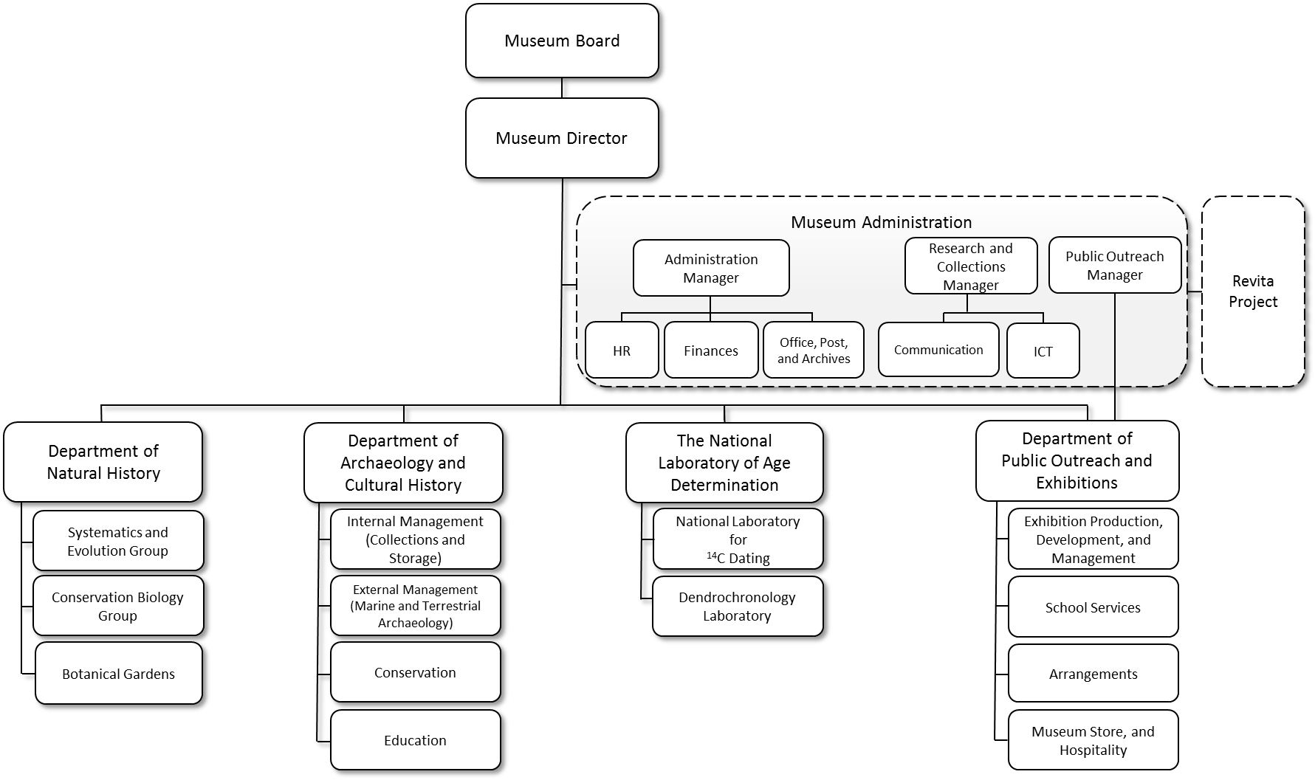

Slide 12
Departments

Slide 13
The National Laboratory of Age Determination (SA)
Dates archaeological,
geological and organic material through radiocarbon dating (14C) and dendrochronology dating (tree-ring analysis)
Changed its name in 2014 (previously known as the Department of Archaeometry)
In 2014 samples from the chapel in the Archbishop’s Palace in Trondheim, were collected for ¹⁴C-dating

Slide 14
Department of Archaeology and Cultural History (SAK)
Studies pre-historic, historic, maritime, and Sami archaeology
It conducts archaeological excavations in accordance with Norway’s Cultural Heritage Act, and runs a cultural heritage conservation laboratory
is responsible for the cultural history collections, as well as teaching the professional archaeology programme
Archaeologists clean a cultivation layer dating from the Pre-Roman Iron Age, at Sjetnan Øvre in Trondheim, summer of 2014.

Slide 15
The Department of Public Outreach and Exhibitions (SF)
Produces and maintains the Museum’s exhibitions, coordinates
public events and school programmes, and other educational
offerings
Manages the Museum Shop
The opening of the exhibition
A game between superpowers – Trondheim 1814.

Slide 16
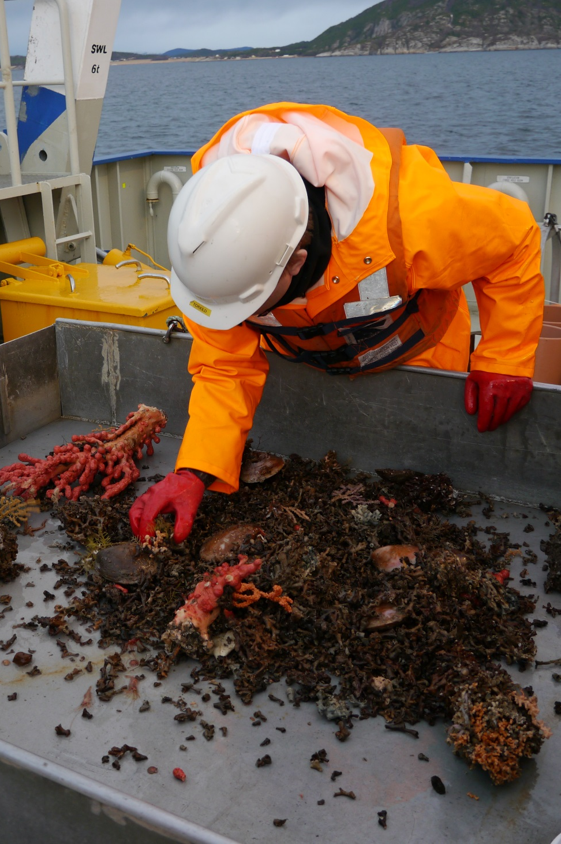
The Department of Natural History (SN) Manages and contributes to the
Museum’s natural history collections
Conducts research in biogeography, biosystematics, and ecology with an emphasis on conservation biology.
Manages Ringve Botanical Garden, Kongsvoll Alpine Garden, and Kongsvoll Biological Station
Researchers collect samples on the FF «Gunnerius», enabling them to map new areas and supply the scientific collections with additional research material.

Slide 17
Research and knowledge development

Slide 18
Scientific publications
The Museum’s number of scientific publications increased 30 % from 2013 to 2014.
The overall quality of publications, measured as the proportion of level 2 publications, improved by 20 %.
The Museum is well on its way to accomplishing its 2016 objective of producing 50 % of its scientific publications based on its scientific collections or time series.

Slide 19
Scientific publications

Slide 20
 | 2014 Results | 2014 Objective | 2015 Objective
Scientific publications based on collections or time series | 45 % | 48 % | 50 %
Events with International participation | 18 % | 19 % | 22 %
Proportion of digitised cultural history collections made available online | 80 % | 88 % | 82 %
Proportion of digitised natural history collections made available online | 61 % | 62 % | 65 %

Slide 21
Public Outreach

Slide 22
Summary
The total number of visitors of exhibitions and botanical gardens remained the same from 2013 to 2014
The department provided a substantial level of activities for School Services in 2014: Approximately 30% of visitors are schoolchildren participating in School Services outreach programmes
The Museum is, however, in need of an extensive effort to become a more active arena for public outreach activities.

Slide 23
Activities
Family Sundays, where visitors meet researchers and information about the institution’s research
For the fifth year in a row the Museum issued invitations to children between 10 to 12 to its summer school programme Sommerlarm
The Museum celebrated the Bicentenary Celebration of the Constitution of Norway by opening of the exhibition A game between superpowers – Trondheim 1814
NTNU University Museum displayed 11 temporary exhibitions

Slide 24
Activities – School Services
Approximately 1000 schoolchildren and teachers participated in the educational experience: Welcomed by the sea – the story behind the taste.
Approximately 30% of all visitors are schoolchildren participating in structured School Services outreach programmes
527 outreach programmes were organised out in 2014
The Newton energy room housed and provided lectures for 62 individual school classes from the 9th grade (ages 14 to 15).
Notes:
Welcomed by the sea – the story behind the taste: The programme is a collaboration between the Museum, biologist Kari H. Bachke Andresen and the national project Den kulturelle skolesekken (The cultural school bag)

Slide 25
Visitors
From Mortal Dinosaurs to the Oil Age
Anniversary Exhibition Knowledge Alarm
Afghanistan – Hidden Treasures

Slide 26
 | 2014 Results | 2014 Objective | 2015 Objective
Total number of visits | 124 036 | 128 500 | 128 500
Of which are visits to the botanical gardens (estimate) | 92 000 | 92 000 | 92 000
Number of School Services public outreach programmes arranged for class visits | 527 | 560 | 535
Total number of guided tours given | 720 | 770 | 715
Total number of exhibitions (permanent/ temporary) | 4 / 11 | 4 / 11 | 4 / 11

Slide 27
Publications in CRISTin
6 of 53 scientific staff produced 50 % of the total content generated in 2014
15 of 53 scientific staff produced 75 % of the total content generated in 2014

Slide 28
Communication

Slide 29
Summary
In 2014 a collaboration began with the newspaper Adresseavisen: a weekly publication in the newspaper’s Saturday supplement where the museum presents an artefact from cultural history collections
NTNU changed its provider of website statistics services to Google Analytics for its webpages in 2014.
In 2014 the Museum began to publish its archaeological excavation reports online, free of charge. The number of downloads are good and previous rapports continue to be downloaded years after their original publication dates.

Slide 30
9 Science Nordic
16 Gemini
16 Forskning.no
 | 2010 | 2011 | 2012 | 2013 | 2014
Media coverage in Norway | 762 | 867 | 1064 | 723 | 824

Slide 31
Digital and Social 2014
23 427
Museum's blogs
50 870 Norark.no
66 898
ntnu.no/vitenskapsmuseet and ntnu.edu/museum
107 907 different page views at Norark.no

Slide 32
Facebook followers
5 351 NTNU University Museum
2 972 Norark.no
1 449 Ringve Botanical Garden
31 496 user engagements
14 873 user engagements
23 111 user engagements

Slide 33
NTNU University Museum natural history journal
NTNU University Museum natural history report
Reports published online 2014: 14
Downloads: 3 000
Issues published online 2014: 6
Downloads: 1 256
Archaeological
excavation report
Downloads: 2 266
Reports published online 2014: 12

Slide 34
Education and recruitment

Slide 35
 | 2011 | 2012 | 2013 | 2014
Archaeology: Number of completed theses with supervisors at the Museum | 3 | 2 | 4 | 3
Biology: Number of completed theses with supervisors at the Museum | 4 | 3 | 1 | 6
Archaeology: Number of field course days | 1824 | 1716 | 1300 | 1135
Biology: Number of field course days | 1220 | 1207 | 1072 | 1015
Archaeology: Number of taught classes | 2144 | 2216 | 2389,5 | 2181,5
Biology: Number of taught classes | 1101 | 1034 | 1312 | 1308

Slide 36
Scientific collections

Slide 37
Scientific collections
1 308 765
Total number of objects in the natural history collections
27 253
1 506 491
6 007
Number of objects added to the cultural history collections in 2014
Number of objects added to the natural history collections in 2014
Total number of objects in the cultural history collections

Slide 38
15
discoveries by metal detectorists in Nord-Trøndelag added to the collections
9 discoveries by metal detectorists in Møre and Romsdal added to the collections
40
discoveries by metal detectorists in Sør-Trøndelag added to the collections
201 finds from metal detectors were received and evaluated
64 of these have so far been added to the Museum’s collections

Slide 39
Employees and organisation

Slide 40
Summary
Work years by the Museum has declined over several years. Between 2010 and 2014, the number dropped from 125.2 to 111.
With the conclusion of the REVITA project, the number of administrative and technical positions dropped
The number of work years in scientific positions increased in the period 2010-2014
NTNU conducted a work environment survey in 2014 on the psychosocial work environment and the organisation of work.
The proportion of females in scientific positions improved from 24 to 35.7% from 2013 to 2014
The 2014 gender balance in work years, was 46.3% for females to 53.7% for males

Slide 41
Total work years: permanent and temporary positions

Slide 42
Work years: scientific and technical-administrative positions

Slide 43
Work years per department, and administration

Slide 44
Work years by department and employment status (2014)

Slide 45
Externally funded work years by department

Slide 46
Employee gender and age ratio (2014)

Slide 47
Gender ratio of scientific positions (2014)

Slide 48
Financial Review

Slide 49
Summary
The 2014 NTNU University Museum income statement shows a surplus of NOK 2.64 million
The Museum's reserve funds were reduced in 2013 due a lower turnover from contributions and commissions than expected, and investments in employee education and skills
The transferred reserves correspond to approximately 17% of the typical operational appropriations of 2014.

Slide 50
Total income distribution 2005-2014

Slide 51
Distribution of costs 2014

Slide 52
Turnover for categories within externally funded activities (BOA) 2010-2014

Slide 53
Public heritage surveys

Slide 54
The number of finds from melted snowdrifts have increased significantly. These arrows from the Oppdal mountains are examples of such finds.

Slide 55
A decorated sheet of gold was, among other objects, found by an metal detectorist at Tornes in Fræna.

Slide 56
The basket star Gorgonocephalus caputmedusae, a medusa’s head,
is a distinctive specie that lives among corals.

Slide 57
The gold ring from Rimol in Melhus, Trondheim: A unique find that dates from the Early Roman Iron Age (200 BC - 400 AC). The ring was discovered and handed in 2014 by an amateur using a metal detector.

Slide 58
A canopy, originally from a pulpit in Orkdal church, is removed as part of the 2014 project of safeguarding the church art collection.
The pulpit was granted by the Nordenfjeldske national museum of decorative art and design.
Notes:
A canopy, originally from a pulpit in Orkdal church, is removed as part of the 2014 project of safeguarding the church art collection.
The pulpit was granted by the Nordenfjeldske national museum of decorative art and design.

