Slide 1
Faculty of Engineering
Onboarding
Communication

Slide 2
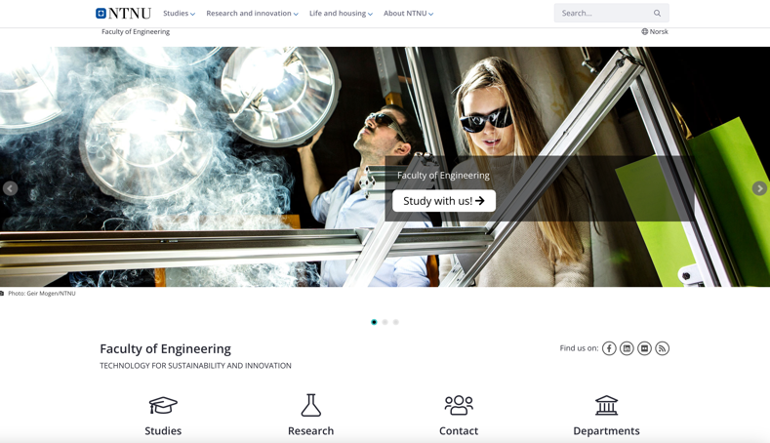
1300+ employees, 6000+ students, 8 departments, 50 study programs
https://www.ntnu.edu/iv

Slide 3
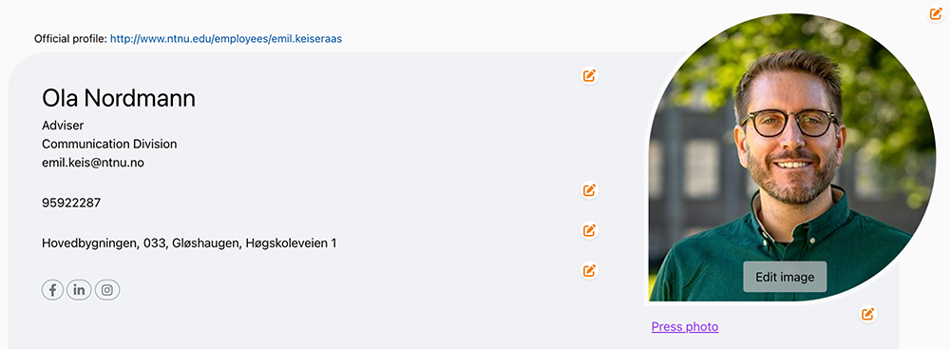
Edit your profile page
https://i.ntnu.no/wiki/-/wiki/English/Edit+your+profile+page
Notes:
Employee profile pages are widely used by colleagues, students and potential national and international partners. If you are applying for research funding, it’s highly probable that your profile page will be visited, so it is important to keep it updated.
To edit the profile page: Log in to Innsida via the Menu at the top right and click on the pencil for editing at the top of the right column.

Slide 4
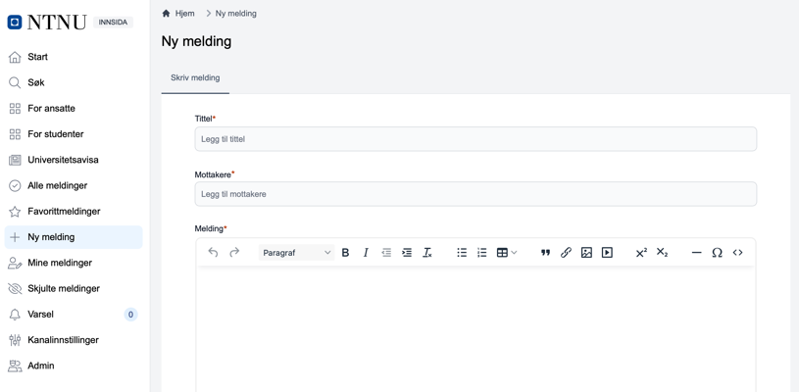
Post a message on Innsida
https://i.ntnu.no/wiki/-/wiki/English/Post+a+message+on+Innsida
Notes:
You can publish messages in channels to which you have write access.

Slide 5
Photo library
https://www.ntnu.edu/photo-library
Notes:
NTNU Photo Library = Fotoware

Slide 6
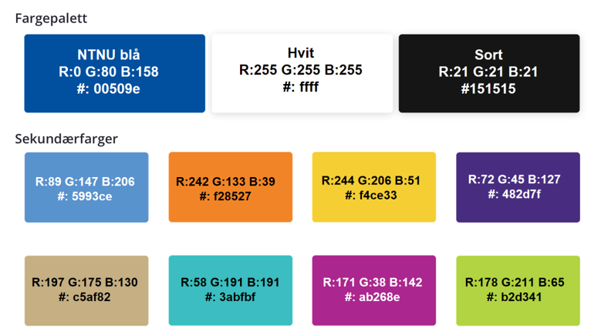
Logo, templates and graphic profile
https://i.ntnu.no/logo-og-maler
Notes:
Ready to use material, templates, colors, logos, create your own material and guidelines for graphic profile and video graphics.

Slide 7
Graphic centre
https://www.ntnu.edu/graphic-centre
Notes:
Graphic Center offers services for NTNU's staff and students. They can assist with graphic advice and design, visualization for research communication, animated graphics, newsletters, conference materials, production of signs, printing, and print completion.

Slide 8
Organize a conference
https://i.ntnu.no/arrangere-konferanse https://www.ntnu.no/konferanser/

Slide 9
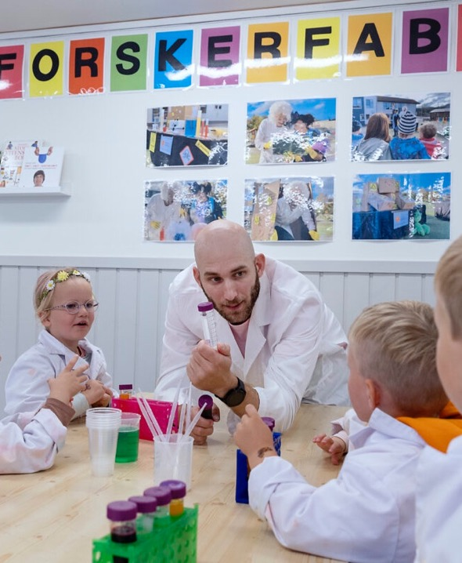
Disseminating
and
communicating
research
https://i.ntnu.no/formidling

Slide 10
Social media
https://www.facebook.com/teknat.ntnu
https://www.linkedin.com/company/ntnu-faculty-of-engineering
https://www.ntnu.no/blogger/teknat
https://i.ntnu.no/wiki/-/wiki/Norsk/Sosiale+medier+-+kanaloversikt+og+kontaktpersoner

Slide 11
Linkedin Tips

Slide 12
Top 10 Tips
Your profile
📸 Upload a Profile Picture ⭐ Get “All-Star” Status 🎤 Use Your Authentic Voice 📝 Craft an Engaging Headline 🖼️ Upload a Profile Banner 🕒 Keep Work History Up-to-Date 🛠️ Highlight Skills and Certifications 🗣️ Get Recommendations 🌐 Expand Your Network Strategically 💬 Be an Active Participant
Notes:
Her er topp ti tips for å lage en vinnende LinkedIn-profil:
Last opp et profilbilde 📸
Få "All-Star"-status ⭐
Bruk din autentiske stemme 🎤
Lag en engasjerende overskrift 📝
Last opp en profilbanner 🖼️
Hold arbeidshistorikken oppdatert 🕒
Fremhev ferdigheter og sertifiseringer 🛠️
Skaff anbefalinger 🗣️
Utvid nettverket strategisk 🌐
Vær en aktiv deltaker 💬

Slide 13
Stop effect
Start with a question or a fact.
Share knowledge with value for the reader.
Evoke emotions:
😂 Humour 💖 Touching 😨 Fear 😠 Provocation 🙌 Recognition 🔥 Engagement
Your post
Notes:
Do not start with: «I am so honoured...», «I was so glad to be invited...» Value, value, value. A great hook and the most important value first.

Slide 14
Use photos with eye contact
+20 %
Clicks

Slide 15
Personal pictures
+45 %
Reach

Slide 16
When to post
Tuesday & Thursday
9-12
Do NOT post several times a day
-20-30 % reach

Slide 17
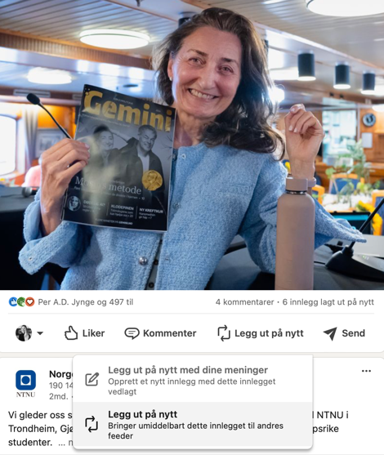
How to increase reach
+20 %
Reach
Before you post: comment on 3 other posts
A comment on your post within 60 min (you can comment on your own post)
Comment before you like a post
+40 %
Reach
2
1
3

Slide 18
#hashtags, @tags and links
# 3-5 (max 10)
@ 4 (but only tag people who responds fast, or you will decrease the reach)
URL Do NOT use a link in the post, post the link as a comment instead

Slide 19
Linkedin
Insight
Target Groups

Slide 20
Objectives
Recruit new employees and promote NTNU as an attractive workplace.
Promote research and innovation environments.
Strengthen collaboration with industry.
Notes:
Målsetting
Rekruttere nye medarbeidere og fremme NTNU som en attraktiv arbeidsplass.
Fremme forsknings- og innovasjonsmiljøene.
Styrke samarbeidet med næringslivet.

Slide 21
Target audience
Potential job seekers aged 25-45+.
Work experience: Professionals with 3-10 years of work experience seeking new career opportunities in academia or research environments.
Industries: Higher education, research, IT services and consulting, technology, and engineering.
Geography: Primarily Norwegian cities, but also international candidates interested in relocating to Norway to work at NTNU.
Key interests: Career opportunities in research and academia, professional development, innovation, and sustainability.
Notes:
Målgruppen
Potensielle arbeidssøkere: 25-45 år
Yrkeserfaring: Profesjonelle med 3-10 års arbeidserfaring som søker nye karrieremuligheter i akademia eller forskningsmiljøer. Bransjer: Høyere utdanning, forskning, IT-tjenester og -rådgivning, teknologi, og ingeniørvirksomhet. Geografi: Primært norske storbyer, men også internasjonale kandidater med interesse for å flytte til Norge for å jobbe ved NTNU. Nøkkelinteresser: Karrieremuligheter innen forskning og akademia, profesjonell utvikling, innovasjon, og bærekraft.

Slide 22
Insight Linkedin Norway
1.25 million have a profile 40–49-year-olds use it the most weekly 7% use it daily 41% men / 32% women
Notes:
1,25 mill har profil 40 - 49 år bruker det mest ukentlig 7% bruker det daglig 41% menn / 32% kvinner

Slide 23
Who do we reach?
City: Oslo (Trondheim) Job function: Engineer Seniority: Senior/Junior Industry: Higher education Company size: 10,000+ / 1,000-5,000
Notes:
By: Oslo (Trondheim) Stillingsfunksjon: Ingeniør Ansenitet: Senior/Junior Bransje: Høyere utdanning Bedriftsstørrelse: 10 000+ / 1000-5000

Slide 24
Job
Engineering
Education
Research
Operations
Business development
Information technology
Sales
Media and communication
Administration
Consulting
Notes:
Stillingsfunksjon: 1 Ingeniørvirksomhet 2 Utdanning 3 Forskning 4 Drift 5 Forretningsutvikling 6 Informasjonsteknologi 7 Salg 8 Medier og kommunikasjon 9 Administrasjon 10 Konsulentvirksomhet

Slide 25
Industry
Higher education
IT services and consulting
Software development
Research services
Oil and gas
Public administration
Business consulting and services
Construction
Industrial machinery manufacturing
Civil engineering
Notes:
Bransje: 1 Høyere utdanning 2 IT-tjenester og -rådgivning 3 Programvareutvikling 4 Forskningstjenester 5 Olje og gass 6 Offentlig administrasjon 7 Forretningsrådgivning og -tjenester 8 Bygg og anlegg 9 Produksjon av industrimaskiner 10 Anleggsvirksomhet

Slide 26
Content – main focus
Insights from the inside: knowledge directly from the research and innovation environments at NTNU
Personal stories from the various academic communities
Lessons from industry collaboration
Notes:
Hovedfokus for innholdet:
Innsikt fra innsiden: kunnskap direkte fra forsknings- og innovasjonsmiljøene ved NTNU
Personlige historier fra de forskjellige fagmiljøene.
Læring fra næringslivssamarbeid
Nyheter fra markedet (ikke oss selv)
Synspunkter og innsikt (med andre personer)
Fakta og nyttig innhold (med lenker)
«Reklame»budskap (med kunder)
Firmahendelser (med bilder og video)

Slide 27
Be likeable
❤️ Unique stories that evoke emotions 👀 Visual 🎯 Relevant 📚 Informative 🎉 Entertaining ✍️ Clear and simple language
Notes:
Tommel opp: Unike historier som vekker følelser Visuelt Relevant Informativt Underholdende Klart og enkelt språk, ingen stammespråk og forkortelser

