Slide 1
NTNU’s organization
NTNU’s organization

Slide 2
NTNU’s organization
BOARD
RECTOR
Pro-Rector for Education
Pro-Rector for Research
Pro-Rector for Innovation
Director of Organisation and Infrastructure
Management, Administration and University Library
Vice-Rector NTNU in Gjøvik
Faculty of Humanities
Faculty of Architecture and Design
Faculty of Information Technology and Electrical Engineering
Faculty of Engineer-ing
Faculty of Medicine and Health Sciences
Faculty of Natural Sciences
Faculty of Social and Educational Sciences
Faculty of Economics and Management
NTNU University Museum
Vice-Rector NTNU in Ålesund
HF
AD
IE
IV
MH
NV
SU
OK
VM
7 depts.
4 depts.
7 depts.
8 depts.
8 depts.
8 depts.
7 depts.
4 depts.
2 depts.
--------------------------
55 DEPARTMENTS

Slide 3
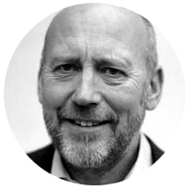
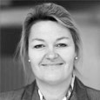
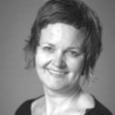
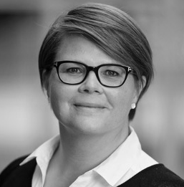
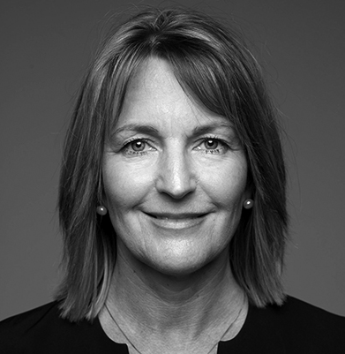
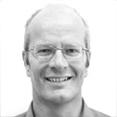
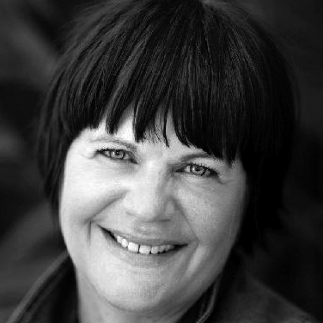
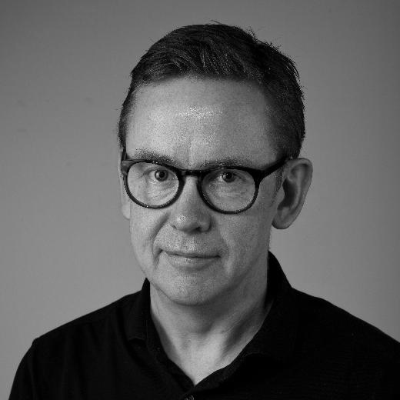
NTNU’s management
Rector NTNU
Anne Borg
Pro-Rector for Education
Marit Reitan
Pro-Rector for Research
Tor Grande
Pro-Rector for
Innovation Toril A. Nagelhus Hernes
Director,
Organization and Infrastructure Bjørn Haugstad
Vice-Rector in Gjøvik
Gro Iren
Kvanli Dæhlin
Faculty of Humanities (HF),
Dean Anne Kristine Børresen
Faculty of Architecture and Design (AD), Dean Sara Brinch
Faculty of Information Technology and Electrical Engineering
(IE), Dean
Ingrid Schjølberg
Faculty of Engineering
(IV), Dean Olav Bolland
Faculty of Medicine and Health Sciences
(MH), Dean
Siri Forsmo
Faculty of Natural Sciences
(NV), Dean Øyvind Weiby
Gregersen
Faculty of Social and Educational Sciences (SU),
Acting Dean Tine Arntzen Hestbek
Faculty of Economics and Manage-ment (OK),
Dean Monica
Rolfsen
NTNU University Museum, Director Hans K. Stenøien
Vice-Rector in
Ålesund
Anne Lise Sagen Major

Slide 4
Fellesadministrasjonen og Universitetsbiblioteket
Education Quality Division
HR and HSE Division
Communi-cation Division
Records Management Division
IT- Division
Division for Governance and Manage-ment Systems
Financial Services Division
Property
Division
University
Library
Research, Innovation and External Relations Division
Campus Development
Section for Education in Gjovik
HSE and Emergency Management Section
IT Support Section
Procurement and Purchasing Section
Property Management Section
Library Administration
Section for education in Ålesund
HR NTNU Section
IT Operations Section
Library Services, Inspiration and Knowledge Centre
Accounting and Project Economics Section
Property Maintenance Section
HR Administration Section
IT Administrative Section
Library Section for Research Support, Data and Analysis
Office of Admission and International Relations
Transaction Services Section - Joint Administrative Units
Property Service Section
Payroll and HR-services Section
IT Development Section
Library Section for Communication, Innovation and Competenc
Section for quality
in education and learning environment
Sustainable Property Development Section
IT Strategy and Management Section
Section for teaching, learning and digital services
Property Division Staff
Library Section for Collections, Resources and Digital Services
Digital Security Section
Library Section for Teaching and Learning Support

Slide 5
HF
AD
IE
IV
MH
NV
SU
OK
VM
Faculty of Humanities (HF)
Department of Philosophy and Religious Studies
Department of Historical and Classical Studies
Department of Art and Media Studies
Department of Modern History and Society
Department of Music
Department of Language and Literature
Department of Interdisciplinary Studies of Culture

Slide 6
HF
AD
IE
IV
MH
NV
SU
OK
VM
Faculty of Architecture and Design (AD)
Trondheim Academy of Fine Art
Department of Design
Department of Architecture and Technology
Department of Architecture and Planning

Slide 7
HF
AD
IE
IV
MH
NV
SU
OK
VM
Faculty of Information Technology and Electrical Engineering (IE)
Department of Computer Science
Department of Electronic Systems
Department of Electric Power Engineering
Department of ICT and Natural Sciences
Department of Information Security and Communication Technology
Department of Mathematical Sciences
Department of Engineering Cybernetics

Slide 8
HF
AD
IE
IV
MH
NV
SU
OK
VM
Faculty of Engineering (IV)
Department of Energy and Process Engineering
Department of Marine Technology
Department of Geoscience and Petroleum
Department of Civil and Environmental Engineering
Department of Structural Engineering
Department of Mechanical and Industrial Engineering
Department of Ocean Operations and Civil Engineering
Department of Manufacturing and Civil Engineering

Slide 9
HF
AD
IE
IV
MH
NV
SU
OK
VM
Faculty of Medicine and Health Sciences (MH)
Department of Health Sciences in Gjøvik
Department of Health Sciences in Ålesund
Kavli Institute for Systems Neuro-science
Department of Clinical and Molecular Medicine
Department of Neuromedicine and Movement Science
Department of Mental Health
Department of Public Health and Nursing
Department of Circulation and Medical Imaging

Slide 10
HF
AD
IE
IV
MH
NV
SU
OK
VM
Faculty of Natural Sciences (NV)
Department of Biology
Department of Biological Sciences Ålesund
Department of Biotechnology and Food Science
Department of Biomedical Laboratory Science
Department of Physics
Department of Chemistry
Department of Chemical Engineering
Department of Materials Science and Engineering

Slide 11
HF
AD
IE
IV
MH
NV
SU
OK
VM
Faculty of Social and Educational Sciences (SU)
Department of Geography
Department of Teacher Education
Department of Education and Lifelong Learning
Department of Social Work
Department of Sociology and Political Science
Department of Psychology
Department of Social Anthropology

Slide 12
HF
AD
IE
IV
MH
NV
SU
OK
VM
Faculty of Economics and Management (OK)
NTNU Business School
Department of International Business
Department of Industrial Economics and Technology Management
Department of Economics

Slide 13
HF
AD
IE
IV
MH
NV
SU
OK
VM
NTNU University Museum (VM)
Department of Natural History
Department of Archaeology and Cultural History

