Slide 1
RESEARCH
Knowledge for a better world
Trondheim | Gjøvik | Ålesund
NTNU Brussels Office

Slide 2
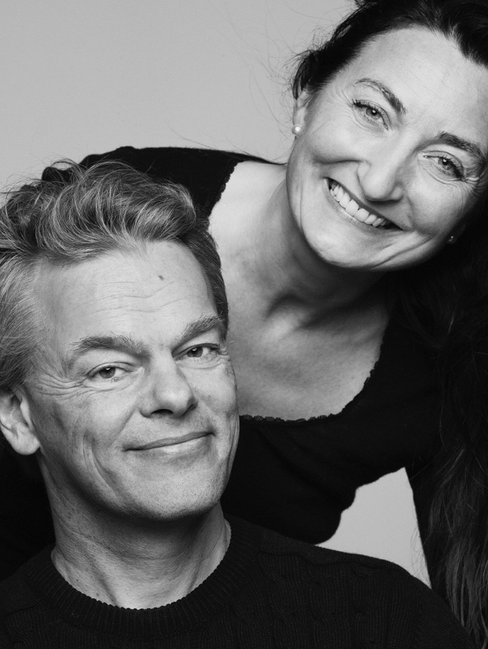
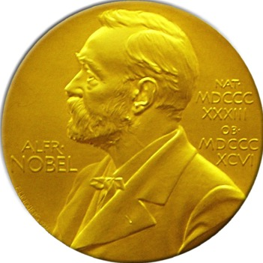
Nobel Prize 2014
Professors May-Britt Moser, Edvard Moser and John O’Keefe were awarded the Nobel Prize in medicine in 2014 for the discovery of neurons that enable a sense of direction, "the GPS of the brain".
Moser and Moser:
For the discovery of grid cells in the entorhinal cortex, which generate a coordinate system in the brain
John O´Keefe (University College, London):
For the discovery of place cells in the hippocampus, which recognize unique locations in the landscape

Slide 3
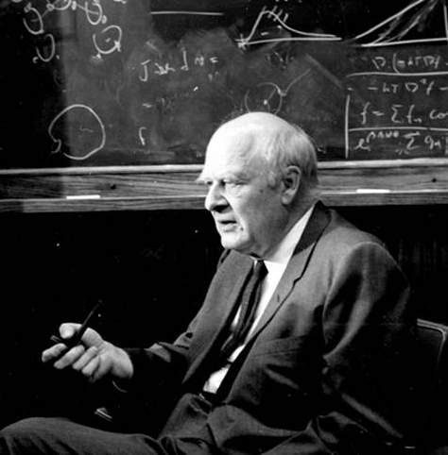
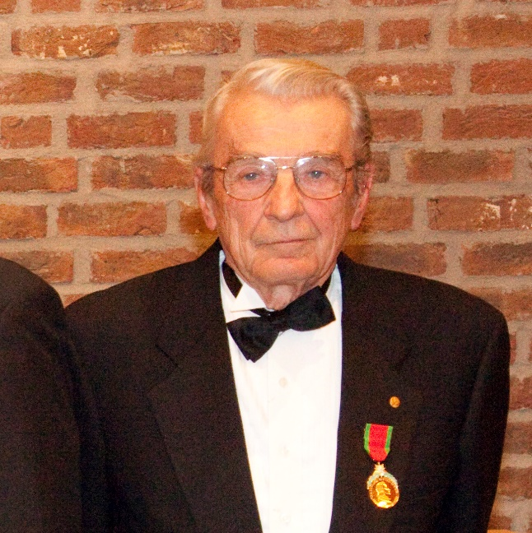
Nobel Prize awarded to former NTH students
Lars Onsager, chemistry, 1969
Ivar Giæver, physics, 1973
Lars Onsager
At NTNU:
Lars Onsager and Ivar Giæver are honorary doctors
Lars Onsager lecture, professorship and medal
Onsager Fellowship Programme
Ivar Giæver
Notes:
The Lars Onsager Professorship Awarded to internationally recognized researchers with outstanding achievements in physics, chemistry or mathematics. The professorship marks NTNU as Lars Onsager's alma mater (the university where Onsager studied).
The Lars Onsager Lecture: A lecture open to the public held by a researcher of the highest international calibre in the disciplines of physics, chemistry, or mathematics. Onsager lecturers include several Nobel Prize winners.
The Onsager Medal: Awarded to winners of the Lars Onsager Professorship and the Lars Onsager Lecture.
Onsager Fellowship Programme: Programme to recruit young, internationally recognized researchers to strengthen NTNU’s subject areas.

Slide 4
Research at NTNU – structure in this presentation
Resources
People
Funding
Infrastructure
Instruments
Internal
External
Results
Publications
PhDs
Collaboration

Slide 5
Research commitment
People
Academic staff
Teaching, research, dissemination
Internal
External
Business and industry
Funding
European
National
Business and industry
Infrastructure

Slide 6
Academic full-time equivalent staff (FTEs) 2019
Teaching, research, and dissemination positions by faculty and gender
Notes:
Men Women Totalsum
AD 86 41 127
HF 174 210 384
IE 585 175 760
IV 726 219 945
MH 370 635 1005
NV 431 292 723
SU 275 407 682
VM 32 24 56
ØK 146 96 241
Totalsum 2825 2098 4923

Slide 7
Academic full-time equivalent staff (FTEs) 2019
Teaching, research, and dissemination positions by faculty and nationality
Notes:
Norwegian International Totalsum
AD 79 48 127
HF 291 93 384
IE 439 321 760
IV 485 460 945
MH 794 210 1005
NV 402 321 723
SU 565 117 682
VM 35 21 56
ØK 182 59 241
Totalsum 3272 1651 4923

Slide 8
Doctoral agreements spring 2020 by faculty and gender
Source: FS (Felles studentsystem)/DBH

Slide 9
Doctoral agreements spring 2020 by faculty and nationality
Source: FS (Felles studentsystem)/DBH

Slide 10
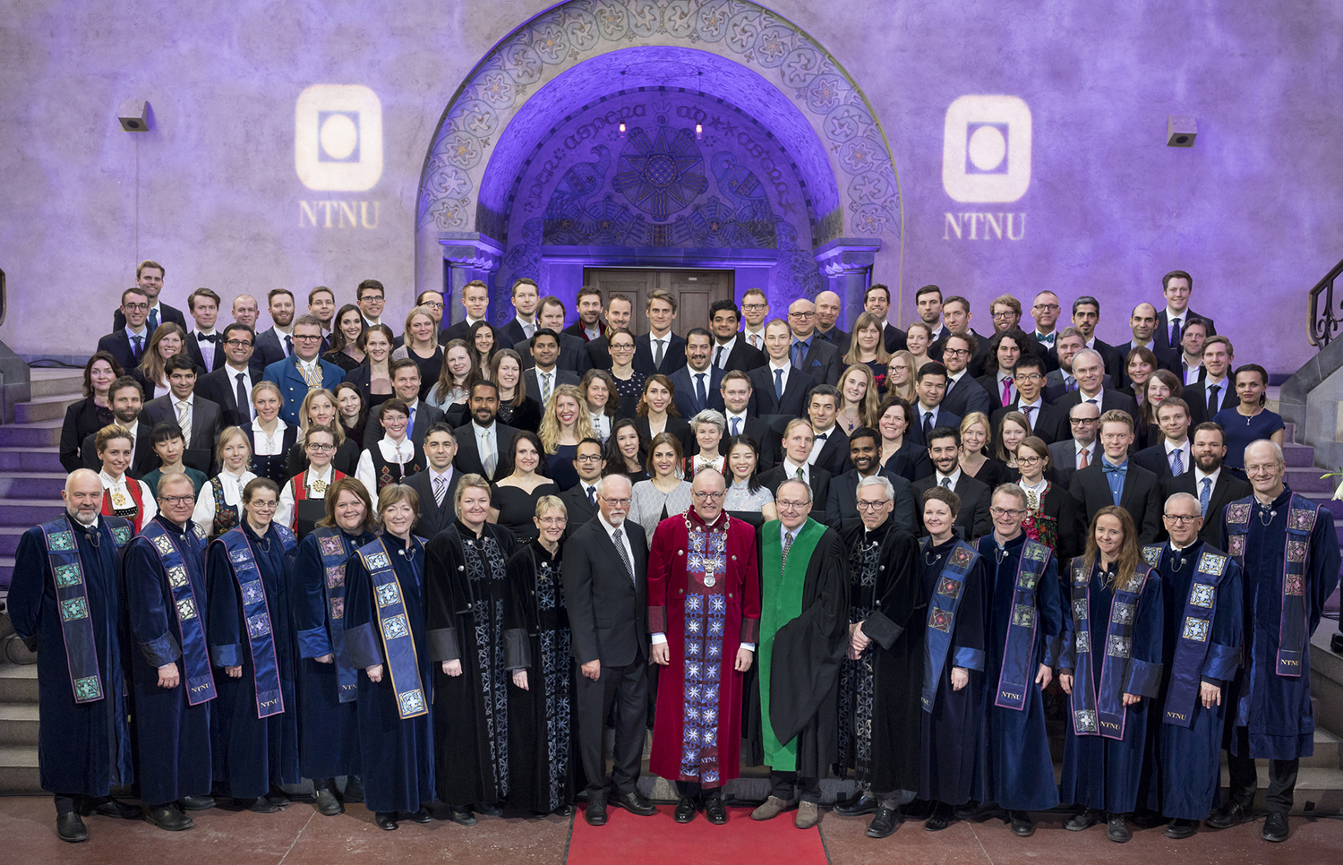
Doctoral degrees
Evaluations confirm the high quality
of NTNU’s PhD education
It is easy for NTNU PhDs to find jobs, and
many of our graduates end up in organizations
outside the university
Student progression in the PhD programmes
is good, and the dropout rate is low
NTNU has many PhD students with foreign
citizenship, especially in technology
NTNU excels with many externally funded PhD candidates, often in collaboration with industry
The Doctoral Awards Ceremony 16 March 2018,
The Aula in the Main Administration Building
In recent years, NTNU has graduates around
400 candidates per year
406 doctoral degrees in 2020

Slide 11
Doctoral degrees 2020 by faculty and gender
Source: FS (Felles studentsystem)/DBH
Notes:
2019:
Women Men Sum
AD 5 6 11
HF 10 6 16
IE 9 48 57
IV 29 83 112
MH 50 33 83
NV 22 41 63
SU 15 10 25
ØK 4 6 10
144 233 377
38 % 62 %
Men – Women = Total
AD: 3 – 3 = 6
HF: 9 – 9 = 18
IE: 52 – 16 = 68
IV: 59 – 22 = 81
MH: 31 – 48 = 79
NV: 41 – 21 = 62
SU: 11 – 22 = 33
ØK: 10 – 5 = 15
___________________
Total: 216 – 146 = 362

Slide 12
Doctoral degrees 2020 by faculty and nationality
Source: FS (Felles studentsystem)/DBH
Notes:
2019:
International Norwegian Sum
AD 7 4 11
HF 2 14 16
IE 30 27 57
IV 58 54 112
MH 20 63 83
NV 30 33 63
SU 5 20 25
ØK 1 9 10
153 224 377
Norwegian – International = Total
AD: 3 – 3 = 6
HF: 14 – 4 = 18
IE: 31 – 37 = 68
IV: 28 – 53 = 81
MH: 63 – 16 = 79
NV: 27 – 35 = 62
SU: 27 – 6 = 33
ØK: 12 – 3 = 15
_______________________
Total: 205 – 157 = 362

Slide 13
Doctoral degrees 2020 by faculty and both gender and nationality
Source: FS (Felles studentsystem)/DBH

Slide 14
Doctoral degrees by gender 2000-2020
Source: NIFU
Notes:
2019:
Women - Men
144 - 233
38 % - 62 %
2017
Men 216 (60 %)
Women 146 (40 %)
Total 362

Slide 15
Research funding 2020
A large proportion of NTNU’s research funds are external and won in competition
NTNU has considerable funding from business and industry and the public sector
Total research funding: 2.1 billion of totally 4.9 billion NOK
16,9%
3,7%
57,4%
22,0%
Source: NIFU R&D funding statistics (2020), in mill NOK

Slide 16
Research funding 2020 by faculty (mill NOK)
Base funding
External
funding
Source: NIFU R&D funding statistics (2020)

Slide 17
Funding from the Research Council of Norway 2020
The university sector
NTNU receives a large proportion of the Research Council of Norway's grants to Norwegian universities and university colleges:
27 per cent in 2020
Source: Research Council of Norway (2020)
Notes:
UiT 395 260 246,61
USN 31 702 392,08
UiS 86 238 556,89
UiO 1 009 672 672,36
UiB 519 490 510,20
UiA 56 845 732,23
OsloMet 121 140 814,55
NTNU 935 242 052,55
NMBU 237 171 033,23
Nord 21 751 771,77

Slide 18


European infrastructure
ECCSEL – European Carbon Dioxide Capture and Storage Laboratory Infrastructure. Headed by NTNU.
The ECCSEL consortium brings together selected top-level research groups in carbon capture and storage from nine European countries
NTNU and SINTEF collaborate on ECCSEL

Slide 19
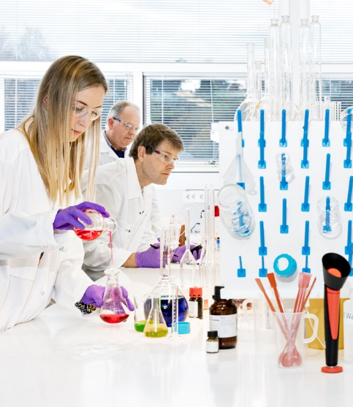
National infrastructure
NTNU’s many large and small laboratories are used for research and teaching
NTNU and SINTEF collaborate formally to operate several of the laboratories
NTNU works in close collaboration with business and industry on infrastructure
First-class laboratories are an important competitive factor and have high priority
Laboratories of great national importance include the Marine Technology lab, the National Smart Grid Laboratory, the Norwegian Colour and Visual Computing Laboratory, the Waterpower Laboratory

Slide 20
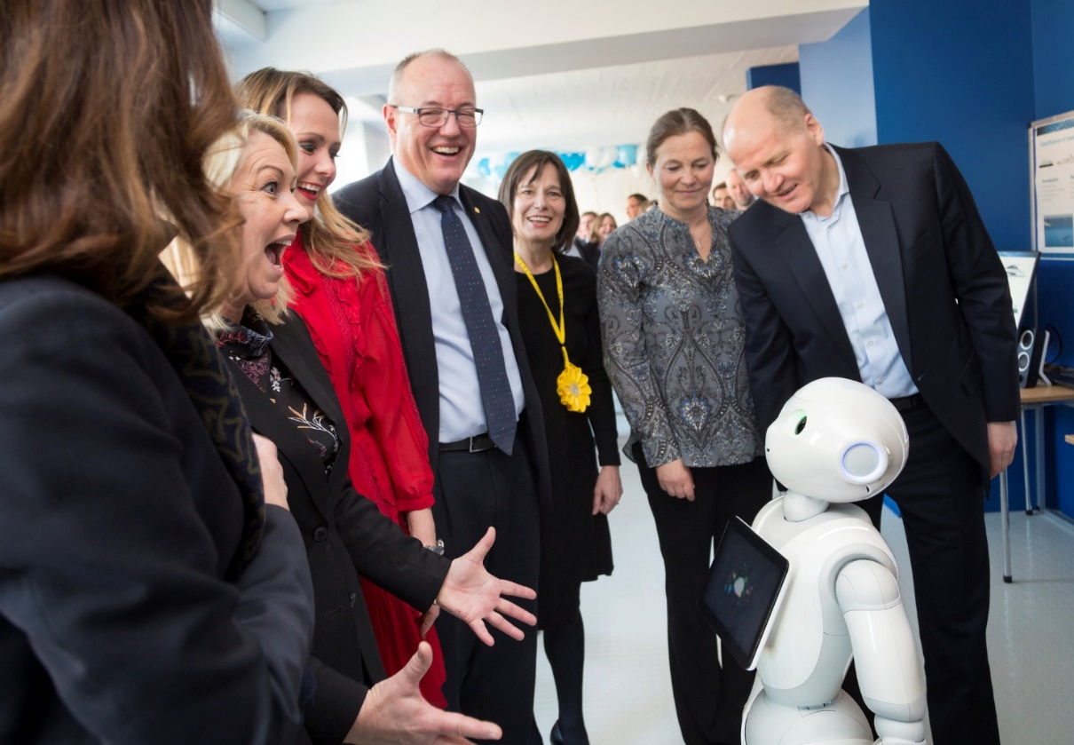
Telenor-NTNU AI Lab
Telenor and NTNU are partners
AI = Artificial Intelligence
Research on machine learning and applied research
Goals:
New products, services, businesses, jobs
120 sq m for master's students, courses, events such as hackathons, demo room for visitors
Telenor's investment: professorship, postdoc positions, master's and PhD candidates,
hardware and software, innovation network

Slide 21
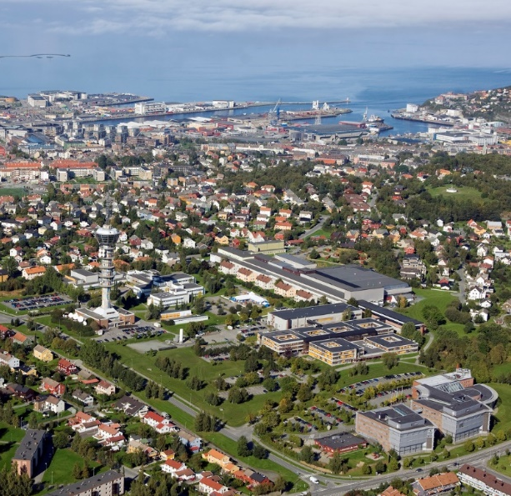
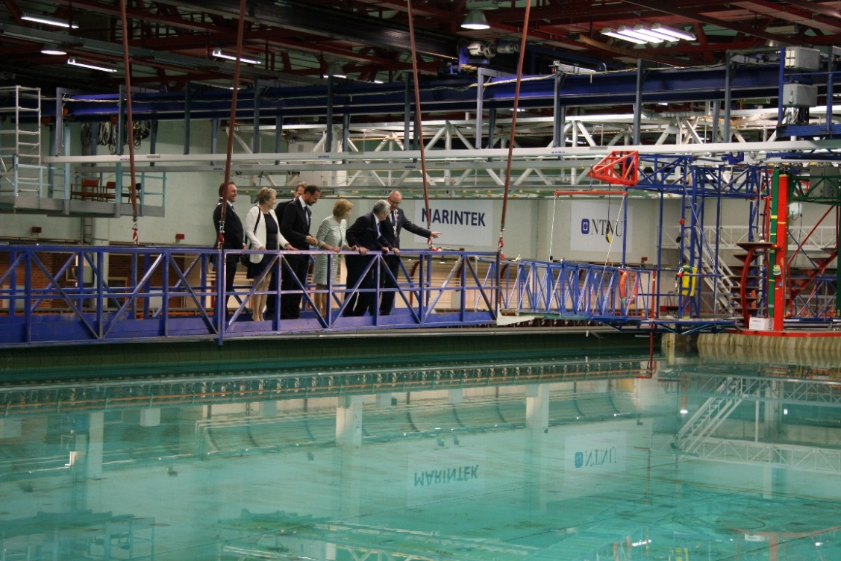
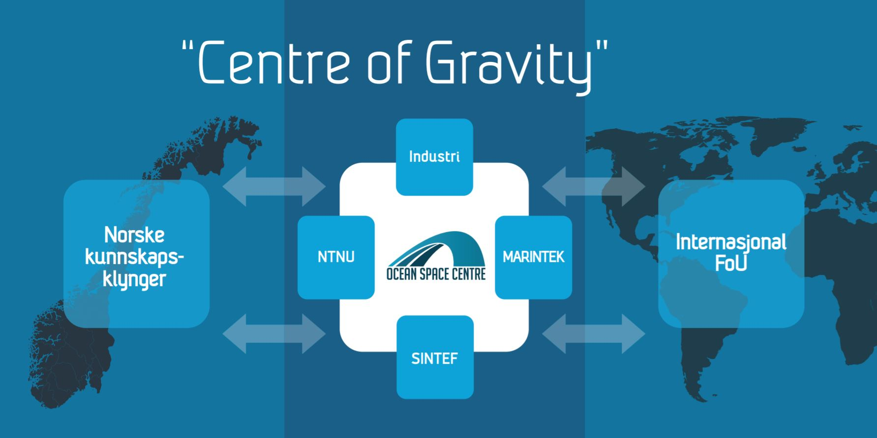
Ocean Space Centre
A knowledge centre for ocean space technology
Industry
Norwegian
knowledge
clusters
International R&D
Network of knowledge communities and
industry players
Norwegian Government's ocean strategy, February 2017: Realization of the OSC
Aims to contribute to national change
The OSC will replace the Marine Technology Centre at Tyholt in Trondheim. Installations in the Trondheim Fjord, at Hitra/Frøya and in Ålesund

Slide 22
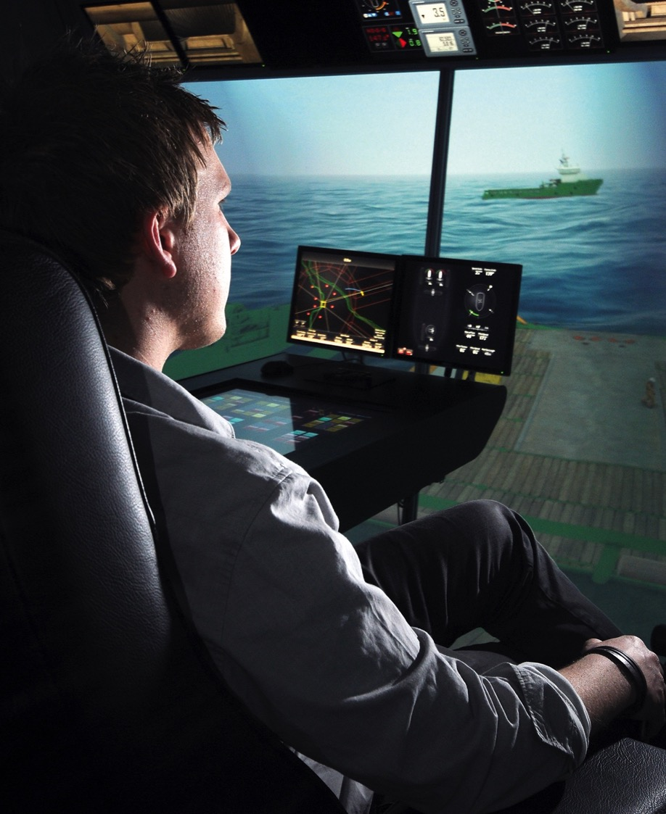

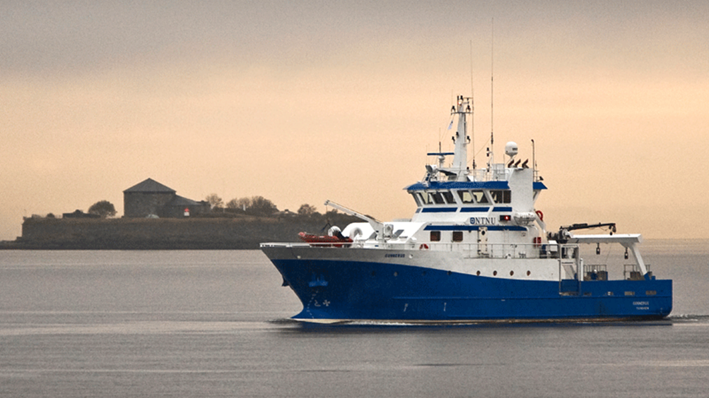
Ocean space infrastructure
Ocean Space Centre
AMOS Centre of Excellence: R/V Gunnerus, AUR Lab, UAV Lab, marine technology, ship model basin, etc.
MOVE Centre for Research-based Innovation: simulator, vessels
Trondheim Fjord, the world’s first test site for autonomous vessels

Slide 23
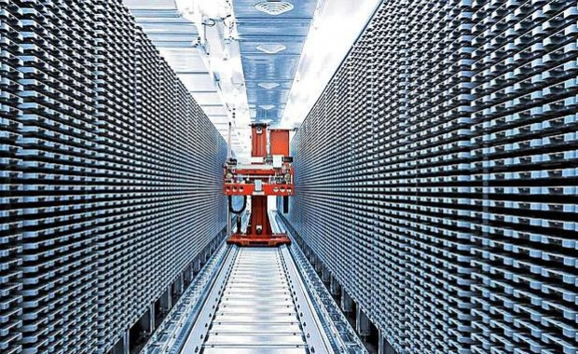
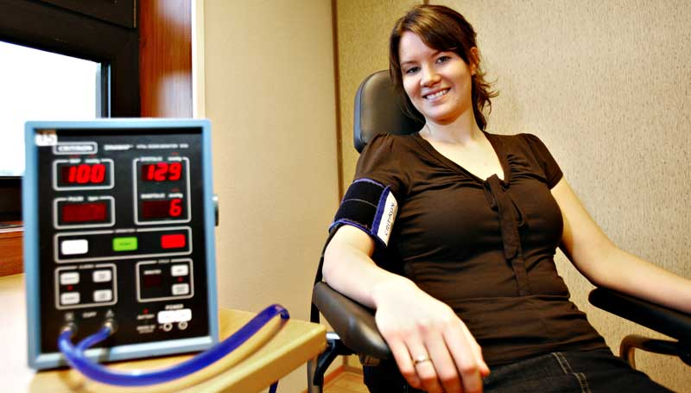
Health infrastructure
St Olavs Hospital
The Nord-Trøndelag
Health Study (HUNT)

Slide 24
Research instruments
External
EU
Research Council of Norway
Private
Strategic research areas
Enabling technologies
Research excellence initiative
Internal

Slide 25

Participation in 2020
1000 million NOK
198
projects
1813
applications
Aim
1100 million NOK
Awarded
1639
partners
50
countries
19 August 2020

Slide 26

EU – ERC
European Research Council
Large individual grants to outstanding researchers
17 of NTNU’s researchers are awarded ERC Grants
Interdisciplinary projects, pioneering ideas, unconventional, innovative approaches

Slide 27
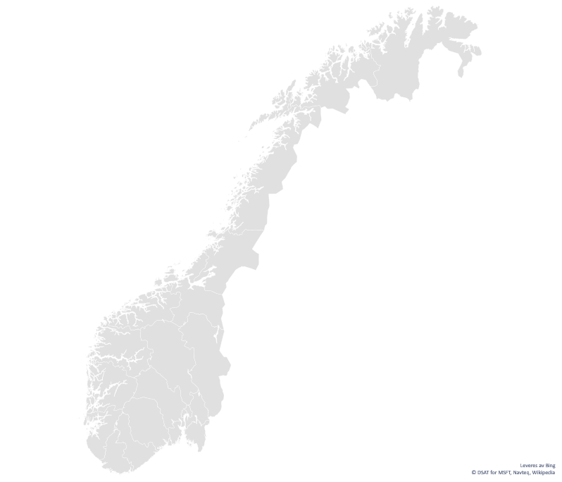
The Research Council of Norway – centre activities
23 SFF/CoE
CBD – Centre for Biodiversity Dynamics
CEMIR – Centre for Molecular Inflammation Research
CNC – Centre for Neural Computation
AMOS – Centre for Autonomous Marine Operations and Systems
PoreLab – Porous Media Laboratory
QuSpin – Center for Low Dissipation Quantum Spintronics
+++
Autoship – Autonomous Ships
CASA – Centre for Advanced Structural Analysis
CGF – Centre for Geophysical Forecasting
CIUS – Centre for Innovative Ultrasound Solutions
CRAI – Norwegian Center for Research-Based Artificial Intelligence Innovation
iCSI – Industrial Catalysis Science and Innovation
Metal Production
MOVE – Marine Operations in Virtual Environments
NORCICS – Norwegian Center for Cybersecurity in Critical Sectors
PhysMet – Senter for en bærekraftig og konkurransedyktig metallindustri
SAMCoT – Sustainable Arctic Marine and Coastal Technology
SUBPRO – Subsea production and processing
+++
46 SFI/CRI
14 FME/CEER
CenSES – Centre for Sustainable Energy Studies
HydroCen – Norwegian Research Centre for Hydropower Technology
ZEN – Zero Emission Neighbourhoods in Smart Cities
+++
Infographics: The Research Council of Norway
Notes:
The Research Council of Norway finance
23 SFF / CoE of which NTNU host 6 (listed above), and is partner in 3
46 SFI / CRI of which NTNU host 12 (listed above), and is partner in 14
14 FME / CEER of which NTNU host 3 (listed above), and is partner in 6

Slide 28

Centres of Excellence – SFI
Long-term and coordinated basic research
at a high international level
NTNU hosts 6 and is a partner in 3 SFIs
in: biodiversity, inflammation, neuroscience, autonomous marine operations, porous media, spintronics, space science, biomedical IT, equality/society

Slide 29


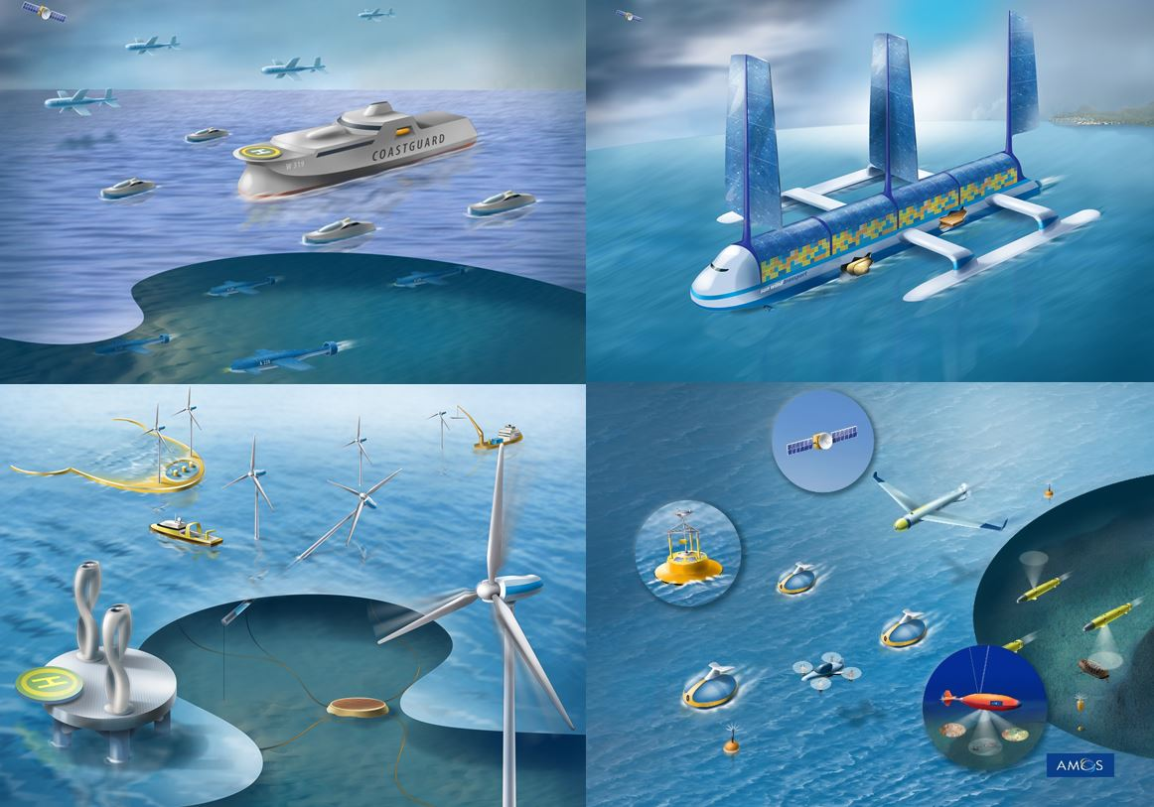
AMOS – Centre for Autonomous
Marine Operations and Systems
Areas
Autonomous vessels and robots
Safer, smarter and greener marine operations
Research results are used to develop intelligent ships and marine structures, autonomous vessels and robots for operations in extreme environments.
A variety of laboratories, including:
R/V Gunnerus, AUR Lab, UAV Lab, Marine Cybernetics lab, ROBOTNOR, ship model basin

Slide 30

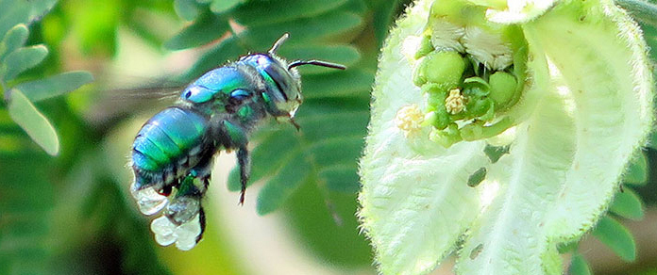
CBD – Centre for Biodiversity Dynamics
Research on how biodiversity and levels of organisms change over time and in different places
Areas
Population ecology
Evolutionary biology
Community dynamics

Slide 31

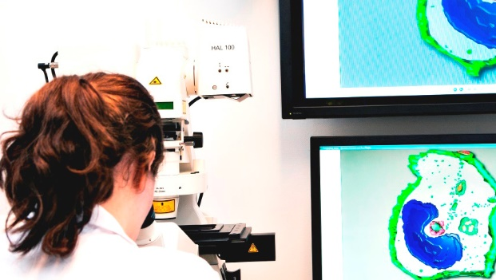
CEMIR –
Centre of Molecular Inflammation Research
How can inflammation be linked with so many different diseases, such as atherosclerosis, cancer, type II diabetes, Alzheimer’s disease, inflammatory bowel disease and obesity?
CEMIR’s hypothesis: The key to curing chronic inflammatory diseases is in very early
phases of the inflammatory response.

Slide 32
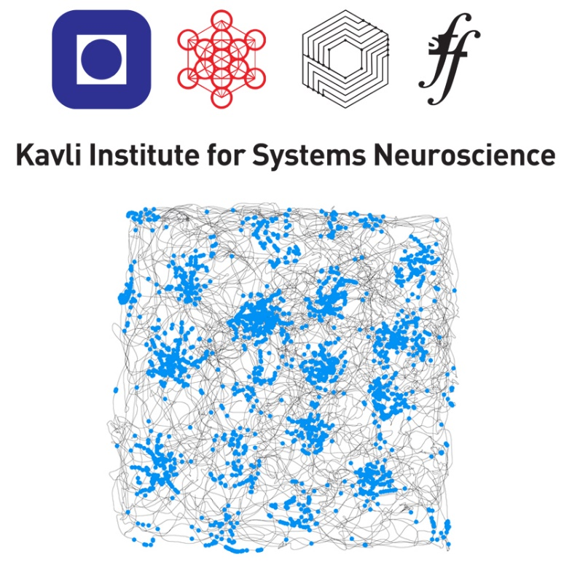
The Kavli Institute for
Systems Neuroscience /
Centre for Neural Computation
Vision: To understand the emergence of higher brain functions in any system in any species
One of 20 centres funded by the Kavli Foundation at recognized universities around the world
Nobel Prize in Physiology or medicine 2014

Slide 33

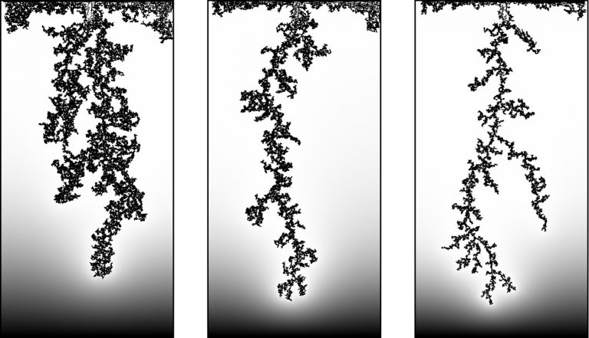
PoreLab – Porous Media Laboratory
NTNU and UiO are the hosts
Porous media are solids with spaces
filled with fluid or gas
Knowledge of porous media is important in
everything from the oil industry to extracting drinking water from underground water reservoirs
Research: Experimental, theoretical and computation methods of complex
fluid flows in porous media
Goal: A comprehensive unified theory
Photo: Department of Physics, University of Oslo

Slide 34


QuSpin – Centre for Low Dissipation Quantum Spintronics
Goal: Describe, characterize and develop
recently identified quantum approaches for
controlling electrical signals in advanced nanoelectronics
Vision: Trigger a revolution in low-power
ICT in an energy-efficient society

Slide 35

Centres for Research-based Innovation
NTNU hosts 12 SFI centres
Autoship – Autonomous ships
CASA – Centre for Advanced Structural Analysis
CGF – Centre for Geophysical Forecasting
CIUS – Centre for Innovative Ultrasound Solutions
CRAI – Norwegian Center for Research-Based Artificial Intelligence Innovation
iCSI – Industrial Catalysis Science and Innovation
Metal Production
MOVE – Marine Operations in Virtual Environments
NORCICS – Norwegian Center for Cybersecurity in Critical Sectors
PhysMet – Senter for en bærekraftig og konkurransedyktig metallindustri
SAMCoT – Sustainable Arctic Marine and Coastal Technology
SUBPRO – Subsea production and processing
NTNU is a partner in 14 SFI
Centre for Industrial Biotechnology, Centre for Subsurface Well Integrity, Plugging and Abandonment, CIRFA, CtrlAQUA, DigiWells, EXPOSED,Floating structures for the next generation ocean industries, Harvest, Klima 2050, Manufacturing, Offshore Mechatronics, Precision Health Center for optimized cardiac care, SIRIUS, Smart Maritime
The centres work together with leading companies in various sectors and industries
The centres could be key contributors to change in Norway

Slide 36

Centres for Environment-friendly Energy Research (FME)
NTNU hosts 3 FME centres
HydroCen – Norwegian Research Centre for Hydropower Technology
NTRANS – Norwegian Centre for Energy Transition Strategies
ZEN – The Research Centre on Zero Emission Neighbourhoods in Smart Cities
NTNU is a partner in 7 FME
Bio4fuels, CINELDI, HighEFF, MoZEES, NCCS, Northwind, The Norwegian Research Centre for Solar Cell Technology
The centres conduct research on technology development in renewable energy and CO₂ management

Slide 37

Strategic areas of research 2014–2023
NTNU Energy NTNU Health NTNU Oceans NTNU Sustainability
The strategic research areas aim to:
Work together across disciplines, solve complex challenges of great importance
Face global challenges with an interdisciplinary and flexible organization
Strengthen cooperation with the world of work and our innovative capability
Increase NTNU’s
share of international research funds

Slide 38
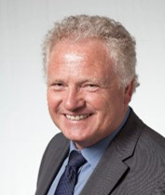

Strategic research area 2014–2023
– Energy for a better society
Director
Johan E. Hustad
GOALS
AREAS
Help to increase interdisciplinary cooperation and research in the field of energy
Improve access to funding for energy environments
Connect NTNU’s energy environments with external stakeholders, both industry/business and research partners
Contribute a knowledge base to key players in society
Help to increase innovation from the energy environments
Renewable energy sources
Energy storage
Energy efficiency in buildings and industry
Integrated energy systems
Low-emission transport
Development of knowledge and policy
www.ntnu.edu/energy

Slide 39
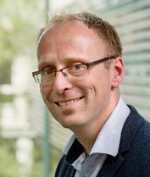
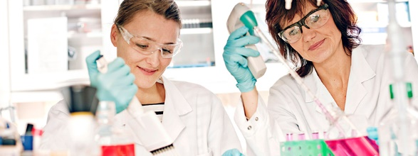
Strategic research area 2014–2023
– Innovative solutions to complex challenges
Director
Magnus Steigedal
AREAS
GOALS
Health promotion, disease prevention and empowerment
Gaming technology in rehabilitation
Diagnostics and treatment
Precision medicine – more effective treatment
ICT, welfare services and organization of health services
Inequalities in health – effective introduction of technology
Better resource utilization
Effective treatment of patients
  Develop new expert communities and new skills, emphasizing sustainable health services
  Help to improve global health
www.ntnu.edu/health

Slide 40
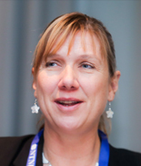
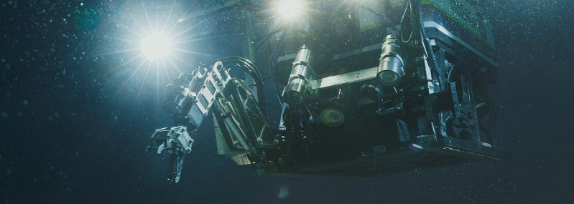
Strategic research area 2014–2023
– Knowledge for a sustainable ocean
Director
Siri Granum Carson
AREAS
WHAT WE DO
Maritime transport
Into the deep ocean
Polar science and technology
Sustainable seafood and marine bioresources
Marine minerals and renewable energy
Marine environment, society, and sustainability
Coordinate interdisciplinary activities in research, education and innovation
Help to develop the knowledge base in the maritime, oil and gas and aquaculture sectors
Develop knowledge requirements in shipping, the oceans, Arctic exploration, the seafood production, marine resources and energy, the marine environment and society and food
BRIDGEHEAD AQUACULTURE
Guri Kunna vgs
Blått kompetansesenter (Blue centre of expertise)
NTNU
NOK 11.3 million from Research Council of Norway
www.ntnu.edu/oceans

Slide 41
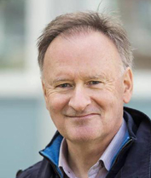

Strategic research area 2014–2023
– Knowledge for change
Director
Helge Brattebø
AREAS
INTERDISCIPLINARY RESEARCH
Sustainable use and conservation of biodiversity and ecosystem services
The transition to a circular economy and sustainable production and consumption systems
The transition to smart, sustainable cities and built environment
Climate change: Mitigation and adaptation
Innovative models, solutions and technologies
Modelling, analysis and environmental impact assessment
Consumer behaviour and governance for realizing improvement potential
www.ntnu.edu/sustainability

Slide 42
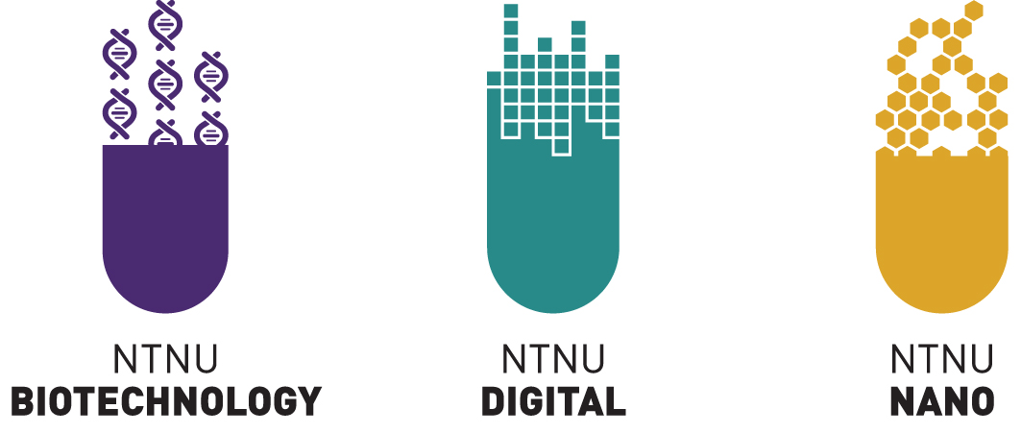
Enabling technologies
The enabling technologies will:
Strengthen and prioritize outstanding long-term and generic research
Coordinate and develop internationally leading research infrastructure
Create a platform for education at a high international level

Slide 43

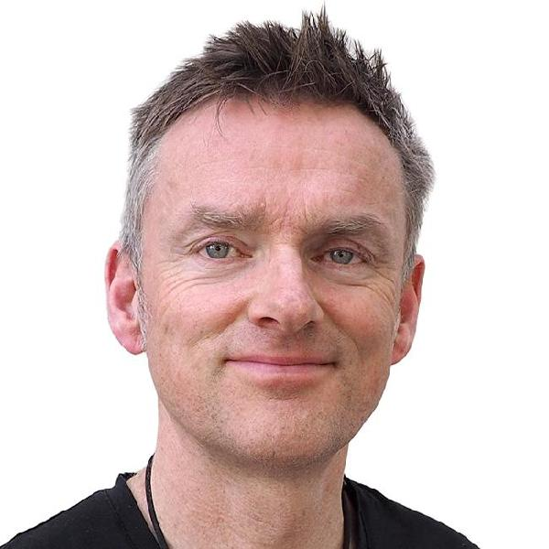
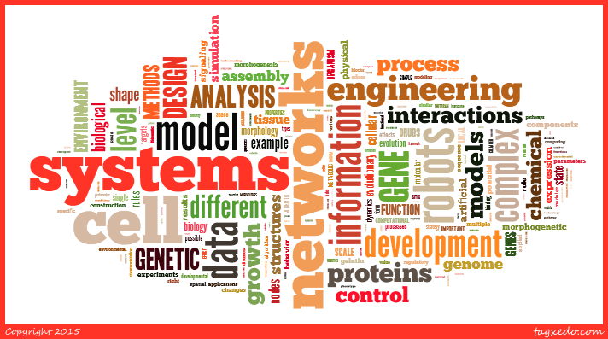
Enabling technology
NTNU Biotechnology
is a close collaboration between NTNU, SINTEF and St Olavs Hospital
R&D – RESEARCH AND DEVELOPMENT
Director
Trygve Brautaset
Human Physiome
Genome Editing
Biopolymer Engineering
Bioreactor Design and Operation
Phenomics Technology
Therapeutic Targeting
Aquaculture Biotechnology
Morphogenetic Engineering
Tissue Engineering
Analysis, Design and Control of Microbial Systems
Synthetic Biology Engineering
Responsible Research and Innovation
The interaction between life sciences,
mathematical sciences and engineering
Notes:
The design of the NTNU Biotechnology programme reflects the conviction that extensive transdisciplinary interaction between the life sciences, mathematical sciences and engineering is the key to transformative 21st century biotechnology. It is developed in close conjunction with SINTEF and St. Olavs hospital. SINTEF is the largest independent research organization in Scandinavia, and St. Olavs hospital (Trondheim University Hospital) is tightly integrated with our Faculty of Medicine and Health Sciences.
This slide shows the twelve R&D streams sorting under the NTNU Biotechnology umbrella. All of them emerge from the confluence of life sciences, mathematical sciences and engineering and define the core of the NTNU Biotechnology programme.
Stig W. Omholt is the director of NTNU Biotechnology and Laila Berg is the coordinator.
NTNU is the leading institution of the Norwegian Centre for Digital Life funded by the Research Council of Norway under its BIOTEK2021 program. The centre's main mission is to become the major vehicle for reorienting and concerting Norwegian R&D on biotechnology in the years to come.
NTNU’s commitment to enabling technologies is intended to help develop new industries and new products, and new solutions in most areas of society such as food production, greater energy efficiency, transport and health services. NTNU Biotechnology, NTNU Digital, NTNU Nano.
This slide shows the twelve R&D streams sorting under the NTNU Biotechnology umbrella. All of them emerge from the confluence of life sciences, mathematical sciences and engineering and define the core of the NTNU Biotechnology program.
Stig W. Omholt is the director of NTNU Biotechnology and Laila Berg is the coordinator.
NTNU is the leading institution of the Norwegian Centre for Digital Life funded by the Research Council of Norway under its BIOTEK2021 program. The centre's main mission is to become the major vehicle for reorienting and concerting Norwegian R&D on biotechnology in the years to come.
*******
Innretningen av NTNU Biotechnology-programmet gjenspeiler at den mest effektive måten å utvikle ny grensesprengende bioteknologi på er gjennom tett kobling av livsvitenskapene, de matematiske vitenskapene og ingeniørvitenskapene. NTNU Biotechnology-programmet er utviklet i nært samarbeid med SINTEF og St Olavs Hospital (Universitetssykehuset i Trondheim).
Dette lysbildet viser de tolv forskningsstrømmene under NTNU Bioteknologi paraplyen som utgjør kjernen i NTNU Bioteknologi-programmet. Alle har en tett kobling av livsvitenskapene, de matematiske vitenskapene og ingeniørvitenskapene.
NTNUs satsing på muliggjørende teknologier skal bidra til å utvikle nye næringer og nye produkter, og til nye løsninger på de fleste samfunnsområder som eksempelvis matproduksjon, energieffektivisering, transport og helsetjenester. NTNU Bioteknologi, NTNU Digital, Nano@NTNU.

Slide 44

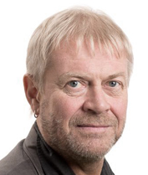
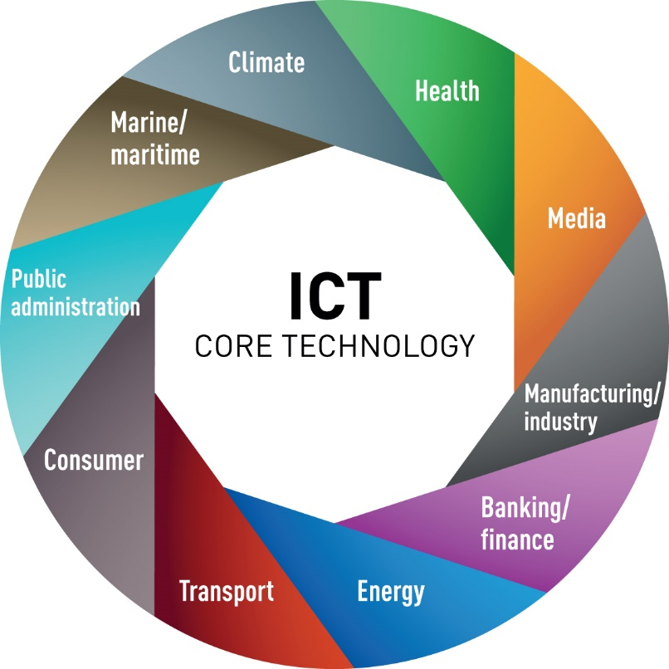
Enabling technology
NTNU Digital centres on generic ICT
AI / machine learning
Big data analytics
The Internet of Things (IoT)
Smart systems
Decision support
Human+machine
Security and reliability
Privacy
Reliability, vulnerability
Risk analysis
Cybersecurity
Director
Torbjørn Karl
Svendsen
AREAS
Autonomous systems
Automation
Robotics
Navigation
Computations
Energy efficiency
Electronic components
Telenor-NTNU AI Lab:
Joint commitment to machine learning and big data analytics

Slide 45
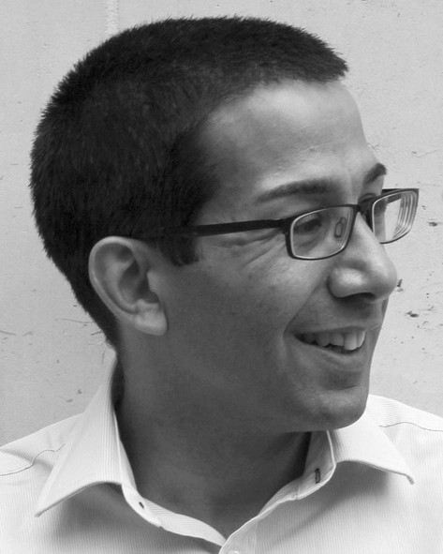

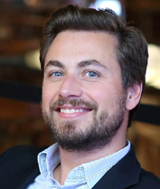
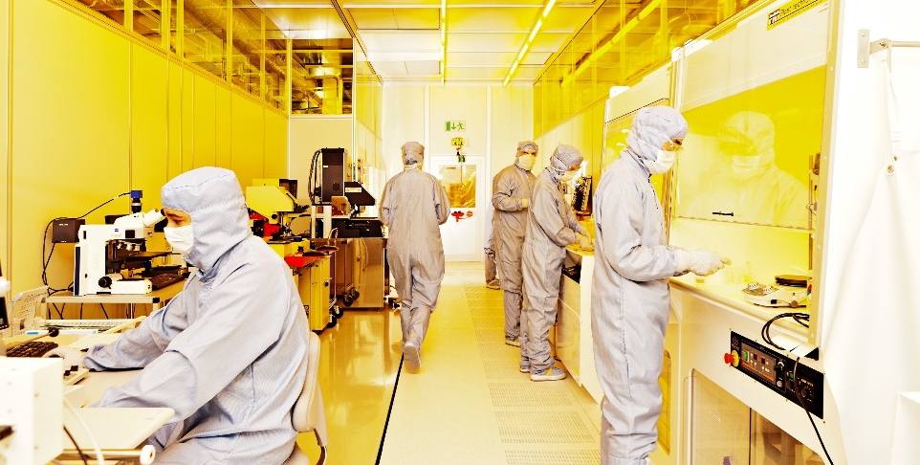
Enabling technology
NTNU Nano
coordinates research and education in
nanotechnology, nanoscience and functional materials
Director NTNU Nano
John de Mello
AREAS
Nanomaterials
BioNano / nanomedicine
Nanoelectronics, nanomagnetism, nanophotonics
Director NanoLab
Peter Köllensperger
NANOLAB INFRASTRUCTURE
Central cleanroom facility at NTNU
Heads the national infrastructure Norwegian Micro- and Nanofabrication Facility (NorFab)
ESFRI initiative EuroNanoLab
Notes:
(previously NANO@NTNU)

Slide 46

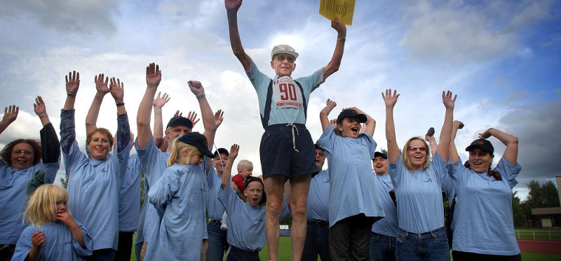
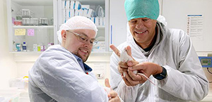
K.G. Jebsen centres
Mainly funding for maritime and medical research
K.G. Jebsen Center for Genetic Epidemiology
HUNT data
Studies genetic variation at population level
Digitizing genetic material, stringent requirements for ethics and data security
K.G. Jebsen Center for Alzheimer’s Disease
Research on how Alzheimer's disease occurs in the brain
Nobel Prize winning basic research on rats and mice is translated into clinical research on humans
Promising basic research results on healthy brains are translated into brains that have been affected by the disease
The goal is to develop early diagnoses, and find an effective treatment
Former centres at NTNU:
K.G. Jebsen Center for Exercise in Medicine (CERG)
K.G. Jebsen Center for Myeloma Research

Slide 47
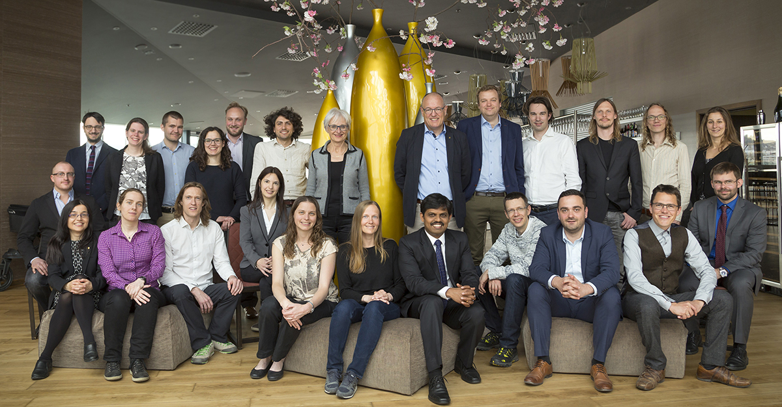
NTNU Outstanding Academic Fellows Programme
GOALS
Give selected talented researchers at NTNU the very best opportunities for academic development and recognition of merit.
Facilitate internationally leading careers in research and development of pioneering research
Win more ERC grants

Slide 48
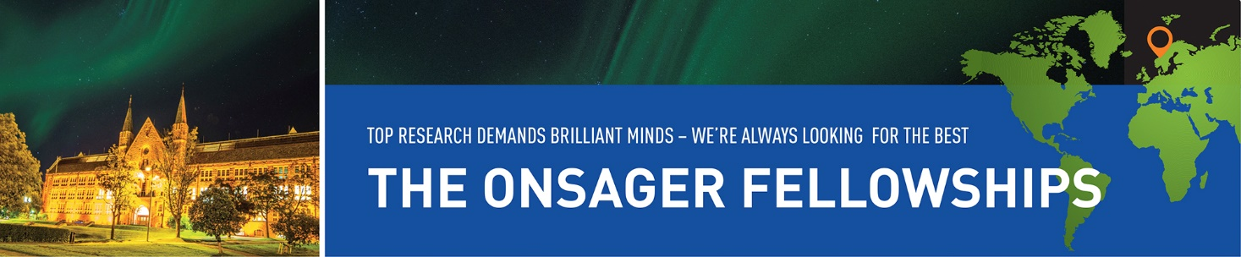
Onsager Fellowship Programme
Young, internationally outstanding researchers strengthen NTNU’s academic environments

Slide 49
Results of research
PhDs
Internal and external funding
Collaboration with industry
Research visits abroad
Partners
Business and industry
Public sector
Collaboration
Peer review
Open Access
+ Public- and user-oriented dissemination
Publications

Slide 50
Doctoral degrees
Evaluations confirm the high quality
of NTNU’s PhD education
It is easy for NTNU PhDs to find jobs, and
many of our graduates end up in organizations
outside the university
Student progression in the PhD programmes
is good, and the dropout rate is low
NTNU has many PhD students with foreign
citizenship, especially in technology
NTNU excels with many externally funded PhD candidates, often in collaboration with industry
The Doctoral Awards Ceremony 16 March 2018,
The Aula in the Main Administration Building
In recent years, NTNU has graduated nearly
400 candidates per year
377 doctoral degrees in 2019
Notes:
362 PhD degrees in 2017
AD: 6
HF: 18
IE: 68
IV: 81
MH: 78
NV: 63
NV: 33
ØK: 15

Slide 51
Doctoral degrees 2019 by faculty and gender
Source: FS (Felles studentsystem)/DBH
Notes:
2019:
Women Men Sum
AD 5 6 11
HF 10 6 16
IE 9 48 57
IV 29 83 112
MH 50 33 83
NV 22 41 63
SU 15 10 25
ØK 4 6 10
144 233 377
38 % 62 %
Men – Women = Total
AD: 3 – 3 = 6
HF: 9 – 9 = 18
IE: 52 – 16 = 68
IV: 59 – 22 = 81
MH: 31 – 48 = 79
NV: 41 – 21 = 62
SU: 11 – 22 = 33
ØK: 10 – 5 = 15
___________________
Total: 216 – 146 = 362

Slide 52
Doctoral degrees 2019 by faculty and nationality
Source: FS (Felles studentsystem)/DBH
Notes:
2019:
International Norwegian Sum
AD 7 4 11
HF 2 14 16
IE 30 27 57
IV 58 54 112
MH 20 63 83
NV 30 33 63
SU 5 20 25
ØK 1 9 10
153 224 377
Norwegian – International = Total
AD: 3 – 3 = 6
HF: 14 – 4 = 18
IE: 31 – 37 = 68
IV: 28 – 53 = 81
MH: 63 – 16 = 79
NV: 27 – 35 = 62
SU: 27 – 6 = 33
ØK: 12 – 3 = 15
_______________________
Total: 205 – 157 = 362

Slide 53
Doctoral degrees 2019 by faculty and both gender and nationality
Source: FS (Felles studentsystem)/DBH

Slide 54
Doctoral degrees by gender 2000-2019
Source: NIFU
Notes:
2019:
Women - Men
144 - 233
38 % - 62 %
2017
Men 216 (60 %)
Women 146 (40 %)
Total 362

Slide 55
Our collaboration is ranked as #1 in the world (THE)
Everyday collaboration in 27 SFI, FME and SFF and
23 Gemini Centres, which includes more than 1000 employees
Collaboration in 18 H2020 projects with more than 300 links with international project partners
200 laboratories in collaboration
Collaboration on ECCSEL ERIC, European research infrastructure for carbon capture and storage
Joint publication of scientific articles,
1600 articles during 2012–2017
Business
and public sector
Value creation
NTNU
Education
and research
SINTEF
Contract research
Teamwork model – extensive cooperation with the private and public sectors through joint projects and research centres
For more information: https://www.ntnu.edu/research/partnership

Slide 56


Open Science
Action plan for Open Access
with ambitious goals
Data repository
Information portal
NTNU channels for dissemination of results
Principles for open access to research data generated at NTNU
NTNU’s publishing policy

Slide 57
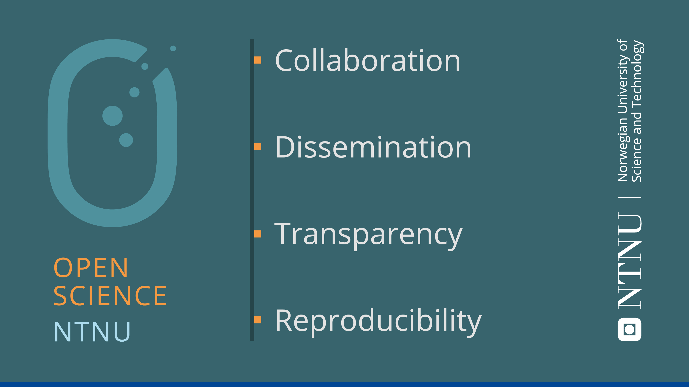
Notes:
Open Science: open and free sharing of knowledge. But Open Science has the motto «As open as possible, as closed as necessary», and emphasizes responsible and ethical research, and the balancing of different concerns. This is in line with NTNU’s «Knowledge for a better world».
NTNU would like to highlight four essential values and ideals as the basis for the work with Open Science:
-Collaboration: Research is an enterprise based on cooperative work, and builds on knowledge that others have produced
-Dissemination: Research output should be shared and made accessible, both for other researchers as well as the rest of society
-Transparency: Opening up the reserach process from beginning to end, including methods, procedures, results and ethical considerations, to ensure quality and integrity
-Reproducibility: Research results should be validated and reproduced
Open Science = Science done right!

Slide 58
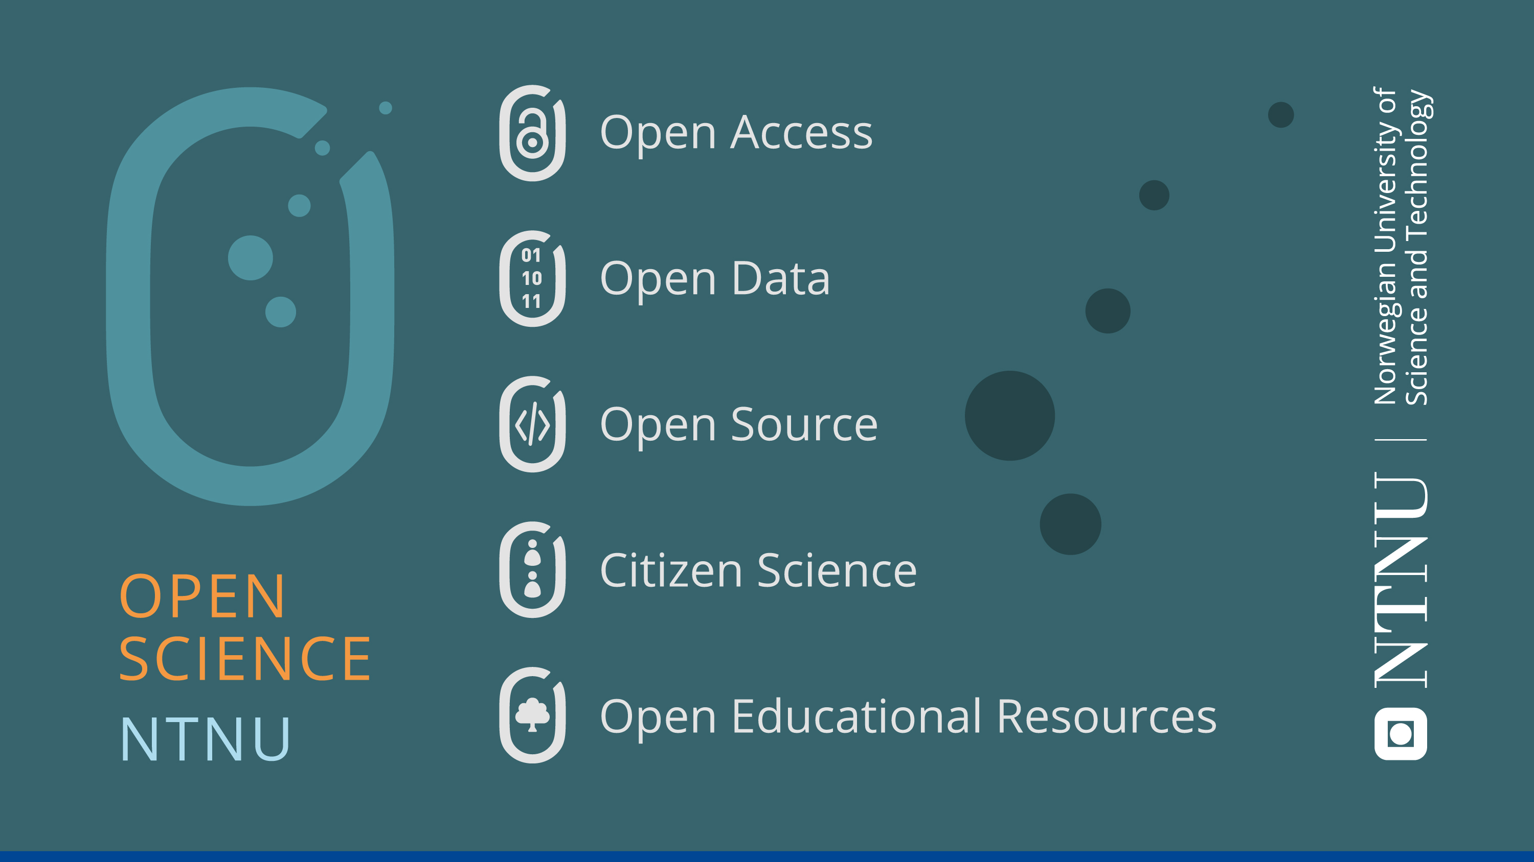
Notes:
Open Science is an umbrella term which includes several aspects or topics. NTNU focuses on the following areas:
-Open Access to research publications
-Open Data; sharing, as well as good management, of reserach data
-Open Source; sharing/publishing code, scripts, models and software in research
-Citizen Science; involving users and non-scientists in reserach projects
-Open Educational Resources; making training materials openly available

Slide 59
Source: Cristin

Slide 60
Source: Cristin
Notes:
2012: 122
2013: 146
2014: 118
2015: 125
2016: 117
2017: 137

Slide 61
Kilde: SciVal

Slide 62
Source: SciVal

Slide 63
Number of NTNU publications 2004–2017
Source: DBH

Slide 64
Number of citations per publishing period in 2006–2015
Source: Leiden ranking

Slide 65
Joint publication with business and industry 2012–2017
Source: SciVal
Notes:
2012: 122
2013: 146
2014: 118
2015: 125
2016: 117
2017: 137

Slide 66
Some examples of academic activity
Mathematics
NTNU Cyborg
IEEE Fellow
European health
Universal design

Slide 67
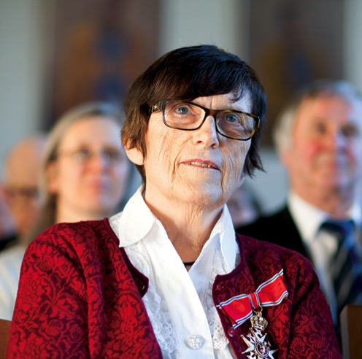
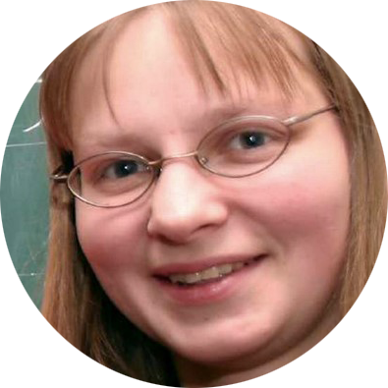
Mathematics
Idun Reiten
Among the foremost mathematicians in work
on representation theory for algebras. Royal Norwegian Order of St. Olav for her contribution as a mathematician, and honorary doctorate at Bielefeld University.
Eugenia Malinnikova
Honoured with the Clay Research Award: a prize for mathematicians who have made major breakthroughs in mathematical research.
ShanghaiRanking ranks NTNU’s mathematics department as the foremost in northern Europe

Slide 68
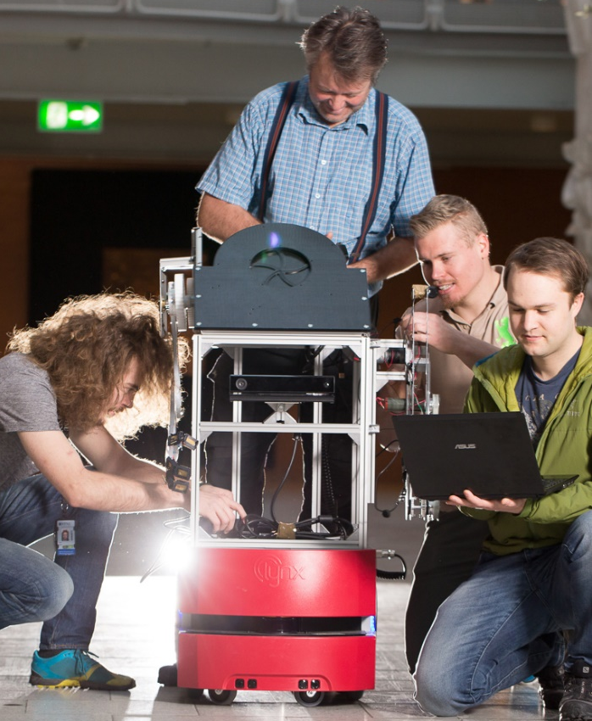
NTNU Cyborg
Development of an interactive social robot interfaced with
a biological "brain", biological neural networks
Interdisciplinary: computer science, cybernetics, neuromedicine, ethics and design
Basic research, applied research, student projects
GOALS
Robots that can communicate
Understand how brain injury can be repaired
Understand how new computers can be designed
Partners:
NTNU Morphogenetic Engineering, SOCRATES (NTNU and HiOA), Telenor-NTNU AI Lab, NTNU NanoLab, SINTEF ICT – Applied Cybernetics, NTNU Spark*, StartNTNU

Slide 69
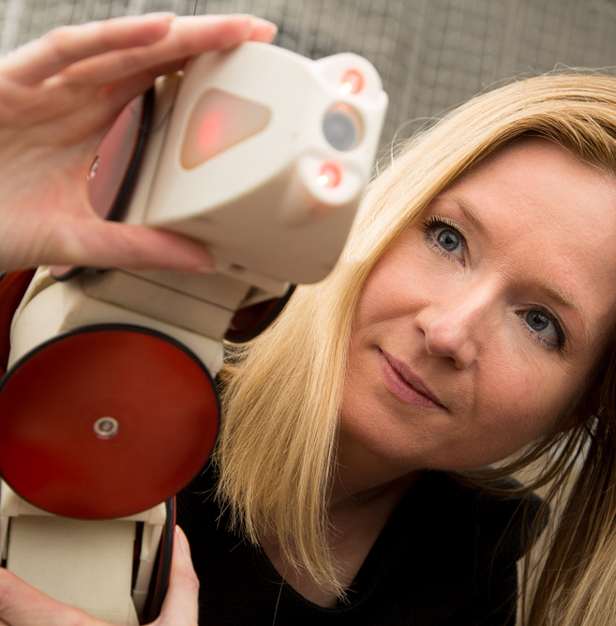
IEEE Fellow
Kristin Ytterstad Pettersen
First woman in the Nordic countries to be honoured with the IEEE Fellow Grade
Research on control of mechanical systems (ships, AUVs, robot manipulators, snake robots), autonomous vehicles, robotics
Entrepreneur behind the spin-off company Eelume

Slide 70
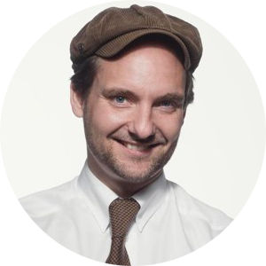

European health
Terje Eikemo leads two large EU projects surveying health
Euro-GBD-SE:
How can we reduce inequalities in health?
The European Social Survey (ESS): What makes Europeans ill? Health survey on smoking, alcohol, physical activity, childhood, health services, work environment, living conditions, education.

Slide 71
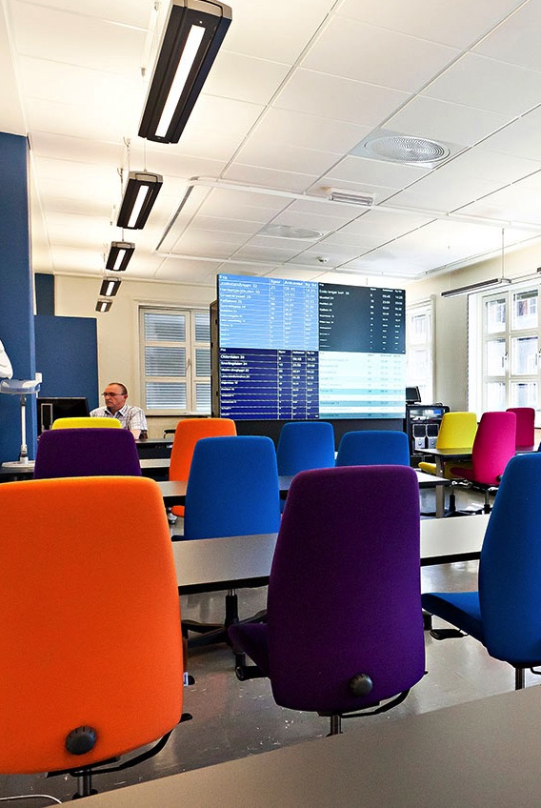
Universal design
Norwegian Research Laboratory for Universal Design, NTNU in Gjøvik
Studies issues related to vision, hearing and mobility for buildings, outdoor areas, transport and design
Human Senses Lab; vision and hearing
Full-Scale Lab; models and testing
Lecture room

Slide 72

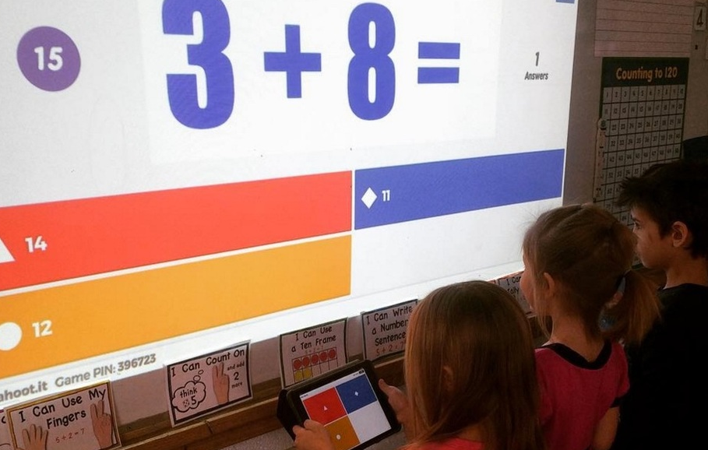
Game-based learning
Learning platform with more than 50 million monthly active users
Professor Alf Inge Wang,
Department of Computer Science,
invented a classroom quiz game that became

Slide 73










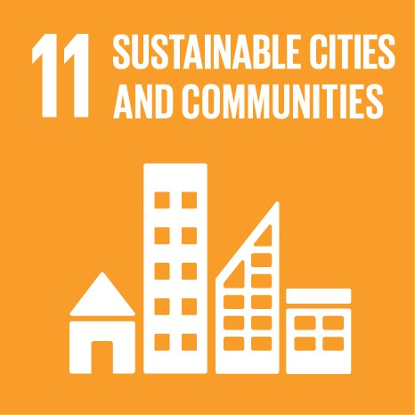






UN Sustainable Development Goals
Do you have examples from NTNU that can be linked
to the goals?
kontakt@komm.ntnu.no
www.ntnu.no/baerekraftmaal
Notes:
From vision to action: Explore NTNU in the light of UN’s Sustainable Development Goals.
25 September 2015: The member states of the UN adopted 17 goals for sustainable development towards 2030.

