Slide 1
EDUCATION
Knowledge for a better world
Trondheim | Gjøvik | Ålesund
NTNU Brussels Office

Slide 2
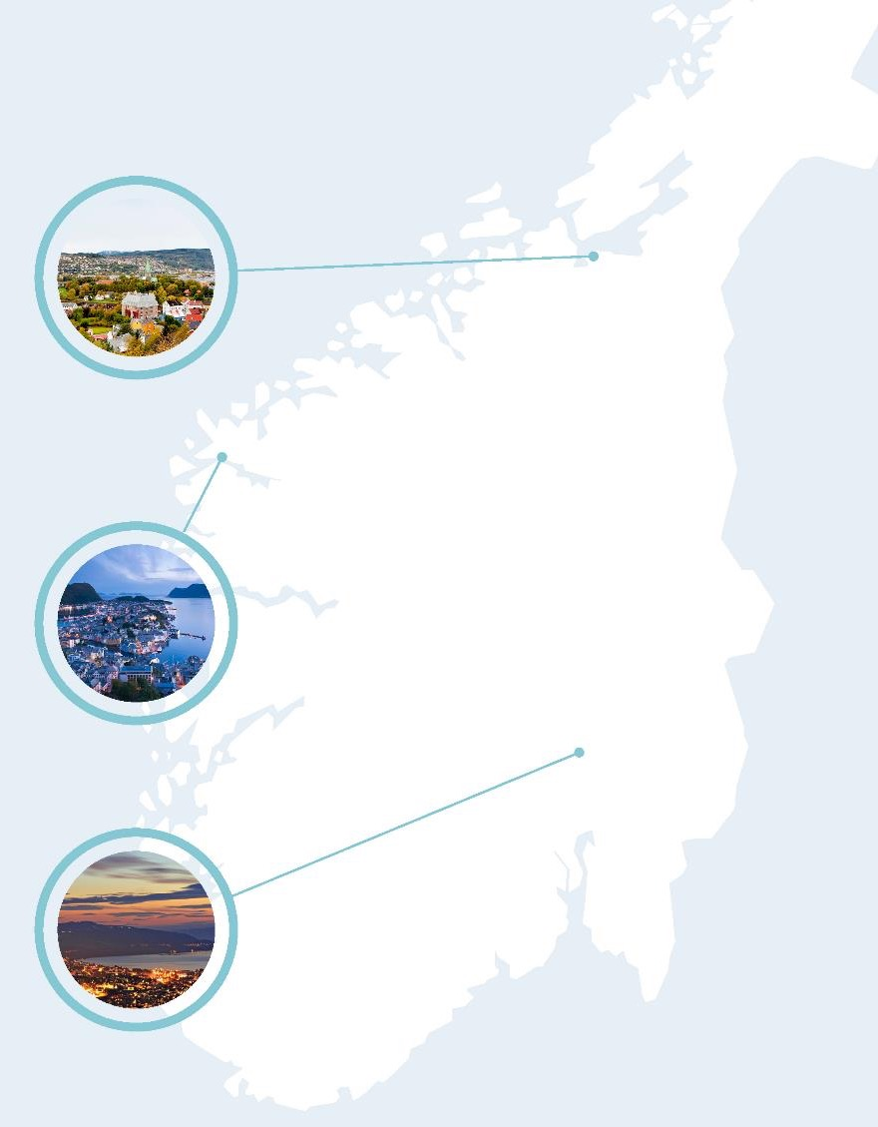
Study programmes at NTNU
Main profile in science and technology
Several professional programmes
Great academic breadth in the humanities, social sciences, economics, medicine, health sciences, educational science, architecture, entrepreneurship, art disciplines and artistic activities
Variety of continuing and further education opportunities
Programmes of study are developed in close partnership with business and the working world
Three university cities

Slide 3
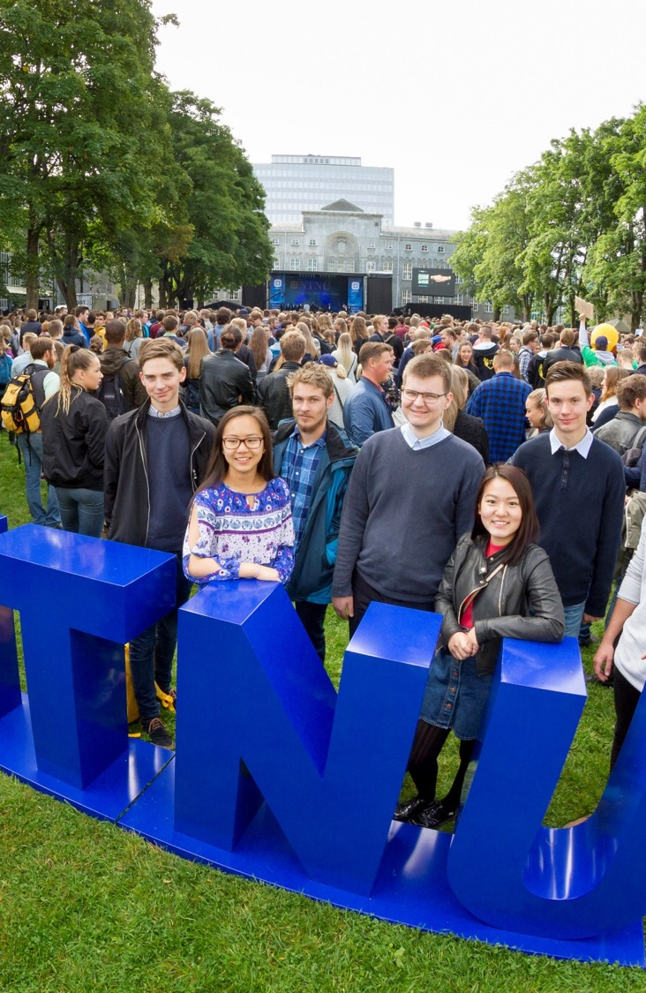
NTNU students
autumn 2019
Total 41 971 students
  Trondheim: 35 638 (84.9 per cent)
  Gjøvik: 3 920(9.3 per cent)
  Ålesund: 2 413 (5.7 per cent)
Almost half in science and technology subjects
NTNU is Norway’s largest in technology, engineering, teacher education and architecture
Nationally, NTNU is the university that recruits the most
3629 students are from abroad (9 per cent)
Notes:
After the merger with the university colleges in Sør-Trøndelag, Gjøvik and Ålesund, NTNU has become Norway's largest university with 42 000 registered students in the autumn of 2018
(Here, subjects in science and technology are defined as the following codes in the Norwegian Database for Statistics on Higher Education (DBH): engineering, technology, mathematical and natural sciences, maritime, medical laboratory technology. The number of registered students in these categories totals 18066, which is 45 %.)
About half of the students are women, but we see that there is an unbalanced (and traditional) gender ratio for a number of our study programmes.

Slide 4
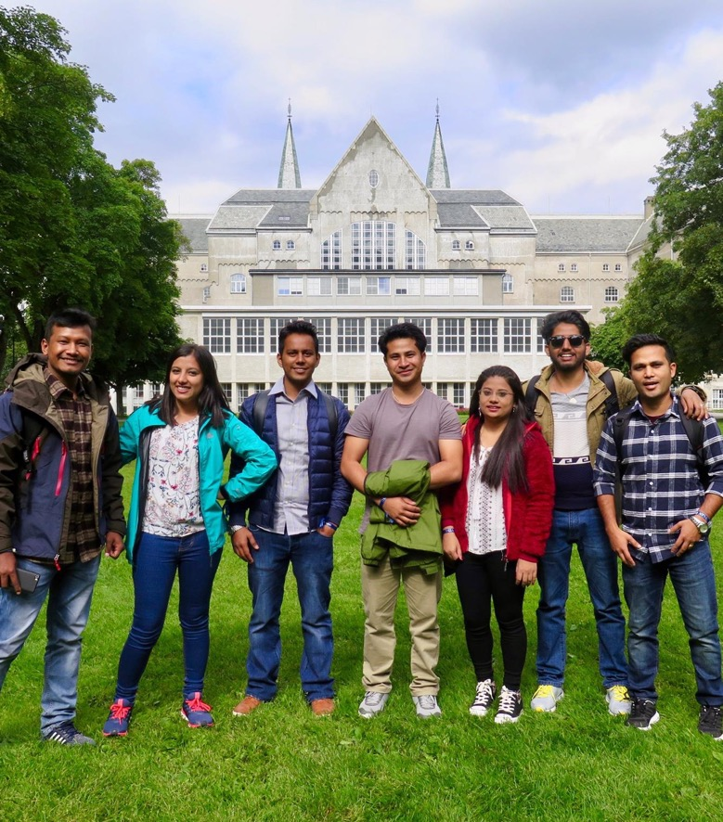
Internationalization of education at NTNU
NTNU is an internationally oriented university, with:
about 3500 international students
hundreds of mobility and collaboration agreements with leading international academic communities and institutions worldwide
about 70 master’s programmes taught in English
a goal that at least 40 per cent of all full-degree students will have a period of study abroad
a vision of being internationally outstanding in education and research

Slide 5
Number of students at NTNU
autumn 2019
SU | Faculty of Social and Educational Sciences
IE | Faculty of Information Technology and Electrical Engineering
IV | Faculty of Engineering
MH | Faculty of Medicine and Health Sciences
HF | Faculty of Humanities
ØK | Faculty of Economics and Management
NV | Faculty of Natural Sciences
AD | Faculty of Architecture and Design
Registered students in autumn 2019 (Source: DBH)
Notes:
Reg stud 2018
Fak Totalt Andel kvinner
AD 1352 57.3 %
HF 4204 56.7 %
IE 7720 25.1 %
IV 6483 29.2 %
MH 6056 77.4 %
NV 3540 53.3 %
SU 8361 69.6 %
ØK 4192 42.0 %
NTNU 63 63.5 %
Sum 41971 50.5 %
DBH: Number of registered students in the autumn of 2017 – number of registered students (% women)
Faculty of Social and Educational Sciences 8 201 (69,4 %)
Faculty of Information Technology and Electrical Engineering 7 069 (22,5 %)
Faculty of Engineering 6 833 (30,2 %)
Faculty of Medicine and Health Sciences 5 615 (77,2 %)
Faculty of Humanities 3 825 (58,3 %)
Faculty of Economics 3 820 (45,9 %)
Faculty of Natural Sciences 3 524 (52,9 %)
Faculty of Architecture and Design 1 239 (54,6 %)
NTNU (unspecified sub-units) 54 (55,6 %)
Total 40 180 (50.4%)

Slide 6
Top 10 programmes of study
NTNU has the most first-priority applicants in Norway - 25 240 in 2020 (NUCAS admission service)
Programme​ | Number of places planned​ | Number of 1. priority applicants​ | First-priority applicants per place​
Film and Video Production - Bachelor's Programme | 20 | 212 | 10,6
Clinical Psychology Programme, 6 years | 94 | 778 | 8,3
Physiotherapy Programme | 80 | 583 | 7,3
Medical studies | 155 | 1071 | 6,9
Music Technology - Bachelor's Programme | 25 | 146 | 5,8
Industrial Economics and Technology Management | 180 | 994 | 5,5
Bachelor of Science - Nautical Studies | 27 | 143 | 5,3
Bachelor in Information Technology | 55 | 291 | 5,3
Graphic Design - Bachelor's Programme | 30 | 150 | 5,0
Bachelor in Digital Business Development | 65 | 323 | 5,0
Notes:
The table shows which full-time programmes at NTNU have the most first-priority applicants per place.
In total 23,502 applicants had programmes of study at NTNU as their first priority in the autumn of 2019. (In addition to these numbers of applicants, there are local admissions to master’s programmes and further education.)
In total, 50,393 people – more than every third applicant – have NTNU as one of several choices.
1. BIBYG-F Bachelor i ingeniørfag - Bygg- Nettbasert (11,8)
7. BØKLED-F Bachelor i økonomi, ledelse og bærekraft (6,6)

Slide 7
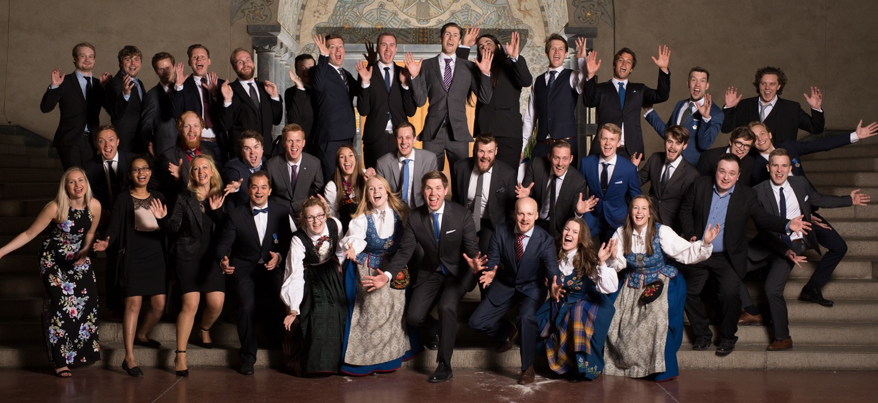
Number of graduates in 2019
7 586 bachelor’s and master’s degrees
377 doctorates
4 624 in further education with credits, and in experience-based master’s degree programmes
Notes:
The photo is from: https://www.flickr.com/photos/ntnuime/35239962586/in/album-72157685003532715/

Slide 8

NTNU VIDERE
Further education and part-time studies
Study while working
Short- and longer-term courses with credits
Flexible teaching:
online courses and courses with group sessions
Bachelor’s and master's level
Customized in partnership with public- and private-sector organizations
Notes:
John Helge Hamberg and Unni Lundberg are specialist nurses at Helsehus in Trondheim. They have taken the further education programme “Advanced Clinical Nursing”.
“After I took the further education programme, I have a better understanding of what to prioritize and patients’ needs. I see other actions we can take for patients now than I did before, and I clearly notice that what I do in my work has become more knowledge-based,” says John Helge.

Slide 9
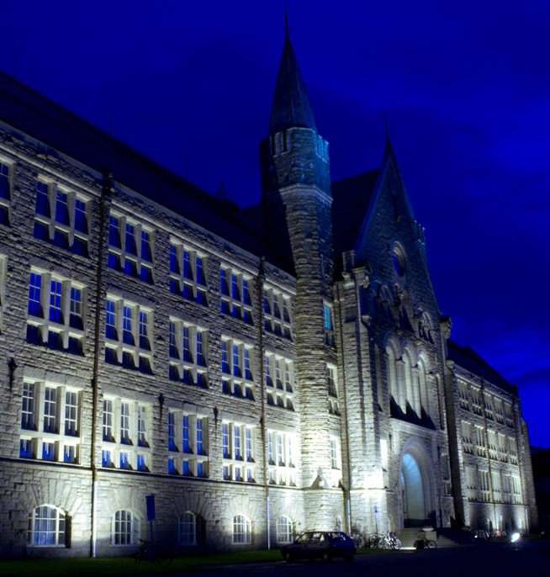
Why do students choose NTNU?
Academic quality and opportunities
Attractive study environment
Career opportunities
Notes:
Why do students choose NTNU – what do they say themselves?
Students highlight “Opportunities”. Both in their studies and in their free time. The breadth at NTNU give students a wealth of opportunities to explore what they are interested in greater depth. There are also many opportunities for a variety of leisure interests.
They highlight “Quality”. Students emphasize the professional quality of NTNU’s programmes, and the high academic standard, which challenges them. They also highlight NTNU’s good reputation and contact with the business community.
“Jobs” and careers are important for our students. Many students highlight good opportunities for jobs as one of their reasons for choosing NTNU.

Slide 10
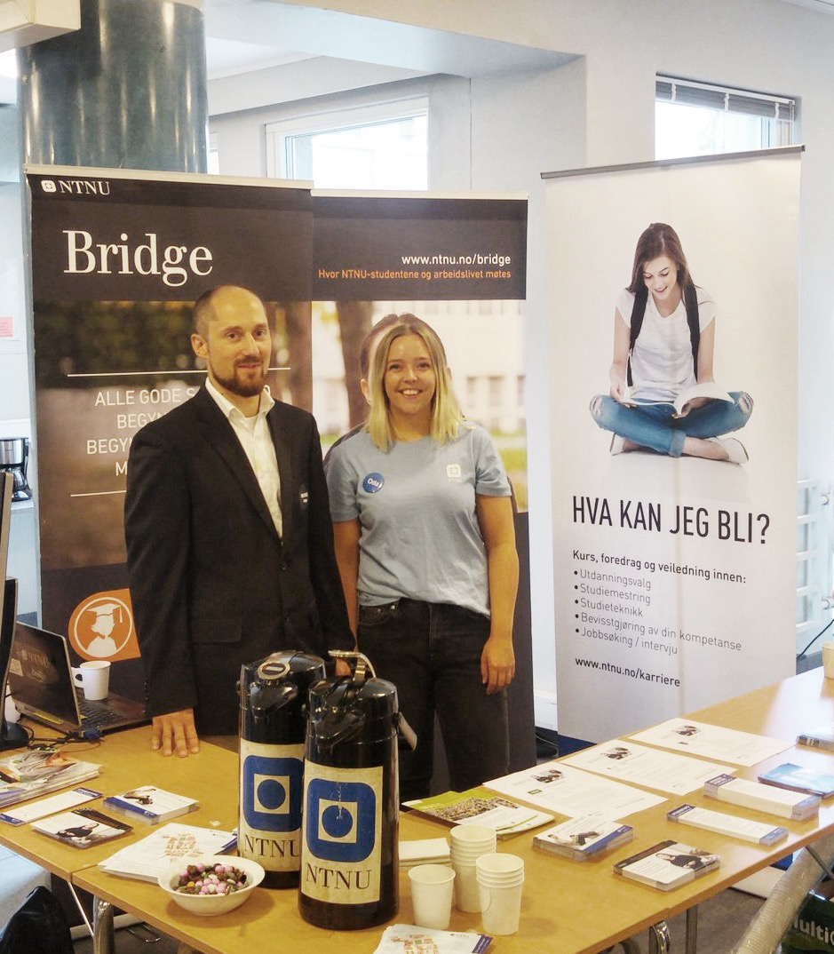
Career opportunities
NTNU’s career services (NTNU Karriere)
  Training and guidance in how to choose a study programme, student life and job search
NTNU Bridge
  Contact between students and the business community
Notes:
NTNU’s career service (NTNU Karriere) offers career guidance and courses in studying effectively, study techniques, exam techniques, and presentation techniques for students. Job search and interview training courses are also available.
The service aims to help students to see their potential and opportunities and to make meaningful choices throughout their studies.
NTNU Bridge is NTNU’s official portal linking NTNU students with the working world for collaboration on topics for theses and assignments, internships and jobs
Talented graduates from NTNU are in demand in the private and the public sector. NTNU has a strong position in Norwegian working life – many employers start seeking out our students long before they graduate.

Slide 11

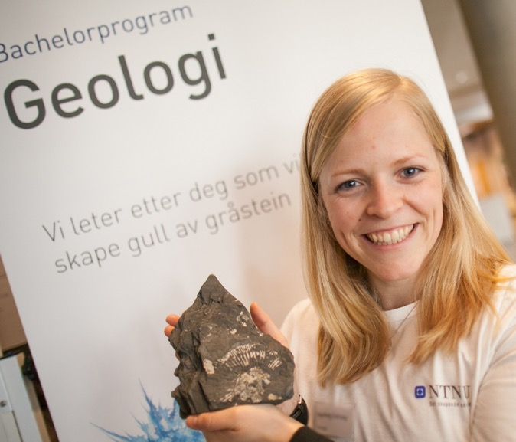
Recruitment of women
Recruitment of female students to education in technology, engineering master’s and bachelor’s degrees and IT
Examples of actions:
  The Girl Project Ada
  Jentedagen (Girls’ Day) and technology camp for girls
  Career networks
Recruitment of female employees
Examples of actions:
  Start-up packages
  Qualification fellowships
  Mentoring programmes

Slide 12
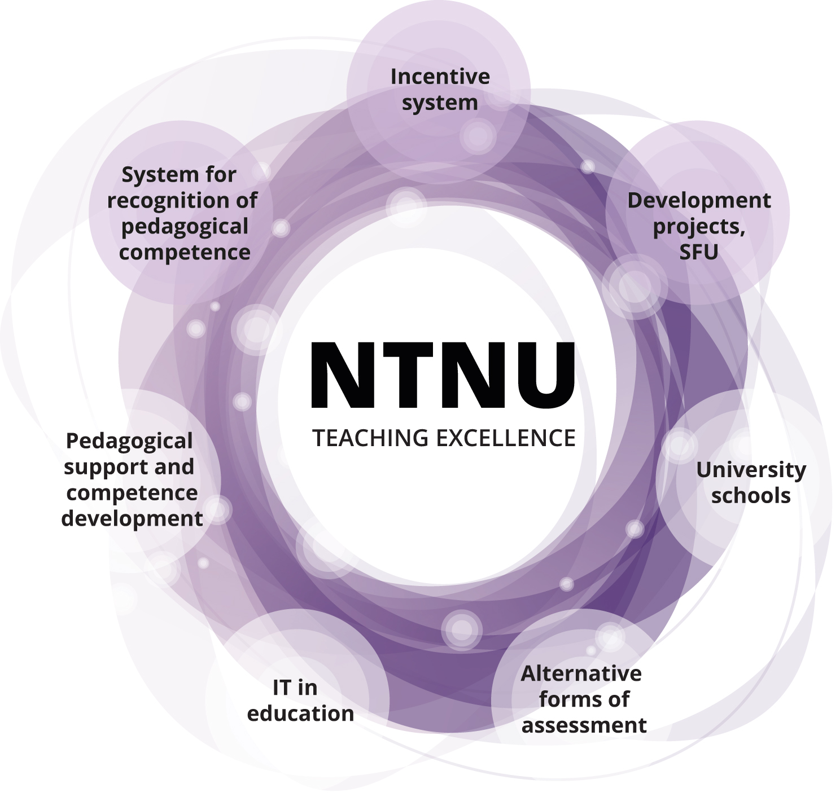
NTNU
Teaching Excellence
The aim is to promote:
development of innovative teaching, learning
and assessment methods
The initiatives should lead to:
improved learning outcomes for students
Notes:
NTNU Teaching Excellence is a strategic initiative aimed at helping NTNU to achieve its goal of providing education reflecting quality at a high international level. This requires long-term and systematic efforts to develop and strengthen teaching skills and quality.
NTNU Teaching Excellence was established in 2015 as a superstructure over several initiatives promoting development of innovative teaching, learning and assessment methods.The aim of the initiatives is to improve students’ learning outcomes.

Slide 13


IT in education
A programme in cooperation between IT and Education focused on improving education quality by customizing good IT services
Previous and ongoing projects:
  New e-learning system – Blackboard
  Computer-aided assessment
  Office 365 for students and staff
  Learning object repository (LOR) for storing and sharing learning resources
Notes:
Photos: https://www.ntnu.edu/excited og https://www.ntnu.no/toppundervisning/it-i-utdanning

Slide 14

E-learning platform
– Blackboard
Aim: Learn anywhere, any time!
Blackboard is used across campuses to support learning that actively involves students
NTNU is working to make Blackboard
  unifying – a consistent shared workspace
  flexible
  close to academic disciplines
6 700 employees and 40 000 students adopted Blackboard in autumn 2017

Slide 15
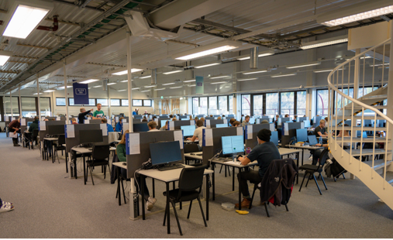
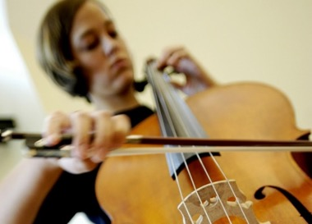
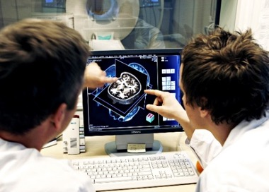
Computer-aided assessment quality – modernization – standardization and efficiency
NTNU (2018):
200 000 grades
Over 6 000 courses
Courses with more than
2 000 candidates
More than 7 000 bachelor’s and master’s degrees
165 000 written exams
35 % digital implementation
Plan
and
prepare
Process
explanation
/appeal
Finalize and archive
Carry out
Grade
Notes:
Quality in assessment – closer to reality with tools and forms of expression that reflect teaching and working life
We have conducted digital written exams supported by:
The LingIT package (tool adapted to special needs)
Office support: Word and Excel
Various tools for drawing, design and modelling: Solidworks, Autodesk AutoCAD 17, Autodesk Dynamo 18, Autodesk Robot 18, Plaxis 2D,
We use multimedia for a richer form of expression. Examples include:
Video for sign language interpreters where they both submit videos as an assignment and film themselves during exams
Music for music education, including “listening tests”
Colour images that can be used interactively as examination questions
We have had some continuous assessments in digital form, which are relatively low-cost in that they often (primarily) have automatic grading or are in the form of assignments/shorter take-home examinations.
Photo 1 was taken by Arve Bremseth at the IT Division. The picture shows digital exams at Sluppen.
The last two pictures here are from ntnu.no/bilder. They illustrate the growing diversity in assessment possibilities that the use of multimedia and 3rd-party software can provide.
Benefits of digital assessment:
Quality of administrative procedures – digital workflow reduces the number of manual errors
Modernization – digitalization of assessment and work tools
Standardization and efficiency – coordination and digitalization of solutions and processes towards a more effective NTNU
Total exams written at NTNU (both traditional and digital): 165 000 consisting of: 143 000 in Trondheim, 12 000 in Ålesund, 10 000 in Gjøvik

Slide 16
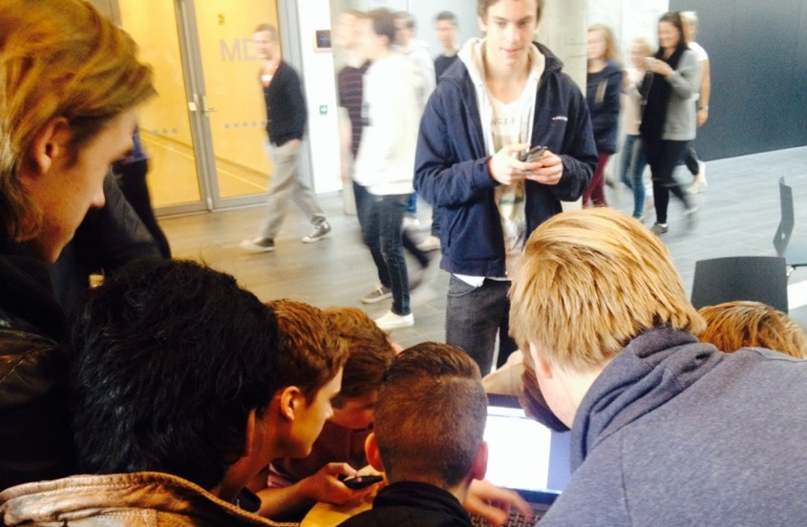

NTNU DRIVE is a network of employees working with technology, teaching methods, change management and research in education
NTNU MOOC
Develops teaching, technical and administrative support for educators who want to develop flexible online courses using MOOC (Massive Open Online Course) technologies at local, national and international level.
NTNU IKU
Offers support and training to employee groups who want to develop teaching and study programmes systematically. IKU stands for internal skills development in Norwegian.
NTNU BETA
Offers support and collaboration in innovation as well as learning technology and digital services. They will help you experiment and gain experience in the use of educational technology.
Notes:
NTNU DRIVE wants to share and develop knowledge about how new technologies and digital services can help to improve the quality of teaching and learning.
Good teaching depends on sound skills in the subject area as well as knowledge about how learning takes place, how learning processes are organized and how competence is assessed. Good teaching enables variation and adaptation in the development of students’ knowledge, skills and attitudes in academic and relevant contexts. Good teaching uses new technologies and digital services to encourage cooperation and learning, and is adapted to our digitalized society. Changing the way we teach and organize learning processes requires motivation, attention and not least time. For NTNU to develop new understanding and practices in teaching at the individual department or programme of study, systematic collaboration over time will be needed.
NTNU DRIVE is a strategic initiative that aims to support teaching staff, heads of departments and heads of study programmes who want to develop digital skills in several ways:
Courses with an online component and development support are offered through NTNU IKU.
Help in technology-supported teaching for the production of online courses and training is provided through NTNU MOOC.
Teaching staff who want to pilot new digital services can get help through NTNU BETA.

Slide 17
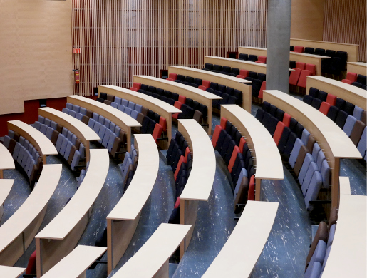
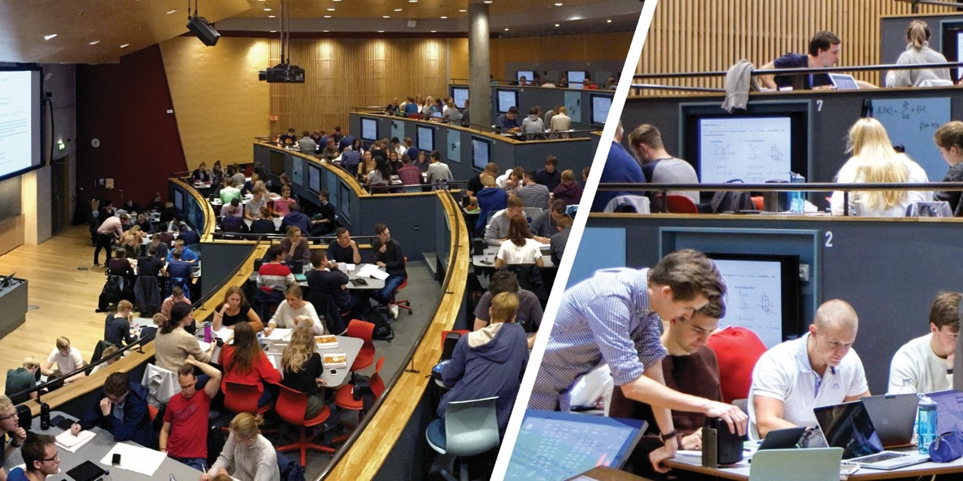
Learning spaces
Have an impact on forms of learning and interaction patterns
Important tools for creating a good learning and working environment for students and staff
Lecture room R2 at NTNU’s Gløshaugen campus, before and after modernization
Notes:
NTNU’s campuses should encourage and inspire learning, research, dissemination and innovation. Buildings and rooms have an impact on forms of learning and patterns of interaction. They are an important tool for creating a good learning and work environment for students and employees.
In January 2016, work began on the Campus project at NTNU. In this connection, the Property Division has been asked to plan and establish pilot projects that support new forms of learning and teaching while creating effective social and academic meeting places. Pilots are developed by the Property Division, students, educators, academic employees, architects and IT employees in collaboration. Evaluation of these pilots provides an important basis for NTNU’s campus development.
The picture shows R2, which is a large auditorium extending over two levels in the Realfagbygget building. This pilot project involves testing students’ learning outcomes after the modernization of a traditional amphitheatre auditorium. After the reconstruction, R2 still has the lectern, projector and blackboard familiar from traditional auditorium teaching. However, the rows of desks have been replaced by 4 (5) levels, where 28 group stations have been distributed. Each station has a shared screen that can be linked to students’ own devices. Near the screens, each group also has a whiteboard, a speaker, and a microphone. At the lectern, the subject teacher/instructor can control the content to be shared on the screens. In this way, we have tried to facilitate increased student activity, increased teamwork, and opportunities for switching between a variety of learning activities.
R2 has capacity for 160 students and was put into service in September 2017.

Slide 18
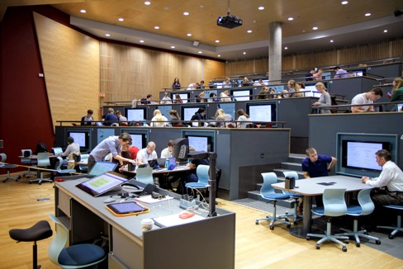
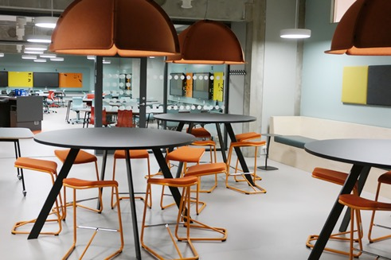
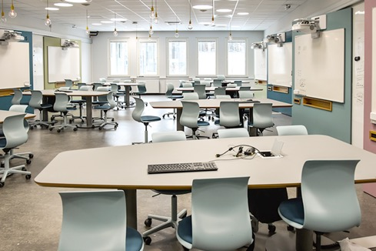
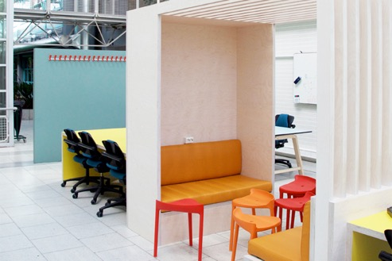
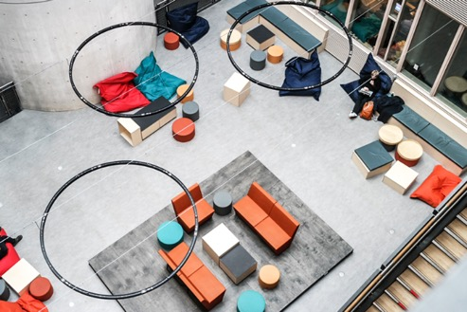
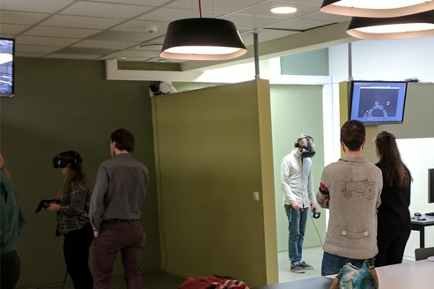
Learning spaces
R2 – Realfagsbygget, Gløshaugen
Sandkassa (Sandbox) – Dragvoll
Smia – Sentralbygget, Gløshaugen
Koopen – Elektrobygget, Gløshaugen
U1 – Realfagsbygget Gløshaugen
VRLab – Dragvoll
Notes:
R2 is a large auditorium extending over two levels in the Realfagbygget building. This pilot project involves testing students’ learning outcomes after the modernization of a traditional amphitheatre auditorium.We have tried to adapt the space to encourage increased student activity, increased teamwork, and opportunities for switching between a variety of learning activities.
Sandkassa at Dragvoll and Smia at Gløshaugen aim to explore how teaching spaces can be designed for more varied teaching that switches between lecturing and group work. It has been important to pilot new technology, such as interactive screens and sharing of screens. In Sandkassa, students also have access to several adjoining group rooms as well as a video recording booth.
Koopen was a pilot project for adapting to more practical teaching in groups, as a supplement to auditorium teaching. The area was also intended to function as an informal student area/meeting point outside class hours, and help to give the students a sense of belonging to the place where they were studying.
The learning spaces in U1 were a pilot project launched in the context of NTNU’s ongoing efforts to develop a living campus. The goal of the pilot project was to explore new forms of learning spaces – with a sharper focus on self-initiated work – teamwork – exploration and experimentation. However, an important part of the project was to investigate how the new learning arena could be seen in connection with the common areas of the Realfagbygget and could provide access to them, such as the library, the cafeteria, the café, and the social zones around the auditoriums, corridors and atriums.
The VR Lab Dragvoll focuses on learning and has state-of-the-art VR / AR equipment. This includes HTC Vive, Hololens and Mixed Reality. From the start, the lab has been widely used by students at master’s and bachelor’s degree level in a variety of subject areas: IT, geography, psychology, cybernetics, biotechnology, educational theory and practice, and teacher education.

Slide 19
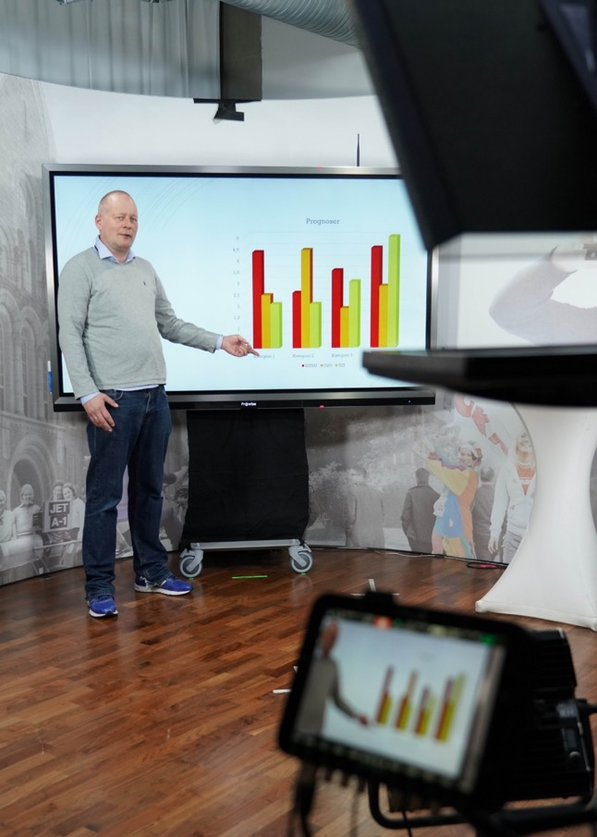
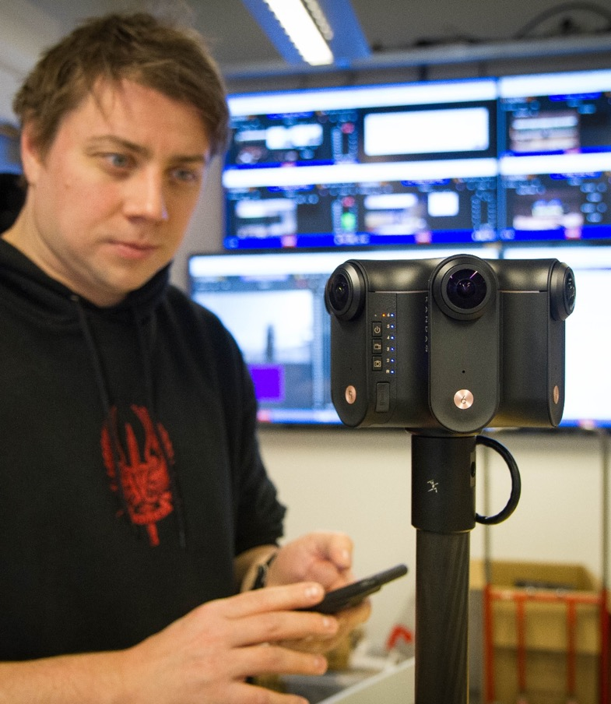
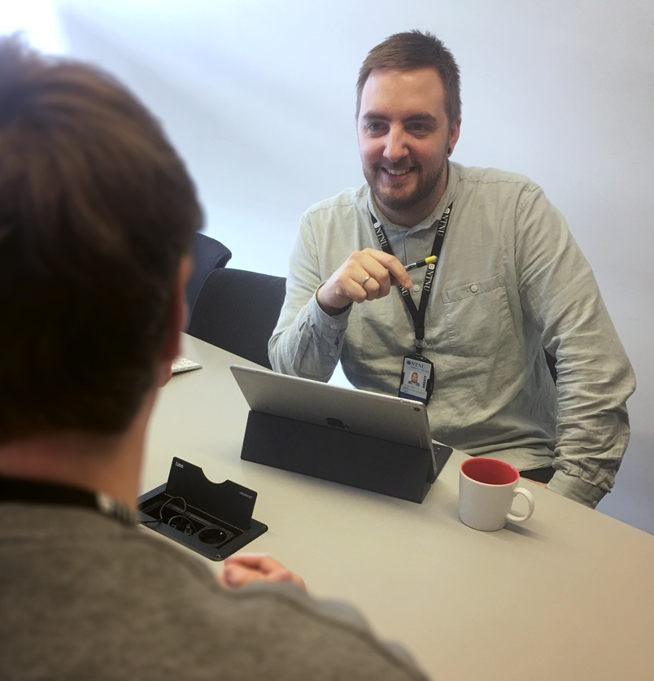
Video production
Experimental development
Advice
Multimedia Centre
Notes:
Video production
Automatic recording
Currently about 30 rooms
Fly on the wall – Documentation of teaching
Up-to-date
Unmanned
Set up manually at the beginning of the semester.
Studio recording
Videos adapted for teaching purposes
Requires staffing
Tailored content – shorter
Can be used for flipped learning, for example
Created with the format in mind
Field recording
Go out into the lab, field, office etc
Lighting, camera, audio equipment
Documentary approach
Interview setting
Self-service studio
Own production with good technical facilities
We provide training at the start
Well-suited for volume production of video
Flipped classroom – Students can produce video themselves
Increases technical quality compared to recording at your own desk
Experimental development
New technology for teaching
Need not be created for educational use – Find new areas of application
Development of premises. New learning spaces. New use of technology.
Self-service studio
Virtual reality
Advice
For video production in a studio and the field, as well as self-service studio
Investments in own equipment
Digitalization of teaching
Content production – Adaptation with video in mind
Collaboration
NTNU DRIVE
The Centre for Teaching and Learning
IT Division
Communication Division
Campus Services Division
Property Division

Slide 20
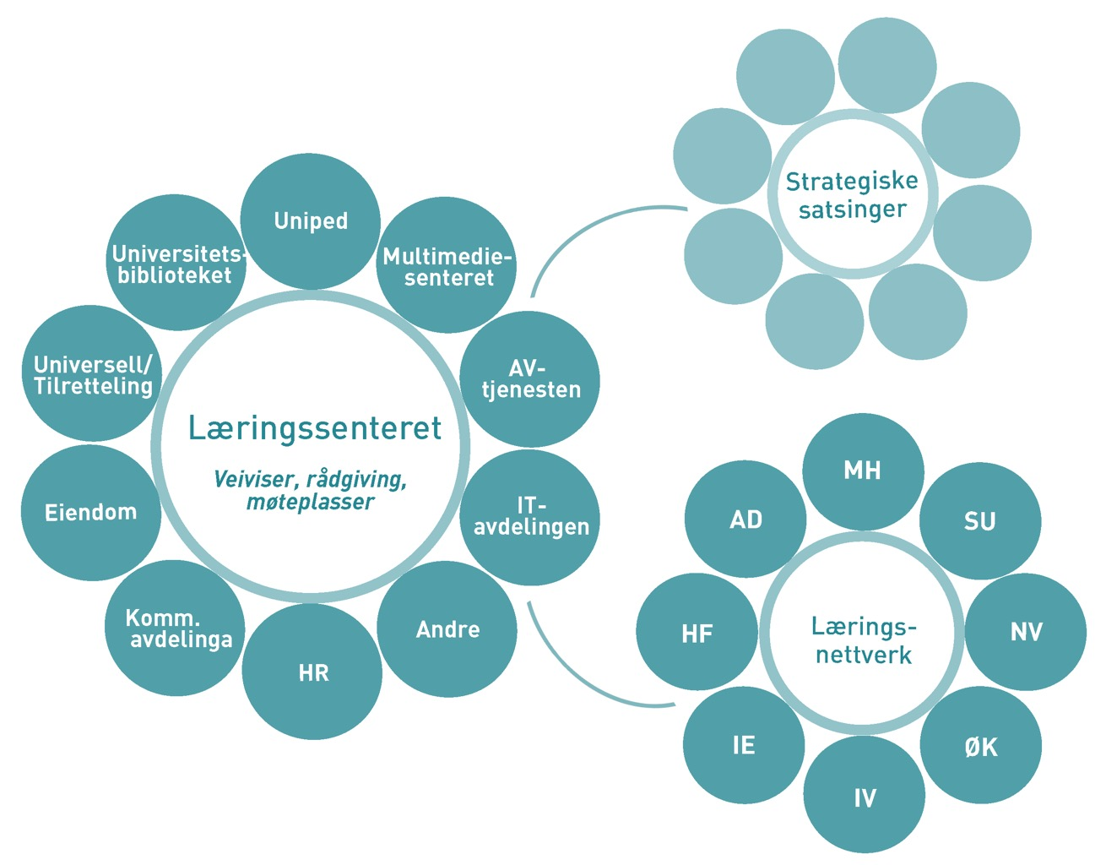
Pedagogical support and skills development
Learning Centre
Guide, consulting, meeting places
Uniped
Multimedia Centre
AV service
IT Division
Others
HR
Comm. division
Property
Universal / Special needs
University Library
Strategic initiatives
Learning network
Notes:
The university has established the Centre for Teaching and Learning, also known as LSS, to offer guidance to educators and academic groups. The centre showcases the potential of technology-supported learning. It provides opportunities for sharing experience by creating meeting places and contributing to advisory services and skills development. The centre's activities focus on technology-supported learning.
The figure shows how the centre has created and maintains networks at NTNU:
The teaching and learning support network has dedicated representatives from all the faculties, who provide a link to support and coordinate activities close to the subject areas.
The central network of units providing support services and organizational units is a meeting place for coordinating activities in relation to the faculty as well as support for strategic research areas
In addition, strategic research areas are mentioned because the LSS centre aims to contribute both before they begin and during the implementation phase. Ahead of the initiatives, the centre can help to provide an effective direction in calls for proposals, in design and possibly in applications for funding. During the implementation phase, the centre can offer its internal resources and can draw on expertise and resources from the networks when needed.
Management of digital tools and services:
The Centre for Teaching and Learning has worked closely with the Blackboard project in the implementation phase.
On behalf of the education area, the centre works closely with NTNU IT to develop a management model that also creates a basis for development.
This model is so generic that it can be used to provide a system for the management of other tools for education, such as
Office 365 for co-writing, collaboration and sharing
URKUND, plagiarism checker,
DLR (Digital Learning Resources) for reuse of learning resources,
Inspera for assessment and exams.
This community for technology-supported learning also offers the interdisciplinary skills that are vital for identifying which skills development, at which level and to what extent, is needed to exploit digital tools and services.
Sharing of experience is important for spreading good ideas and for motivating and inspiring more and more people to make use of new forms of learning, teaching and assessment. The Centre for Teaching and Learning therefore offers
Local meetings on learning and teaching at NTNU
The Learning Festival (læringsfestivalen), which is a national conference
The journal Læring om læring (Learning about learning) for publishing – currently nationally, but it is open to Scandinavian languages.
Learning spaces have been an area of focus for NTNU, and will continue to be throughout the campus process. The Centre for Teaching and Learning has dedicated a half-time position to coordination, events, training and documentation of the use of these spaces. The centre would like to contribute this competence to further development at NTNU.

Slide 21
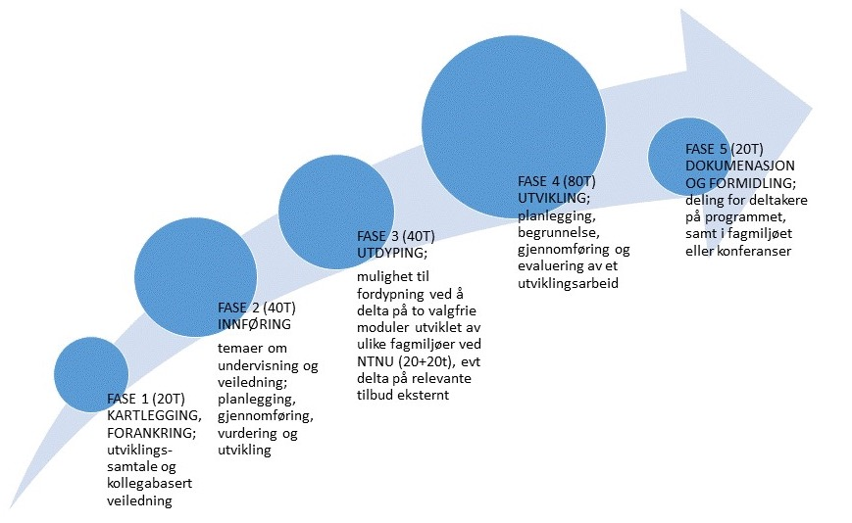
Core skills in university teaching
– development and pilot of new model
PHASE 5 (20 hours)
DOCUMENTATION AND DISSEMINATION; sharing with participants in the programme, as well as in the academic community or conferences
New model for core skills in university teaching that will replace today’s programme (Pedup).
The model will be tested in a pilot in 2018-2020.
PHASE 2 (40 hours)
INTRODUCTION
topics on teaching and supervision;
planning, implementation, assessment and development
PHASE 1 (20 hours)
MAPPING, ANCHORING; development dialogue and peer mentoring
PHASE 4 (80 hours)
DEVELOPMENT;
planning, justification, implementation and evaluation of work in experimental development
PHASE 3 (40 hours)
SPECIALIZATION; opportunity to specialize by taking part in two elective modules developed by various academic environments at NTNU (2O+20 hours), or in relevant external programmes
Notes:
New opportunity: 200 hours distributed over one academic year. Goal: The basic skills achieved will provide a solid platform for the individual, giving them an opportunity for further development in the merit system. Learning outcome descriptions (LUBs) in accordance with the Norwegian Qualifications Framework (NKR) and guidelines from the Norwegian Council for Higher Education (UHR) will form the basis of the new model. The proposed model consists of five phases that build on and reinforce each other, illustrated in the figure:
The model emphasizes commitment (phase 1), development (phase 4) and dissemination (phase 5) in the participants’ academic environment to address teaching, guidance and development work as a collective concern.
The introduction (phase 2) addresses research-based knowledge and skills in teaching and guidance.
A prerequisite for the model is that all faculties at NTNU, in cooperation with relevant support units, are gradually involved by contributing modules (phase 3) that are based on the strengths of the academic communities. The Working Committee recommends that external (national and international) and online modules can be included (phase 3).
The aim of the modules is to ensure relevance for the faculties and flexibility for participants, as well as to realize the opportunities offered by multiple campuses. The term “phases” is used to show the structure, framework and progression of the model, but can be developed further in the academic community in connection with the pilot. The same applies to the name of the phases and the proposed sequence. The pilot creates an opportunity for testing and evaluation of the model.
The plan is that all or part (modules) of the new programme will be made available to new employees without basic competence as in current practice, and that the programme will also be made available to everyone in both academic and technical-administrative positions.

Slide 22
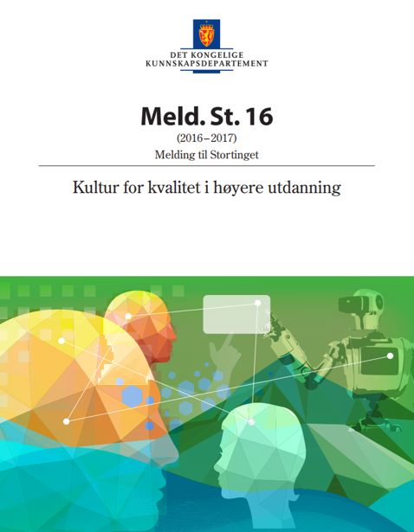
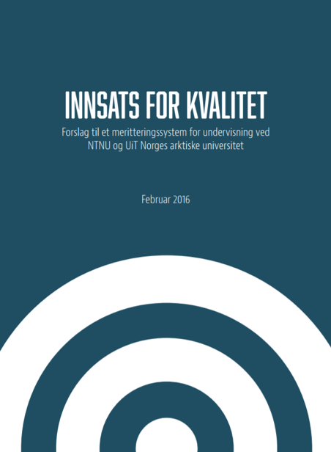
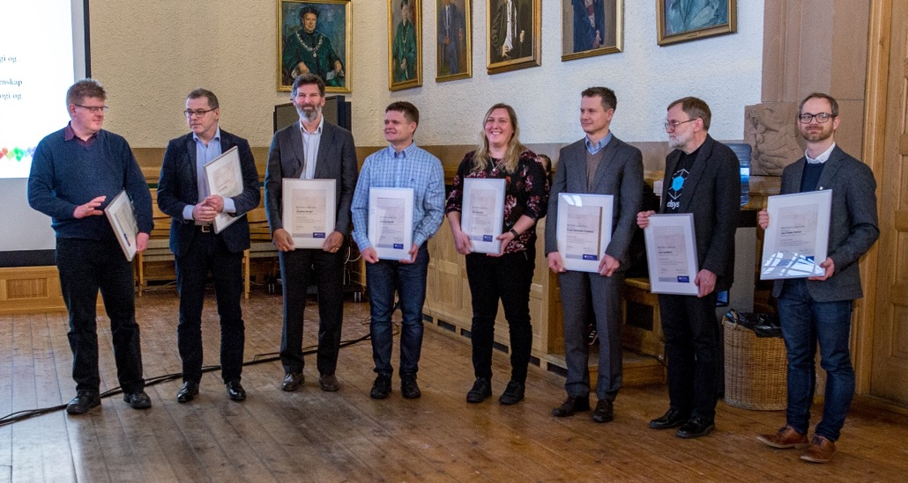
Pedagogical merit systems
NTNU wants to raise the status of teaching through initiatives including recognition and reward of skilled teachers. In January 2018, 9 teachers received merit awards.
Notes:
Work on pedagogical merit systems began in cooperation with UiT The Arctic University of Norway in 2015. In 2016, a joint working group delivered the report “Innsats for kvalitet” (“A Commitment to Quality”), with the aim of creating the basis for a system so generic that it could also be extended to the rest of the sector.
Report to the Storting 16 (2016-2017) Quality Culture in Higher Education, page 22, states that
“The Government requires the higher education institutions to develop pedagogical merit systems to encourage more teaching initiatives and to reward important development work. Merit systems should promote education quality by remunerating academic employees according to documented results. One of the goals of this White Paper is to raise the status of educational activities and place greater value on teaching competence than it currently enjoys, not just at the appointment stage but from a career perspective.
NTNU advertised the first application period - a pilot - from 15 August to 15 October 2017. The Application Committee is broad-based, with experience from Lund University, from Tromsø, the academic director of the work and a student representative. In addition, a representative of each faculty with close links to the disciplines has participated in the work. In this first pilot period, we received 37 applications and 9 teaching staff members received merit awards – see the photo: Hans Georg Schaathun, Jan Ketil Rød, Eirik J. Irgens, Henning Fjørtoft, Hilde Lea Lein, Frank Alexander Kraemer, Lars Lundheim, Jan Frode Hatlen, Jonathan Wright (not shown).
2018:
The second application period took place from 15 April to 15 September. This time 23 applications were received, of which 9 were from women.
In this second round, associate professors (førstelektorer) and professors (dosenter) were also eligible to apply for recognition of teaching merit.
Future:
The university would like to establish a “Teaching Academy” for teaching staff with recognized merit. The details have not been fully specified, but the scheme should provide a basis for further development of practitioners with merit in cooperation, and for a form that enables NTNU to benefit from their skills at the institutional level.

Slide 23






School-university partnerships in Trondheim
Better teacher education
Better schools
Practice- and research-based teacher education
Strengthen practice as a learning arena in teacher education
Professional learning community
Exploratory and knowledge-based teaching and guidance
Identity as educators of teachers and a teacher education institution
Co-created R & D
New practice-based and relevant knowledge about schools and teacher education
Notes:
The R&D track is the core of the project
Develop co-created R&D practices in the school-university partnerships – teachers, researchers and students
The initiatives/tools are inspired by the university hospital model, but the approach has been adapted to schools
Continuing and further education for employees at the university schools, joint and school-based
- in 2016 further education in guidance and R&D work, courses for practical training supervisors, for teachers at the Charlottenlund schools
15 credits, – Gunnar presents research and experience from this initiative
- in autumn further continuing and further education in experimental development at primary schools. Further education for teachers and
continuing education for school staff responsible for before- and after-school care (SFO). Parallel joint and school-based courses. Nina Vasseljen is responsible and
work with the primary schools will be presented during the parallel sessions after lunch.
2. PhD candidates are important in the university hospital. We have appointed 4 PhD candidates, two from the public sector whose workplace is at the Charlottenlund schools and two at the university. Currently appointing two more in connection with the primary schools initiative. Important to keep research skills in the school system after the candidates have defended their thesis. A strategy in the project is to develop a separate job category as a PhD teacher in order to achieve this. Rune Flatås, coordinator of the Charlottenlund university-school partnership is leading this initiative. Together with Even Einum, who is a PhD candidate at Charlottenlund, he will present this work later today.
3/4. It is important to develop R&D projects in the school system – teachers develop inquiry-based practices, apply and take part in R&D. Appointed R&D managers in 20% positions who are researchers from NTNU who will help teachers in this work. During the spring of 2017, a number of R & D projects started in the Charlottenlund schools – some large and some small – presentation during the parallel sessions – university schools, upper secondary schools, separate section for vocational subjects with projects related to vocational subjects.

Slide 24



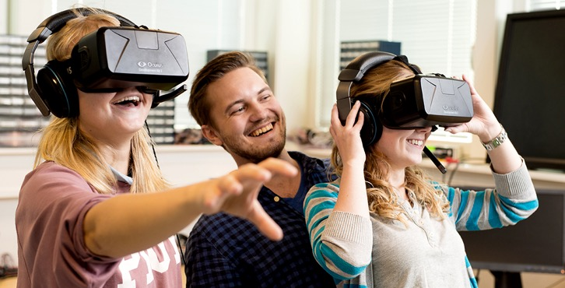
Centres of Excellence in Higher Education
ENgage – Centre for Engaged Education through Entrepreneurship
ENgage aims to increase the number of students with entrepreneurial skills and a mindset that will make them change agents in a variety of contexts in Norway and the rest of the world.
Linked with NTNU and Nord University.
ExcITEd – Excellent IT Education
ExcITEd wants to put Norway at the forefront of innovative IT education and to make ICT subjects more attractive.
Linked with NTNU and Nord University.
Notes:
NTNU received two Centres of Excellence in Higher Education (SFU) in the autumn of 2016, with start-up in 2017. Project period for both: 2017-2021.
Each centre receives between four and eight million Norwegian kroner per year. The purpose is to encourage outstanding education. The Centres of Excellence also aim to contribute to good relationships between education and society and the professions, as well as spreading knowledge.
Centre of Excellence in Higher Education (SFU): duration of 5 years, with potential for renewal for another 5 years.
Entrepreneurship as a vehicle for student engagement and learning (ENgage) originates from the Faculty of Social Sciences and Technology Management, but is a consortium which consists of a number of participants, such as the NTNU Entrepreneurship Center, Experts in Teamwork, TrollLABs and Spark NTNU. The Centre is headed by Roger Sørheim.
From the web pages on Centres of Excellence in Higher Education (SFUs) from the Norwegian Agency for Quality Assurance in Education (NOKUT):
ENgage works to increase the number of students with entrepreneurial skills and mindsets that make them change agents in a variety of contexts in Norway and the rest of the world. The purpose of the Centre is to educate students to meet complex societal challenges through entrepreneurship whatever the business or industry they enter.
ENgage develops education for students from all disciplines and professions. The Centre focuses on students’ commitment and creativity to enable them to manage future challenges. Through interdisciplinary cooperation in real-life projects, students gain knowledge and competence both inside and outside the classroom.
With their partners, students can develop their own businesses, bringing business ideas to life and work with real societal challenges. Through a consortium consisting of the NTNU Entrepreneurship School, Nord University Business School, Spark NTNU, TrollLABS and Experts in Teamwork at NTNU, ENgage will have dedicated learning and research activities. The Centre also has other partners domestically and abroad.
Excellent IT Education (ExcITEd) originates from the Faculty of Information Technology, Mathematics and Electrical Engineering (IME) at NTNU. The aim of this centre is to boost tertiary education in Norway: all education above secondary level and vocational schools. Keywords: Increased learning through increased student participation, a stronger focus on project-based learning, earlier involvement of students in R&D. The Centre is strongly committed to testing and to some extent developing computer-aided learning tools. The same academic group was also a finalist in 2013, when it was named 2-IT. The Centre is headed by Guttorm Sindre.
From the web pages on Centres of Excellence in Higher Education (SFUs) from the Norwegian Agency for Quality Assurance in Education (NOKUT):
ExcITEd aims to put Norway at the forefront of innovative IT education and to make ICT subjects more attractive to young people. To achieve this, the centre works closely with students, other faculties and potential employers – and not least, the school system. ExcITEd wants to increase diversity in IT education by improving knowledge about different IT disciplines and career opportunities in this field.
ExcITEd wants to raise the quality of IT education both in Norway and abroad. The Centre therefore uses research-based knowledge of didactics in IT subjects. By evaluating new learning methods and working together with students and across disciplines, the Centre will find the success factors that contribute to a good learning environment.
Project-based learning plays a key role at ExcITEd and the Centre uses active learning methods to achieve its goals. Examples of these methods are that students learn from each other, use state-of-the-art technology and build networks with the business community. An important point for ExcITEd is that students get the opportunity to develop and to design their own projects themselves – sometimes right up to the finished product. In this way, they hope that students will build the skills to work creatively in a real-life "playground".

Slide 25
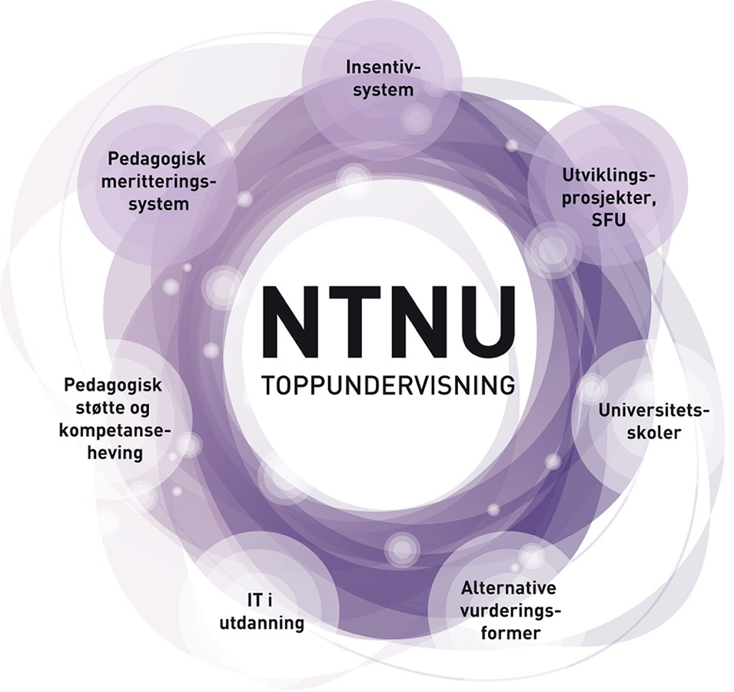
Development projects
_{Incentive systems}
_{Pedagogical merit system}
_{Development projects, SFU}
NTNU Teaching Excellence grants funding for 15 projects focusing on innovative education. Project start 2018
7 of 22 projects in flexible higher education supported by the Norwegian Agency for Digital Learning in Higher Education for 2018 were from NTNU.
The Norwegian Agency for Digital Learning in Higher Education has awarded NOK 22 million over three years to the DigGiLU project, aimed at a lasting improvement in digital skills among various actors in teacher education.
Pedagogical support and skills development
_{School-university partnerships}
_{IT in education}
Alternative forms of assessment

Slide 26







Formative testing and feedback
An innovative education project led by Tobias S. Slørdahl, MD PhD
Three principles of learning are used in the project
Testing
Intervals
Interleaving
Testing improves memory of what is tested
You remember better if you study at intervals over time and not in blocks.
You remember better if you mix the subjects you want to learn
Application in three projects for medical students
Testing progress
Testing clinical skills
Feedback on practice
Students track their progress through monthly tests and can compare results with fellow students. The final test has questions based on previous tests.
Development of a system where the students themselves create exercises for a test circuit and then test each other and give each other feedback.
Trial of a method for feedback to students in supervised professional training at a local hospital in central Norway. The method is used in specialist education of doctors in the USA, among other countries.
Icons from flaticon.com
Notes:
Adaptive formative testing of progression
Every month, all students at NTNU’s medical school will be given a test from a test database developed in-house. The test consists of multiple-choice questions from subjects in the current semester/year. They can keep track of their own progress and compare themselves with their fellow students. The final test for the semester or the year will be adaptive: The system has identified the areas in which the individual student needs most practice before the exam, and asks the student questions based on these specific areas.
Formative Objective Structured Clinical Examination (OSCE) with peer feedback (testing clinical skills)
Medical students are tested in clinical skills through an OSCE exam. In this project, we want to develop a system in which students themselves create exercises for a test circuit and then test each other and give each other feedback on clinical skills such as recording a medical history, examination techniques and other skills.
Mini Clinical Evaluation Exercise (Mini-CEX) in practice (Feedback on Practice)
Medical students have placements at local hospitals in central Norway. Medical students, and students in general, receive little feedback on their own skills. We want to test a method for feedback that is used in specialist training of doctors in the USA, among other countries, to find out whether students receive more feedback and learn more from this feedback.

Slide 27
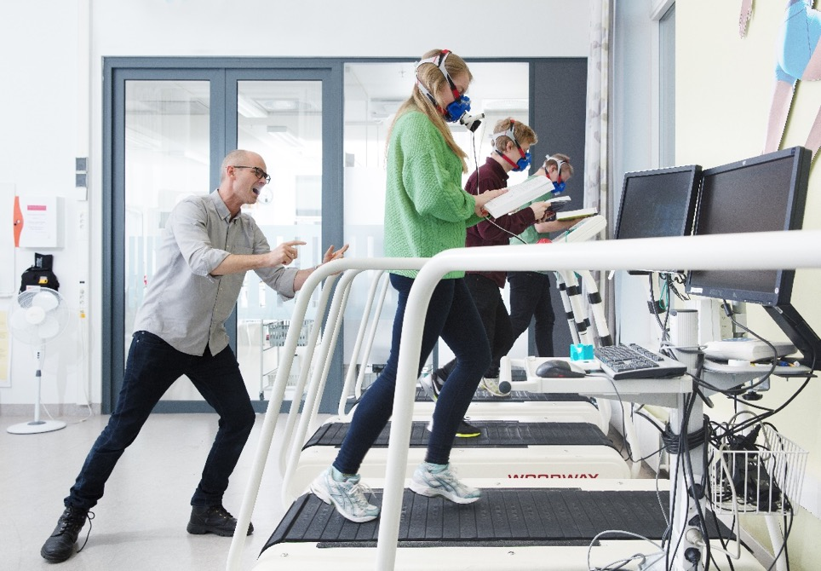
χ: Collective. Individual
In an optimal learning environment, students and teachers have good individual skills and the ability to work together
How can we encourage course teachers to use of scientifically documented teaching methods?
How can we encourage course teachers to work together on teaching?
Can we gain inspiration from top-level sports to optimize the learning situation?
How can we use digital
tools to collaborate in creating
new learning activities?

Slide 28
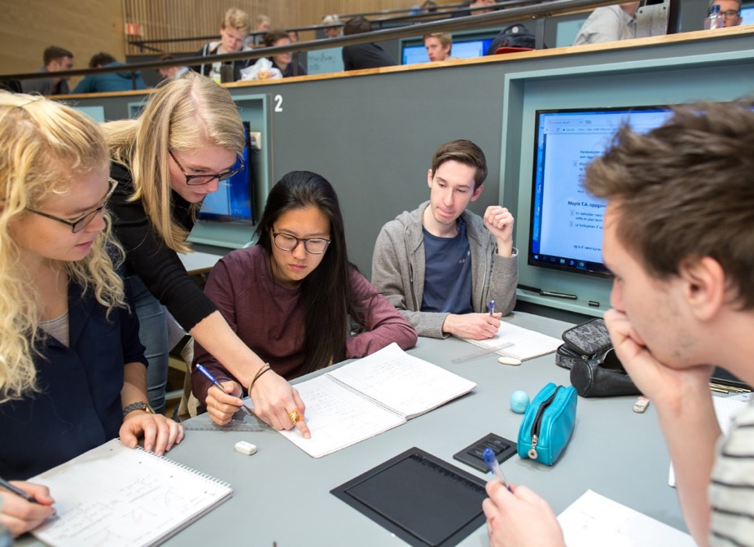
ACT! ACTive learning in core courses in mathematics and statistics for engineering education
Goal: Modernize the form and content of basic course units in mathematics and statistics
Develop the content of the courses in dialogue with users for a better match with current needs
Develop open access interactive, multimodal digital learning resources
Develop learning environments characterized by student activity

Slide 29
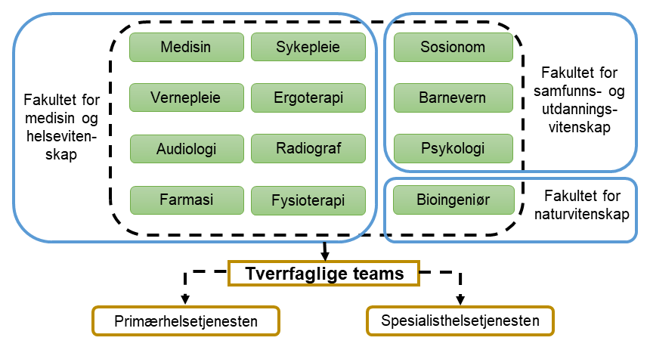

TverrPraks
TverrPraks aims to prepare students for
interdisciplinary collaboration in the workplace.
TverrPraks is a full-scale interdisciplinary practice.
TverrPraks includes all 1300 students in the final
year of NTNU’s 12 different study programmes in
the health and social professions, distributed across three faculties and three campuses.
Students participate in interdisciplinary teams where, on an independent basis, they carry out inter- disciplinary assessment in a real-life practice situation
Faculty of Medicine and Health Sciences
Medicine | Social Education | Audiology
Pharmacy | Nursing | Occupational Therapy
Radiography | Physiotherapy
Faculty of Social and Educational Sciences
Social work | Social education and child welfare
Psychology
Faculty of Natural Sciences
Medical laboratory technology
Interdisciplinary teams
Primary health service
Specialist health services
Notes:
Project Manager Aslak Steinsbekk aslak.steinsbekk@ntnu.no.
Coordinator: Bjørn Rosén bjorn.rosen@ntnu.no
Background: With growing specialization in the health services, more people will be involved in the treatment and follow-up of the individual patient. These must have insight into each other's competence and must be able to work together across their disciplines. However, the programmes of study offer little opportunity for interdisciplinary practice, and there is a national requirement and a professional desire to establish such practice as part of interprofessional teamwork (TPS).
Goal: TverrPraks aims to prepare students for interdisciplinary collaboration in the workplace.
Method: Through TverrPraks, all students in the final year of NTNU’s 12 different programmes in the health and social professions will carry out an interdisciplinary assessment together with other professions in a real practice situation.
The participating programmes of study at NTNU are social education (vernepleie), nursing, physiotherapy, audiology, radiography, pharmacy, medicine, occupational therapy, child welfare, social work, medical laboratory technology and psychology. The nursing and medical laboratory technology programmes in Ålesund and the nursing, occupational therapy and radiography programmes in Gjøvik also participate. This totals just over 1300 students every year.
Implementation: Students are assigned to interdisciplinary groups with 4-6 students from different programmes of study in their final year. The team gathers at the agreed practice site and receives information about the person they are to assess. They have given time to plan what they will do before they start the assessment, which lasts for a maximum of 2 hours.
How they solve the task is up to the team and the composition of professions among its members. The students each contribute their specialized skills in the assessment, and they will use this in teamwork so that their combined competence leads to a better result for the patient.
A challenge to be solved: The reason that there is no full-scale interdisciplinary practice with many professions in the current programmes of study is the complexity of organizing this. TverrPraks is therefore also a logistics project for exploring and establishing solutions that help to realize interdisciplinary practice in areas outside the programmes in health and social professions as well.

Slide 30

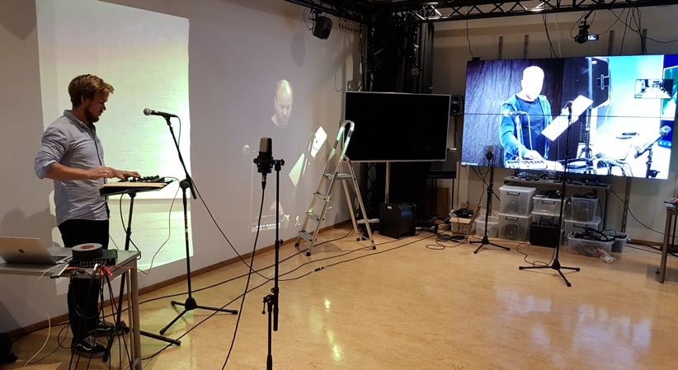
SALTO
Student-active learning with two-campus organization
Goal: Develop effective pedagogy for study
programmes with students on two campuses
Focus on active student learning:
  Collaborative learning
  Flipped classroom
A flexible learning space:
  Pedagogy-Space-Technology (PST)
  Physical-virtual interaction, being together
  and resource sharing
Ambition: Be a laboratory for
"cross-campus" teaching
Notes:
The starting point for the project is the division of students across two campuses, a highly relevant challenge after the structural reform in Norway’s higher education sector. We aim to develop effective pedagogy with activity on both campuses at the same time, with an emphasis on teamwork, resource sharing and communication. We will look at established strategies for active student learning and develop them further in a “cross-campus” context:
Collaborative learning: Project work, problem-based learning and development projects in groups across campuses.
Flipped classroom: Development of digital learning materials and common methods for in-depth exploration, discussion and application of subject matter across campus boundaries.
The project will manage and refine a two-campus learning space for physical-virtual collaboration over the Internet, so that students and teachers can explore solutions in pedagogy, methods and technology together. A joint master’s programme in Music, Communication and Technology (NTNU and the University of Oslo, UiO) forms the framework for the project. We expect to be an open laboratory of “cross-campus” teaching and will regularly share our experience in academic communities within and outside NTNU.

Slide 31
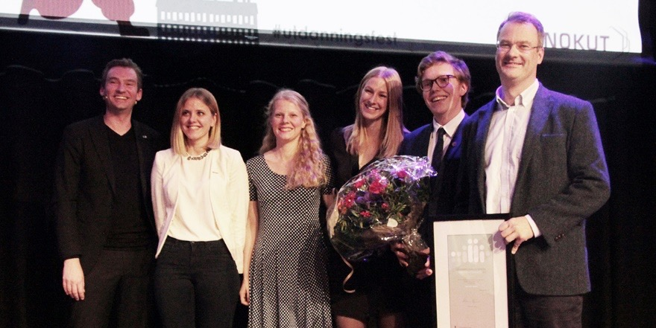
Education quality
In 2017, the project “National Assessment in Medicine” won the Educational Quality Award.
The project is a collaboration between the faculties of medicine at the universities of Oslo, Bergen, Tromsø and NTNU.
Photo: NORWEGIAN AGENCY FOR QUALITY ASSURANCE IN EDUCATION (NOKUT)
Notes:
The purpose of the Educational Quality Award is to reward outstanding quality initiatives in Norwegian higher education, and encourage institutions and academic communities to make systematic efforts to develop the quality of their programmes further. The Ministry of Education and Research presents the Educational Quality Award every year. The award is managed by the Norwegian Agency for Quality Assurance in Education (NOKUT).
The Educational Quality Award for 2017 went to the project “National Assessment in Medicine (Nasjonal delprøve i medisin)”, which is a collaborative project between the four faculties of medicine at the University of Oslo (UiO), NTNU, the University of Bergen (UiB) and UiT, the Arctic University of Norway. The project involves developing an exam for medical students in the 12th semester of their studies. The assessment is uniform across the universities. The assessment assesses clinical reasoning through multiple-choice questions (MCQ) that are administered digitally. In 2017, 319 students completed the assessment. The attendance rate was between 73 % and 94 % at the different places of study.
The aim of the national assessment project is to test relevant knowledge that recent graduates in medicine should master. This assessment also provides an additional learning opportunity because the questions and the answer key with reasons are published online immediately after the examination. This gives students an opportunity to comment on and criticize the exam. Students also have access to an examiners’ note, where students can see what has been considered and acted on as a result of comments on the exam.
Previous good results in the competition for the Educational Quality Award:
NTNU and the university colleges in Sør-Trøndelag, Gjøvik and Ålesund have also won awards individually before the merger:
Educational Quality Award 2015: NTNU Live Studio
NTNU Live Studio is a community of practice between students and NTNU. Through NTNU Live Studio, students have an opportunity to carry out real-world building and planning projects. Examples of Live Studio projects include FRIrom, which is a rooftop pavilion for patients and their families at St. Olavs Hospital, reconstruction after Typhoon Haiyan in the Philippines, rebuilding of an old smokehouse on a Hardanger apple farm and a variety of projects related to urban development in Trondheim. NTNU Live Studio is also part of NTNU’s TRANSark Centre, which conducts research on learning in architectural education programmes . Through NTNU Live Studio, TRANSark will systematize and develop knowledge about learning through real-world projects.
Educational Quality Award 2012: Ranking: 1. Lillehammer University College (HiL), 2. University of Oslo (UiO) and 3. Gjøvik University College (HiG) . “The Simulation Centre” at Gjøvik University College received NOK 200 000 (out of NOK 1 million in total).
Educational Quality Award 2011: Sør-Trøndelag University College (HiST) and UiO shared the first place. “Room for Learning” at the HiST Faculty of Informatics and e-Learning was awarded NOK 500 000 (out of NOK 1 million in total).
Educational Quality Award 2010: Ranking: 1. Telemark University College (HiT), 2. University of Oslo (UiO) and 3. NTNU. «ForVei - guidance to students from a preventive perspective emphasizing well-being, mastery and the ability to get things done» received NOK 200 000 (out of NOK 1 million in total).
(Source: https://www.nokut.no/siteassets/utdanningskvalitetsprisen/tidligere-vinnere-ukp.pdf)

Slide 32
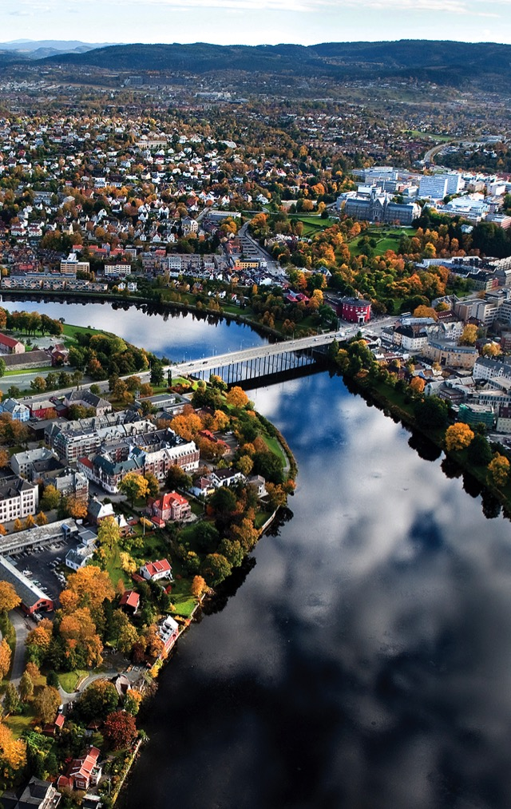


UNIVERSITY CITIES
Trondheim
Gjøvik
Ålesund
Notes:
NTNU students have a strong commitment and organize most student activities themselves.
All the NTNU cities have an attractive study environment close to the business community.
Students highlight the study environment as one of the reasons for applying to NTNU. The study environments offer a wealth of social activities that students organize themselves, ranging from sports and culture to events for meeting businesses and study tours.
Many exercise and fitness activities are available to students and each city has its “Student House" for student events.
When students start their studies, they spend the first few weeks getting to know the city, the campus and each other through Fadderuken, the orientation programme. During this period, new students are integrated in the programme of study, the student environment and activities. They are assigned a “buddy”, who is an experienced student in the same programme of study but at a higher level.
The academic and social student organizations known as Linjeforeningene play an important role in the student community. A Linjeforening is a group of students from a specific programme of study who work together to create a better social and academic environment. They organize seminars, conferences in specific disciplines (fagdager) and business presentations where students meet representatives of the business community, and many of them find summer jobs in this way.

Slide 33

Studying in
Trondheim
– more than one of five residents is a student
Norway’s best student city
Studentersamfundet
NTNUI – Norway’s largest and most comprehensive sports club with 14 000 members
Under Dusken – Scandinavia’s oldest active student newspaper
UKA – Norway’s largest cultural event
ISFiT – the world's largest international student festival
Notes:
What makes Trondheim the best student city in Norway?
More than one out of every five residents is a student – this means that students make up a large proportion of Trondheim's population. This makes students a strong group who make their mark on the city, with a wide variety of activities on offer, organized for and by students throughout the year.
The city bustles with life when the students are here. Major student events and the summer holidays both make an impression on Trondheim.
Volunteering plays a key role in Trondheim as a student city. Almost all student activities are based on volunteer work. Some of the voluntary organizations run by students for students are:
The Studentersamfundet student association, NTNU’s sports association NTNUI, the student newspaper Under Dusken, the cultural event UKA, and the international student festival ISFiT.
In addition, the linjeforeninger (academic and social student associations) and student businesses offer a social arena for their members for both personal and professional development.
Studentersamfundet in Trondheim: An organization for students in Trondheim, which is owned and run by its 12 000 members. The round red building houses a café and a restaurant as well as countless bars. Concerts, a variety of cultural events and debates are held throughout the year. Virtually all of the work at Studentersamfundet in Trondheim is done by students on a voluntary basis. The work is organized in teams called gjenger (gangs), which take on everything from student radio, theatre and the Symphony Orchestra to marketing, cafés and catering as well as renovation of the building itself. Fully 1250 students work voluntarily at Samfundet.
Examples of some of the gangs at Studentersamfundet include Under Dusken, UKA and ISFiT.
Under Dusken Is Scandinavia’s oldest active student newspaper. This is a free newspaper produced by students, concentrating on topics and content relevant to students.
UKA is Norway’s largest cultural festival, and 1600 student volunteers organize the entire event. UKA includes a review, theatre, courses and concerts. UKA is organized every second year, and lasts for about 3 weeks in October.
ISFiT is the international student festival in Trondheim, which is THE WORLD’S largest international thematic student festival. ISFiT is held every other year in February. Here, more than 400 students from all over the world take part, and the students’ peace prize is awarded. The festival covers relevant political or social issues. There are concerts, workshops and debates with famous international participants.
NTNUI is Norway’s largest and most comprehensive sports association with more than 12 000 members and 50 different activities. Examples of these activities include football, basketball, lacrosse, underwater rugby, diving, rowing, biathlon (cross-country skiing combined with rifle shooting) and dog walking. Many of the groups have various levels of difficulty, so that one can both try something new or practise a familiar sport at a higher level.

Slide 34
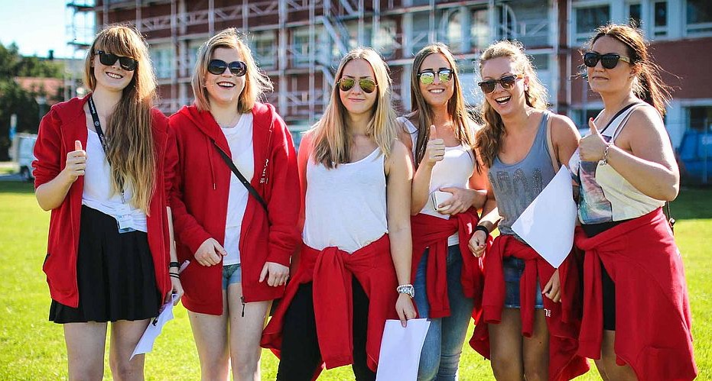
Studying in Gjøvik
The city on Lake Mjøsa,
largest in Innlandet.
Long traditions as a centre
of trade, industry and education
International research community
The academic groups work closely with the community and business
A wealth of music, cultural and outdoor activities
Inclusive, active student environment
  Student groups for all interests
  The Media House Fiber; student radio, student TV, student newspaper
  Huset, the students’ building and an important meeting place
  UKA festival
Notes:
Gjøvik – the student city close to everything.
Gjøvik is the largest city in the Innlandet region with a population of 30 000.The city is well-known for its wealth of music, cultural and outdoor activities.
Gjøvik has beautiful beaches along Lake Mjøsa, and students have magnificent cycling and ski trails as well as hiking trails nearby.
There are 3600 students at NTNU in Gjøvik, which means that it is a small and close-knit student community. As a student in Gjøvik, it is easy to get to know your fellow students even across disciplines, and many students meet in the common cafeteria on campus.
Students say that they appreciate the close contact they have with lecturers and academic groups.
In Gjøvik there are many student groups and student organizations for everything from board games to American football.
UKA in Gjøvik is a student festival held each year in February. UKA includes everything from skiing days at Hafjell, reunions for high school graduates, a revue, concerts and stand-up.
Gjøvik has the Olympic Cavern Hall – which is the world’s largest subterranean auditorium. Events held here include hockey, ballet and concerts.
Studenthuset in Gjøvik is a social meeting place where students organize activities including gaming evenings, quizzes, stand up, concerts and theme evenings. They have a pub/café, disco and much more.

Slide 35
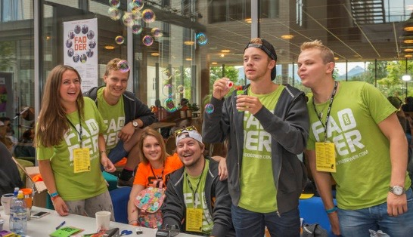
Studying in Ålesund
Student city between fjord and mountains, with unique Art
Nouveau architecture
Globally oriented business with
an entrepreneurial mindset and innovative communities
World-leading maritime business clusters
Campus Ålesund brings education, research and business close together
Social and inclusive student life
  Student organizations work for activities and events for everyone
  U.-KA Festival
  Banken Studenthus, the students’ building and an important meeting place
Notes:
Ålesund - City between the fjord and the mountains
With a population of almost 50 000, Ålesund is known as one of Norway’s most beautiful cities, close to the ocean, the mountains and the city centre.
There are 2500 students at NTNU in Ålesund. As a new student, it is easy to get to know fellow students, both in the orientation period and on campus, especially in the cafeteria where students often meet.
The student building “Banken Studenthus” is the home of the Ålesund Studentersamfundet students’ association (ÅSS), run by student volunteers, who organize everything from student revues, quizzes, wine bars with a troubadour, Oktoberfest, Halloween, school-leavers’ reunions, courses and more.
As well as ÅSS, the student city offers a variety of organizations and activities for students.
U.-KA is a city ​​festival organized by the students. During U.-KA you can experience everything from theme parties, live music, concerts and revues.
The programmes of study in Ålesund have close ties with the maritime business cluster with subjects such as nautical studies and shipping. An extensive and globally oriented export industry also makes its mark on the city, with several large companies close to the campus. Example: Rolls Royce
Ålesund offers a wealth of opportunities for sporting activities in natural surroundings. Summit hikes in the Sunnmøre Alps, paddling in the city centre, surfing at Alnes or diving in Brosundet.
The Jugendfest, held each year in August, is a large music festival. Matoma, Sivert Høyem and Europe are some of the artists who have performed here.
NTNU Ålesund also has CampusUka (Campus Week), which takes place in the last week of September - and offers activities between students and employees, with concerts, drive-in cinema, academic conferences and quiz challenges.

