Slide 1
SHORT INTRO
Knowledge for a better world
Trondheim | Gjøvik | Ålesund
NTNU Brussels Office

Slide 2
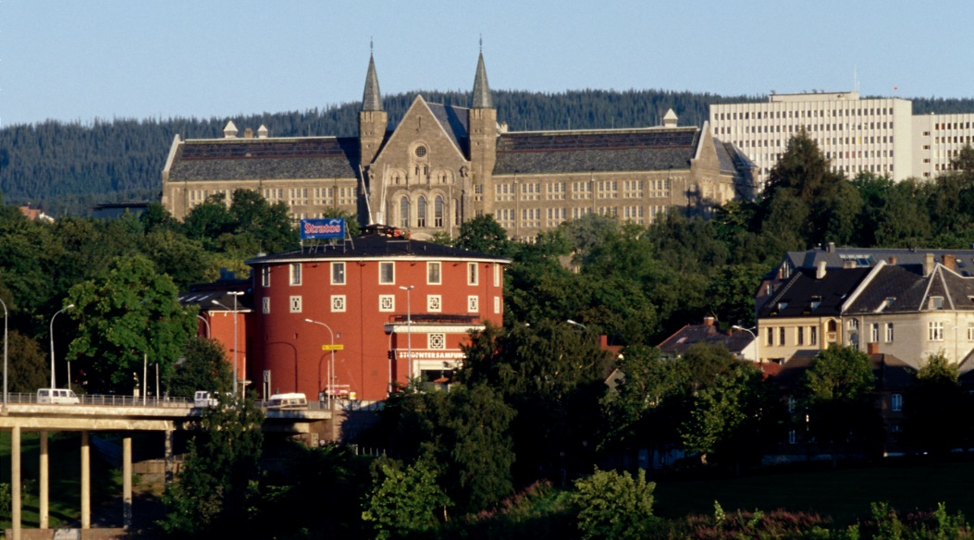

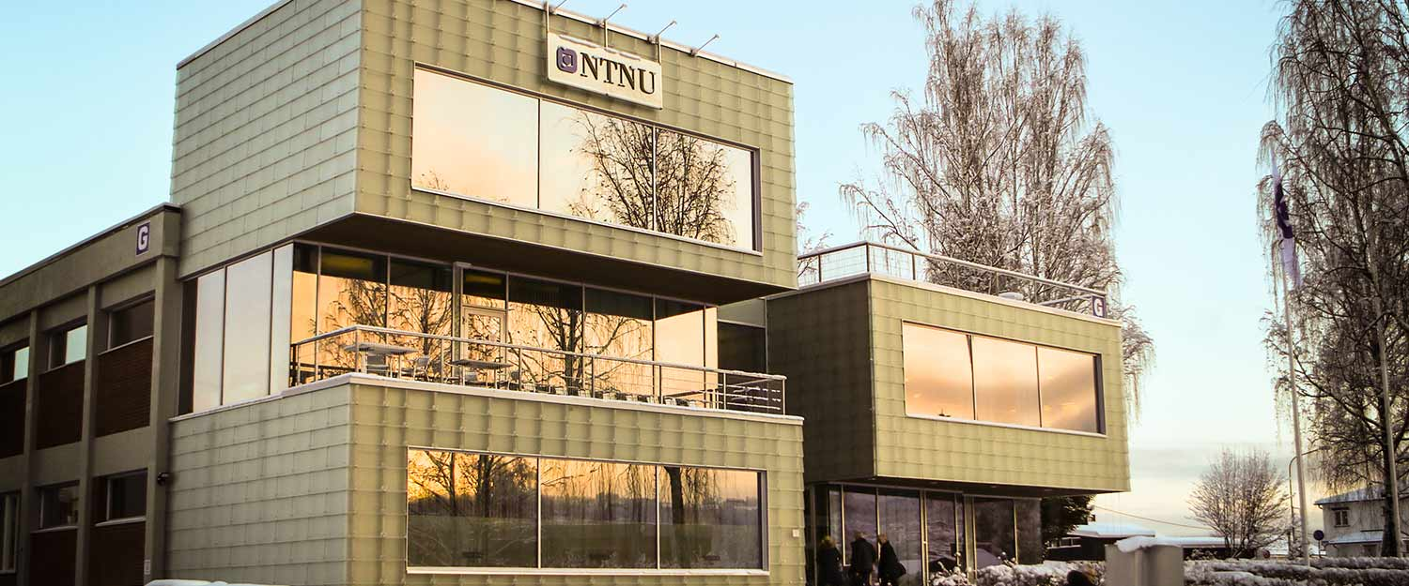
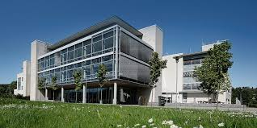
Main profile in science and technology
Academic breadth: humanities, social sciences, medicine, health sciences, science of education, architecture, fine arts and performing arts
Headquarters in Trondheim with campuses in Gjøvik and Ålesund

Slide 3

Key figures
8 faculties, 55 departments and NTNU University Museum
8051 person-years (2022)
43 422 registered students (2022)
8333 completed bachelor’s and master’s degrees (2022)
399 doctoral degrees (2022)
Owned or rented facilities 734 000 m²

Slide 4
Key figures
Annual budget: 10,5 billion NOK
of which 2,6 billion from external sources
Owned or rented facilities 734 000 m²

Slide 5

Programmes of study
399 programmes of study (2022), as well as continuing and further education
Main responsibility for higher education in technology in Norway, and largest in engineering, teacher education and architecture
Aims to be a national hub in programmes of professional study
Graduates:
8333 completed bachelor’s and master’s degrees (2022)
4062 in further education courses with credits, and in experience-based master’s degree programmes(2022)
399 completed doctoral degrees (2022)
Notes:
Basis for the statement that we “educate most teachers”: The merged NTNU has postgraduate teacher education (praktisk-pedagogisk utdanning, PPU), master’s programmes in teacher education (lektorutdanning), teacher education for primary and lower secondary schools (grunnskolelærerutdanning - GLU programme, grades 1-7 and 5-10) and teacher education in vocational subjects. According to the Database for Statistics on Higher Education (DBH), NTNU educated 571 teachers in 2016, while HIOA educated 498. Here, we have not included preschool teacher education (where HIOA has 171 and NTNU has none)

Slide 6
Students
2021
44 200 students:
  Trondheim: 85 %
  Gjøvik: 9 %
  Ålesund: 6 %
Just over half are
women
8 % international,
from 121 countries
Most first-priority applicants
in Norway, 25 500 in 2021 (SO)
The university that recruits
most nationally
The seven largest education areas
Notes:
Total number of first-priority applicants: 51 170

Slide 7
Students at the faculties i 2021 – men and women
Notes:
HF: Faculty of Humanities
AD: Faculty of Architecture and Design
IE: Faculty of Information Technology and Electrical Engineering
IV: Faculty of Engineering
MH: Faculty of Medicine and Health Sciences
NV: Faculty of Natural Sciences
SU: Faculty of Social and Educational Sciences
ØK: Faculty of Economics and Management

Slide 8
Students at the faculties in 2021 – international
Shares | 16.8 % | 13.0 % | 6.6 % | 13.6 % | 5.4 % | 9.9 % | 3.4 % | 5.8 %
Notes:
HF – Det humanistiske fakultet
AD – Fakultet for arkitektur og design
IE – Fakultet for informasjonsteknologi og elektroteknikk
IV – Fakultet for ingeniørvitenskap
MH – Fakultet for medisin og helsevitenskap
NV – Fakultet for naturvitenskap
SU – Fakultet for samfunns- og utdanningsvitenskap
ØK – Fakultet for økonomi

Slide 9
Total full-time equivalents (FTEs) in 2020: 7761
Two out of three (5057) work with teaching, research and dissemination (academic positions),
of which more than 42 per cent are women and approx. 35 per cent are international
Notes:
2020:
Other positions 77,2
Operations and maintenance positions 237,95
Administrative positions 1554,03
Support positions for teaching, research and dissemination 834,63
Teaching, research and dissemination 5057,92
Total 7761,73

Slide 10
NTNU’s percentage of the sector in 2017
Notes:
Academic FTEs (teaching, research and dissemination positions)
NTNU: 20 %
UiB: 10 %
UiO: 17 %
Credits
NTNU: 16 %
UiB: 6 %
UiO: 10 %
Publication points
NTNU: 21 %
UiB: 14 %
UiO: 26 %

Slide 11

















NTNU will actively contribute to achieve the UN Sustainability Development Goals
Notes:
From vision to action:
Trough the UN, the world has agreed on 17 sustainability development goals.
NTNU has contributed to knowledge for a better world by clearly prioritizing efforts and resources in line with the UN’s sustainability development goals.

Slide 12





Research
Participating in 263 Horizon 2020 projects and has been awarded 27 ERC grants
Granted NOK 800 million from the Horizon 2020 programme.
Is the institution that is awarded the most funding from the Research Council of Norway
Host or partner for 46 major research centres (SFF, SFI, and FME)
399 doctoral degrees completed in 2022
Internal initiatives to develop and recruit top researchers
Strategic research areas and enabling technologies in 2014–2023:
ENERGY HEALTH OCEANS SUSTAINABILITY
Notes:
Other important partners in addition to SINTEF:
St Olavs Hospital
NTNU Samfunnsforskning AS (NTNU Social Research)
Centre for Care Research
Møreforsking (applied research and development)
Smartgrid
Business and industry
SFF – Centres of Excellence
SFI – Centres for Research-based Innovation
FME – Centres for Environment-friendly Energy Research

Slide 13
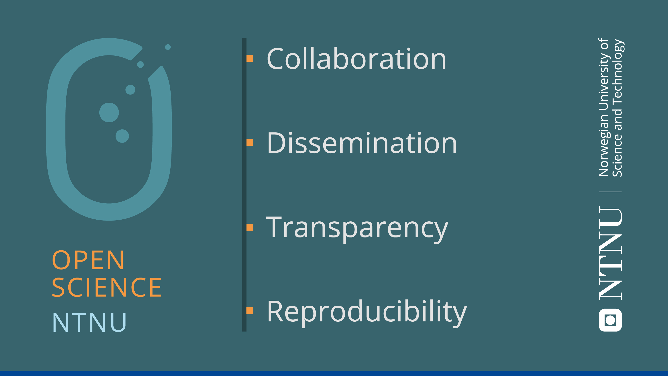
Notes:
Open Science: open and free sharing of knowledge. But Open Science has the motto «As open as possible, as closed as necessary», and emphasizes responsible and ethical research, and the balancing of different concerns. This is in line with NTNU’s «Knowledge for a better world».
NTNU would like to highlight four essential values and ideals as the basis for the work with Open Science:
-Collaboration: Research is an enterprise based on cooperative work, and builds on knowledge that others have produced
-Dissemination: Research output should be shared and made accessible, both for other researchers as well as the rest of society
-Transparency: Opening up the reserach process from beginning to end, including methods, procedures, results and ethical considerations, to ensure quality and integrity
-Reproducibility: Research results should be validated and reproduced
Open Science = Science done right!

Slide 14
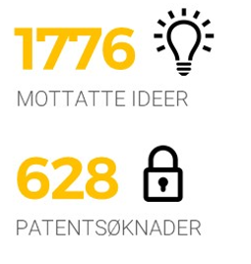
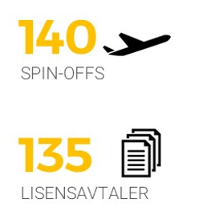
Innovation and commercialization
NTNU allocates NOK 10 million for verification of technology each year
Establishing internal network with 15 innovation positions working with
idea search and paving the way for development and commercialization of research
So far, TTO has raised NOK 1.1 billion in loan capital for spin-offs from NTNU
ideas received
spin-offs
patent applications
licence agreements
Notes:
NTNU Discovery – 10 millioner per år med ramme på 1 mnok per hovedprosjekt

Slide 15
Collaboration with the working world
Wide-ranging collaboration in education (internships, business networks, etc)
Almost 8% of NTNU’s external income comes from business and industry
In 2005–2015, NTNU collaborated with business and industry in more than 10 000 projects.
This included some 1 200 Norwegian and 760 international companies
Close collaboration with SINTEF, ranked as No. 1 in the world in the Times Higher Education ranking
88 industrial PhDs and 9 public-sector PhD projects
Participates in 6 Norwegian Centres of Expertise, 2 Global Centres of Expertise and 2 European Knowledge and Innovation Communities (KICs)
University Hospital, University Schools and University Municipality
Notes:
Andre viktige samarbeidspartnere i tillegg til SINTEF:
St. Olavs Hospital
NTNU Samfunnsforskning
Senter for omsorgsforskning
Møreforsking
Smartgrid
Næringslivet

Slide 16
and
The collaboration was ranked as #1 in the world (THE)
Daily collaboration in 27 SFI, FME og SFF’s and
23 Gemini-centres, including more than 1,000 employees
Collaboration in 18 H2020 projects with more than 300 links to project partners internationally
Collaborates on 200 laboratories
Collaborates on ECCSEL-ERIC, European Carbon Dioxide Capture and Storage Laboratory Infrastructure – European Research Infrastructure Consortium.
Publishing scientific articles together,
1600 articles in the period 2012–2017
Business
and public administration
NTNU
Education
and research
SINTEF
Contract research
Interaction model – Extensive collaboration with business and public sector through joint projects and research centers
For more information:
ntnu.edu/research/partnership

Slide 17
QS
CWUR
International rankings
THES
Center for World University Rankings
Shanghai
QS World University Rankings
Times Higher Education Supplement (THES)
Academic Ranking of World Universities (Jia Tong)
7
9
5
3
No. 359 in the world
(June 2019)
No. 162 in the world
(Oct 2019)
An international panel established by the Research Council of Norway concluded in 2015 that Norway has two technology environments at the world’s top level, both at NTNU:
Structural Impact Laboratory (SIMLab)
Marine Structures
In group
401-500
in the world
(Sept. 2019)
In group 101-150
in the world
(Aug. 2019)
In March 2017 THES published an overview showing that
NTNU has the most productive institutional collaboration in the world, due to the close teamwork with SINTEF.
Notes:
THES is regarded as the best and most prestigious ranking.
In research and education, «reputation» makes up 33% of the score for each university.
The results are based on a survey of 17 500 academics from all over the world.
NTNU has a poor score in this reputation survey.
If we had done as well here as the number of research citations would suggest,
calculations show that we would have ended up in group number 135–140 in the world.

Slide 18
NTNU’s organization
BOARD
RECTOR
Pro-Rector for Education
Pro-Rector for Research
Pro-Rector for Innovation
Director of Organization
Director of Finances and Property
Management, Administration and University Library
Vice-Rector
NTNU in
Gjøvik
Faculty of Humanities
Faculty of Architecture and Design
Faculty of Information Technology and Electrical Engineering
Faculty of Engineer-ing
Faculty of Medicine and Health Sciences
Faculty of Natural Sciences
Faculty of Social and Educational Sciences
Faculty of Economics and Management
NTNU University Museum
Vice-Rector
NTNU in
Ålesund
HF
AD
IE
IV
MH
NV
SU
OK
VM
7 depts.
4 depts.
7 depts.
8 depts.
8 depts.
8 depts.
7 depts.
4 depts.
2 depts.
--------------------------
55 DEPARTMENTS

Slide 19


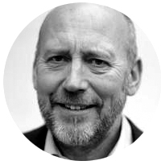
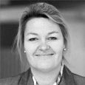
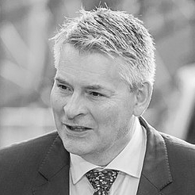
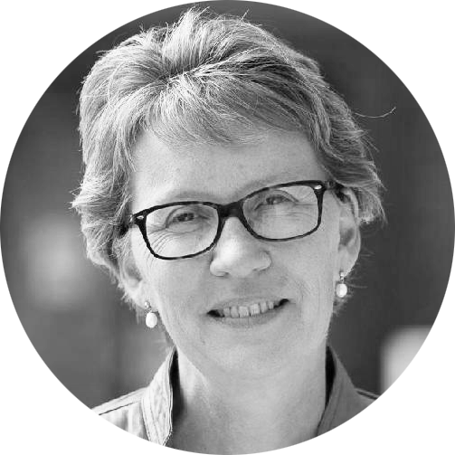
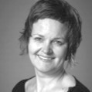
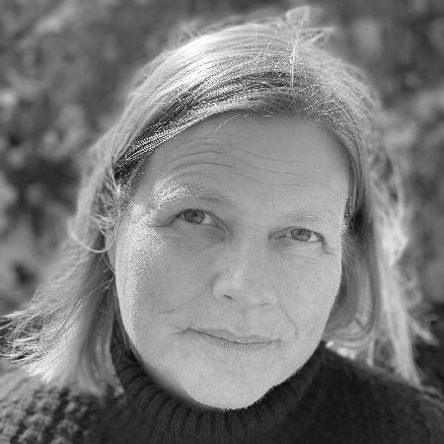
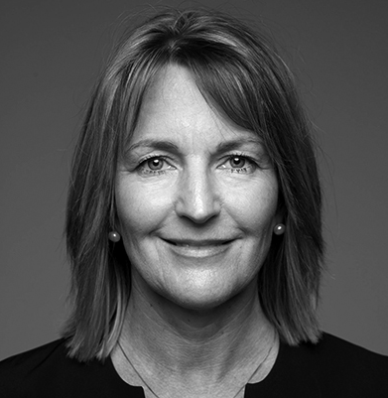

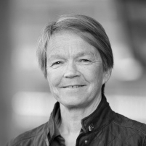
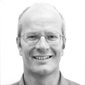
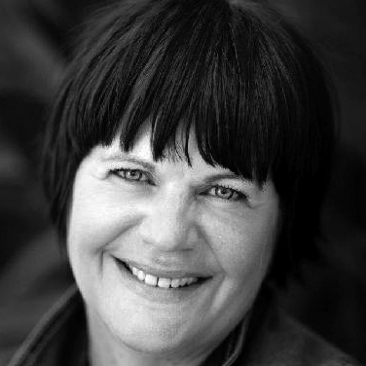

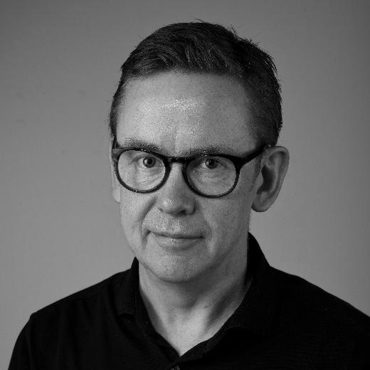

NTNU’s management
Rector NTNU
Anne Borg
Pro-Rector
for Education
Marit
Reitan
Pro-Rector
for Research
Tor
Grande
Pro-Rector for
Innovation
Toril A.
Nagelhus Hernes
Director,
Organization and Infrastructure
Bjørn
Haugstad
Vice-Rector in
Gjøvik
Gro Iren
Kvanli Dæhlin
Faculty of Humanities (HF),
Dean
Anne Kristine
Børresen
Faculty of Architecture and Design (AD), Dean
Marianne
Skjulhaug
Faculty of Information Technology and Electrical Engineering
(IE), Dean
Ingrid Schjølberg
Faculty of Engineering
(IV), Dean
Olav
Bolland
Faculty of Medicine and Health Sciences
(MH), Dean
Siri
Forsmo
Faculty of Natural Sciences
(NV), Dean Øyvind
Weiby
Gregersen
Faculty of Social and Educational Sciences (SU),
Acting Dean
Tine Arntzen
Hestbek
Faculty of Economics and Manage-ment (OK),
Dean
Monica
Rolfsen
NTNU University Museum,
Director
Hans K. Stenøien
Vice-Rector in
Ålesund
Anne Lise
Sagen Major

Slide 20
Management, administration and University Library
Education Quality Division
Student and Academic Division
Student Services Division
HR- and HSE Division
Communi-cation
Division
Records
Management Division
IT-
Division
Division for Governance and Manage-ment Systems
Financial Services Division
Property Division
University Library
Division
for Research,
innovation and
external
relationships
Campus
Develop-ment
Centre for Continuing Education and Professional Development
Education Section Gjøvik
Office of International Relations
HSE
Section
IT Support Section
Financial Advisory Section
Project Section
Payroll and HR-services Section
IT Operations Section
Building Management Section
Education Section Ålesund
Transaction Services Section
IT Management Section
Planning, Development and Management Section
Financial Services Centre
IT Development Section
Technical Management Section
IT Strategy and Governance Section
Property Service Centre
Digital Security Section

Slide 21
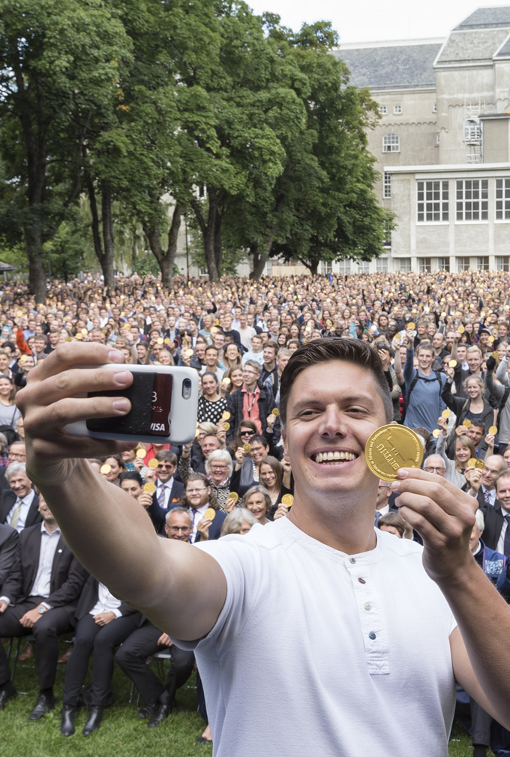
NTNU develops campus
Better able to solve complex societal challenges
Relevant candidates with interdisciplinary competence
Increased value creation
Role model for environment and sustainability
Model for public development in Norway – innovative and on the forefront

