Slide 1
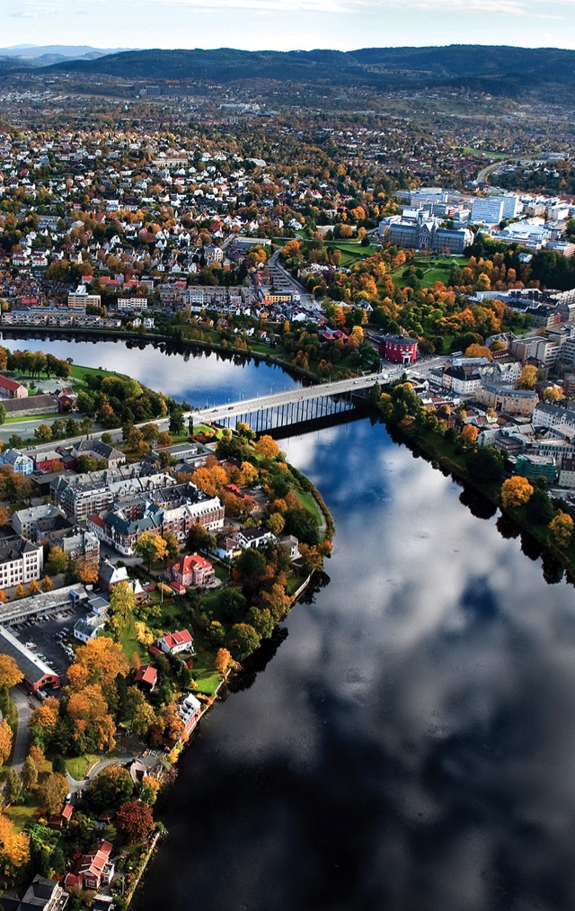
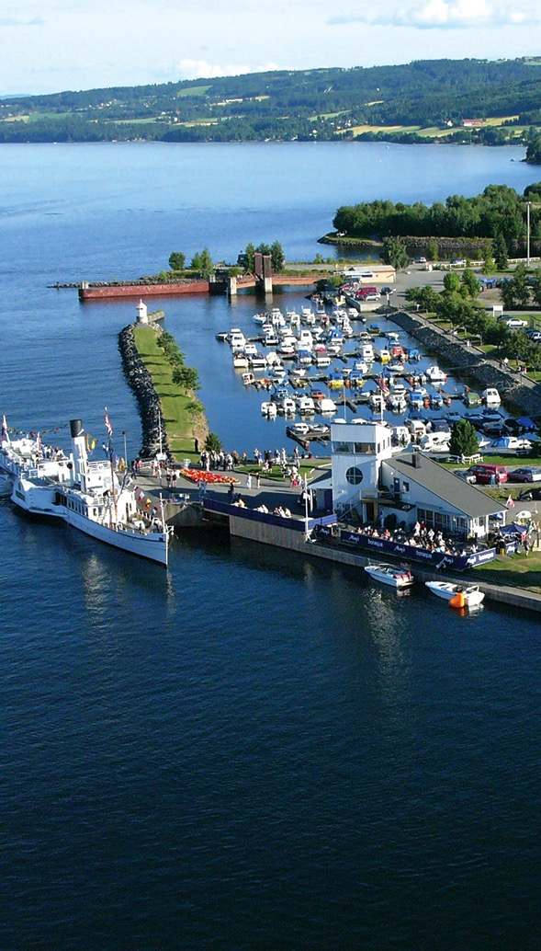
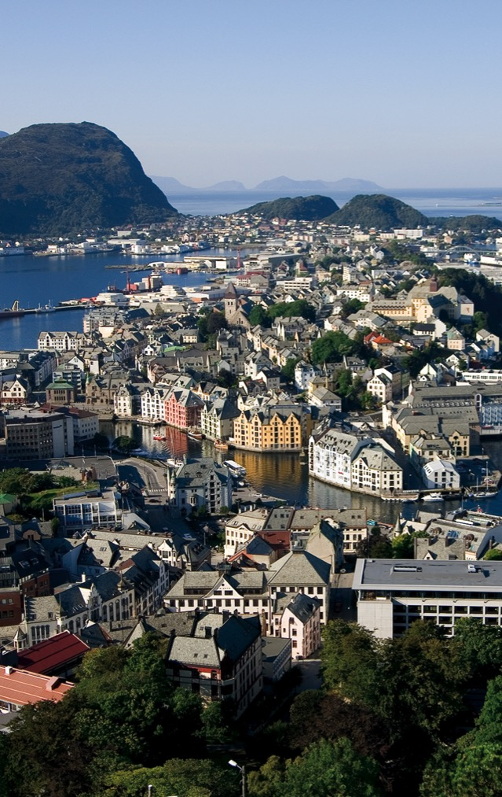
TRONDHEIM
GJØVIK
ÅLESUND
LEVANGER

Slide 2
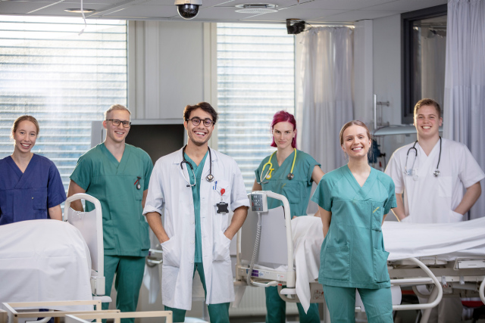
Who are we?
6500 students
About 1800 employees
Situated in four cities:
Trondheim, Gjøvik, Ålesund and Levanger
830 mill. funding
570 mill. external funding
(pr 2023)

Slide 3
Organisation
Rector
The Faculty Board
Dean
Vice Deans
Faculty administration
Department of Health Sciences in Gjøvik
Department for Health Sciences in Ålesund
Department of Clinical and Molecular Medicine
Kavli Institute for Systems Neuroscience
Department of Mental Health
Department of Public Health and Nursing
Department of circulation and medical imaging
Department of Neuromedicine and Movement Science
Departments
F a g e n h e t e r

Slide 4
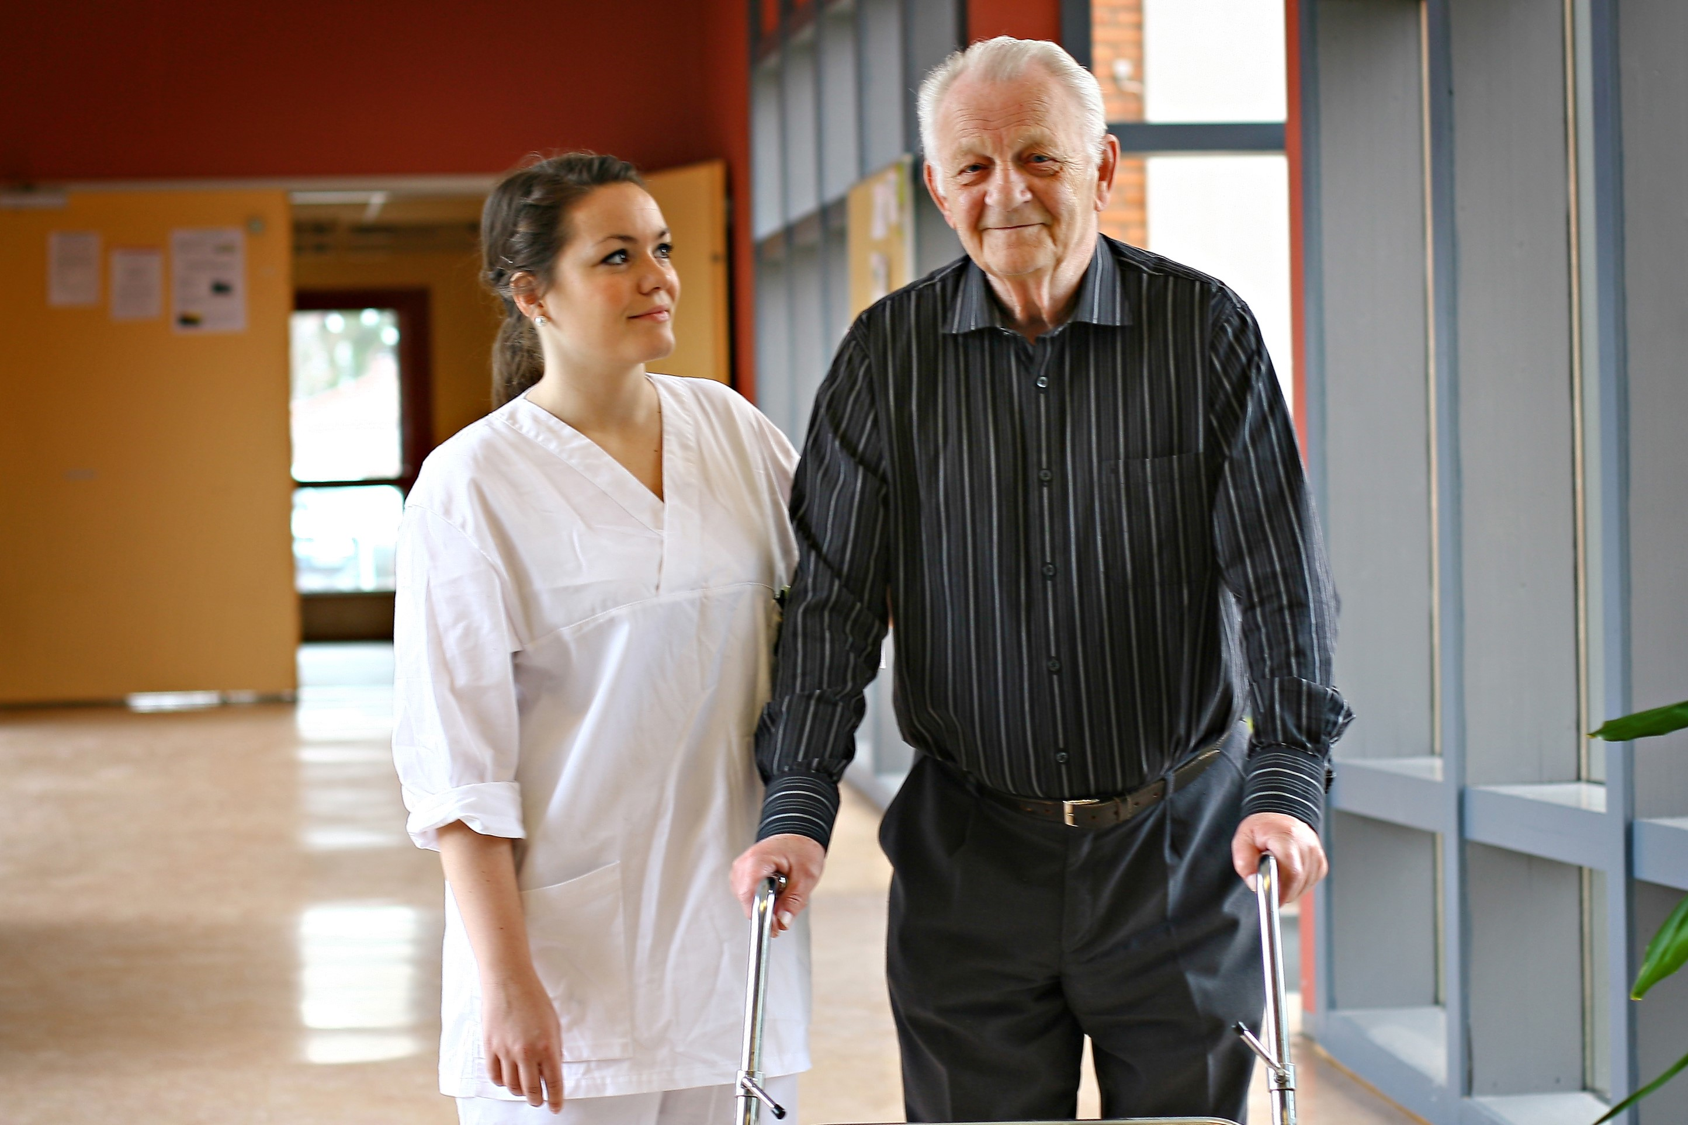
Studies
Our programmes of study are research-based and socially relevant.
We work close with:
Specialist health services, regional health authorities
St. Olavs hospital, Trondheim University Hospital
Central Norway Regional Health Authority
Municipal health and care services
Trondheim University Muncipality
SINTEF

Slide 5
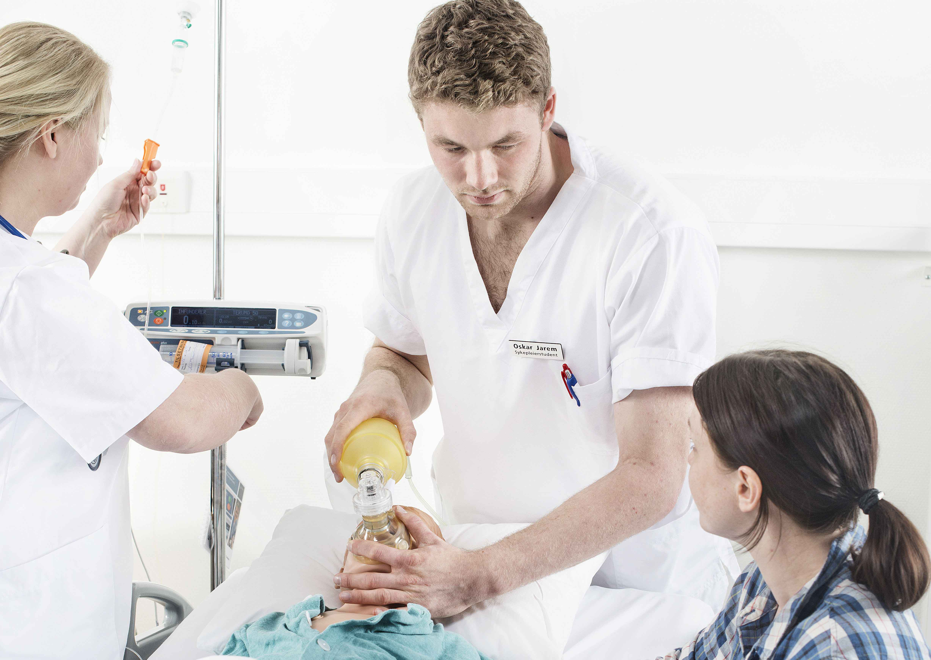
Study programmes
For applicants with a high school degree
Medicine 6 years (Trondheim/Levanger, Ålesund)
Audiology 3 years (Trondheim)
Human Movement Science 3 years (Trondheim)
Occupational therapy 3 years (Gjøvik, Trondheim)
Physiotherapy 3 years (Trondheim)
Radiography 3 years(Gjøvik, Trondheim)
Paramedic Science 3 years (Gjøvik)
Nursing 3 years (Gjøvik, Trondheim, Ålesund)
Social education 3 years (Trondheim)

Slide 6
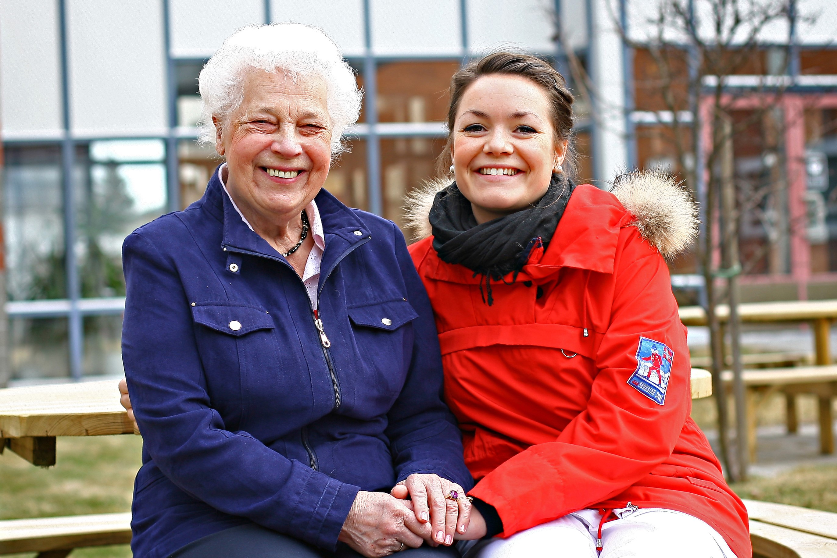
Study programmes
For applicants with a bachelor’s degree
Advanced practice nursing (Ålesund, Gjøvik)
Clinical Health Science (Trondheim)
Clinical Nursing (Gjøvik, Trondheim, Ålesund)
Healthcare Informatics (Trondheim)
Health Care Management (Ålesund)
Health Nursing (Ålesund, Trondheim)
Medical Imaging Technologies (Trondheim)
Midwifery (Trondheim)
Molecular Medicine (Trondheim)
Neuroscience (Trondheim)
Mental Health (Trondheim)
Pharmacy (Trondheim)
Physical Activity and Health (Trondheim)
Public Health (Trondheim)

Slide 7
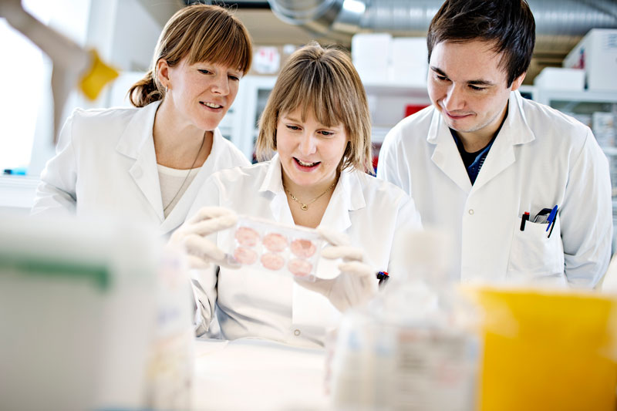
PhD Education
PhD in Medicine and health science
PhD in Medical Technology

Slide 8
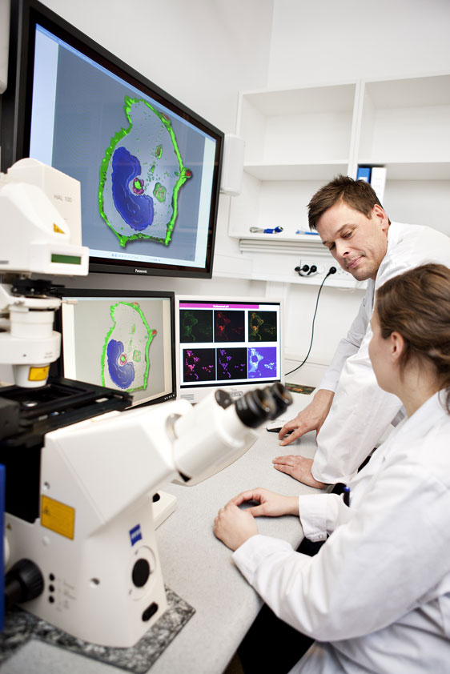
National research schools
Norwegian Research School for Research and Development of Municipal Health and Care
Norwegian Research School in General Practice
National Research School in Digital Life
Norwegian Research School in Global Health
Norwegian PhD School of Heart Research

Slide 9
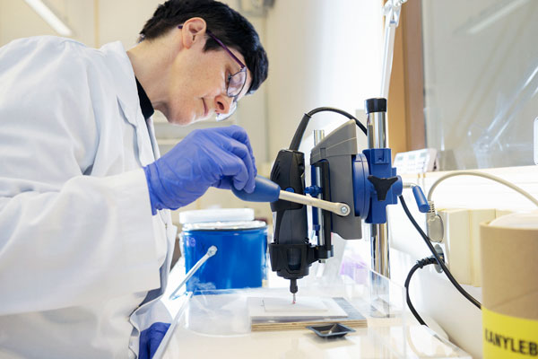
Research
Research at the Faculty of Medicine and Health Sciences consists of a wide range of research fields in medicine and health. The research comprises basic research, translational research at the intersection between basic and clinical research, as well as applied research.
The faculty hosts several centers for outstanding research and research-driven innovation, K. G. Jebsen centers, major EU projects, as well as the Nord-Trøndelag Health Survey Research Centre and biobank.
In 2014, May-Britt Moser and Edvard Moser, along with John O'Keefe, were awarded the Nobel Prize in Physiology or Medicine for the discovery of the brain's navigation system.

Slide 10
Research Centres
Norwegian Centres of Excellence (SFF):
Centre for Algorithms in the Cortex (CNC)
Centre for Neural Computation (CNC)
Centre of Molecular Inflammation Research (CEMIR)
Centre for Research-based Innovation (SFI):
Centre for Innovative Ultrasound Solutions (CIUS)
K. G. Jebsen Centre
K.G.Jebsen Centre for Alzheimer’s Disease (JCA)
Other centres
European Palliative Care Research Center (PRC)
Centre for Care Research
Regional Centre for Child and Youth – Mental Health and Child Welfare (RKBU)
Egil and Pauline Braathen and Fred Kavli Centre for Cortical Microcircuits (BKC)

Slide 11
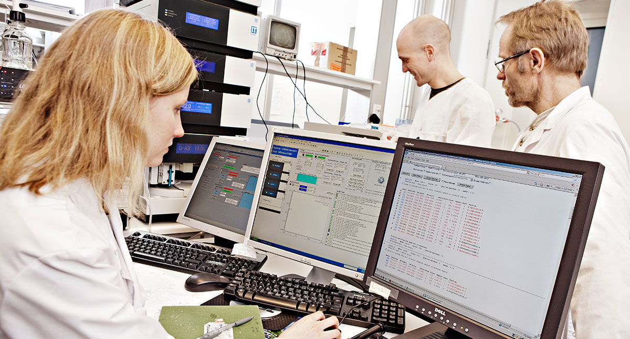
Core facilities
The Faculty of Medicine and the Central Norway Regional Health Authority have organised several laboratories with advanced equipment and expertise are into core facilities.
These research facilities offer a necessary infrastructure connected to specialized expertise for regional, national and international researchers from research institutions and the industrial sector.

Slide 12
Innovation
In cooperation with business and industry, the public sector and health services, we develop new services, products and new ways of working. Innovation and inventive activities contribute to value creation and better health from a global perspective.
Exsamples
APIM
PAI - app excersise
Vscan - ultrasound
MultiGuide
Innovation in Health Care

