Slide 1
bullying and harassment at NTNU - Norwegian University of Science and Technology
Institutional Report
© 2019 Ipsos. All rights reserved. Contains Ipsos’ confidential and proprietary information and may not be disclosed or reproduced without the prior written consent of Ipsos.

Slide 2
Contents
Project information 03
Summary 08
Bullying and harassment 10
Sexual harassment 16
Sexual assault 22
Familiarity with whistleblowing procedures 24
Background variables 28
Contact Ipsos 32

Slide 3
Project information
3
© 2019 Ipsos.

Slide 4
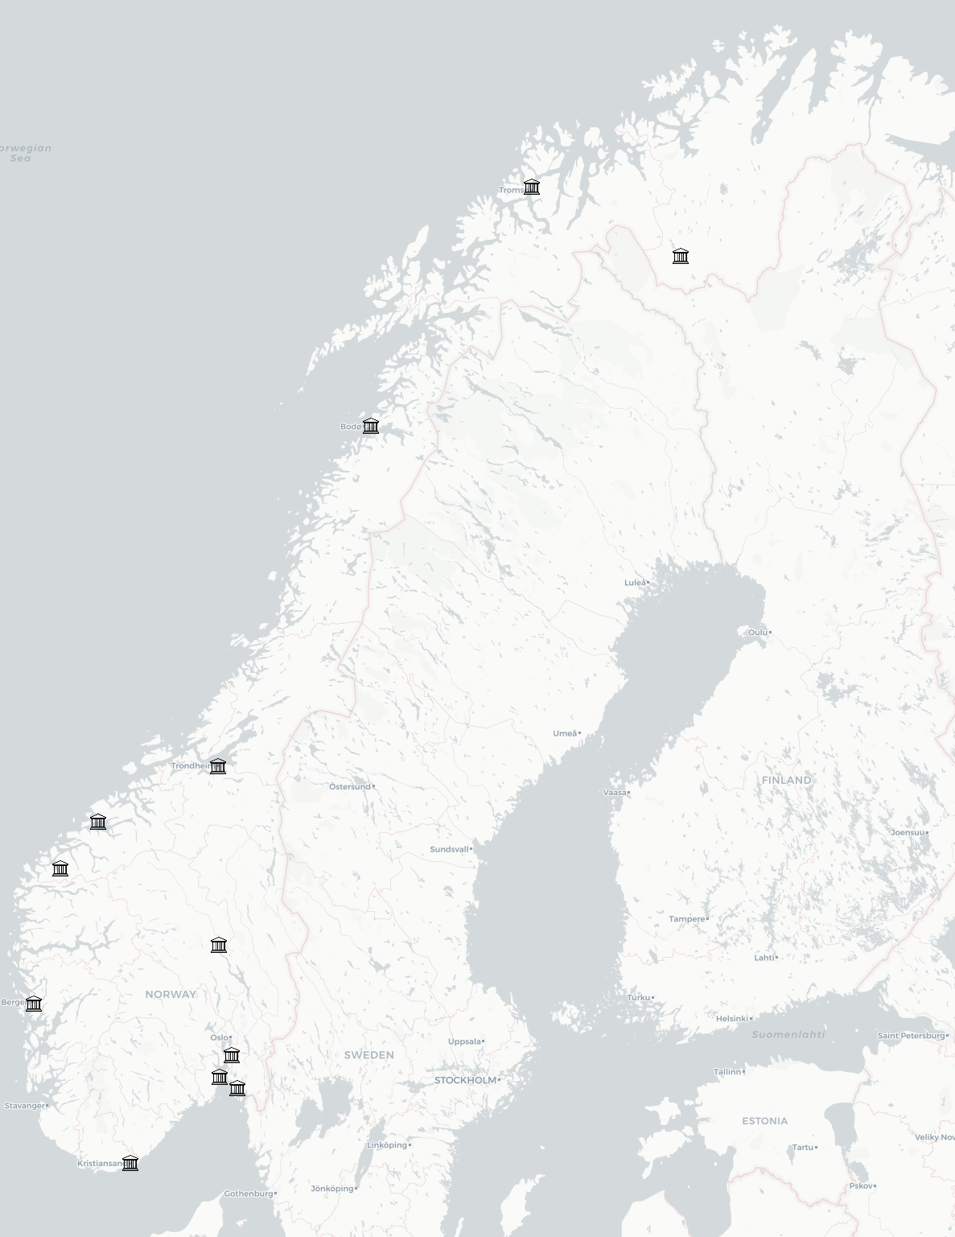
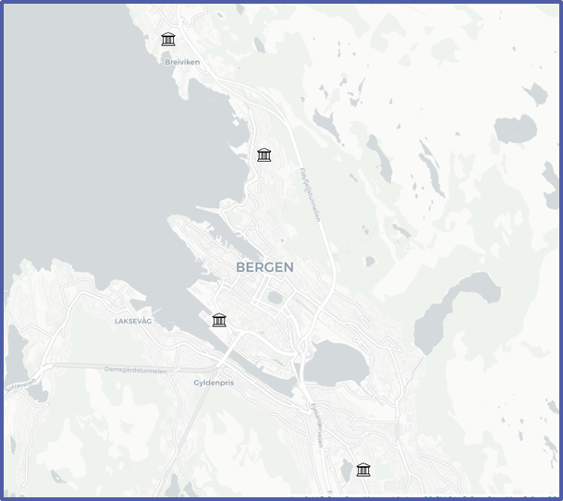
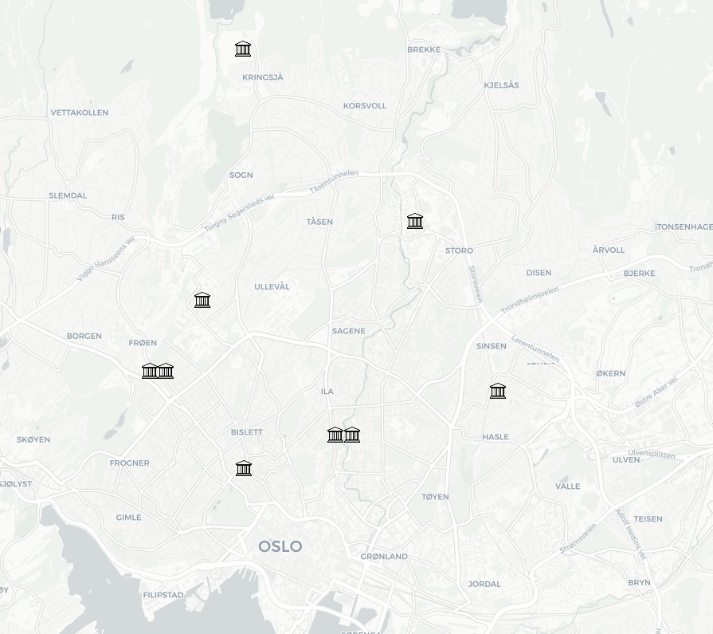
Participating institutions
UiT The Arctic University of Norway
NHH - Norwegian School of Economics
Sámi University of Applied Sciences
NLA University College
Nord University
Norwegian School of Sport Sciences
University of Bergen
BI Norwegian Business School
Western Norway University of Applied Sciences
Queen Maud University College of Early Childhood Education
NTNU - Norwegian University of Science and Technology
University of Oslo
Norwegian Academy of Music
Fjellhaug International University College
Molde University College
Norwegian Police University College
Volda University College
Oslo School of Architecture and Design
Oslo National Academy of the Arts
Inland Norway University of Applied Sciences
OsloMet - Oslo Metropolitan University
BERGEN REGION
OSLO REGION
University of South-Eastern Norway
Norwegian University of Life Sciences
Østfold University College
Ansgar University College and Theological Seminary
University of Agder

Slide 5
Project information
Background, purpose and methodology
About the institutional report
About the questionnaire
Ipsos has conducted a questionnaire survey for the University of Agder mapping bullying and harassment in the higher education sector.
The purpose of the survey was to map the scope and frequency of bullying and harassment in the workplace, as well as instances of sexual harassment and sexual assault.
The questionnaire was sent out to 42,778 employees at 26 participating higher education institutions. A total of 17,984 respondents completed the questionnaire, which represents a response rate of 42 %. The survey was conducted between 20 May and 11 June 2019.
The survey was a population survey in which all employees were invited to participate. Therefore, no sample was selected in advance and we did not specify quotas based on the employees’ background variables.
For these reasons, no generalisations have been made with respect to the rest of the population that did not respond.
This report presents the responses from NTNU - Norwegian University of Science and Technology.
8,702 questionnaires were sent out and responses were registered from 3,423 employees. This represents a response rate of 40 % and is 3 % below the average.
The comments made on the graphical presentations of the figures note which background variables stand out as important differences in the responses.
If it is significant that more women than men responded, this is noted in the text. The same applies to age, position category and leadership responsibilities.
The report consists of four parts plus a section on background variables. The questionnaire has also been provided as an appendix to the report.
Where there are no comments on significant variations between categories of background variables, then either there were no significant differences between the categories in a variable or the background variables were omitted for anonymity considerations.
The questionnaire was produced by Ipsos in consultation with the client and is included as an appendix to this report.
The survey asked questions on four topics:
Bullying and harassment
Sexual harassment
Sexual assault
Familiarity with the whistleblowing system and experiences from using it
The questionnaire contains a number of in-depth questions about the form, frequency and originator of the various forms of negative attention, as well as questions about background variables such as gender, age and job description.

Slide 6
Project information
Anonymity considerations
Given the sensitive topics covered by the survey, there are a number of questions for which only the total percentage per alternative is stated, without the respondents’ background variables.
We do not state background variables such as gender, age and position where fewer than 10 respondents have selected an alternative so as to exclude any possibility of giving out personally identifiable data. We make an exception to this rule in the national report, which contains no references to which institution the respondent belongs.
Nor do we state responses to follow-up questions if the base consists of fewer than 10 respondents. This is because Ipsos cannot know the internal circumstances that could make the respondents’ answers personally identifying information.
Background variables are also withheld where, irrespective of the number of respondents, they may act as personally identifying information.
This is a choice that has been made independently of the client and any questions concerning these assessments should be directed to Ipsos.

Slide 7
Project information
Methodological challenges
All questionnaire surveys present challenges that could influence the results. In this survey, which is a population survey, the most important challenge is that we do not know the characteristics of those who did not respond. Ideally, the members of a population that do not respond should be normally distributed and only consist of random differences in background variables.
We know that more men than women have not responded to the survey with the result that the percentage of women who have answered the survey is higher than the percentage of women who work in the higher education sector. This constitutes a bias in the sample since the women’s answers account for a larger proportion of the total.
There may be several reasons for this bias. First of all, we know that women – on average – have a higher response rate to questionnaire surveys. Secondly, the topic itself may be a determining factor. If it is the case that one group is exposed to bullying and harassment, or sexual harassment or sexual assault, more often, then this group may be more inclined to respond to the survey.
The opposite may also be true, that groups that are less often exposed to it do not feel a need to let their voice be heard.
These considerations are crucial when assessing the respondents’ representativeness. If there are no systematic differences between the group that has responded and the group that has not responded, then we can generalise the responses to apply to the entire population. If this is not the case, then we can say nothing more about the population other than what falls within the limits of the sample’s responses.
In sample surveys, where one selects a randomised sample of the population in advance, we subsequently weight the answers based on the known characteristics of the population as a whole. This has not been done in this survey for a number of reasons:
This is a population survey and not a sample survey that draws a sample from a small proportion of the population with the aim of generalising the answers to the rest of the population. On the contrary, this survey is intended to map the frequency of bullying/harassment, sexual harassment and sexual assault. The purpose, therefore, is not to generalise the findings to the entire population, but to map how many have experienced what the survey is asking about.
It would also be detrimental to weight the answers of those who have reported, for example, sexual assault based on the sample’s gender balance.
The consequence of this is that we use the formulation “X % of the respondents have experienced...” rather than “X % of employees in the higher education sector have experienced...”. It is important to be clear about the difference between these two, although with a response rate of 42 % of the entire population, we are also sure we have identified general trends without the entire population have responding.
We therefore believe that the survey provides us with important insights into the higher education sector without us requiring us to weight the results.

Slide 8
Summary
8
© 2019 Ipsos.

Slide 9
Main findings
Summary
Bullying and harassment
Sexual harassment
Sexual assault
Whistleblowing
12 % have been bullied or harassed in their current employment in the past 12 months.
14 % of the women stated that they have been bullied or harassed, compared with 9 % of the men.
One sixth of those who have been bullied or harassed stated that this has happened on a weekly basis.
Almost 1 out of 6 stated that they have been bullied or harassed because of their gender.
4 out of 5 of those who have been bullied or harassed, stated that the harassment was verbal.
Almost half of those who have been bullied or harassed have been subjected to it by an equal colleague.
A total of 1.8 % stated that they have been sexually harassed in their current employment in the past 12 months.
4 % of PhD candidates/postgraduates/senior research fellows have been sexually harassed.
A fifth of those who have been sexually harassed stated that this has happened on a weekly basis.
75 % of those who have experienced sexual harassment were harassed verbally.
57 % of those who have been sexually harassed stated that they were subjected to the harassment by an equal colleague.
4 out of 5 of those who have been subjected to sexual harassment stated that they were subjected to it by a man.
A total of 4 respondents have been subjected to a situation where someone had sexual intercourse with them through the use of force, or have felt compelled, threatened or pressured into having sexual intercourse.
No background variables are stated for anonymity considerations.
4 out of 10 did not know where to access the whistleblowing system at their higher education institution.
Half of the respondents in the 18-29 age group did not know where to access the whistleblowing system.
3 out of 5 of those who have been bullied or harassed have not reported any negative aspects or situations which have affected them in their current employment in the past 12 months.
6 % have reported negative aspects or situations which have affected people other than themselves in their current employment in the past 12 months.
1 out of 4 of those who have been bullied or harassed have reported negative aspects or situations which have affected people other than themselves.

Slide 10
Bullying and harassment
10
© 2019 Ipsos.

Slide 11
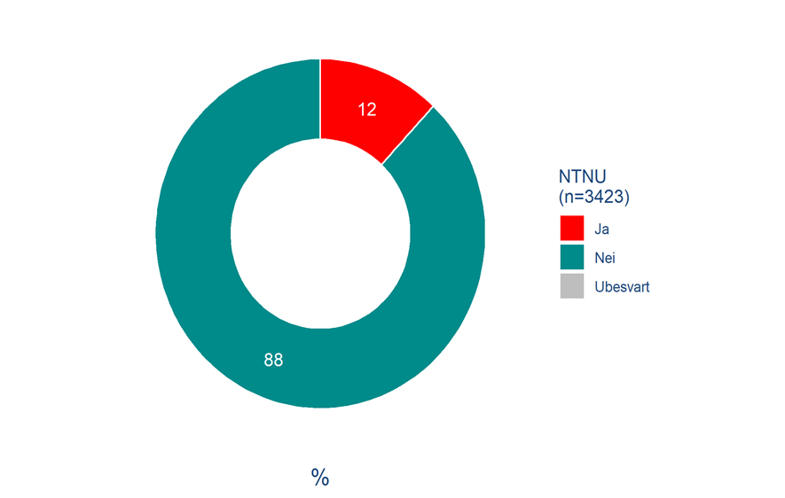
Have you been subjected to bullying or harassment in your current employment in the past 12 months?
Bullying and harassment
More than 1 out of 10 have been bullied or harassed
Just over 1 out of 10 (12 %) of the respondents at NTNU stated that they have been bullied or harassed in their current employment in the past 12 months.
More women (14 %) than men (9 %) stated that they have been bullied or harassed in their current employment.
Managers without personnel responsibilities stated slightly more often (15 %) than average (12 %) that they have been bullied or harassed in their current employment in the past 12 months.
10 % of the respondents in the technical/administrative job category stated that they have been bullied or harassed.
Q7: Have you been subjected to bullying or harassment in your current employment in the past 12 months?
Base: 3,423

Slide 12
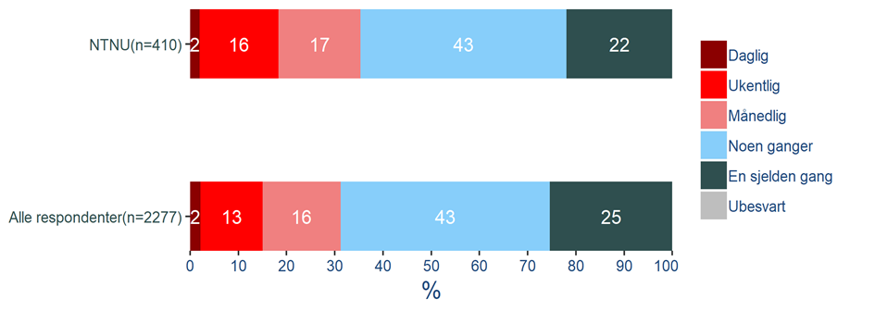
How often in the past 12 months have you been subjected to bullying or harassment in your current employment?
Bullying and harassment
Frequency of bullying and harassment
The remaining part of this section reports on the responses to a number of follow-up questions that were asked of those who have experienced bullying or harassment in the workplace in the past 12 months. Only those who responded Yes to the previous question were asked these questions, i.e. 12 % of the sample (410 respondents). Therefore, the following percentages apply to this group only.
Of those who have been bullied or harassed, 35 % stated that this has happened on a monthly basis or more often. 43 % stated that it has happened occasionally and 22 % stated that it has happened rarely.
There are no other significant differences in background variables.
Q8: How often in the past 12 months have you been subjected to bullying or harassment in your current employment?
Base: 410 (filter: respondents who have been bullied or harassed in the past 12 months)

Slide 13
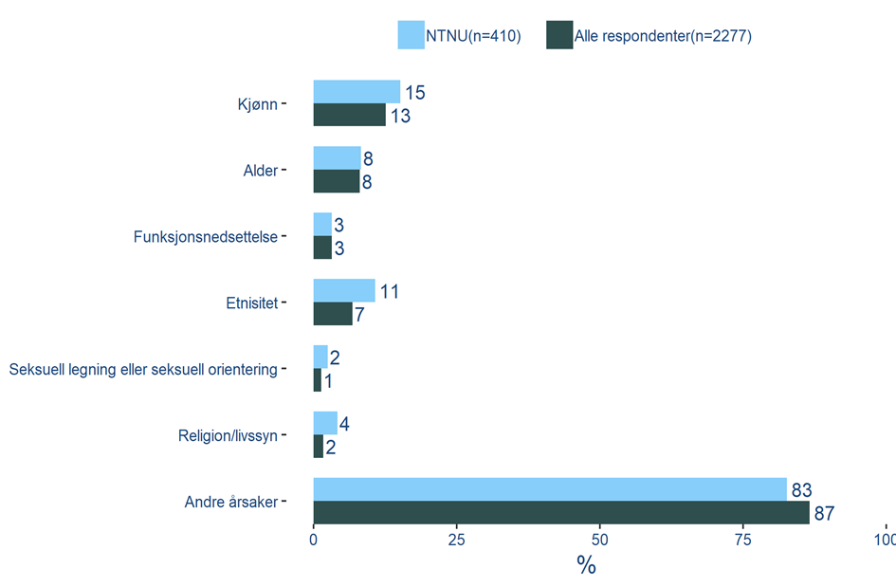
Have you been subjected to bullying or harassment on the basis of one or more of the following factors in your current employment in the past 12 months?
Bullying and harassment
Other causes of bullying/harassment most common
More than 8 out of 10 stated that the bullying/harassment they have experienced was based on other reasons.
15 % of those who have been bullied or harassed stated it was because of their gender. A larger proportion of women (20 %) than men (5 %) stated this alternative.
A larger percentage of men (7 %) who have been bullied or harassed stated it was because of their religion/philosophy.
A larger percentage of PhD candidates/postgraduates/senior research fellows who have been bullied or harassed stated it was because of their ethnicity (23 %), sexual orientation (6 %) or religion/philosophy (11 %).
Q9: Have you been subjected to bullying or harassment on the basis of one or more of the following factors in your current employment in the past 12 months?
Base: 410 (filter: respondents who have been bullied or harassed in the past 12 months)

Slide 14
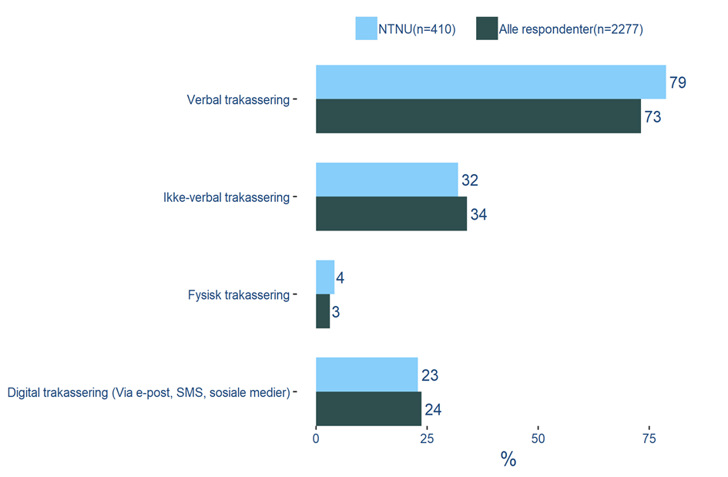
Have you been subjected to any of the following forms of bullying or harassment in your current employment in the past 12 months?
bullying and harassment
4 out of 5 stated that the harassment was verbal
79 % of those who have experienced bullying or harassment stated that it was verbal.
A higher proportion (32 %) of those in the 40-49 age group who have experienced harassment, stated that it was digital harassment.
Q10: Have you been subjected to any of the following forms of bullying or harassment in your current employment in the past 12 months?
Base: 410 (filter: respondents who have been bullied or harassed in the past 12 months)

Slide 15
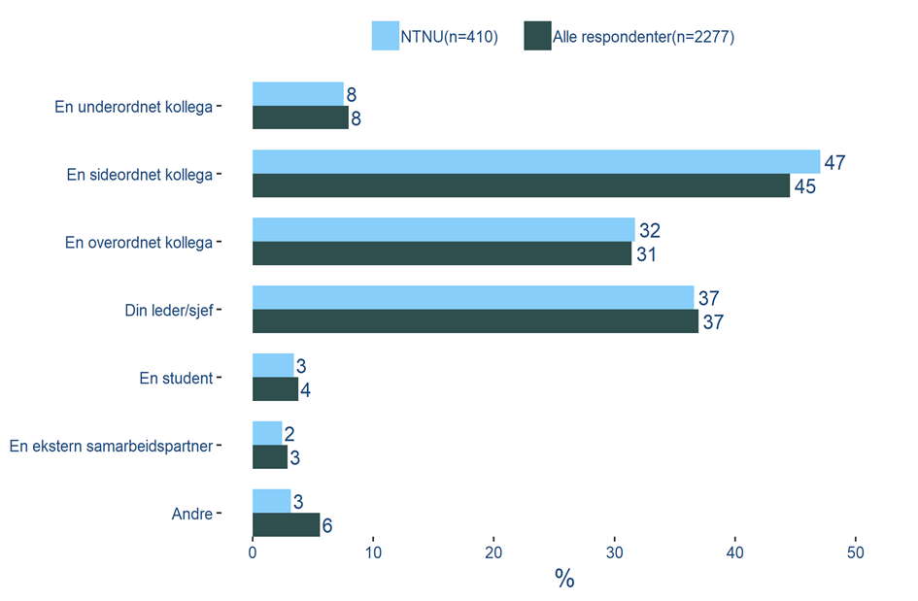
What type of position did the person subjecting you to bullying or harassment in your current employment in the past 12 months have?
Bullying and harassment
Most often equal colleagues
47 % of those who have been bullied or harassed stated that they were subjected to it by an equal colleague. 37 % responded that it was their manager/leader.
50 % of the men have been bullied or harassed stated that they were subjected to it by their manager/leader.
46 % of the PhD candidates/postgraduates/senior research fellows who have been bullied or harassed stated that they were subjected to it by an equal colleague.
Q11: What type of position did the person subjecting you to bullying or harassment in your current employment in the past 12 months have?
Base: 410 (filter: respondents who have been bullied or harassed in the past 12 months)

Slide 16
Sexual harassment
16
© 2019 Ipsos.

Slide 17
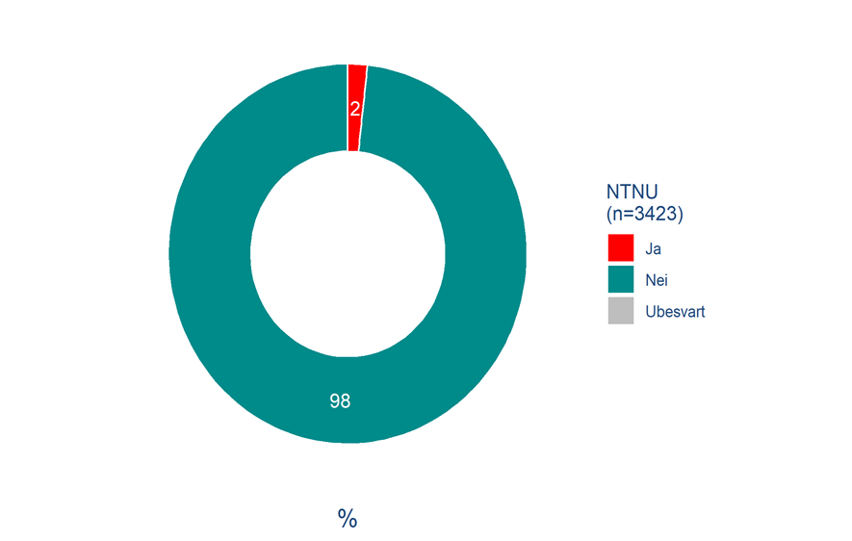
Have you been subjected to sexual harassment in your current position in the past 12 months?
sexual harassment
4 % of PhD candidates/postgraduates/senior research fellows have been sexually harassed
1.8 % have been subjected to sexual harassment in the workplace in the past 12 months. This represents a total of 60 respondents.
The percentage that have been sexually harassed decreases with age. Among the youngest (18-29 years) old, 3 % stated that they have been sexually harassed. Among the oldest (60+ years old) the figure is 0.5 %.
More women have been sexually harassed (2 %) than men (1 %).
4 % of the PhD candidates/postgraduates/senior research fellows stated that they have been subjected to sexual harassment in their current position in the past 12 months.
Q12: Have you been subjected to sexual harassment in your current position in the past 12 months?
Base: 3,423

Slide 18
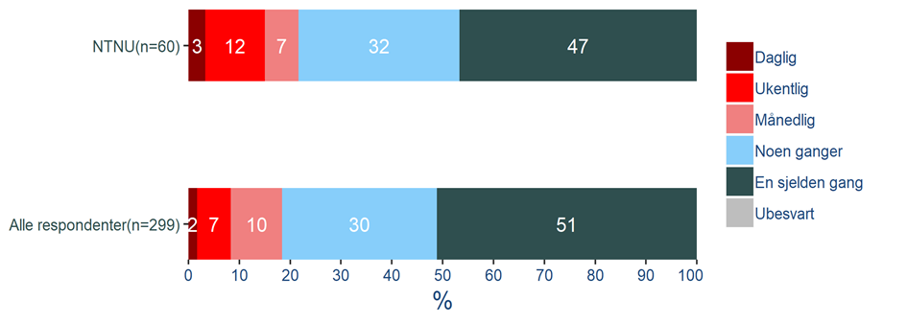
How often have you been subjected to sexual harassment in your current position in the past 12 months?
Sexual harassment
Frequency of sexual harassment
The remaining part of this section reports on the responses to a number of follow-up questions that were asked of those who have experienced sexual harassment in the workplace in the past 12 months. Only those who responded Yes to the previous question were asked these questions, i.e. 1.8 % of the sample (60 respondents). Therefore, the following percentages apply to this group only.
22 % of those who have been sexually harassed stated this has happened on a monthly basis or more often, 32 % stated that it has happened occasionally, and 47 % stated rarely.
36 % of PhD candidates/postgraduates/senior research fellows that stated that they have been sexually harassed stated this has happened on a monthly basis or more often.
Q13: How often have you been subjected to sexual harassment in your current position in the past 12 months?
Base: 60 (filter: respondents who have been subjected to sexual harassment in the past 12 months)

Slide 19
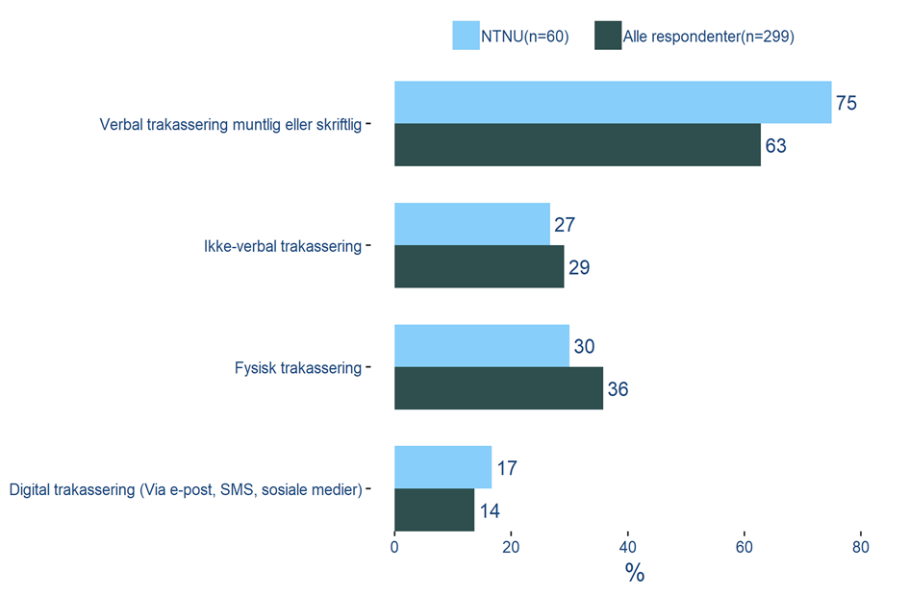
Have you been subjected to any of the following forms of sexual harassment in your current employment in the past 12 months?
Sexual harassment
Verbal harassment most common
75 % of those who have been sexually harassed stated that it was via verbal harassment. 30 % stated that it was physical harassment and 27 % stated that it was non-verbal harassment.
No background variables stand out with respect to this question.
Q14: Have you been subjected to any of the following forms of sexual harassment in your current employment in the past 12 months?
Base: 60 (filter: respondents who have been subjected to sexual harassment in the past 12 months)

Slide 20
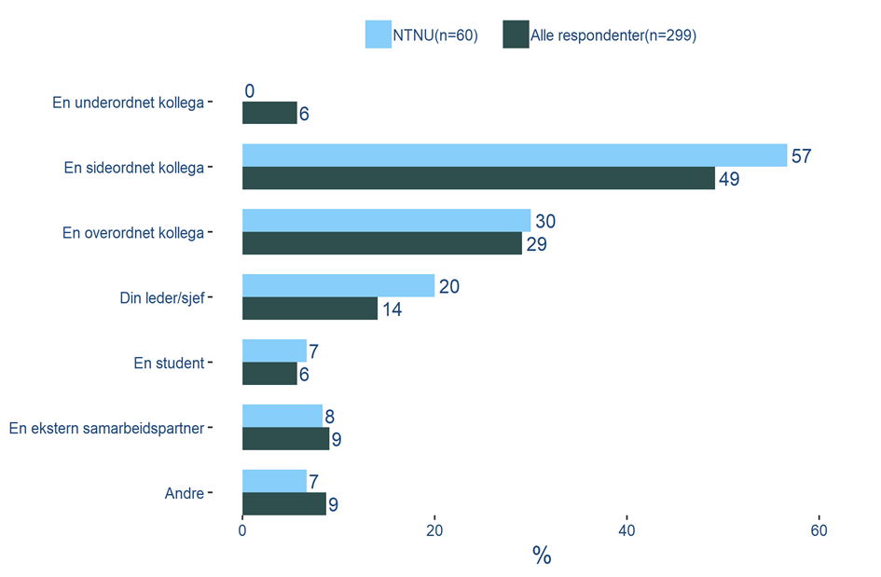
Who was it that subjected you to this?
Sexual harassment
Most often equal colleagues
57 % stated that they were subjected to the sexual harassment by an equal colleague. 30 % stated that it was a superior that subjected them to it, and 20 % stated that it was their manager/leader.
More men than women stated that they have been subjected to sexual harassment by a student.
No other background variables stand out with respect to this question.
Q15: Who was it that subjected you to this?
Base: 60 (filter: respondents who have been subjected to sexual harassment in the past 12 months)

Slide 21
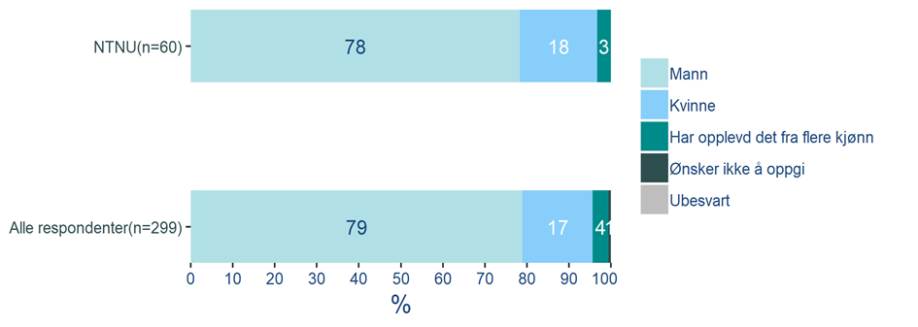
Was the person who subjected you to this:
Sexual harassment
Men responsible for most sexual harassment
Among those who have been sexually harassed, the women stated to a higher degree than average that they were harassed by men (94 %), while men respond stated that they were generally harassed by women (77 %).
Q16: Was the person who subjected you to this:
Base: 60 (filter: respondents who have been subjected to sexual harassment in the past 12 months)

Slide 22
Sexual assault
22
© 2019 Ipsos.

Slide 23
Have you in the past 12 months, in your current employment, been subjected to a situation where someone had sexual intercourse with you through the use of force, or have you felt compelled, threatened or pressured into having sexual intercourse?
Sexual assault
4 respondents subjected to sexual assault
4 respondents stated that they have been subjected to a situation where someone had sexual intercourse with them through the use of force, or have felt compelled, threatened or pressured into having sexual intercourse in the past 12 months.
A total of 9 respondents stated that they don’t know or were not sure whether they have been subjected to a situation where someone had sexual intercourse with them through the use of force, or have felt compelled, threatened or pressured into having sexual intercourse in the past 12 months.
For anonymity considerations, no light will be shed on background variables or the other responses of the 4 respondents in this report.
4
respondents
Q17: Have you in the past 12 months, in your current employment, been subjected to a situation where someone had sexual intercourse with you through the use of force, or have you felt compelled, threatened or pressured into having sexual intercourse?
Base: 3,423

Slide 24
Familiarity with whistleblowing procedures
24
© 2019 Ipsos.

Slide 25
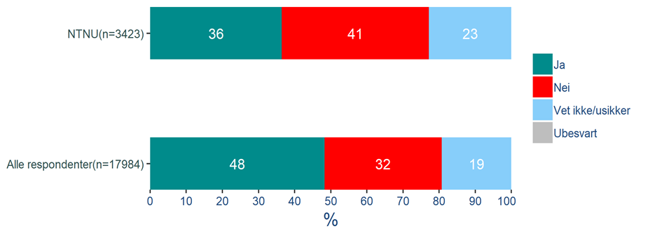
Do you know where you can access the whistleblowing system at your institution?
Familiarity with whistleblowing procedures
4 out of 10 do not know where to access the whistleblowing system
41 % did not know where to access the whistleblowing system at their higher education institution. This is substantially higher percentage than the national average.
A small proportion of younger respondents knew than older ones. 51 % of the 18-29 age group did not know where to access it, compared with 35 % in the 60+ age group who did not know.
23 % were unsure about where to access the whistleblowing system at their higher education institution. 36 % know where to access it.
Q21: Do you know where you can access the whistleblowing system at your institution?
Base: 3,423

Slide 26
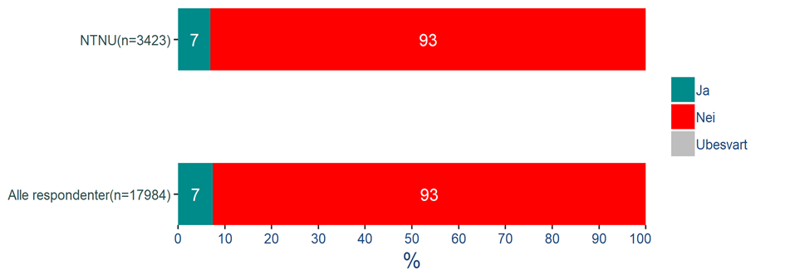
Have you reported any negative aspects or situations as defined above which have affected you in your current employment in the past 12 months?
Familiarity with whistleblowing procedures
2 out of 5 who have been bullied or harassed have reported it
39 % of those who have been bullied or harassed in their current employment in the past 12 months have reported the negative aspects or situations which have affected them.
Only 30 % who have been subjected to sexual harassment have reported the negative aspects or situations in the past 12 months.
Q22: Have you reported any negative aspects or situations as defined above which have affected you in your current employment in the past 12 months?
Base: 3,423

Slide 27
Have you reported any negative aspects or situations as defined above which have affected other people than yourself in your current employment in the past 12 months?
Familiarity with whistleblowing procedures
6 % have reported negative aspects or situations which have affected other people
24 % of those who have been bullied or harassed in their current employment in the past 12 months have reported the negative aspects or situations which have affected people other than themselves.
4 % of those who have not been bullied or harassed have reported negative aspects or situations which have affected people other than themselves.
Q23: Have you reported any negative aspects or situations as defined previously which have affected other people than yourself in your current employment in the past 12 months?
Base: 3,423

Slide 28
Background variables
28
© 2019 Ipsos.

Slide 29
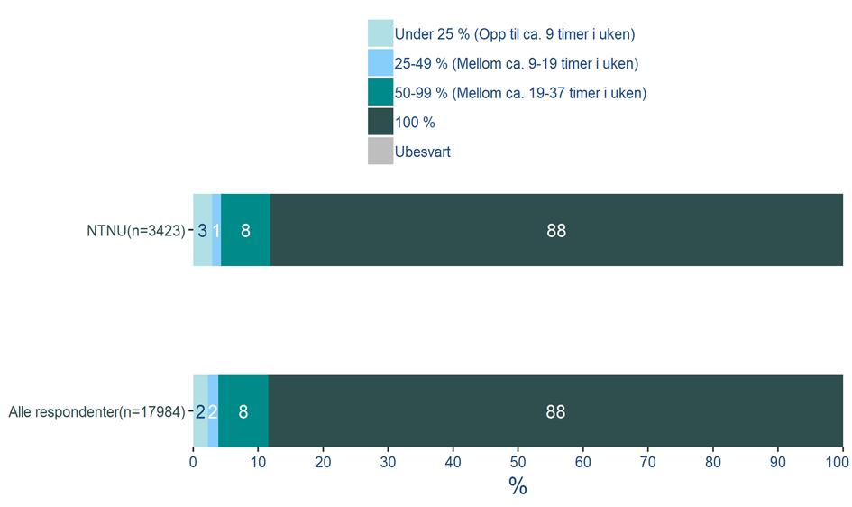
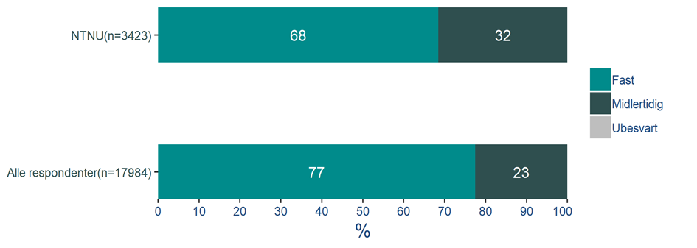
Do you have a permanent or a temporary position?
Background variables
What is your FTE percentage (employment percentage)?
Paste graphic here ☺
Paste graphic here ☺
Q1: Do you have a permanent or a temporary position?
Base: 3,423
Q2: What is your FTE percentage (employment percentage)?
Base: 3,423

Slide 30
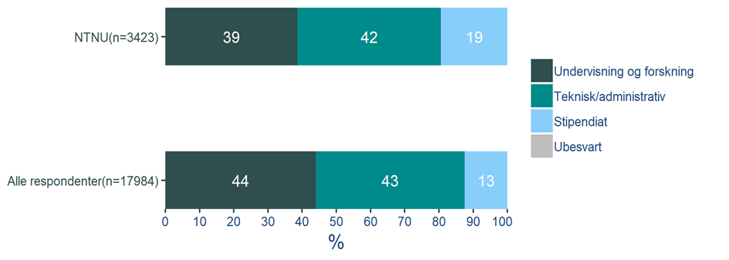
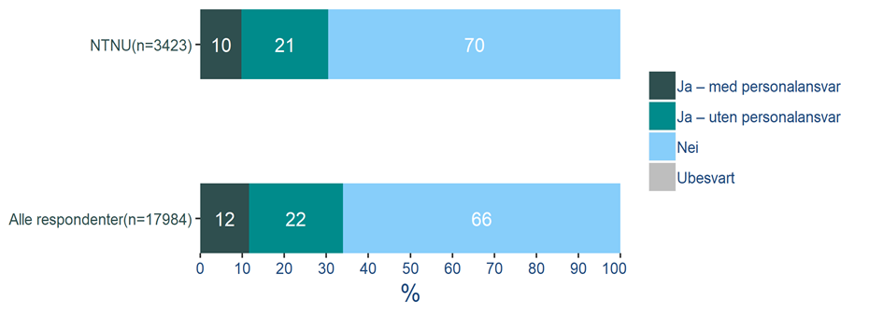
Which employment category do you belong to?
Background variables
Do you have leadership responsibilities in your role?
Paste graphic here ☺
Q3: Which employment category do you belong to?
Base: 3,423
Q4: Do you have leadership responsibilities in your role?
Base: 3,423

Slide 31
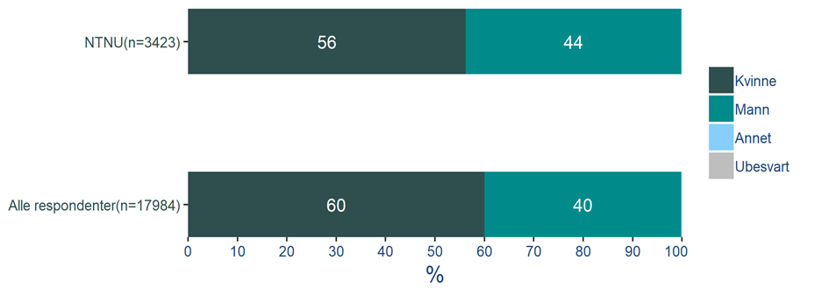
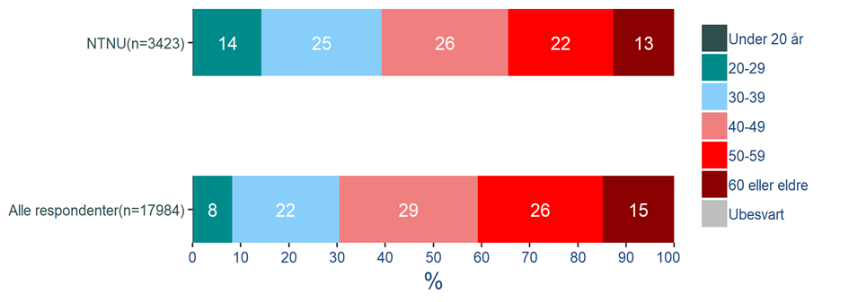
What is your gender?
Background variables
What is your age?
Paste graphic here ☺
Q5: What is your gender?
Base: 3,423
Q6: What is your age?
Base: 3,423

Slide 32
Contact Ipsos
Arild Sæle
Project manager
Mads Motrøen
Responsible for analysis and reporting
Linn Sørensen Holst
Manager
arild.sæle@ipsos.com
mads.motroen@ipsos.com
linn.holst@ipsos.com
+47 926 63 227
+47 995 87 968
+47 975 94 285

Slide 33
ABOUT IPSOS
Ipsos ranks third in the global research industry. With a strong presence in 88 countries, Ipsos employs more than 16,000 people and has the ability to conduct research programs in more than 100 countries. Founded in France in 1975, Ipsos is controlled and managed by research professionals. They have built a solid Group around a multi-specialist positioning – Media and advertising research; Marketing research; Client and employee relationship management; Opinion & social research; Mobile, Online, Offline data collection and delivery.
Ipsos is listed on Eurolist - NYSE-Euronext. The company is part of the SBF 120 and the Mid-60 index and is eligible for the Deferred Settlement Service (SRD).
ISIN code FR0000073298, Reuters ISOS.PA, Bloomberg IPS:FP
www.ipsos.com
GAME CHANGERS
At Ipsos we are passionately curious about people, markets, brands and society. We deliver information and analysis that makes our complex world easier and faster to navigate and inspires our clients to make smarter decisions.
We believe that our work is important. Security, simplicity, speed and substance applies to everything we do.
Through specialisation, we offer our clients a unique depth of knowledge and expertise. Learning from different experiences gives us perspective and inspires us to boldly call things into question, to be creative.
By nurturing a culture of collaboration and curiosity, we attract the highest calibre of people who have the ability and desire to influence and shape the future.
“GAME CHANGERS” - our tagline - summarises our ambition.

