Slide 1
Information cafe for Project manager
BOTT ØL
25.11.22

Slide 2

Practical information
The purpose of the information cafe is to give you as a project manager information about how the introduction of new finance- and payroll systems (BOTT ØL) affects you as a project manager and what you are expected to carry out in terms of training before 1 January 2023.
Notes:
Merete

Slide 3
Agenda
Introduction: What is BOTT ØL and why are we doing it? | 10 min
Brief introduction about the project manager role | 5 min
Main changes for project manager | 10 min
Training for project manager | 10 min
Where can you find more information | 5 min
Questions and answers | 20 min
Notes:
Merete

Slide 4
What is "BOTT ØL"?
Unit 4: financial system (order, project, invoice and accounting) SAP: payroll system Self-service solutions (time, holiday, travel, expenses, etc.)
The project has long used "BOTT ØL" as a short name.
BOTT
Stands for "Bergen, Oslo, Trondheim (NTNU) and Tromsø and are the four universities that together have described and acquired the systems
ØL
Stands for finance and payroll systems and describes what the project will deliver
At NTNU, from the moment we start operating the systems, they will be:
Unit 4: financial system (order, project, invoice and accounting)
SAP: payroll system
Self-service portal (time, holiday, travel, expenses, etc.)
Notes:
Tor

Slide 5
What does BOTT bring?
Our tasks today
Systems today
Systems 2023
Budgeting,
Staffing plan,
virksomhetsrapporter
BEVISST plan
BEVISST innsikt
BEVISST plan
BEVISST innsikt
Accounting,
order,
project,
Oracle
Basware PM/IP/CM
Maconomy
ResearchPro
Unit 4 ERP - DFØ
Salary,
recording hours,
absence,
holiday
HR-portalen / PAGA
SAP – DFØ + selvbetjeningsportal

Slide 6
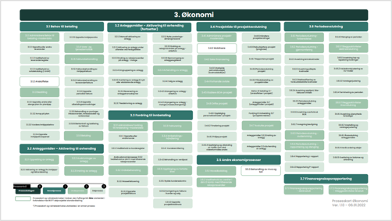
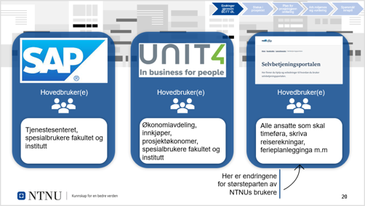
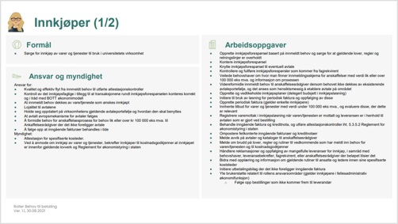
More than a system change: Process, Systems and Organization (PSO)
Together with UiB, UiO og UiT we have developed shared systems, process and roles. UiB, UiO and UiT have already put the system into use.
Last year, a lot of work was done to understand these processes and take them «home to NTNU» and working in a PSO perspective where we have to make the three parts fit together.
BOTT ØL will mean that many employees will have new roles, will have to work in new ways, and all employees will in one way or another have one or more new systems to deal with
Processes
Systems
Organization
Brukerdokumentasjon, roller, opplæringsmateriell med mer ligger på felles samleside: bott-samarbeidet.no

Slide 7

Introduction to the project manager role
The purpose of the role Project manager is to strengthening the units research in accordance with goals, strategy and academic interest by creating financial room for action.
Key tasks for the role:
Competence requirements
Clarify the project idea, resource use and net contribution with the project owner.
Basic knowledge of the BOA regulations and internal guidelines
Basic knowledge of routines within the project process
Basic knowledge of application processes for external funding sources
Basic knowledge of the TDI model
Basic knowledge of the company's financial model
Competence requirements set for the role of Approver in other processes (BtB, FtI, Salary)
Prepare project description, application and submit it, as well as evaluate financing offers together with project owner etc.
Provide input to the application and project budget and communicate project changes to the project economist
Report financial and professional status, as well as final report to project owner and financier
Implement decided measures and carry out evaluation of projects
Note that for project managers who are not active users of iAccess, there will be no/very little change in how the management information is obtained or which management information is obtained.
* See full description of tasks in role description (in Norwegian)

Slide 8
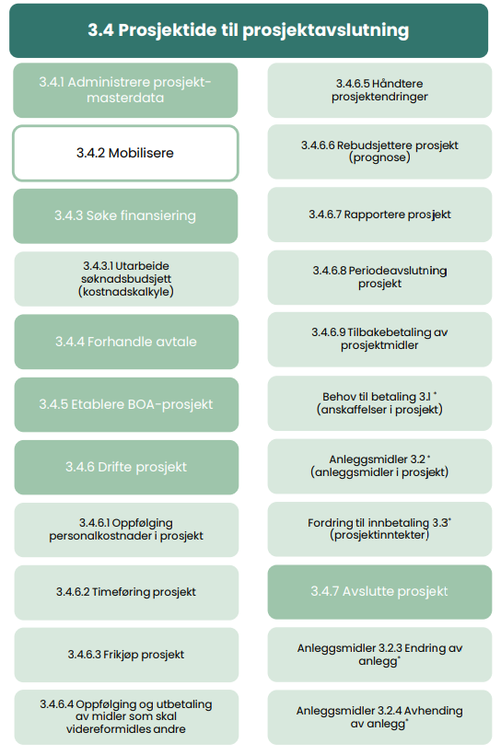
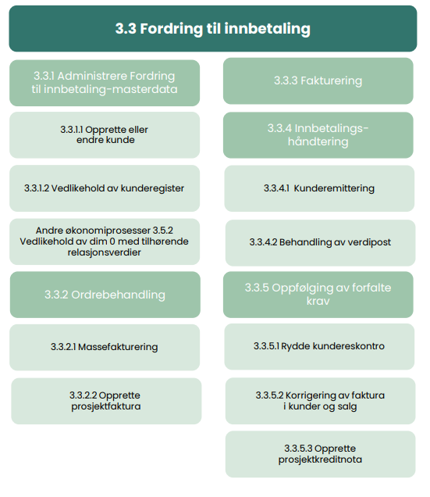
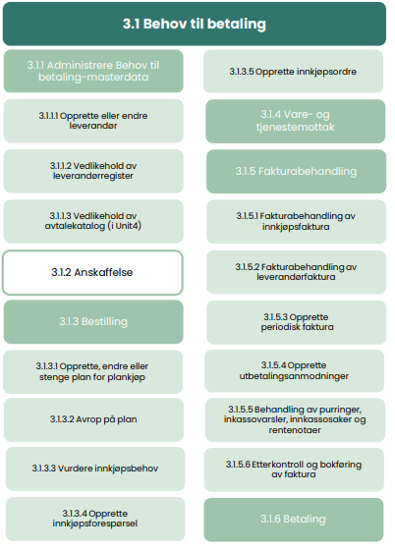
The project manager will have responsibilities and tasks within the processes
Prosjektidé til prosjektavslutning, Behov til betaling(BTB) og Fordring til innbetaling(Fti)
- Desciption in norwegian

Slide 9
Main changes for project manager
Today's systems
Maconomy (timer)
ReseachPro (prosjektsøknad)
iAccess (prosjektrappport i Maconomy)
Systems after 01.01.23
Unit4 ERP
  Søknadsmodulen(The application module/
  Pre-award (in 2023)
SAP Self service portal (time management project)
Bevisst (economy)
Travel bills, reimbursement claims and applications for holidays and absences must be made in the SAP Self-service portal or DFØ App
Registration of project time in SAP Self-service portal or DFØ App
New project and sub-project numbers..
During 2023:
The project manager gets access to Bevisst through the Project Manager portal and can monitor his own project portfolio in addition to the project economist.
Registers projects in the system solution already at the application stage.
Notes:
Terje

Slide 10
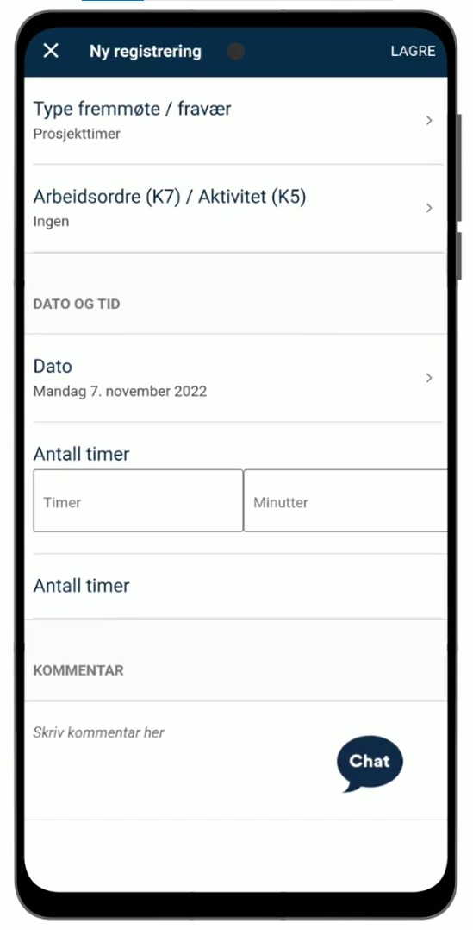
Clarification on time registration
If there is a requirement or desire for time registration on a project, it must be done by the employee himself (project employee/project manager), either in the DFØ app or in the DFØ Self-service portal.
Project timekeeping will only be applicable if:
Financiers (e.g. EU) require a detailed overview of work effort
It is not possible to enter salary costs directly on a project (direct accounting)
The free-purchase solution for burdening the project manager's/project resource's work effort does not give an accurate enough picture of the resource effort
Scope – which projects:
How (if applicable)
Requirements for individual time registration will mainly affect EU projects, but may also apply to other BOA projects. Which projects it may be relevant for will vary between the units and must be clarified locally.
Video: How to keep project hours in the DFØ app
Notes:
Terje

Slide 11
In summary: Impact Project manager
Until 01.01.23
After 01.01.23, but before BEVISST and Pre-award are put into use
After 01.01.23 and after the introduction of BEVISST and Pre-award
Little affected, but may experience less availability from project economists as a result of training and adaptation for those in new systems
Expected training needs are linked to process and role training in the form of e-learning for the role, as well as relevant information meetings
Project economists now have access to a new project module with a large selection of project management reports that will be made available to project managers..
The project manager does not have access to report solutions himself and during this period is dependent on dialogue with the project economist and that the project economist distributes reports to the project manager. (for those who themselves have not taken out reports from iAccess, this will not result in any change)
Main changes for Project Manager occur during this period
Will require time for training and getting used to new solutions
NOTE: In addition to changes that affect your role as project manager, see information that applies to the ordinary employment relationship as a scientific employee or administrative roles if you are assigned any of these.

Slide 12
Timeline from the project manager's point of view
Activities in the project
20.09 – 20.12: Main period for training for project economists
01.01: GO-LIVE and start-up phase for new systems
TBA: BEVISST Project manager portal is ready for use
TBA: Pre-award ready for use
Impact for a project manager
During this period, the project economist will spend a lot of time on training in role, process and system. Some reduced availability from the project economist must therefore be expected.
Reduced availability and level of service from professional resources must be expected as a result of time to become familiar with systems and any start-up challenges
Project managers must be available for training and time must be set aside for this
Alle K-steder, prosjektnummer og delprosjektnummer vil være nye
Training and familiarization for project managers in the new project management solution.
The project manager is dependent on a close dialogue with the project economist who will assist in the follow-up of the project by, among other things, making available project reports from Unit4 ERP (until BEVISST is complete)
Notes:
Skal vi også ta med det som treffer en vanlig ansatt – skal vi evt. ta den med på neste slide?
Spørsmålet er også om vi skal ha mer enn 1 slide

Slide 13
Training for project manager
Before the Pre-award and complete BEVISST solution is available, training for the project manager will include:
NTNU Information meetings
DFØ E-learning about the self-service solution / DFØ app
Note that some project managers may also hold other roles in other processes. For those concerned, the training course linked to these roles will also be followed.
See a complete overview of training per role on the project's training intranet page(in Norwegian)
Questions related to which roles you have been assigned should be directed to the introduction manager for BOTT ØL locally

Slide 14
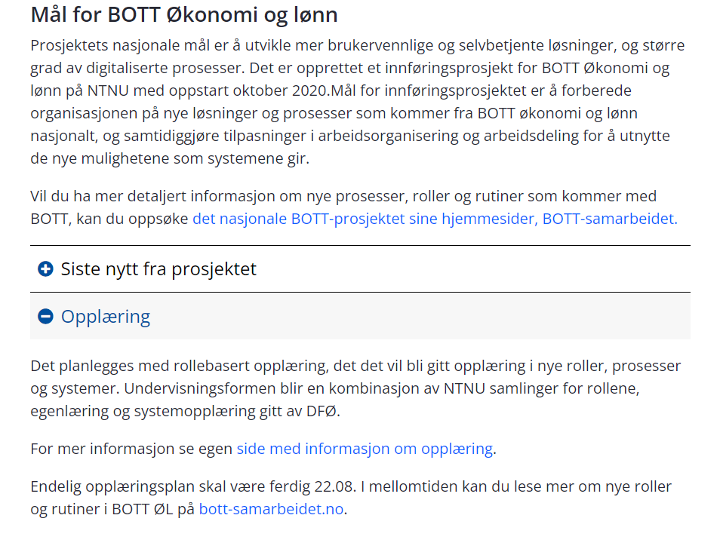
Website
Prosjektets nettside (In Norwegian)
Opplæringsside (In Norwegian)

Slide 15
Process advisors Project economics
HF - Siri Bjørnerud
IE - Anders Kongsli Kvernberg, Magnhild Tangvik
IV - Jannike Vaag Kvendset, Magnus Lyslo Haugskott, Maya Foss Sharma
MH - Hanne Stene Snerting, Henning Boganes, Kamilla Korsnes Rivera
NV - Tor Magne Volden, Tomas Hermansen
SU - Anniken Herje (frem til 31.12)
ØK - Magnus Brenne Domben
VM - Klaus Ramberg
AD - Åse Lereggen
FA -Linda Katrin Myren Vada
Oversikt over prosessrådgivere innen prosjektøkonomi på NTNU
Notes:
Christina

Slide 16
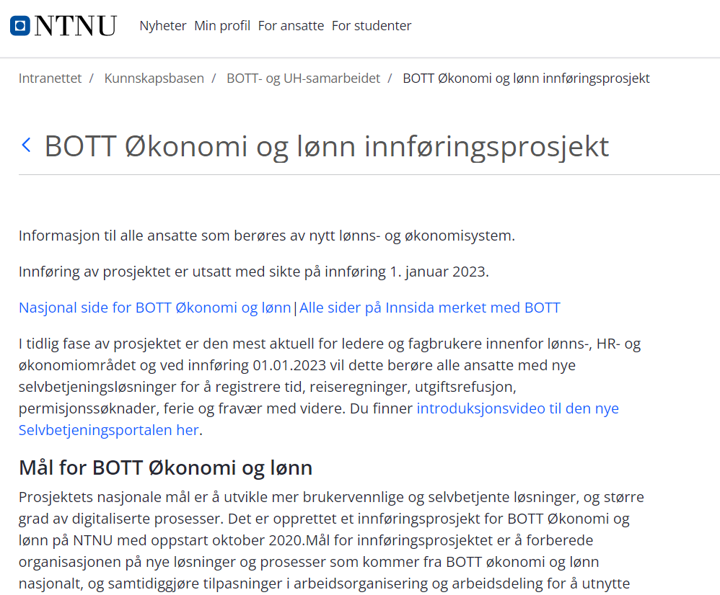
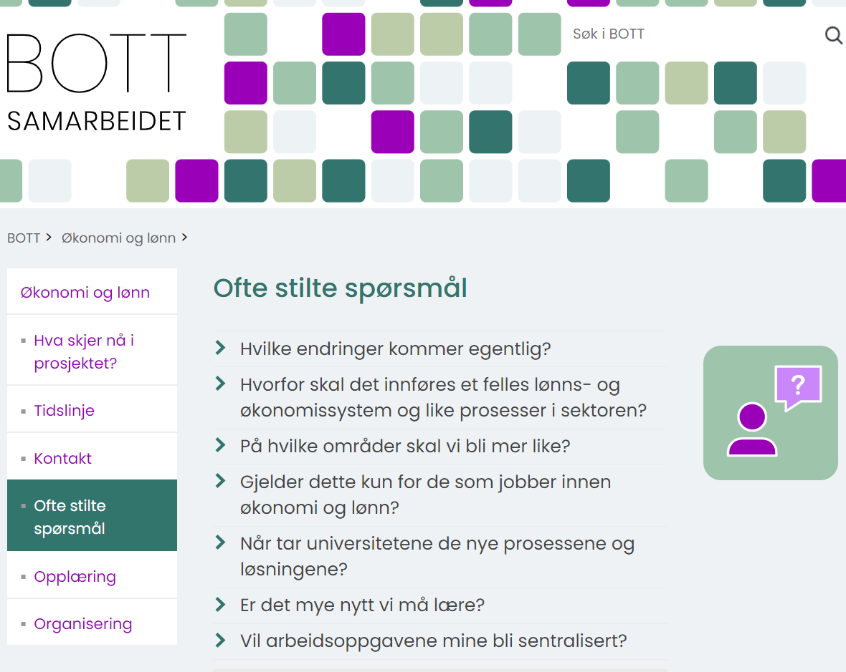
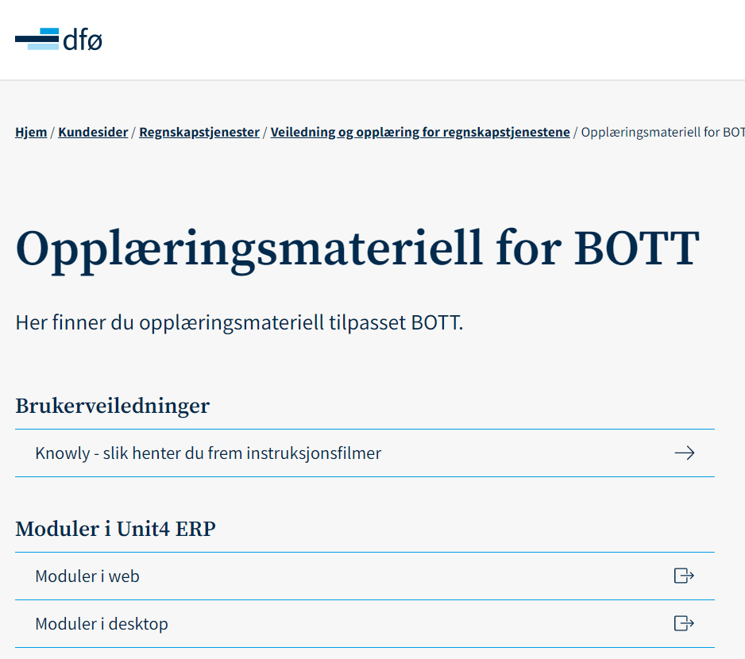
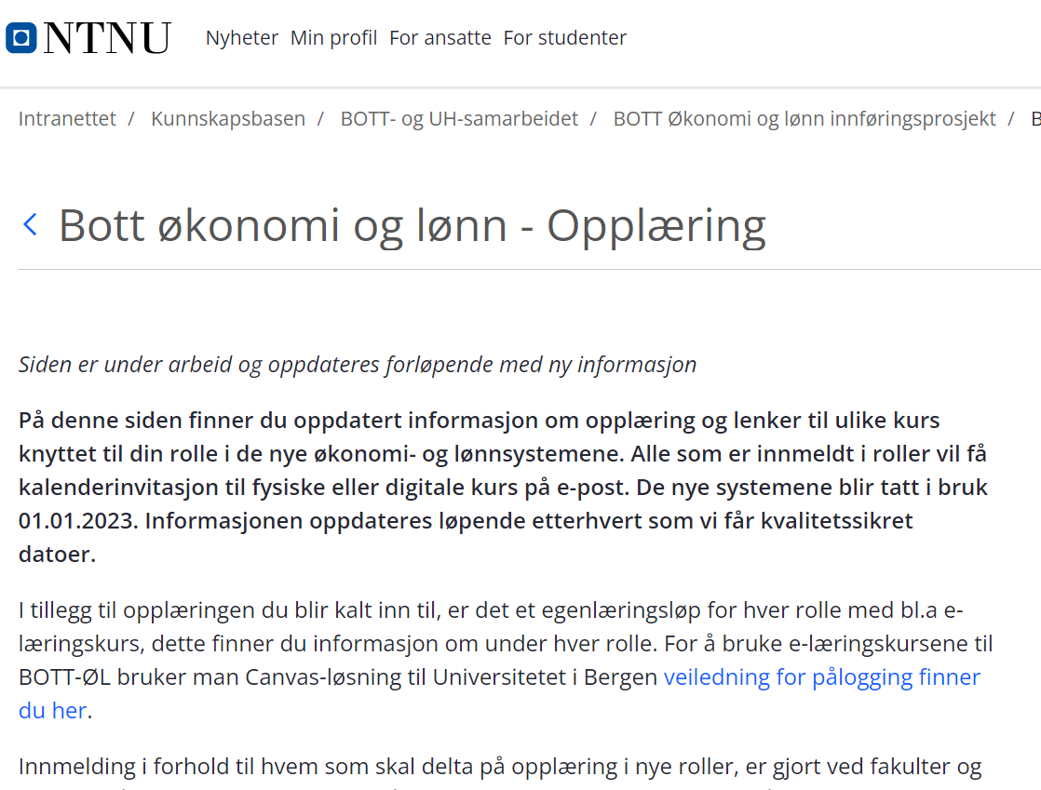
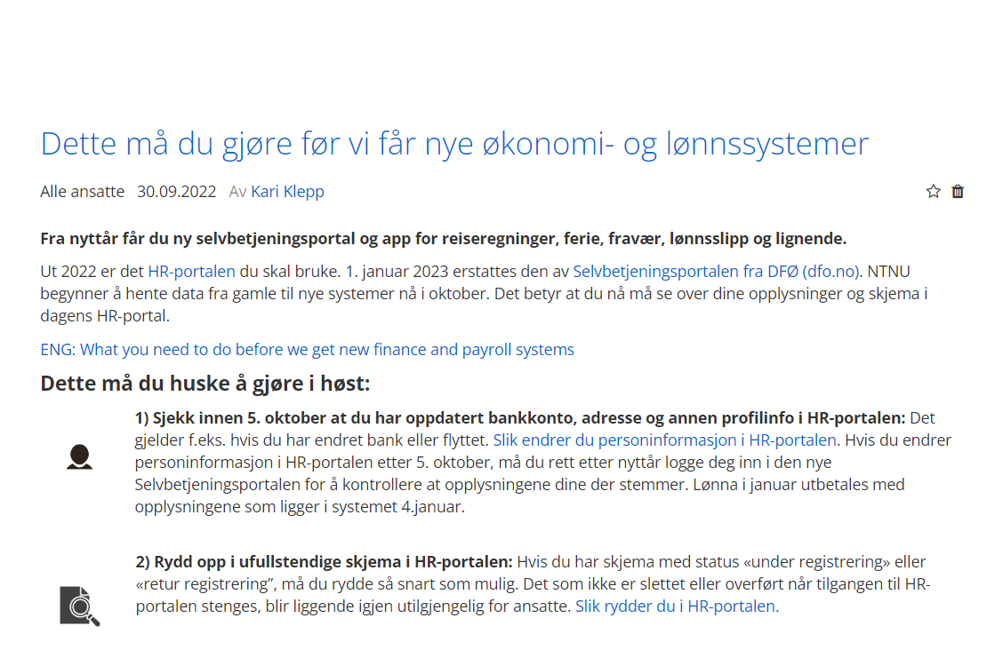
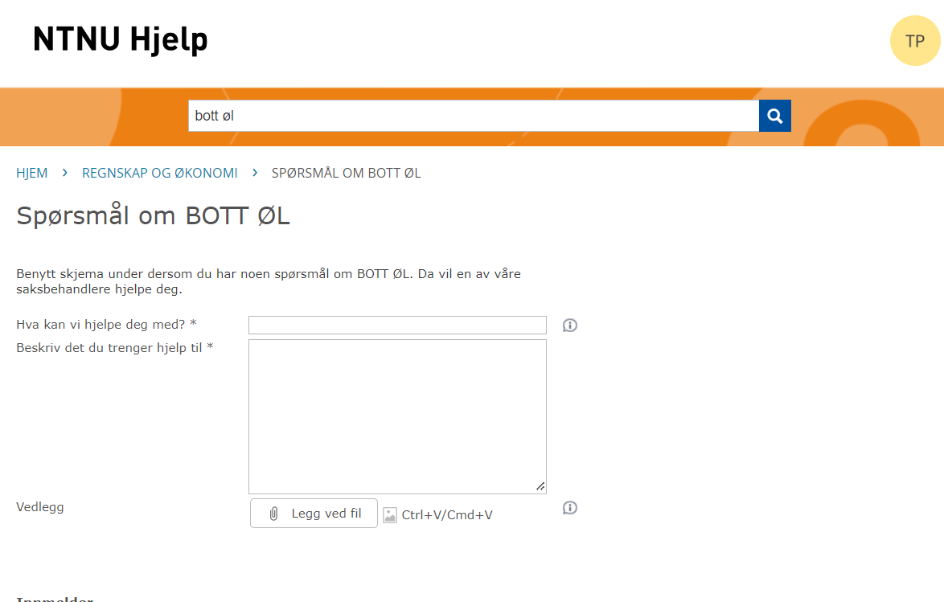
Where can I find more about the project?
Pages are in Norwegian
Intranet siteBOTT ØL
Bott-samarbeidet.no
DFØs training pages
Intranet site training
NTNU Help
Innsida

Slide 17

Thank you for your participation!

