Slide 1
INFORMASJONSMØTE
Masterstudenter IBT
Valg av masteroppgave/veileder

Slide 2
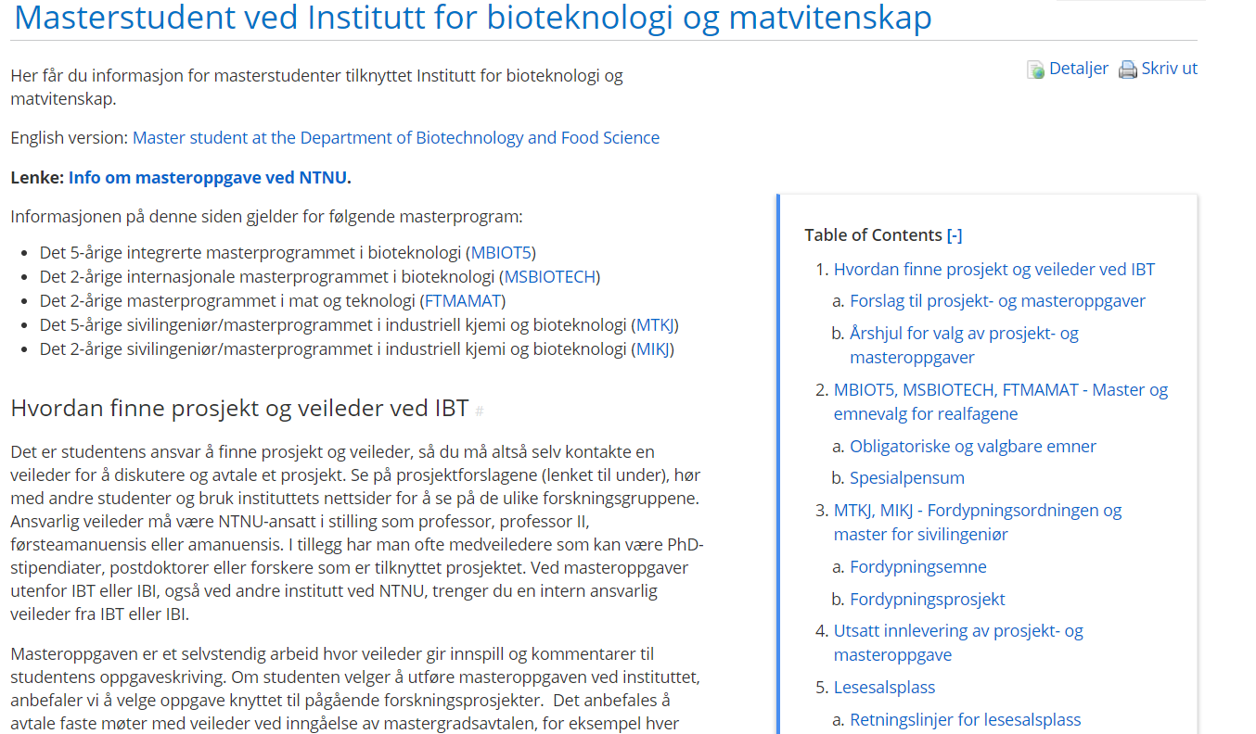
Masterstudent ved Institutt for bioteknologi og matvitenskap
Henrik Stamnes Dahl - studieveileder

Slide 3

Department of biotechnology and food science
Food science division https://www.ntnu.edu/ibt/research/food-science#/view/about
Division leader Jørgen Lerfall
https://www.ntnu.edu/employees/jorgen.lerfall

Slide 4

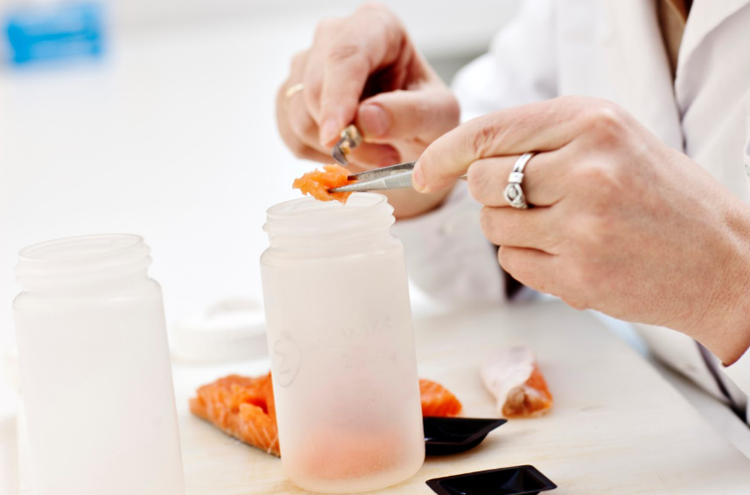
Food science
Quality of food raw materials and food products including changes during processing
Shelf life, food safety, food quality, hygienic design, biofilm, bio-preservation
Marine lipids and proteins
Utilization of rest raw materials and new food raw materials
Key-numbers
Master students* | 30
Bachelor students* | 40
Ph.d.-candidates | 16
Post docs/Prof II | 1(2)
Scientific staff | 15
Technical staff | 4/5
*pr year
Notes:
Enzymteknologi (restråstoff) og bio-konservering
Tverfaglighet

Slide 5
Laboratories
Gløshaugen
  Food chemistry lab
  Analytical lab
Akrinn
  Food processing lab
    Packaging, salting, drying, smoking, heating, pasteurization, fermentation, hydrolysis etc.
  Analytical food chemistry lab
    HPLCs, GC, spectrophotometry etc.
    Vision technology
  Microbiology lab
    PCR etc.
    Class I
    Class II (pathogens)
  Sensory laboratory

Slide 6
Potential supervisors
Supervisors | Topics | Location
Jørgen Lerfall | Processing of seafood, food chemistry, packaging, quality, shelf- life, food safety etc. | Akrinn
Turid Rustad | Food chemistry, rest raw materials, macro algae etc. | Gløshaugen
Alexander Dikiy | Food metabolomics | Gløshaugen
Anita N. Jakobsen | Food microbiology, preservation technology and food safety | Akrinn
Eva Falch | Bioeconomy, sustainable food processing, utilization of by-products | Akrinn
Marcin A. Kurek | Food chemistry, cereals, vegetables, encapsulation, nutrition | Akrinn
Ida-Johanne Jensen | Food nutrition, underutilized seafood resources | Akrinn
Eirin Marie S. Bar | Hygenic design, food safety, sustainable food processing | Akrinn
Lisbeth Mehli | Food microbiology, molecular biology, food safety | Akrinn
Sunniva Hoel | Food microbiology, molecular biology, food safety | Akrinn
Atle Hannisdal | Risk assessment, HACCP | Akrinn
Lene Waldenstrøm | Sensory evaluation of food quality and consumer science | Akrinn

Slide 7
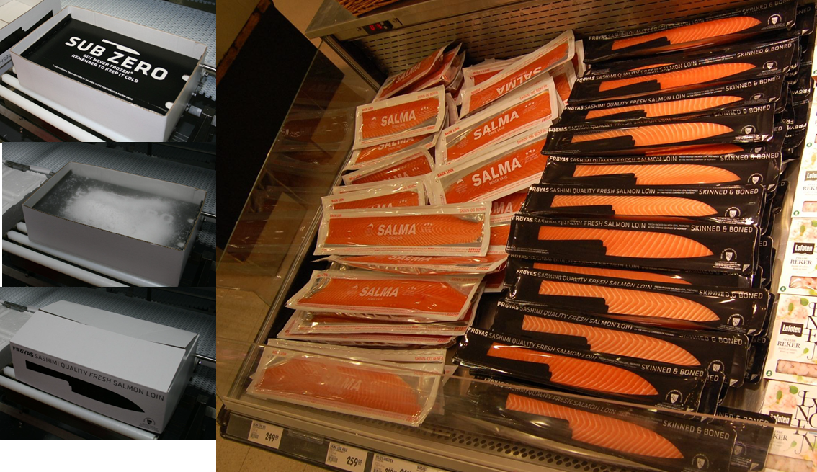
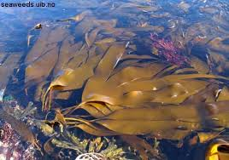
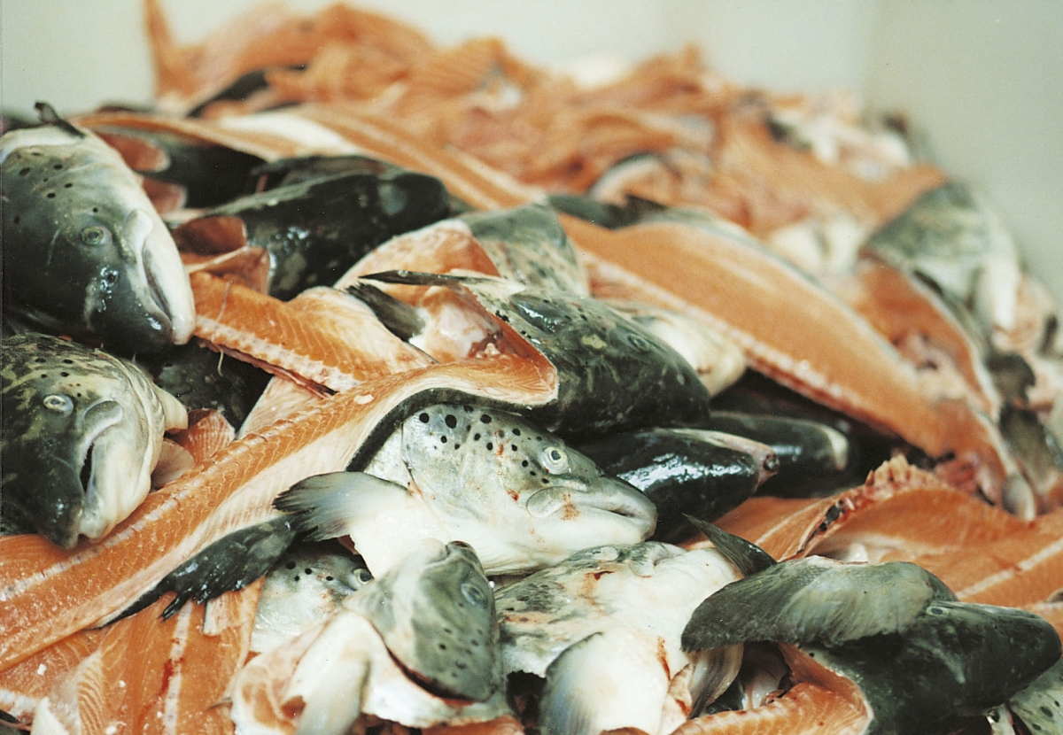
Master projects in food science?
Contact a supervisor within your field of interest
Search for available project and thesis proposals at the NV faculty Hub https://www.ntnu.no/machform/report.php?key=176077xc31903f2c1

Slide 8
Questions?
Please contact the food science division
Jørgen Lerfall
+47 920 34 444 / +47 73 55 97 49
jorgen.lerfall@ntnu.no

Slide 9
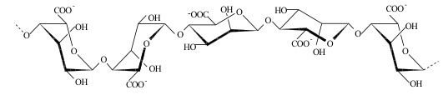
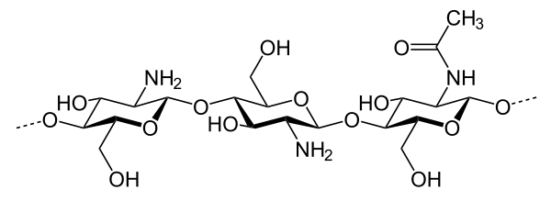
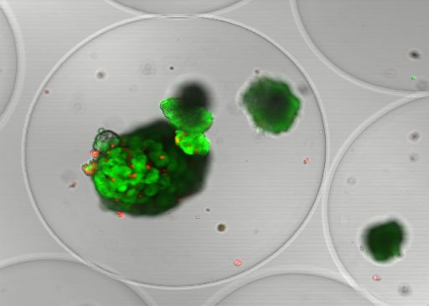

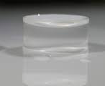
Biopolymer and Biomaterials - NOBIPOL

Slide 10

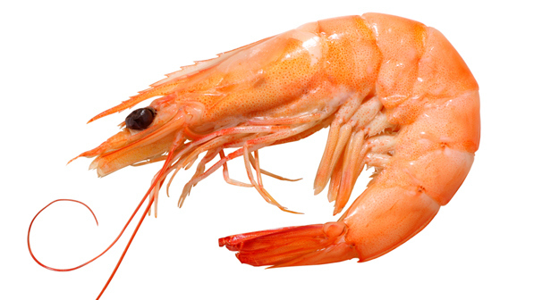

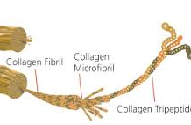
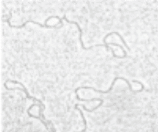
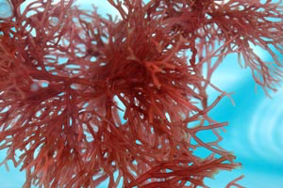
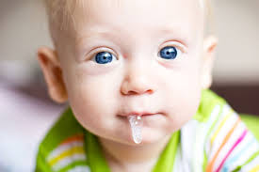
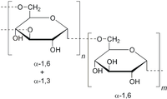
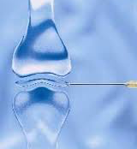
Alginate
Chitin/Chitosan
Cellulose and
Cellulose derivatives
Collagen and gelatin
Xanthan
Agarose and carragenan
Mucins
Pullulan and dextran
Hyaluronan

Slide 11
BIOPOLYMER ENGINEERING
GENETICS
BIOSYNTHESIS
+ CHEMICAL
MODIFICATIONS
PRIMARY STRUCTURE
CONFORMATION
FUNCTIONAL PROPERTIES
BIOLOGICAL FUNCTION
TECHNICAL USE

Slide 12
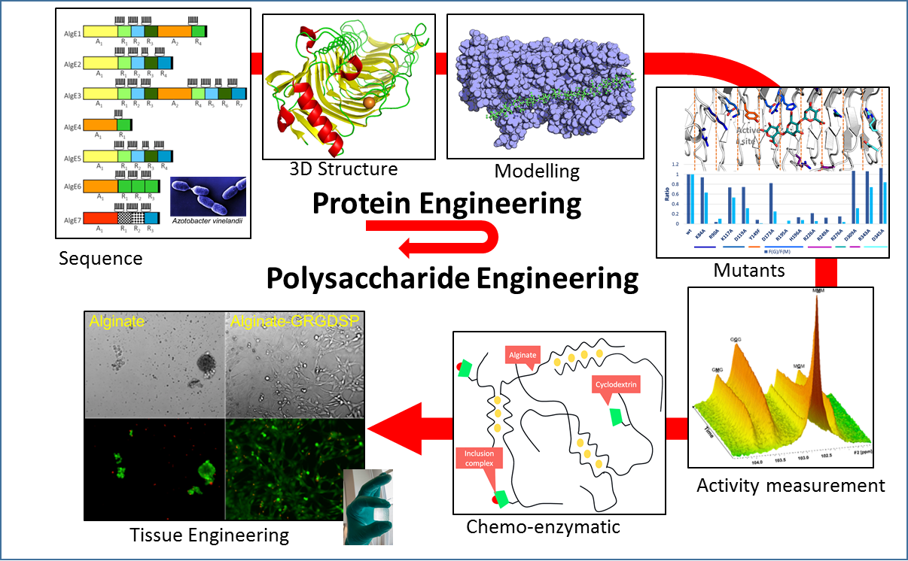
Alginate epimerases: from protein engineering to polysaccharide engineering
Tøndervik et.al Biomacromolecules, 2013, 14 (8), pp 2657–2666
Staninci et.al , Carbohydrate polymers 2018, 180, pp 256-263

Slide 13
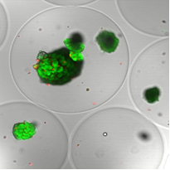
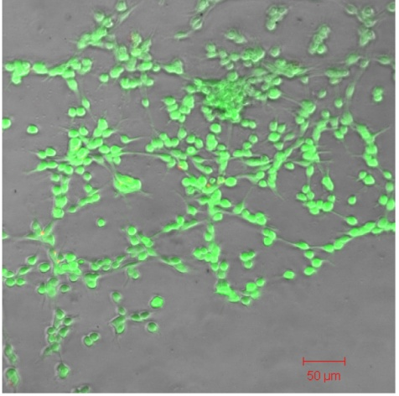
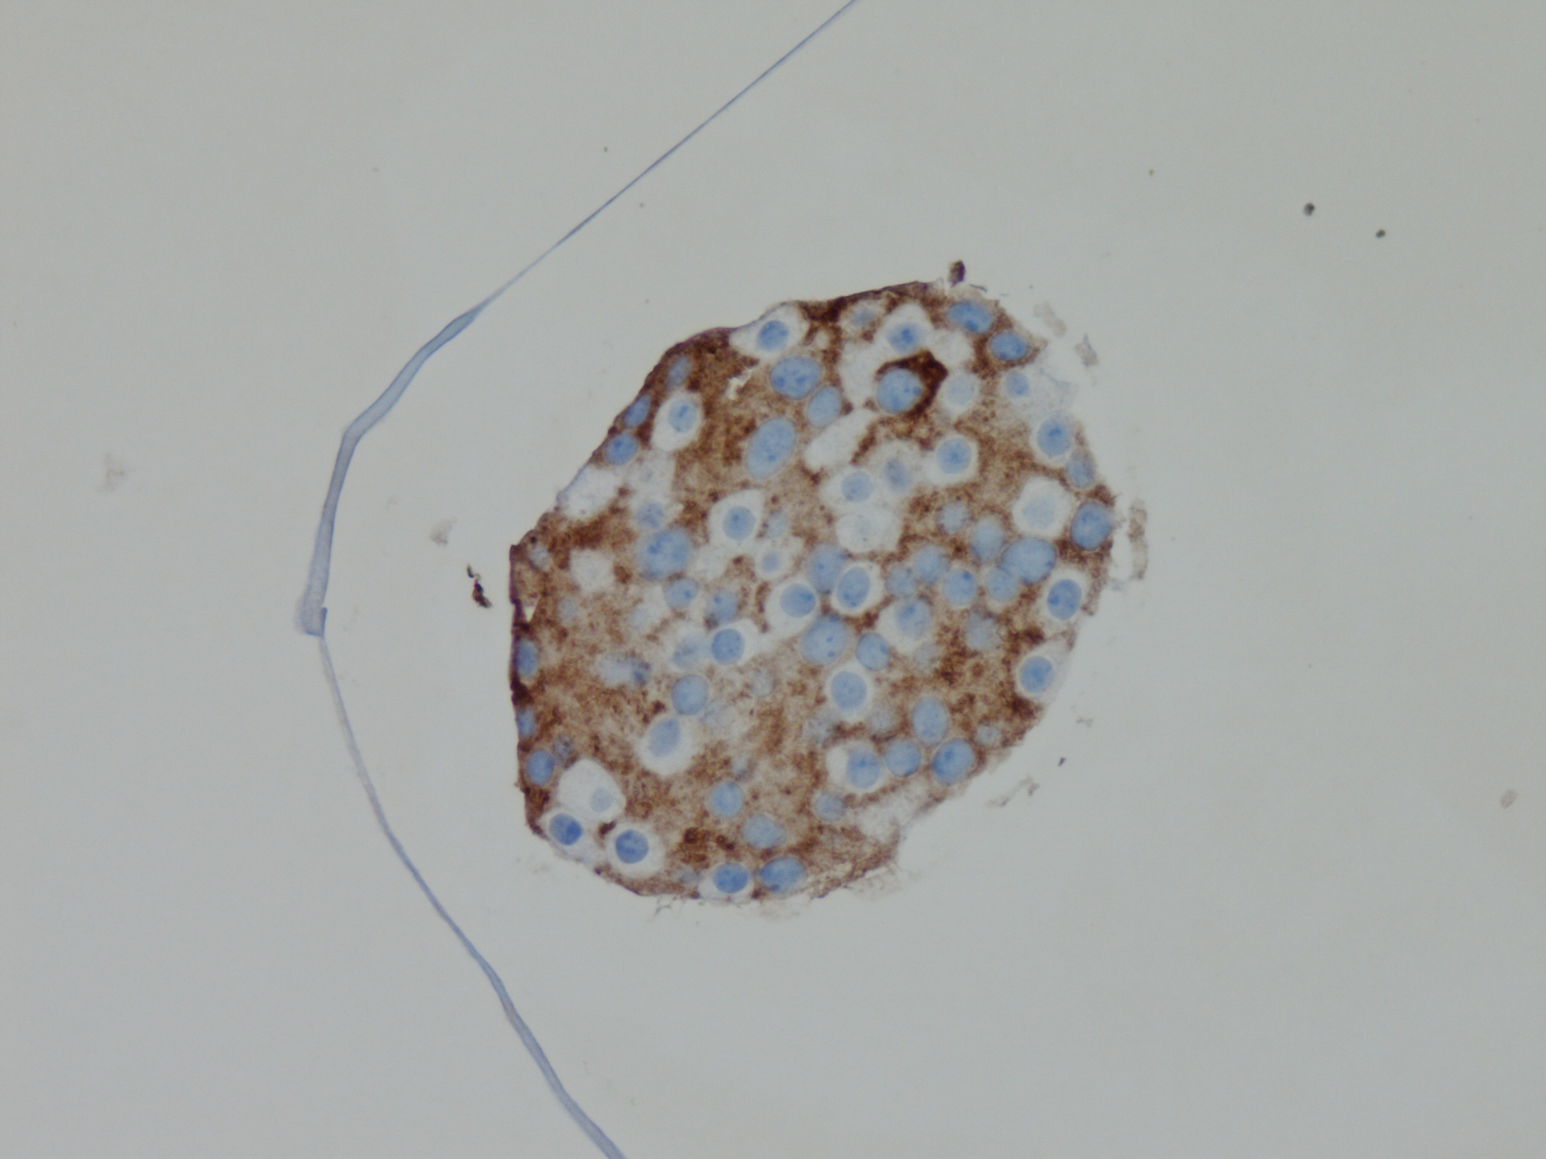
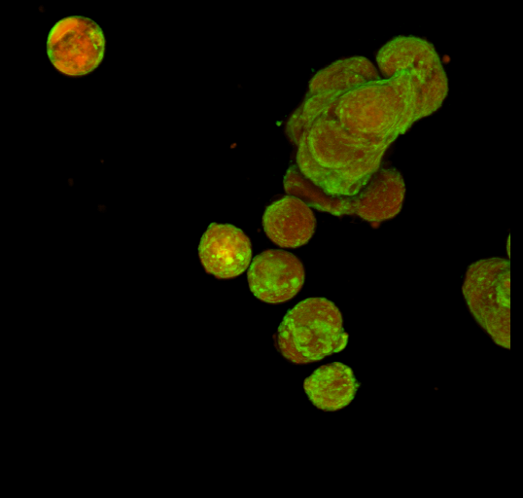
Biopolymers and biomaterials: Tailoring functional and
mechanical properties for use in tissue engineering
Study of polymer grafting (degree of substitution, side products, etc)
Chemical modification
Epimerization
Study of polymer structure (composition, block structure, molecular weight, etc)
Caption:
mannuronan
gelling zones
Functional
sequence
Ionic gel fomation
Study of biomaterial mechanical properties (syneresis, gel strength, stability, permeability, etc)
gelling ion
Cells
Study of cells (viability, morphology, function, etc.)

Slide 14
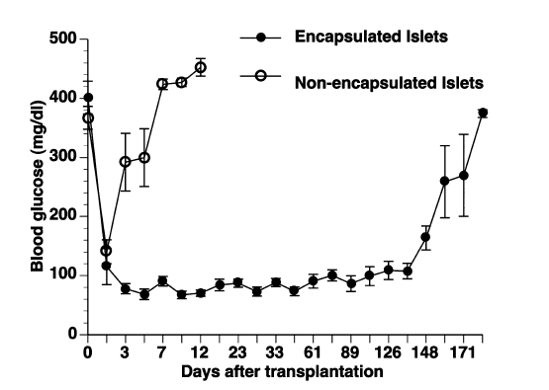
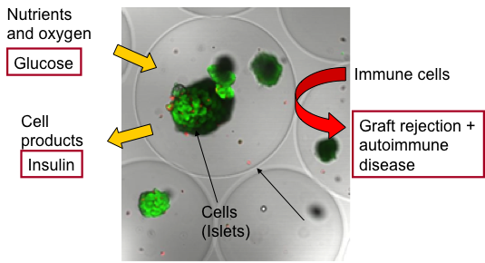
Alginate capsules - immune protection of insulin producing cells for the treatment of Type 1 diabetes

Slide 15
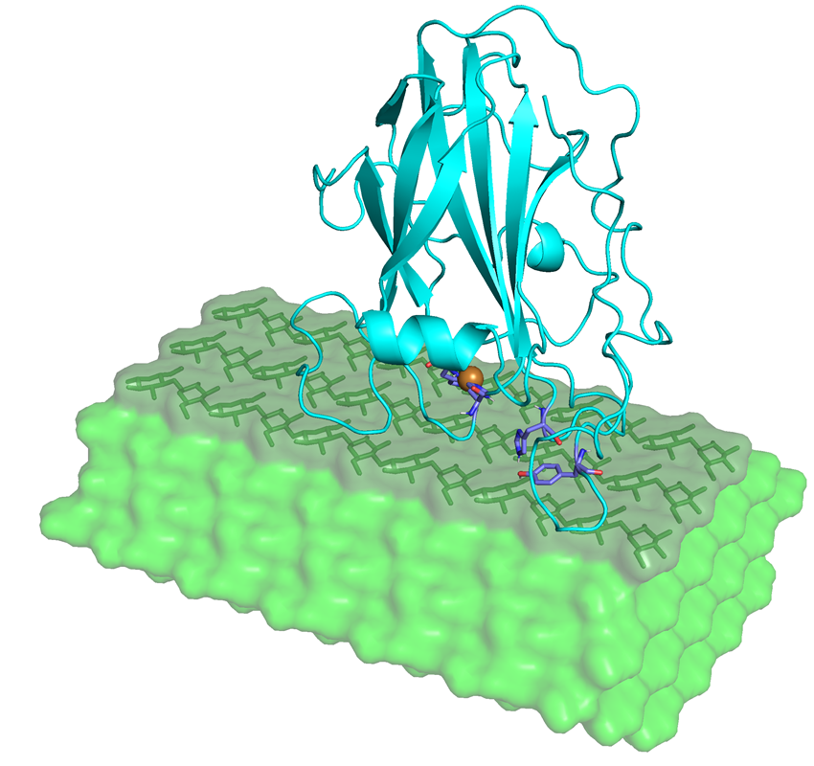
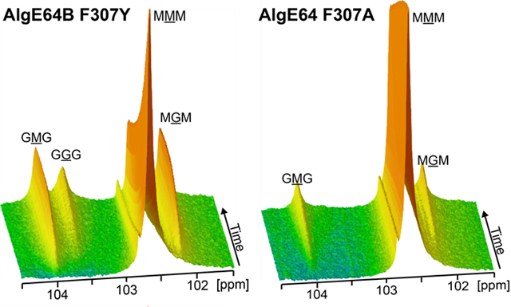
Enzyme – biopolymer interactions
Alginate epimerases
Alginate lyases
Chitinases
Deacetylases
LPMO – Lytic polysaccharide monoxygenases

Slide 16

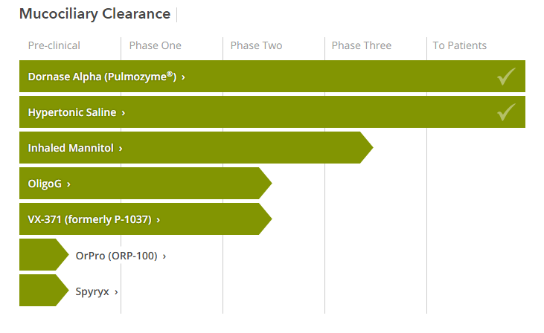

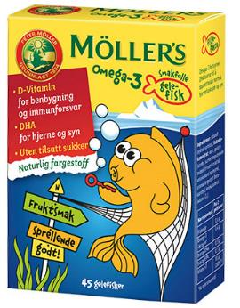
From lab bench to market novel dosage form and novel drug
Cystic fibrosis foundation drug pipeline

Slide 17
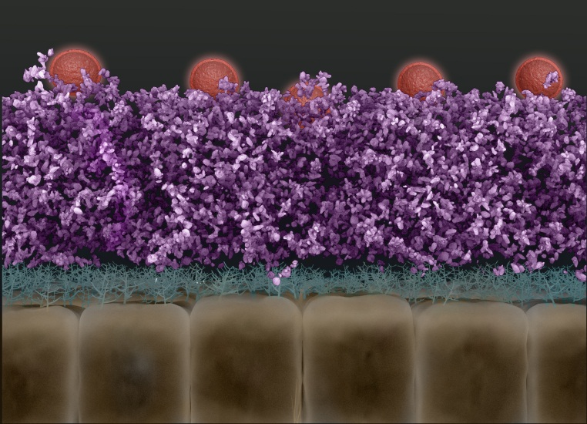
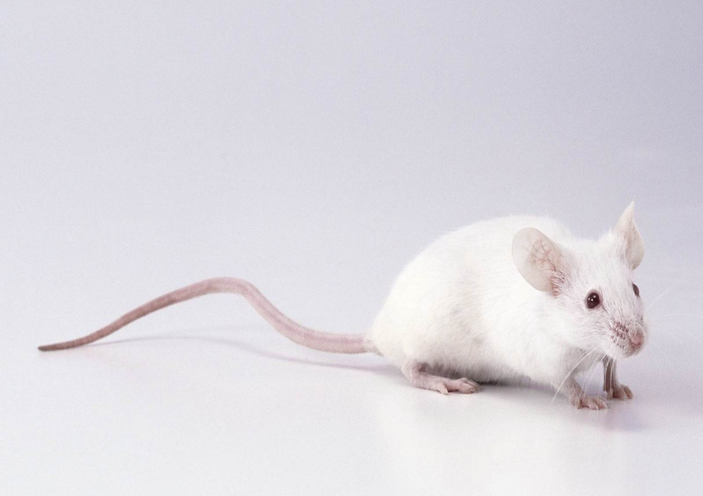
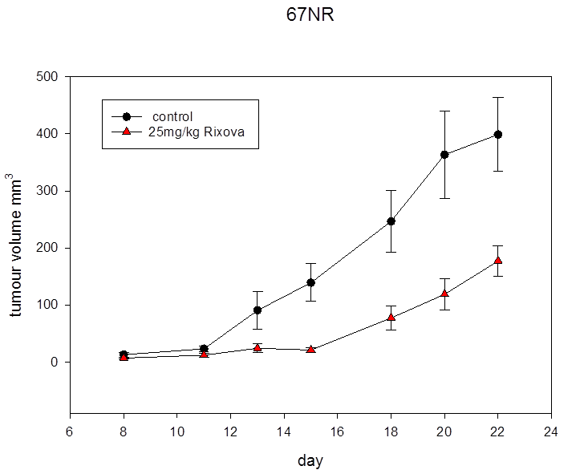
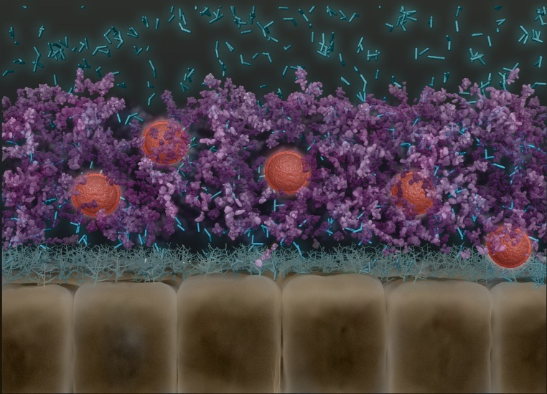
Pharmaceutical innovations mucosal delivery of nanomedicines and oncology applications

Slide 18
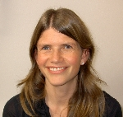

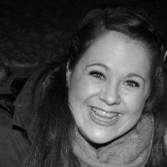
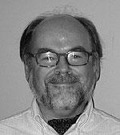
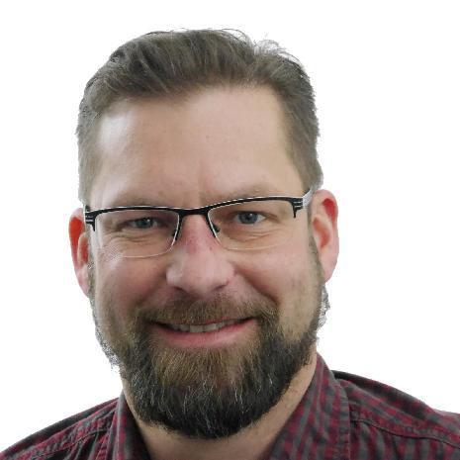
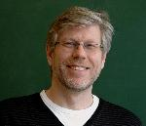
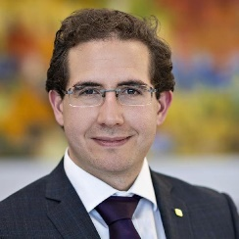
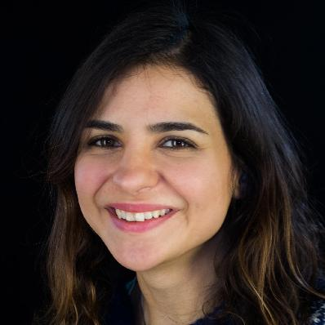


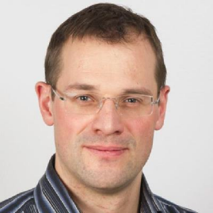
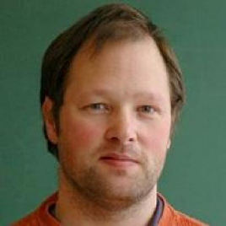
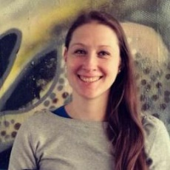
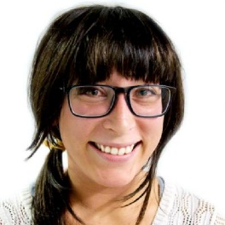
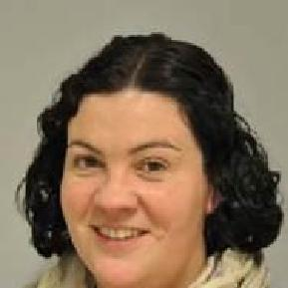
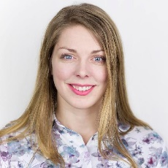
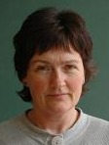

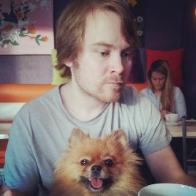
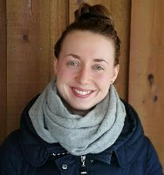
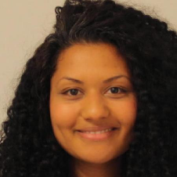

Biopolymer and Biomaterials - NOBIPOL
People
  4 professors
  2 adjunct professors/researchers
  4 post docs
  4 engineers
  11 PhD candidates
  10 – 15 MSc students
Collaborations
  NTNU Dept. of Cancer Research and Molecular Medicine, Dept of Physics,
  Sintef (Sintef Materials and Chemistry)
  Industry (FMC Health and Nutrition, AlgiPharma, Ayanda, etc.)
  Academia, Norway: NMBU, UiT, Nofima, ..
  International: University of Trieste, Italy; University of Illinois at Chicago,
  USA, Aarhus University, Denmark, etc..
+ + +
Notes:
Bjørn Erik Christensen: sette sammen blokk strukturer til nye polymere
Marit Sletmoen: interaksjoner mellom makromolekyler ved bruk av optiske pinsetter og AFM

Slide 19
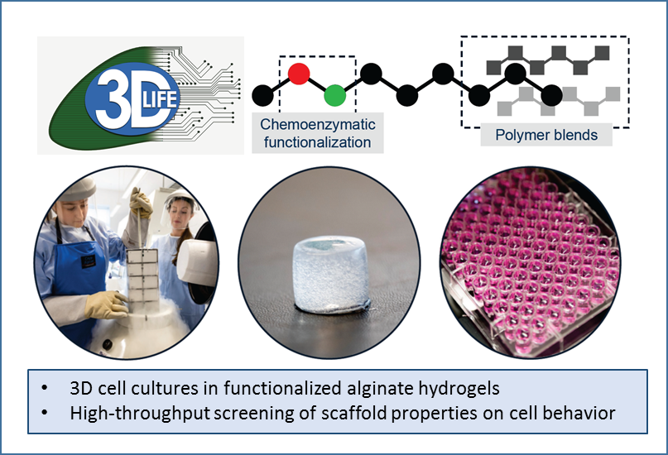
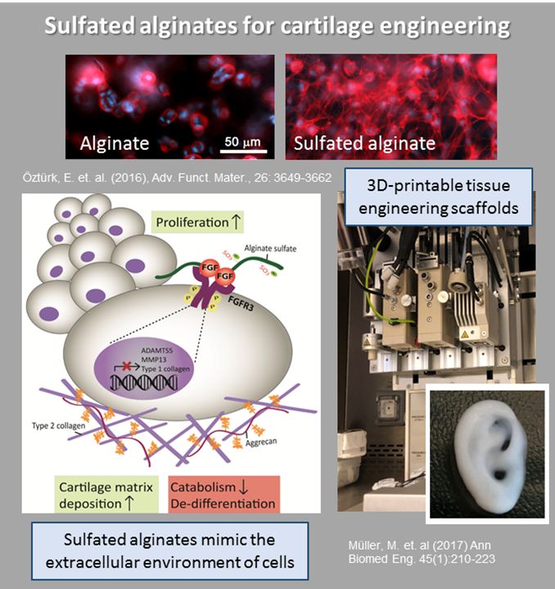
Biopolymer and Biomaterials - NOBIPOL
Projects
  EU projects
  Biotek 2021
  Norwegian Research Council: FriPro, ERA Net,
  Optimization
  NTNU funded projects (NTNU Biotechnology, SO funding)
  Industry
Infrastructure
  NMR
  Preparative and analytical
  colomns (SEC-MALS, HPADEC)
  Rheology
  ITC, Zeta sizer
  Optical tweezers
  AFM

Slide 20








The Norwegian Biorefinery Platform

Slide 21
Contacts
Berit L. Strand (berit.l.strand@ntnu.no)
Finn L. Aachmann (finn.l.aachmann@ntnu.no)
Bjørn E. Christensen (bjorn.e.christensen@ntnu.no)
Kurt I. Draget (kurt.i.draget@ntnu.no)
Catherine Taylor Nordgård (catherine.t.nordgard@ntnu.no)

Slide 22

Analysis and Control of Microbial Systems - ACMS
Professor Olav Vadstein (microbial ecology)
Professor Ingrid Bakke (environmental biotechnology)
Adjunct Assistant professor Kari J. K. Attramadal (aquaculture technology, 20%)
2 post.doc / researchers
10 doctoral students
12 – 16 Master students
Miljøbioteknologi:
Anvendelse av mikrobiologiske prosesser for å løse miljømessige problemer (f.eks. forurensinger), både i naturlige miljøer og i menneskeskapte økosystemer; typisk ved bruk av mikrobielle samfunn

Slide 23


Analysis and Control of Microbial Systems Group, NTNU, 2020
Left to right: Front row: Marthe Hafskjold & Erik, Charlotte Volpe & Raffaele, Sol Gomez de la Torre Canny, Ragnhild Olsen Fossmark, Vilde Årdal, Anne Helene Sandmark; Second row: Kathrine Obrestad, Leila Jafari, Annika Messemer, Thomais Tsoulia, Madeleine Gundersen, Eirik D Lorentsen, Ragnhild L Rong; Third row; Kjetill Østgaard, Randi Utgård, Alexander W Fiedler, Ingrid Bakke, Mathew K Avarachen, Martha KR Drågen, Olav Vadstein; Back row: Ragnhild I Vestrum, Tore Brembu, Marita Gresseth, Kari JK Attramadal, Rune Hatland, Amalie JH Mathisen; Not present: Sharada Navada, Stine Wiborg Dahle, Synnøve Lofthus, Hendrik Langeloh, Ann Isabel Carmo Rosvoll, Hugues Palandre, Ingrid E Harris, Daniel Wæge, Renate Sandberg, Jakob Pettersen, Sunniva I Gaarden, Elin Håberg

Slide 24




Research topics:
Foto: Tora Bardal
Microbial waste and water treatment
  Microbial biogas production systems
  Microbial conversion of ammonium and organic carbon (Recirculating Aquaculture Systems)
Microbial control/management in aquaculture
  How to create healthy microbial water quality
Fish/microbe – interactions
  Interactions between salmon fry and bacteria
  Bacteria free and gnotobiotic yolk sac salmon larvae
Microalgae as production organisms and raw materials
  Molecular analysis of synthesis of silica cell walls
  Microalgae as omega3 producers

Slide 25
Potential Master thesis topics:
Microbial conditions in production systems for the copepod Acartia tonsa
Adaption of a partial nitrification/anammox process to RAS conditions: mapping of chemical nitrogen conversions and biofilm microbiomes
Relationship between gut microbiota and fitness in the water flea Daphnia magna
Effect of mechanical washing of tank walls on microbial water quality in salmon farming
Correlation between microbiomes in RAS and water chemistry/fish welfare using supervised machine learning
Impact of different water treatment strategies (TiO₂-AOP, O₃, UV) on microbiomes and microbial loads in RAS
Optimization of Enhanced Biological Phosphorus Removal (EBPR) process for typical Norwegian conditions
Other topics?????
Capacity for work on algae is fully booked
Notes:
1. Monitoring microbiomes in RAS and on corresponding fish and correlating with water chemistry and fish welfare using supervised machine learning (Samples from full-scale RAS)
Targeted fish species: Atlantic Salmon, Arctic Charr, Yellowtail Kingfish, Seabream, Seabass
2. Impact of different water treatment strategies (TiO2-AOP, O3, UV) on microbiomes and microbial loads in RAS (experiments performed in mini-RAS at Sealab)
Targeted fish species: Atlantic salmon
“Optimization of Enhanced Biological Phosphorus Removal (EBPR) process for typical Norwegian conditions”
• Municipal wastewater treatment plant in Stavanger (IVAR).
• Challenges due to: low temp., low P and VFA, diluted wastewater, large concentration variations, plant configuration and sludge separation issues, etc.
• Most of the work can be done in our wastewater lab (Valgrinda).

Slide 26

Martin Wagner
Bioanalytical Toxicology Group
IBI, NTNU

Slide 27

Our research on plastic pollution
Ecological impacts
Societal change
Human health
Political action
Toxicity in biota
Circular economy

Slide 28

Some examples
HDPE
PET
PLA
HDPE
PS
PS
PET
Chemical analysis
PP
PP
PLA
PUR
LDPE
LDPE
PVC
PUR
In vitro bioassays
PVC

Slide 29

Some examples

Slide 30



Some examples

Slide 31

Martin Wagner martin.wagner@ntnu.no www.biotox.de
@martwagn

