Slide 1
Background:
ECONOMY

Slide 2
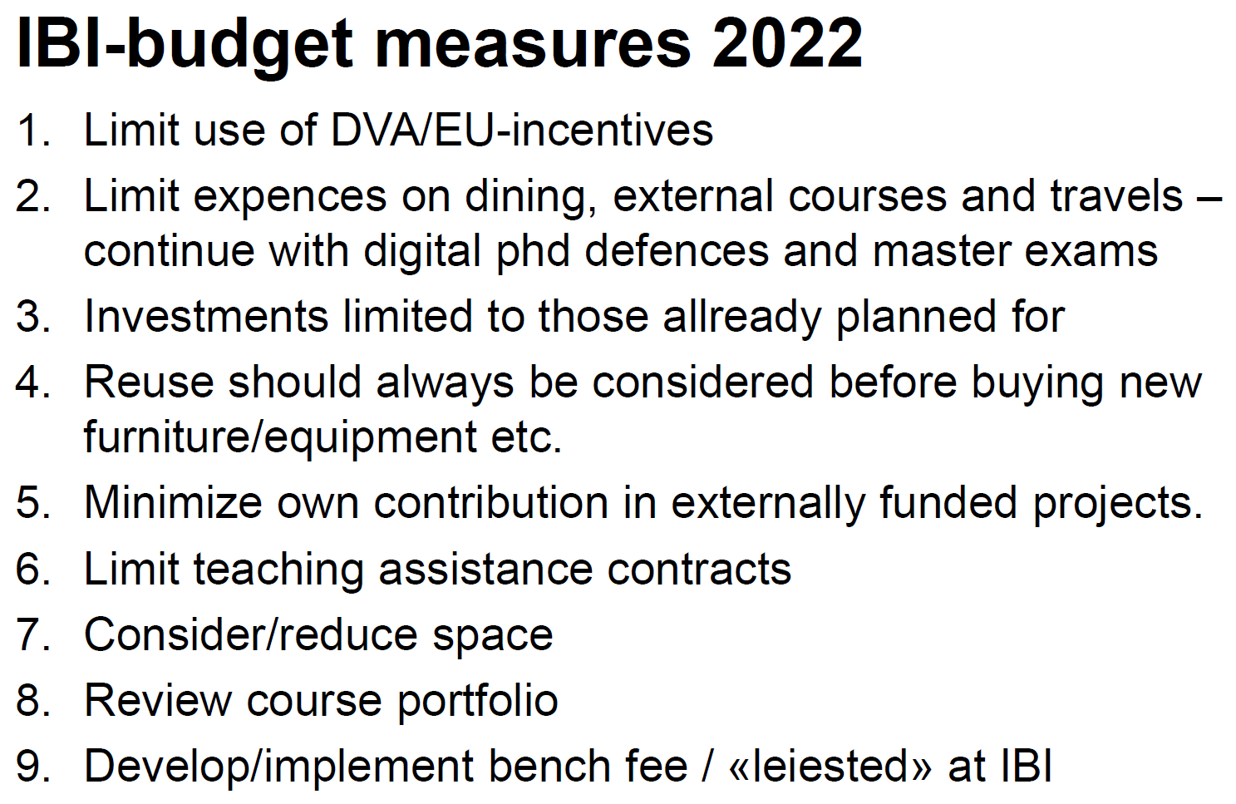

Slide 3
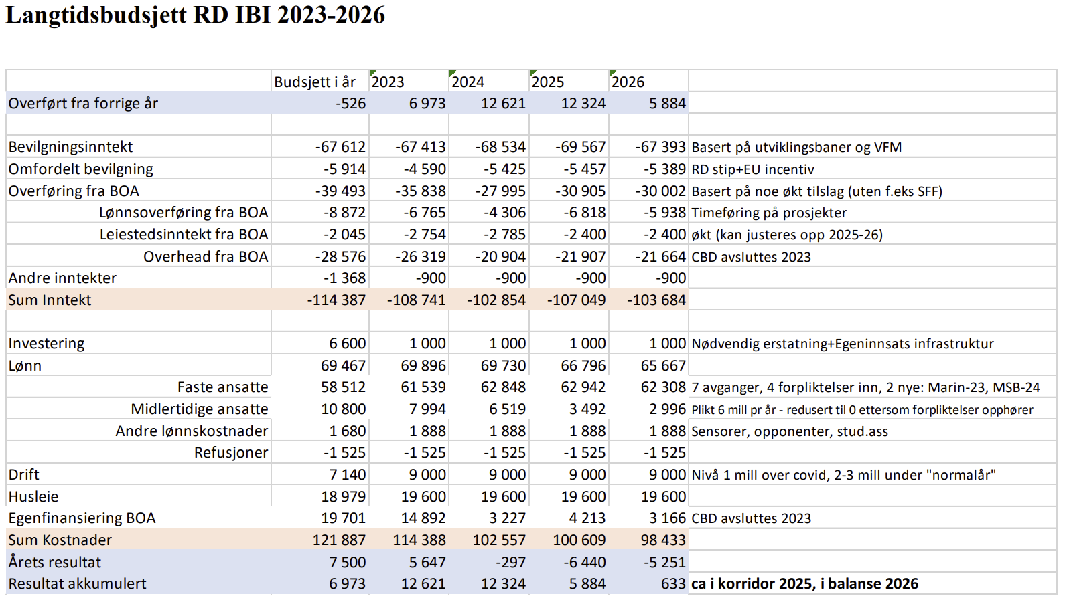

Slide 4
Consequence 1 – Teaching assistance
Only internally financed phds (SO- and RD-) will have a fourth year for teaching assistance
Estimated TA-hours:
2022 | 2026
15 400 | 5 000(?)

Slide 5
Consequence 2 – Permanent staff
Retire/leave -1
New hire +1
 | 2022 | 2023 | 2024 | 2025 | 2026
CBD |  |  |  | -1
Celle/mol.
Marin | -1 | -1 +1
MSB |  | -1 | -1 +1
Fysiologi
Envi.tox. |  | -1

Slide 6
Conclusion
Reduced number of TAs and professors
reduced teaching capacity
Solution?

