Slide 1
Faculty of Economics and Management
Subtitle

Slide 2
Who are we?
A faculty of economics and business with a technological profile
Innovation and entrepreneurship
One of the most popular business administration educations
A department of economics with particular strenghts in research
Approximately 3500 students
Competitive admission to our programmes
Attractive graduates with a very high employability rate

Slide 3
HF
AD
IE
IV
MH
NV
SU
OK
VM
Faculty of Economics and Management (OK)
NTNU Business School
Department of International Business
Department of Industrial Economics and Technology Management
Department of Economics

Slide 4
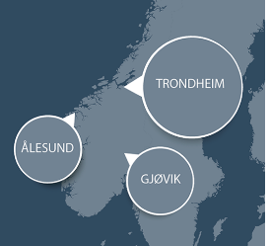
Our departments
NTNU Business School
Department of International Business
Department of Economics
Department of Industrial Economics and
Technology Management

Slide 5
Department of International Business
30 employees
22 academic staff
4,5 adminitrative staff
4-6 PhD-candidates
550 students
4 programmes of study in
Business Administration
Marketing and Management
Campus Ålesund

Slide 6
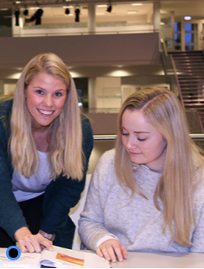
NTNU Business School
100 employees
10-15 PhD-candidates
7 adminstrative staff
1200 students
5 programmes of study in:
Business Administration
Accounting and Auditing
Management of Technology
PhD in Management Accounting and Control

Slide 7
Department of Economics
19 employees
16 academic staff
3 administrative staff
10-15 PhD-candidates
500 students
6 programmes of study in
Economics
Political Economics
Financial Economics
PhD in Economics

Slide 8
Department of Industrial Economics and Technology Management
130 employees
80 academic staff
14 administrative staff
40-50 PhD-candidates
1200 students
5 programmes of study in
Industrial Economics and Technology Management
NTNUs School of Entrepreneurship
HMS
Project Management
Logistics
Business Administration and Management
PhD in Industrial Economics and Technology Management

Slide 9
Continuing and further education
Programmes of study:
Master in Technology Management
Master in Public Administration
Provide specialization profiles to:
Master of Management
A large porfolio of individual courses

Slide 10
Research
The researchers works in close collaboration with the industry and the business community
A strong focus on innovation and entrepreneurship
A strong international orientation

Slide 11
Research areas
Energy transition, energy markets and energy policy
Natural resources, environmental and development economics
Circular economy and sustainable business models
Public economics
Maritime transport optimization

Slide 12
Centres for Environment-friendly Energy Research (FMEs)
CensES - Centre for Sustainable Energy Studies
CINELDI - Centre for Intelligent Electricity
HydroCen - Norwegian Centre for Hydropower Technology
MoZEES - Mobility Zero Emission Energy Systems
NCCS - Norwegian CCS Research Centre
ZEN - The Research Centre on Zero Emission Neighbourhoods in Smart Cities

