Slide 1
Survey of bullying and harassment at NTNU
Carried out Spring 2019
Notes:
The University of Agder and the University of Oslo have been responsible for carrying out the survey. The survey was made in collaboration with the polling agency Ipsos.
8702 NTNU employees were invited to participate in the survey via e-mail. 3423 employees have responded (equals 40 %)

Slide 2
Crucial finds from the survey From the report ‘Bullying and Harassment at the Norwegian University of Science and Technology’
‘In current employment over the past 12 months’
12 % report bullying or harassment
1,8 % report sexual harassment
4 NTNU staff members have experienced sexual abuse
4 out of 10 do not know where to find information on reporting
Further reading:
Announcement at Innsida 22.08.19
Bullying and harassment at universities and colleges (PDF)
Bullying and harassment at the Norwegian University of Science and Technology (PDF)
Notes:
The numbers from the survey are disturbing, most of all for the victims themselves, but also for the working community.
Working at NTNU should be safe. Every staff member at NTNU should have a safe working environment.
Compared to the national results, NTNU does not stand out in particular. This does not diminish the graveness of the results.
BULLYING OR HARASSMENT
12% report having suffered bullying or harassment in their current employment over the past 12 months. The corresponding number from the national survey is 13%.
The questions concerned bullying or harassment that may have taken place in current employment over the past 12 months.
Definitions from the survey:
‘Harassment is when a person is subjected to unwanted negative actions, omissions or utterances that seem, or are intended to seem, offensive, frightening, hostile, degrading or humiliating. This may occur verbally, physically, digitally or socially. Many people may experience various forms of reprehensible actions, but to qualify as bullying they must occur repeatedly and over a span of time.’
SEXUAL HARASSMENT
1,8% report having been subjected to sexual harassment in their current employment at NTNU over the past 12 months, compared to 1,6 % in the national survey.
Research fellows are relatively speaking the group that most frequently reports experiencing sexual harassment, according to the national survey ‘Bullying and Harassment in Universities and Colleges (PDF)’.
The survey defines sexual harassment as follows:
‘Sexual harassment is when a person is subjected to unwanted sexual attention perceived as offensive, frightening, hostile, degrading, humiliating or bothersome.’
SEXUAL ABUSE
4 staff members at NTNU report having been subjected to sexual abuse. This is 4 too many. 9 staff members state that they do not know or are uncertain whether their experiences quaify. This is a very serious matter that should not occur. It is important to emphasize that those who have been victims of a criminal offence should file charges with the police. If prior to this they are in need of an informal and non-committal conversation about the occurence, they may contact the HR and HSE Division.
The question regarding sexual abuse was formulated as follows:
‘Have you, in the course of the past 12 months in your current employment, experienced that someone has achieved sexual intercourse with you through the use of violence, or have you felt forced, threatened or pressured into having sexual relations?’
The wording of the question is similar to the Norwegian penal code’s article 291 a-c, which refers to the offence as sexual assault.
REPORTING
4 out of 10 are unaware of where to find the NTNU reporting system. Relatively few report objectionable behaviour.
How many report?
2 out of 5 of those who have been bullied or harassed have reported objectionable behaviour towards themselves in their current employment over the past 12 months.
1 out of 4 of those who have been bullied or harassed have reported objectionable behaviour towards others.
.
The questions relate to bullying and harassment that may have taken place in your current employment over the past 12 months.
Harassment is when a person is subjected to unwanted negative actions, omissions or utterances that seem, or are intended to seem, offensive, frightening, hostile, degrading or humiliating. This may occur verbally, physically, digitally or socially.
Many people may experience various forms of reprehensible actions, but to qualify as bullying they must occur repeatedly and over a span of time.

Slide 3
NTNU has a zero tolerance policy towards all forms of harassment and other abuses of power. NTNU should be a safe place to work or study.
To process specific cases, employees must report the situation they have been subjected to or witnessed to their employer.
All NTNU employees have a duty to report such behaviour if witnessed or brought to their knowledge.
Notes:
The numbers from the survey are disturbing, most of all for the victims themselves, but also for the working community. Working at NTNU should be safe. Every staff member at NTNU should have a safe working environment.
Because repondents to the survey are anonymized, specific single cases cannot be taken further. Therefore, it is important that staff members report if they themselves have been subjected to anything, or if they have witnessed inappropriate behaviour.
If you require an informal and non-committal conversation, you may contact the HR and HSE Division, union officials or the Directorate of Labour Inspection.
§ 2-3. Employees’ obligation to cooperate (2) An employee must:
d) ensure that employer or safety representative is informed immediately if the employee gains knowledge of harassment or discrimination in the workplace.

Slide 4
How to inform your employer of inappropriate behaviour
Informing one’s employer normally entails alerting one’s immediate superior.
If the employee for some reason is distrustful of their immediate superior, their next-level superior may be alerted, or, in rare cases, the HR/HSE director.
Another option is alerting the safety representative. If the safety representative happens to be a ‘too close’ colleague, the chief safety representative can be contacted.
Notes:
Managers should emphasize the following:
Strongly encourage your staff to inform you or their immediate or next-level superior if they experience or witness bullying, harassment or sexual abuse.
If employees approach you/immediate superior to report experiencing or witnessing inappropriate conduct (such as bullying or harassment), they must be treated with respect and taken seriously.
Manager is bound by duty to investigate
The case must be handled confidentially and with immediate response.
HR and HSE director in certain special cases (E.g. if the employee is distrustful of their immediate superior, or special considerations must be made regarding anonymity, possibly fear of retaliation)
Employer, superior, safety representative. If you report to your employer (immediate superior, other superior, HR and HSE director) or safety representative, they are bound by duty to respond. The Working Environment Act ensures that they all have an obligation to act. When the employer is notified, the obligation to act comes into effect, and the immediate superior is responsible for the formal handling of the case. Please note that safety representatives (as opposed to union representatives) are obliged to inform the employer by their statutory duty to cooperate if they are alerted to such cases.
It is IMPORTANT to emphasize that victims of a criminal offence should report this to the POLICE.
Approaching the party involved
In some cases, it may be wise to approach the culpable party directly, to resolve the issue quickly and at the lowest possible administrative level. The employee must make a personal assessment of the nature and severity of the case. Please note that your employer/NTNU does not expect you to handle such cases on your own.

Slide 5
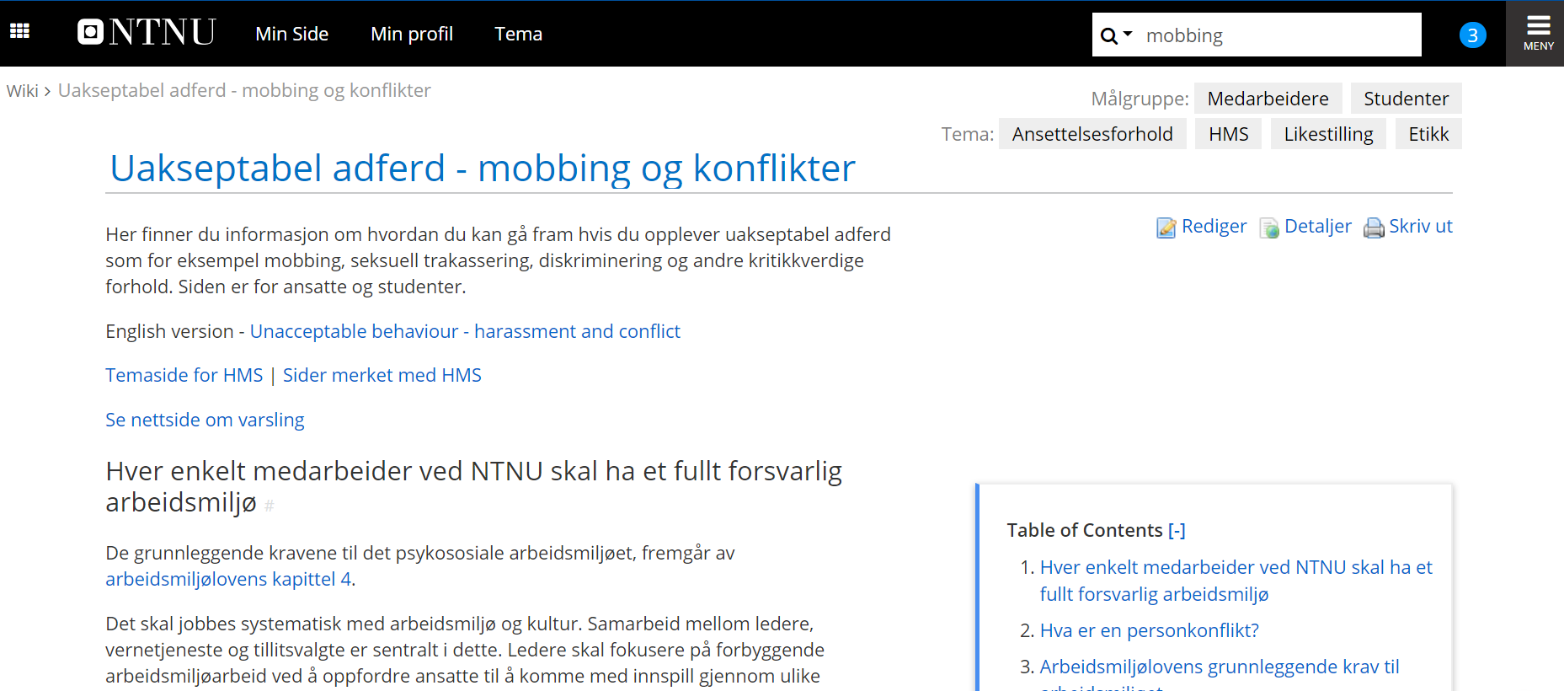
Lenke: https://innsida.ntnu.no/wiki/-/wiki/Norsk/Uakseptabel+adferd+-+mobbing+og+konflikter
Notes:
Knowing how to proceed if you have experienced unacceptable behaviour in the workplace can be hard.
Here you can find information on how to proceed if experiencing unacceptable behaviour such as bullying, sexual harassment, discrimination or other reprehensible occurences. The page is available to staff and students.
You can find the page by for instance typing ‘bullying’ into the search field.
Link: https://innsida.ntnu.no/wiki/-/wiki/Norsk/Uakseptabel+adferd+-+mobbing+og+konflikter

Slide 6
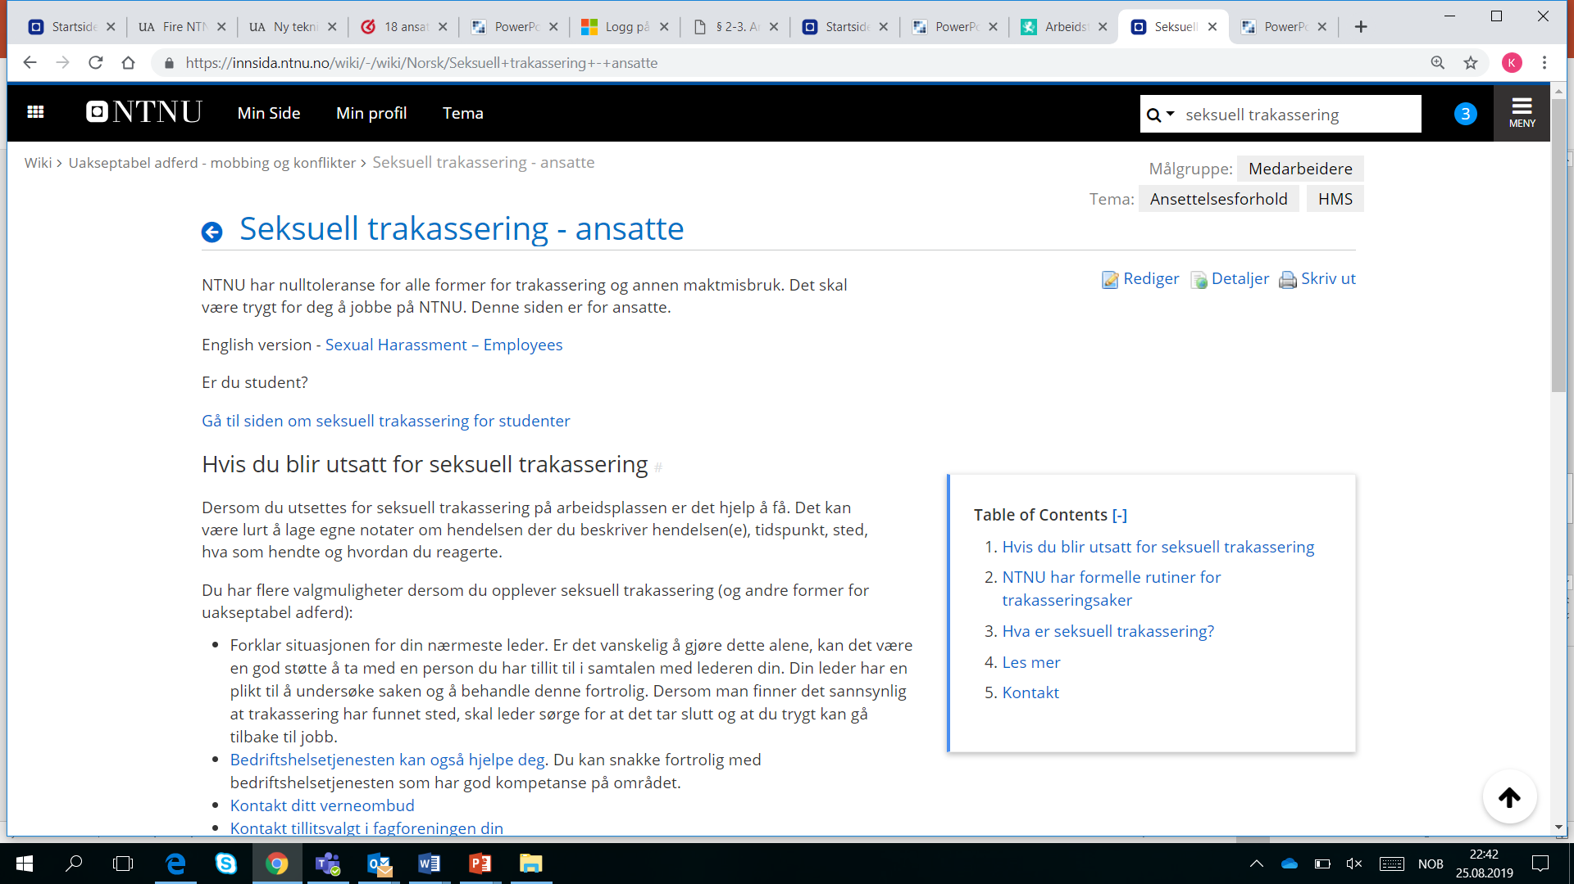
Lenke: https://innsida.ntnu.no/wiki/-/wiki/Norsk/Seksuell+trakassering+-+ansatte
Notes:
You can find the page by for instance typing ‘sexual harassment’ into the search field.
A separate channel for reporting sexual harassment is launched in September 2019.
There is also a separate page on reporting inappropriate behaviour. It can be accessed by searching for ‘reporting’ or ‘whistleblowing’ in Innsida.
https://innsida.ntnu.no/wiki/-/wiki/Norsk/Varsling#section-Varsling-NTNUs+oppf%C3%B8lging+av+varslingssaker

Slide 7
If you require a confidential and informal conversation, you can contact:
HR and HSE Division (BHT)
Your union representatives
Lawyer, doctor, psychologist or other professional with duty of confidentiality to confide in
The Labour Inspection Authority
Note: All of these are bound by duty of confidentiality
Notes:
All of these can be approached in confidentiality. They can also provide advice on your best course of action and how to proceed (process).
The HR and HSE Division (BHT) is a free and independent service where NTNU employees can og for advice. BHT is not bound by the employer’s authority to issue instructions and is obliged to confidentiality. For the HR and HSE Division, this entails acting as a neutral party in handling matters of personal conflict, harassment, inappropriate conduct etc. The HR and HSE Division may also be contacted if you are in doubt as to what you have experienced is something that must be accepted in a workplace or not (i.e. whether what you have experienced/witnessed gives sufficient grounds to notify your employer).
Union representatives. Union representatives have a duty to safeguard the interests of their members, and frequently act as mediators in such cases. Union representatives are not bound by the employer’s authority to issue instructions when assisting union members.
Lawyers, doctors, psychologists, etc. with a statutory obligation to confidentiality may be approached by the individual. As a rule, NTNU does not cover expenses for such assistance unless initiated by the employer.
The Norwegian Labour Inspection Authority can provide general information in matters of conflict. Further reading on the Labour Inspection Authority’s page on psychosocial workplace matters.
---------------------------------------------------------------------------------------------------

Slide 8
The way ahead
NTNU is working continuously to provide staff and students with a good working and study environment where no-one is subjected to bullying, harassment, sexual abuse or other inappropriate behaviour.
A separate channel for reporting sexual harassment is launched in September 2019.
Psychosocial factors in the workplace are reviewed biannually through the Workplace Environment Survey, distributed by e-mail November 4.
What issues exist in our unit regarding culture and improving the workplace environment? How do we want things to be?
Notes:
Thinking in the long term – our most crucial priority is working systematically to develop a workplace environment and culture that leaves no room for unacceptable behaviour – we also want to forge ahead in preventive workplace environment improvements by placing workplace environment on the agenda on a regular basis to identify challenges and take the necessary steps at an early stage.
Managers are encouraged to raise issues relating to this theme. This is an opportunity to pose questions such as:
-How do we want things to be in our workplace?
-What is acceptable behaviour? How do we treat each other?
-What is required to make everyone feel good and safe?
-Are there adjustments needed to ensure that everyone feels safe and has a proper workplace environment?
Make the workplace environment and work a recurring theme in staff meetings and everyday exchanges.
…………………………………………………………………………………………………………………………………………………………………………………………………………………………
The Workplace Environment Survey and the system surrounding it accomodates working continuously with workplace environment improvements on a unit level. Seize the opportunity. (Distributed November 4. Follow-up process in Winter 2020).
What issues exist in our unit regarding culture and improving the workplace environment? – and ensuring that everyone feels safe in the workplace? – Encourage suggestions from employees, either at staff meetings or approaching you/their immediate superior afterwards. It is important that the employees themselves provide the manager with suggestions for needs and wishes. They can also contact the safety representative regarding culture and workplace environment improvements.

