Slide 1
Course Coordinators
Course Evaluations – Student Evaluations and Course Reports in KASPER
Knowledge for a Better World
Notes:
Hello and welcome to the module for course coordinators in KASPER.
//Introduce yourself. Discuss good practice for the meeting: muted microphone, hand-raising, using the chat, etc.
//Explain that the course will cover the practical use of KASPER as a tool.

Slide 2
KASPER
A digital process tool used to assist employees in quality assessment work
The tool is used in quality assurance and study planning work
The idea is to consolidate development, revision, and quality assurance work in one place at both the course and study programme level
Notes:
KASPER is NTNU’s process tool, designed to help employees in quality assurance work. The tool is used for both quality assurance and study planning. The idea is to consolidate the work of developing, revising, and assessing the quality of both courses and the study program as a whole. KASPER was implemented for use by all employees in course evaluations starting in Autumn 2020.
//Ask the participants: “Has everyone here used this tool before?”

Slide 3
Course Evaluations
Course evaluations are a continuous process that take place throughout the entire implementation of a course. You can and should start the evaluation process from the very first teaching activity – At the start of the semester
The course coordinator is responsible for the evaluation, but works with students and other relevant persons in e.g., reference groups
The course report that is ultimately submitted forms the basis for the annual revision of the course (EpN)
A survey of all students taking the course should be held at least every third time.
Notes:
Course evaluation is a continuous process that may be carried out throughout the entire course’s implementation. In KASPER, you will have the opportunity to start the evaluation process from the very first lecture activity at the beginning of the semester. We recommend starting as early as possible, as this will make it easier to include important details.
The course coordinator is responsible for the evaluation, but works together with students, as in the reference group, along with other contributors.
Note: In most cases, student evaluations will be carried out through reference groups and their respective reports. We will also discuss the possibility of adding feedback based on other forms of student evaluations in the course evaluation.
The course evaluation that is ultimately delivered forms the basis of revisions that are carried out annually in EpN (this is an acronym for “emneplanlegging på nett”, or “online course planning”).
NB: Please note that a survey of all students taking a course must be performed at minimum every third time the course is held, to ensure that an accurate representation of the student body is obtained. This is in addition to the regular reference groups or other student evaluations that are carried out at every iteration of the course.

Slide 4
Today’s Agenda
Getting Started
Part 1: Student Evaluations
Other forms of student evaluation
Reference Group
Setting Up Teams
Teams Tabs
Publishing a report
Student Certificates
Part 2: Course Report
Writing the Course Report
Course development plan
Database
The Study Quality Portal
Notes:
Here is the plan for today. This course will take roughly an hour and half. In theory, we should have plenty of time for questions throughout the meeting.
First, we will briefly introduce the tools that will be used for course evaluations, and where they can be found. After that, the module will consist of two parts:
In part 1, we will talk about how to set up student evaluations for a course. For those using the Reference Group method this entails creating a Teams Workspace that will be used to communicate with students and making sure it is set up for report submission.
Additionally, we will cover how to create and print certificates for students that have participated in the reference group. We will also talk about how to go about setting up other forms of student evaluations, and how they can be registered in KASPER.
In part 2, we will talk about writing and submitting a course report in KASPER. This entails creating a course development plan and adding a database to the report. We will also touch on where the reports end up and what they are ultimately used for.
//Remember to mention: Everyone should have received an email stating that the course is ready for evaluations and that they may set up a reference group as soon as the semester has started. Tell participants to speak with their institute contact if they are not able to set up a reference group.

Slide 5
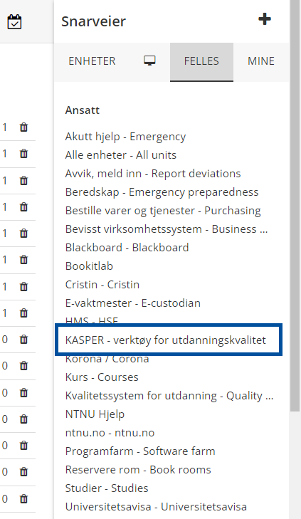
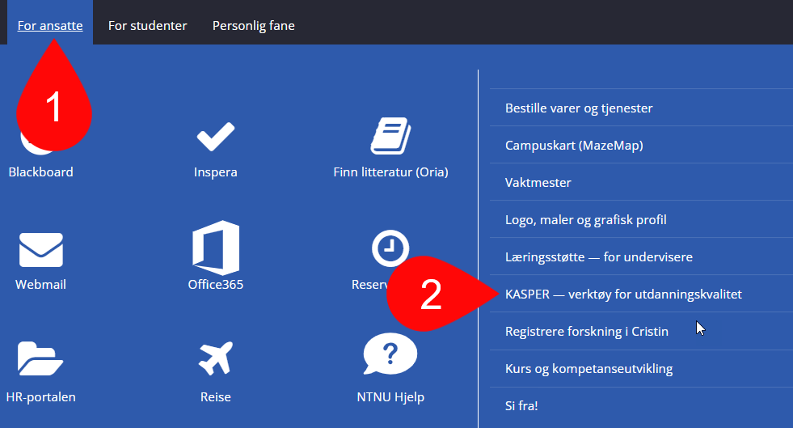
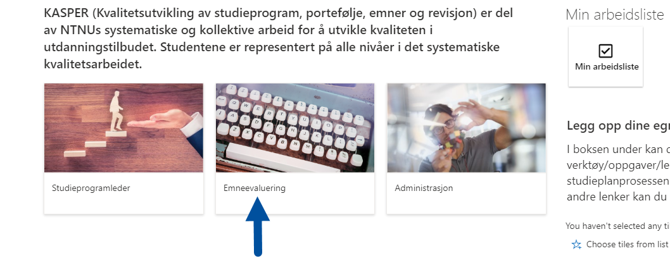
Getting Started
Log in on the main page in KASPER*
Links to the page can be found at Innsida
Navigate to the section entitled “Emneevaluering”
*https://studntnu.sharepoint.com/sites/studieplanlegging
Notes:
We will start by navigating to the main page in KASPER. The URL is https://studntnu.sharepoint.com/sites/studieplanlegging. At Innsida there are links to the tool both under the “For employees” tab, and the “Shortcuts” section.
It’s also possible to log in from the main page for KASPER wikis – https://i.ntnu.no/wiki/-/wiki/English/KASPER+-+Study+programme+management+system
By using any of these login methods you will be redirected to a page where you choose which level you are going to work at: “Studieprogramleder” [Study program coordinator], “Emneevaluering” [Course evaluations], or “Administrasjon” [Administration]. Most of what we will cover in this module is at the course level, but we will also look at the administrative tool “Bekreftelse til student” [Student certification].

Slide 6
Course Evaluation Tools
Here you will find the two most important modules for course evaluations: “Starte studentevaluering” [Start the student evaluation] (1) and “Skrive Emnerapport” [Write the Course Report] (2)
The evaluation process can be started from the first teaching activity at the start of the semester. For most, this will entail setting up a reference group
Notes:
After clicking “Emneevaluering” [course evaluation], you will be redirected to its respective page. Here you will find a short description of what can be done on this page, as well as an introduction to the two most important modules for course evaluations: “Starte studentevaluering” [Start student evaluation] and “Skrive emnerapport” [Write course report]. You may also click “Publiserte emnerapporter” to view earlier course reports in the student quality portal.
The evaluation process may be started as early as the first lecture activity at the beginning of the semester. For most, this will mean setting up student evaluations, most commonly using a reference group.

Slide 7
1. Student Evaluations
Notes:
We will first go through student evaluations, including both reference groups, as well as other forms of student evaluations. We will start by covering how to set up other forms of student evaluations before talking about how to set up reference groups and writing reference group reports in more detail. Are there any questions before we start with part 1?

Slide 8
Select a Course
When you click “Starte studentevaluering” you will find a list of all the courses for which you are a course coordinator
Select the course you wish to set up a student evaluation for (1)
For each course the table lists if an alternative form of student evaluation (2) or reference group (3) has been set up, as well as the report’s status (4)
Notes:
Clicking “Starte studentevaluering” [Start student evaluation], you redirect you to the page with the same name. Here you will see a list of all the courses for which you are designated as course coordinator (1). For each course, you will see if the student evaluation form is either some alternative form of student evaluation (2) or a reference group (3), as well as the current status of the report (4). Click the course you wish to register a student evaluation for.
If you are not able to find the course in question, speak with your institute administrator to get help.
Select the course you wish to set up student evaluation for by clicking the course name. A new window will pop up on the right-hand side.

Slide 9
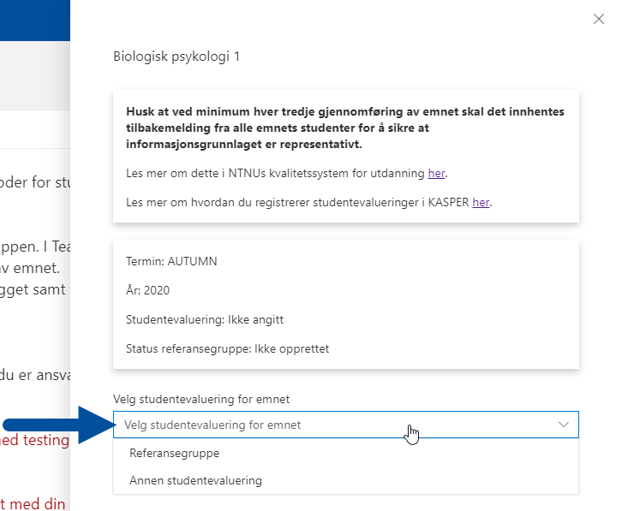
Select Student Evaluation Method
Use the drop-down menu to choose the student evaluation method for the course:
“Referansegruppe” [Reference Group]
“Annen studentevaluering” [Other student evaluation]
Note: If you have already set up a reference group in KASPER, it will not be possible to select another form of student evaluation
Notes:
In the box that pops up there is a drop-down menu where you choose the method of student evaluation: “Referansegruppe” [Reference Group] or “Annen studentevaluering” [Other student evaluation].
Note: If you have already set up a reference group in KASPER, it will not be possible to change to another method of evaluation later.
It is however possible to use both a reference group as well as another form of student evaluation. To do so, you must first set up a reference group as you normally would, and then add the other form of student evaluation to the course report as an extra item in the database. We will talk about how to upload things to the database later in the course.

Slide 10
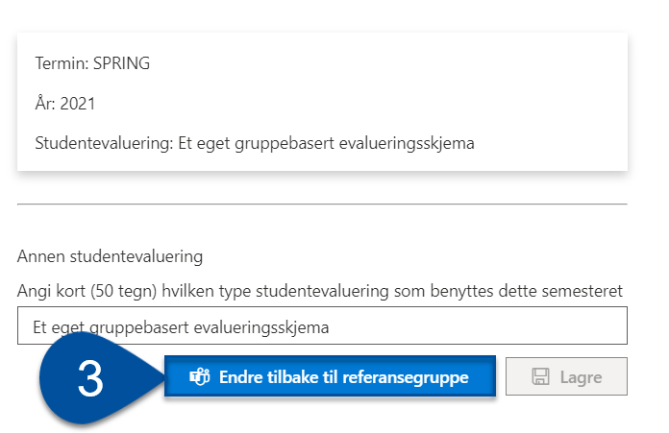
Other Student Evaluation
If you have selected another form of student evaluation, you must:
Fill in what type of student evaluation will be used for the course (max 50 characters) (1)
Then click “Lagre” [Save] (2)
If you change your mind and want to use a reference group after all, you can go back to this page and click “Endre tilbake til referansegruppe” [Revert back to reference group] (3)
Notes:
We will first speak briefly about how to register another type of student evaluation. When you have chosen this option, you must describe which type of student evaluation that will be used for the course, (in max 50 characters) (1) and then click “Lagre” [save] when you are finished (2).
If you change your mind and wish to use a reference group after all, you may go back to the page and click “Endre tilbake til referansegrupper” [Change back to reference group].
It’s important to remember that documentation of the other form of evaluation must be manually uploaded to the course report.

Slide 11
Reference Group
Notes:
We will now go into more detail on setting up a reference group and publishing a reference group report. We will start by going over how to set up a reference group, and for this, we start by selecting the “Rreferansegruppe” [Reference group] option in the drop-down from the previous slide.

Slide 12
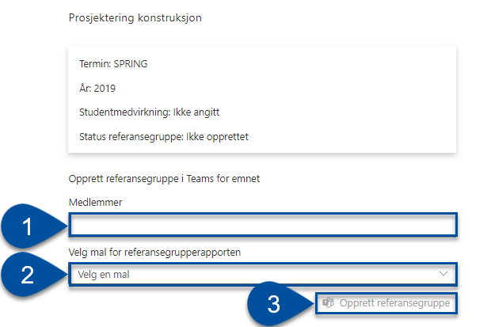
Setting Up a Reference Group
Here you must:
Enter the "medlemmer" [members] of the group (1)
Select a "mal" [template language] (2) for the report
And finally click “Opprett referansegruppe” [Set Up Reference Group] (3) when you are finished
Notes:
In the window that pops up, you will need to enter the students that are part of the reference group and the “Mal” (template language) that you will use for the report.
When adding students, you can choose to either search by name or by the student’s email address. For the latter option, use the following email format: username @ stud.ntnu.no.
When you have filled this out, click “Opprett referansegruppe” [Set up reference group].
NB: You do not need to add yourself. The person creating the reference group will automatically be added as owner of the Team.

Slide 13
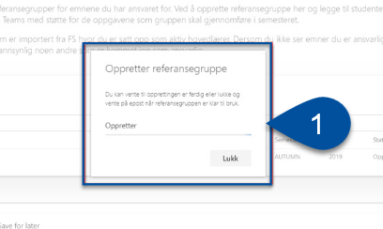
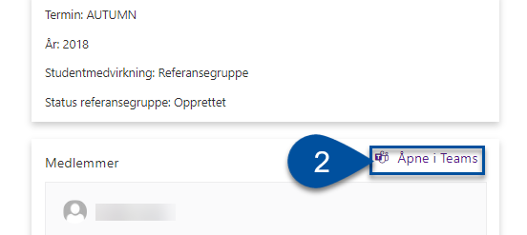
Setting Up Teams
After you have clicked “Opprett” [Set Up], a dialogue box will appear (1), notifying you that the process of setting up a Teams Workspace for the group has begun
When the Workspace has been set up, it will appear in Teams and its members will receive an email notification
It is also possible to open the room from within KASPER (2)
Notes:
After you have clicked “Opprett referansegrupper”, a dialogue box will pop up, indicating that the process of creating a Teams workspace for the group has started. You may close this. When the Team has been set up, it should appear in your Microsoft Teams app, and the members will receive an email notifying them of this via email. This usually only takes a few minutes.
For the course coordinator there is also a link to open the Team from the KASPER page (2).
If the Team has not appeared in your app within a day, send us a request in NTNU Hjelp.

Slide 14
The Reference Group in Teams
Microsoft Teams should already be pre-installed as a part of Office365 if you are using a work PC. It can also be found in the Software Center
To learn more about this, you can read our wiki on Office365 – Teams*
If your students need help using Teams, you can direct them to the wiki on Reference Groups for Students**. This wiki will help them in getting oriented with and using Teams.
*https://i.ntnu.no/wiki/-/wiki/English/Office+365+-+Teams
**https://i.ntnu.no/wiki/-/wiki/English/KASPER+-+Reference+group+tool+-+for+students
Notes:
On your work PC, Teams should already come pre-installed as a part of Office365. If you don’t have it installed yet, you can find it in the software center.
To learn more about using Teams, read our wiki on Office365 – Teams.
If your students need help as well, you can direct them to the Reference Group for Students wiki. This wiki explains how they can get themselves oriented in Teams.

Slide 15
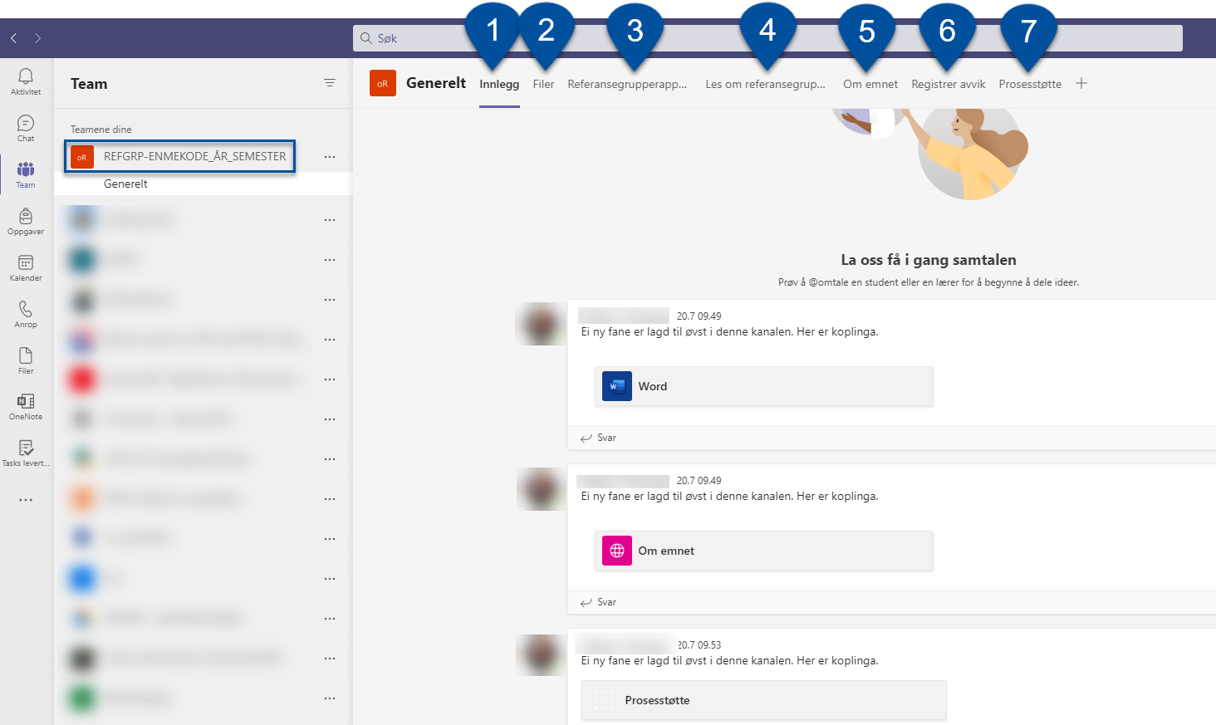
Teams Tabs
The Workspace name is: REFGRP_CODE_YEAR_SEMESTER
The “General” channel has the following tabs:
Innlegg [Posts] (1)
Filer [Files] (2)
Referansegrupperapport [Reference Group Report] (3)
Les om referansegruppe [Read more about Reference Groups] (4)
Om emnet [About the Course] (5)
Registrer avvik [Register Deviations] (6)
Prosesstøtte [Process Support] (7)
Notes:
When the Team has been set up, you will find it in your list as shown in the picture. It will have a standardized name of the form “REFGRP_COURSECODE_YEAR_SEMESTER”, and usually appear at the bottom of the list.
The Team will have a “channel” called “General” and there will again be tabs within this channel. Many of these tabs are primarily oriented towards students in the reference group, but we will take a brief look at all of them in this course.
However, the one tab is the most important for you as a course coordinator is the tab called “Prosesstøtte” [Process Support]. This tab is used by both you and the students to submit the reports. We will talk about this tab in a little more detail shortly.
We will now go through the main tabs.

Slide 16
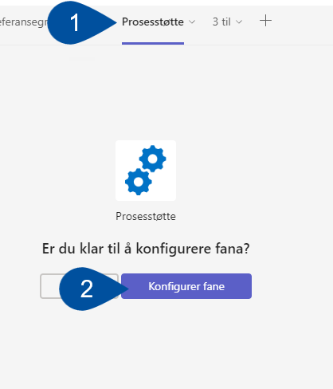
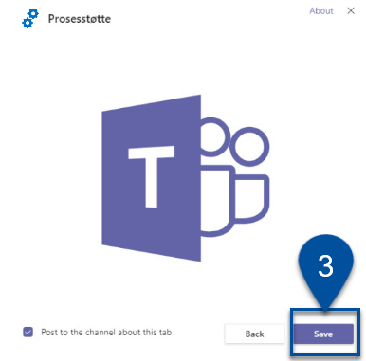
Tabs: Process Support
For students to be able to submit reports, you must give them access to the tab called “Prosesstøtte” [process support]
This is done by clicking the tab (1) then the “Set up tab” button (2), and finally “Save” (3)
NB: In some cases, the tab may not be visible by default. You may then click the plus sign on the rightmost side of the tab bar, search for and add it manually
This tab should also be used to add/remove group members
Notes:
THIS IS THE MOST IMPORTANT PART OF THE COURSE! If you remember anything from today, it should be how to set up the process support tab.
To be able to submit the reference group report, the “Prosesstøtte” [Process support] tab will need to be set up This can be done by clicking the “Prosesstøtte” tab, then “Set up tab” (2), and finally “Save” (3).
NB: In some cases, the tab will not appear on its own. In this case, you can click the plus sign on the right-most side of the bar that contains the tabs, and then add the tab manually from there. When students have finished writing their reference group report, this is where they will submit it.
This tab should also be used to add or remove group members.

Slide 17
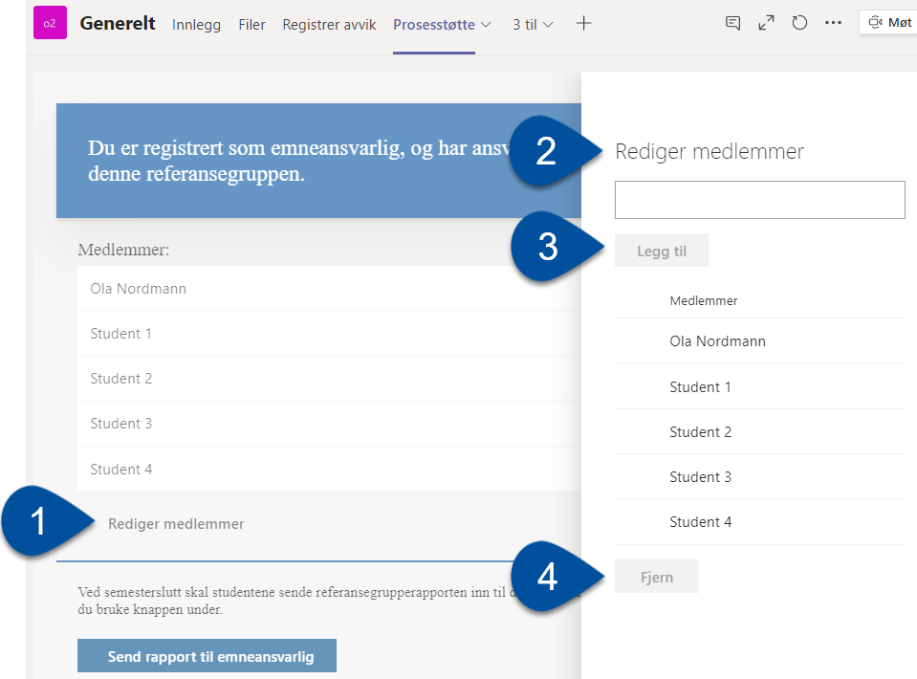
Manage Membership
If you need to edit the members in the reference group after it has been set up, you may do so in the process support tab
Click “Rediger medlemmer” [Edit members] (1). You will then see a menu on the right-hand side
Search for a person (2)
Click “Legg til” [Add member] (3)
To remove an existing member, click their name and click “Fjern” [Remove] (4)
Notes:
If you need to edit the reference group membership after it has been set up, this must be done in the “Prosesstøtte” tab and not in the Teams menu! This is important, as it will ensure that the changes are also implemented in KASPER.
Click “Rediger medlemmer” [Edit members] (1). This will cause a menu to pop up on the right-hand side of the window where you can search for people (2) and when you have found them, “Legg til” [Add member] (3).
To remove an existing member, click their name and click “Fjern” [Remove] (4).
Note: If members are not added in this manner, you will not be able to use KASPER to print a reference group participation certificate.

Slide 18
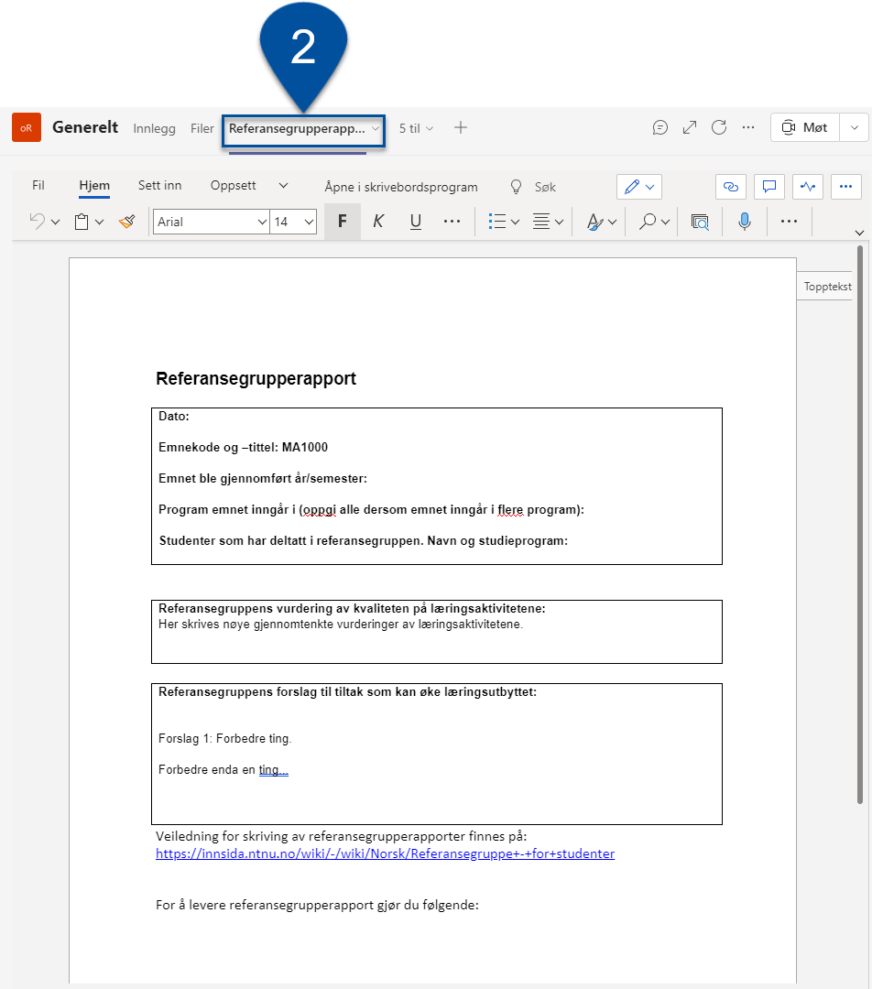
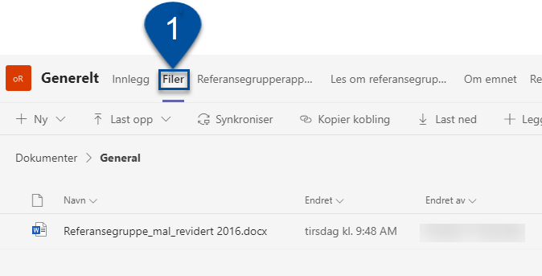
Tabs: Files and Report
In the “Files” tab (1), you will find all the files associated with the reference group. They can be both uploaded and downloaded for use in the evaluation work.
The “Referansegrupperapport” tab (2) can be used to collaboratively work on the report template
Notes:
In the image, you can see what the “Files” and “Referansegrupperapport” tabs look like. Under “Files” (1) you will find the report template that the students should use. In this folder, Everyone in the Team can use this folder to upload and download files for use in your work.
The tab in the right-hand side image (2) is a display window for the template-file, which the students may be used to collaboratively write the report.

Slide 19
Tabs: Registering Deviations
This tab will redirect you to the “Speak up!” page on Innsida, where students may report “deviations” not tied to the academic implementation of the course
Deviations may include health and safety violations, ethical issues, or discrimination and harassment incidents
Such instances should not be described in the reference group report, but rather be submitted in separate deviation report forms, found on this page
Notes:
This tab will redirect you the “Speak up!” page on Innsida, where the students can find information about registering “deviations” that are not related to the academic implementation of the course.
This can include HMS violations, ethical breaches, or incidents of discrimination or harassment. These cases must not be described in the reference group report, but rather in a deviation form.
In this image, we can see what it looks like when a tab links to an external page. It works much like a web browser does, but the navigation is somewhat more limited. E.g., you can follow links on the pages here, but you will not be able to move back to where you started. To do so, you must switch tabs and then go back.

Slide 20
When Students Submit their Report
Students submit their reports via the prosesstøttefanen [Process support tab] (1)
They click “Send rapport til emneansvarlig” [Send report to course coordinator] (2) and choose the report from the list of files (3)
They must make sure to select only the report file and then send it to the course coordinator (4).
Should they have other documents from the reference groups you wish to keep, these can be manually uploaded to the course report in KASPER.
Notes:
Students submit their reports via the “Prosesstøtte” tab (1). When they click “Send rapport” [Send report] (2), they must choose from the list of files from the “Files” tab. Only the report file should be selected (3), and then they click “Send til emneansvarlig” [Send to course coordinator] (4).
When this is done, the course coordinator can “publish” the report, which means it is added to the course report for the respective course.
Should there be a problem hindering the student from submitting the finished report, the course coordinator may follow the same steps to submit it on their students' behalf, providing the completed document is saved in the team.
NB: Additional files that you wish to add to the database must be manually uploaded in the course report. This may include midterm evaluations, minutes from monthly meetings, and so on. You should make sure to do this before publishing the report, as the team will be deleted shortly after.

Slide 21
Publishing the Reference Group Report
When the students have delivered their report, the course coordinator uploads it to the course report in KASPER
In the event the report contains sensitive personal information or regards deviations that are not related to the academic implementation of the course, the report is to be sent in for a public assessment
Click the drop-down menu “Velg handling for referansegrupperapport” [Select action for reference group report] and select “Last opp rapporten til KASPER” [Upload report to KASPER] or “Send rapporten til offentlighetsvurdering” [Send report to public assessment] (1) and click “Utfør” [Submit] (2)
Notes:
When the students have delivered their report, the course coordinator uploads it to the course report in KASPER. It will be added to the course report database.
If the report contains sensitive personal information or discusses deviations that are not related to the academic implementation of the course, the report must be sent in for a public assessment.
Click the drop-down menu “Velg handling for referansegrupperapport” [Select action for reference group report] and select “Last opp rapporten til KASPER” [Upload report to KASPER] or “Send rapporten til offentlighetsvurdering” [Send report to public assessment] (1) and click “Utfør” [Submit] (2)
The reference group team will be deleted shortly after the report is uploaded, or the public assessment is completed. If you have any other documents in the team you wish to keep, you should download these before publishing.
NB: The course coordinator can not edit reports submitted by students. Also, the students can not submit more than once, which we recommend to make clear to them. Should something still go wrong, and you need to allow the students to revise or resend their report, send a request to NTNU Hjelp.

Slide 22
Public Assessment
After you have clicked “Send rapporten til offentlighetsvurdering” [Send report for public assessment], a new box will appear to the right where you fill in the name of your faculty’s secretary for the committee for public assessments (1) and click “Send” (2).
You can click the provided link to find who your faculty’s secretary is.
NB: When the report has been published or the public authority assessment has been made, the Teams Workspace will be deleted
Notes:
If you click “Send rapporten til vurdering” [Send report for assessment], a window will appear on the right-hand side where you must fill in the name of the contact person for the public assessment committee for reference group reports for your faculty (1) and then click “Send” (2).
The assessment committee handles errors and changes outside of KASPER, in dialogue with the students. If the committee determines that the report is not suitable for the public eye, the report will be archived and made private. If someone then wishes to read an archived report, they must apply to do so.
Note: The reason that we have included a link to NTNU’s deviation reporting system (“Speak up!”) in the reference group team is that we wish to make students particularly aware of the correct place for submitting such deviations. This way we avoid having to archive reports.
NB: When public assessment has been carried out, the Teams Workspace will be deleted.

Slide 23
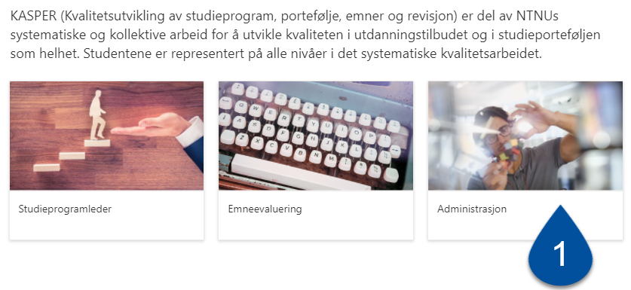
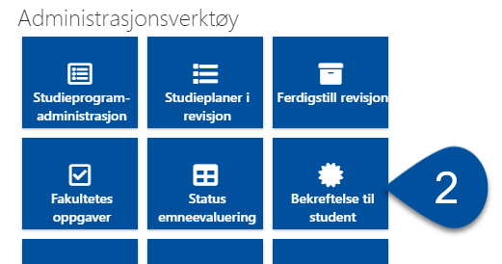
Student Certificates
For reference groups in KASPER, it is simple to create a certificate for participating students
From the start page, click “Administrasjon” [Administration] (1)
Then click “Bekreftelse til student” [Student Certificates] (2)
Notes:
Many students wish to receive a certificate for their participation in a reference group. If you have set up a reference group in Teams, this is easily done in KASPER.
To set up a certificate for students, we have to go back to the start page for KASPER and then click “Administrasjon” [Administration], and then “Bekreftelse til student” [Certificates for students], which will redirect you to the page entitled “Bekreftelse på deltakelse i referansegruppen” [Certificate for participation in the reference group].

Slide 24
Certificate for participation in the reference group
Søk etter studenter [Search by student]:
Søk etter emnekode [Search by course code]:
To set up a certificate, click the printer icon
Notes:
On this page there is a search menu with two alternatives that can be used to find the student you wish to create a certificate for. You can either search for a student directly (1) or search by the course code (2), which shows you all students who have taken this course.
Søk etter studenter [Search for student]: Here you can write the name of the student, and the search will return an overview of all the courses where the student has been in a reference group. You must choose the course that you wish to print a certificate for.
Søk etter emndekode [Search by course code]: Here you can search for a course by using its course code. The search result will show all the members in a reference group for the course for all semesters. Here you choose the student you wish to print a certificate for.
In both cases you must click the printer icon to the right to create the certificate.
NB: Be a little patient here, as it may take several seconds for the results to show up.

Slide 25
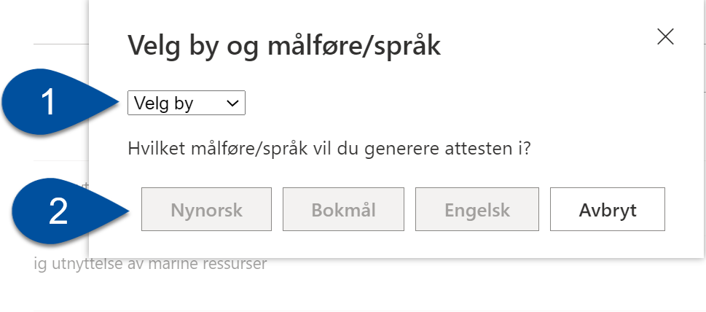
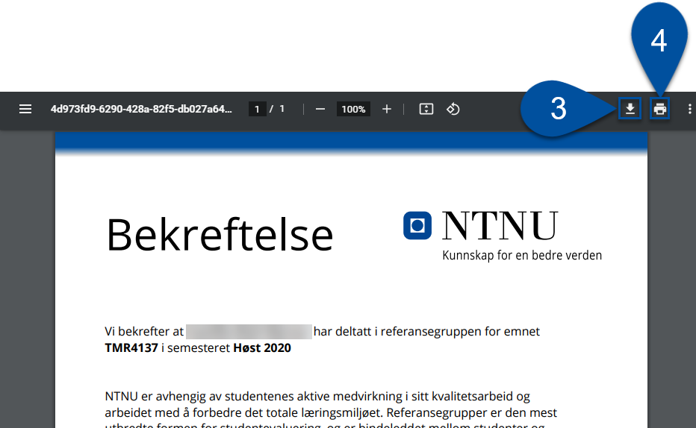
PDF- Certificates
"Velg by" [Select a city] (1) and “Målføre/Språk” [language] (2)
This gives you a PDF template customized to the student. It can either be downloaded (3) or printed directly (4)
The certificate must be signed by the course coordinator or someone from the institute administration
Then you send the certificate to the student
Note: If you have used some other form of student evaluation, you may request an alternative certificate from the institute
Notes:
After you have clicked the printer icon, a window will appear where you must select “by” [city] (1) and ”språk” [language] (2).
The result is a PDF template of the certificate that is customized to the student. You can choose to either download (1) or print (2) the certificate.
The certificate must be signed by the course coordinator or someone from the institute administration, before it can be sent to the student. The document can either be signed and sent digitally or printed to send a physical copy.
Note: If you have used some other student evaluation method than a reference group, or if you have not set up a reference group in KASPER, it is not possible to print a certificate for the student as shown in this user guide. In this case, contact the institute for an alternative certificate.

Slide 26
2. Course Reports
Notes:
Are there any questions before we begin with part 2?
[Check the time, ask if people need a break]
[If needed] Let’s take a short break before starting part 2.

Slide 27
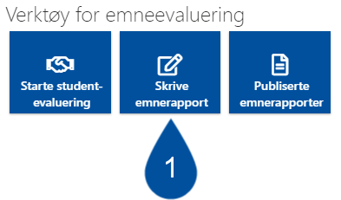
Writing Course Reports
Select “Skrive emnerapport” [Write Course Report] (1)
Select the course you wish to write a report for (2)
Notes:
To start writing course report, you need to go back to the “Emneevaluering” [Course evaluation] page that you were at earlier. Here, you click the tool entitled “Skrive emnerapport” [Write course report]. This will redirect you to the page entitled “Mine emnerapporter” [My course reports].
Here you will see all the courses that you are responsible for, sorted by semester. If your course happens to span several semesters, it will be listed under the semester in which it began.
Click the name of the course you wish to write the course report for.

Slide 28
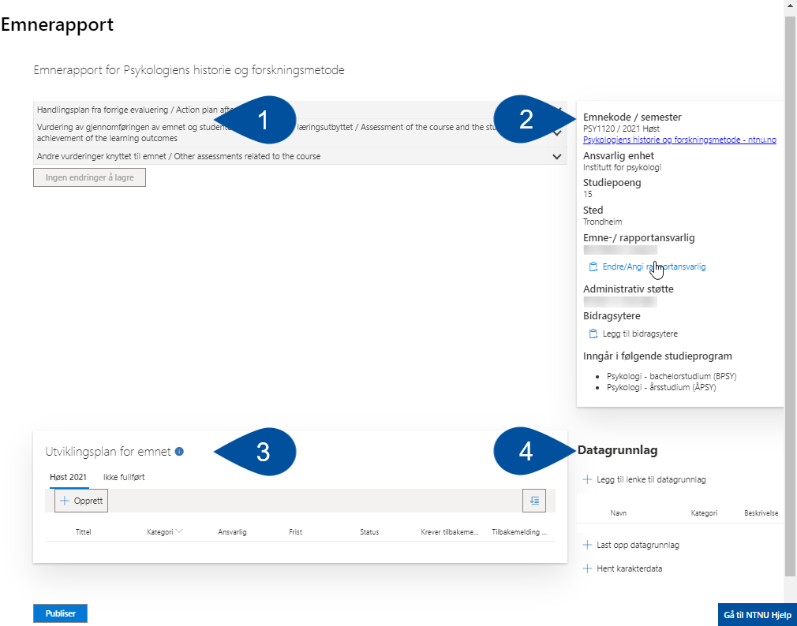
Writing Course Reports – Main Parts
The page where you write the course report consists of four main parts:
Text fields (1) where you write the report text
Information about the course (2)
“Utviklingsplan for emnet” [Course development plan] (3)
“Datagrunnlag” [Database] (4)
Notes:
The page in which you will write the course report consists of four main parts:
Text fields where you will write the report text
Information about the course
Course development plan
The database
We will now go through each one of these parts one by one.

Slide 29
1.1 Text boxes
How to fill out the text fields:
Open the fields by clicking the respective row (1) and fill out the relevant text
Click on “Hjelpetekst” (2) to find some bullet points to guide your evaluation
When you are finished writing the evaluation, click “Lagre” [Save] (3) found under the text field
You can also click “Lagre alle endringer” [Save all changes] (4) to save all fields at once.
Notes:
Here are three text boxes you should use to evaluate the course: “Action plan after last evaluation”, “Assessment of the course and the students’ achievement of the learning outcome”, and “Other assessments related to the course”. The idea here is to use the course report for active assessment and development of the course, not just detailing how it was carried out.
You open the fields by clicking on each row (1) and fill in relevant text. In each box, you will find some help texts (2) that may guide your assessments. When you have written your evaluation, click “Lagre” [save] (3) below the text field. You can also click “Lagre alle endringer” [save all changes] (4) to save all the fields simultaneously.

Slide 30
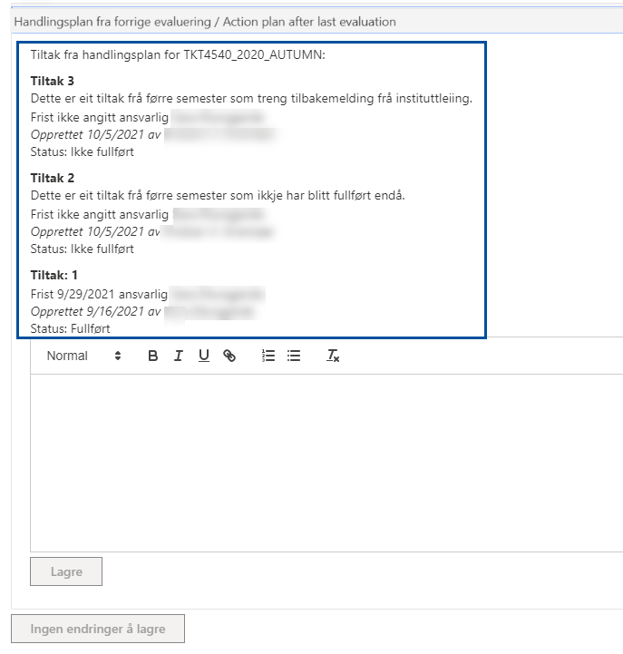
1.2 Action plan after last evaluation
Tasks from previous evaluations will be listed here
Use the text field to evaluate the implementation of these tasks
Notes:
This text field differs slightly from the others. Here you will find a list of “Tiltak” [Tasks] from earlier evaluations. Tasks from the *latest* evaluation will be listed here whether they have been completed or not, while older tasks will only be listed if they have not been completed. The idea is to use this field to evaluate the implementation of the tasks, or, if applicable, detail why they have not been implemented.
We will return with more information on the topic of tasks later in this course.

Slide 31
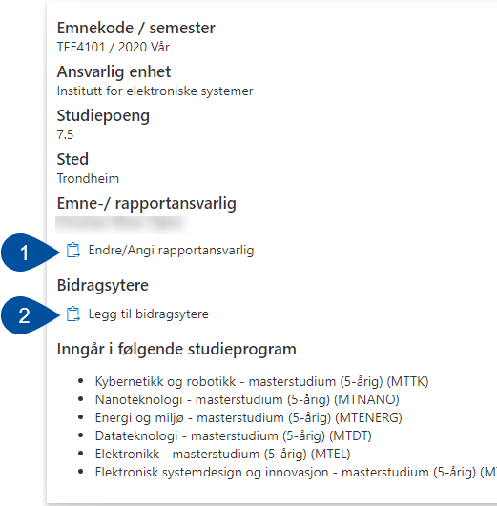
2. Information About the Course
To the right of the text fields, you will see some information about the course
In the “Emne-/rapportansvarlig” [Course-/Report Coordinator] (1) og “Bidragsytere” [Contributors] (2) fields, you can add additional people to the course report
Notes:
To the right-hand side of the text fields, you will see some information about the course: “Emnekode / semester” [Course code / semester], “Ansvarlig enhet” [Responsible entity], “Studiepoeng” [Study points], “Sted” [Location], “Emne-/rapportansvarlig” [Course-/report coordinator], “Bidragsytere” [Contributors], and “Inngår I følgende studieprogram” [Part of the following study programmes].
Most of these are just there to inform you of the specifics of the course, but under Course-/report coordinator and Contributors, you can other people to help you with the report. The Course-/report coordinator will be granted all the same accesses to the course in KASPER as the regular course coordinator, including ownership of the reference group Team, and the ability to publish the course report. Contributors will be able to write the report, add items to the course development plan and database, but not publish the report.
Note that it is only possible to add one additional course-/report coordinator, but as many contributors as needed.

Slide 32
3.1 Course development plan
This is where you add and keep tabs on “tiltak” [tasks], “oppgaver” [assignments] “notater” [notes], and “avvik” [non-conformities], which make up the course development plan
These follow the course report from semester to semester and will be sorted in tabs along the top bar.
This makes it easy to follow up on how suggested changes to the course have been handled. Any contributors or report coordinators you have added will also be able to create tasks.
Notes:
The course development plan is used to organize “tiltak” [tasks], “oppgaver” [assignments], “notater” [notes], and “avvik” [non-conformities]. These will follow the course reports from semester to semester and be sorted in tabs.
Tasks
Tasks are meant to be the main tool to track how the course develops over time. New tasks will be published along with the course report and follow its action plan until they are marked completed. The course coordinator may also choose to have the institute give their feedback on suggested tasks.
Institute admins will be able to view all course action plans with their suggested tasks on the KASPER page “Oversikt emnerapporter” [Course report overview]. If you have asked for feedback on a task, they will reply from there.
Non-conformities
Registering non-conformities are about reporting issues that affect the students’ learning and fall outside what is seen as normal variation in quality for the course. This includes temporary issues that remain unsolved longer than normally expected. When a non-conformity is reported the institute administration will be able to view them in “Oversikt emnerapporter”, like tasks.
Assignments and notes
Assignments and notes may be used to register other issues that you need to remember, but that are not necessary to publish with the report.
Click “Opprett” [Create] to add a new item to the plan.

Slide 33
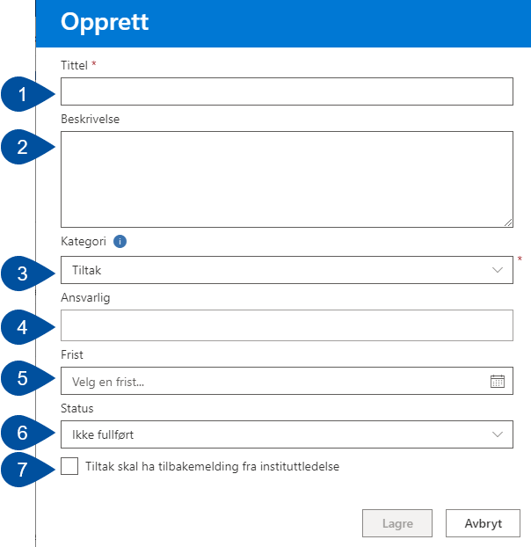
3.2 Adding Items to the Development Plan
Fill out the fields with the necessary details:
Tittel [Title] (1)
Beskrivelse [Description] (2)
Select the “Category” (3)
Choose a person to be “Ansvarlig” [responsible] (4)
Set the “Frist” [Deadline] (5)
Choose a “Status” (6)
Tick this box if you need feedback from the institute (7)
Notes:
Fill out the form with the necessary details.
Title (1): Give it a descriptive title. This field is mandatory to fill out.
Description (2): Here you may describe the item in greater detail if needed.
Category (3): Select a category from the drop-down menu; Task, assignment, note or non-conformity
Responsible (4): This field lists who is responsible for the item. This will by default be the course coordinator but can be delegated to someone else. You do this by clicking the X next to their name, and then search for a replacement.
Deadline (5): If necessary, choose a date from the calendar.
Status (6): Use the drop-down menu to select a status. The default is “Ikke fullført” [Not completed].
Should you be adding a task that needs feedback from the institute, check the box at the bottom left (7).
When you have filled in all the necessary details, click “Lagre” [Save].

Slide 34
3.3 Making changes to the items
If you wish to make changes to an already existing items, first select it (1) and then click “Detaljer” [Details] (2). This will open the same form as was displayed in the previous slide.
If you wish to sort the items by status, click the button in the top-right corner (3).
Notes:
If you wish to make changes to an already registered item, select it (1) and then click “Detaljer” [Details] (2). You will then be sent back to the form we were looking at in the previous slide.
If you need to sort the tasks by status, click the button in in the top-right corner of the list (3).

Slide 35
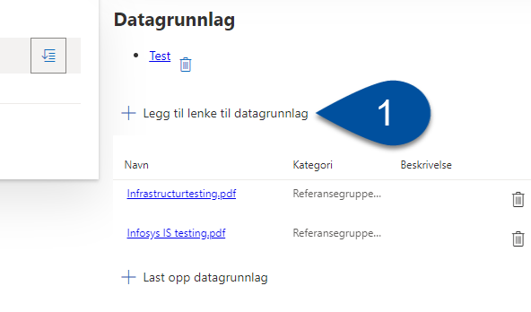
4.1 Database – Add a Link
The database is where you add reports, surveys, meeting minutes, or other forms of data that form the basis for your report, and possibly supplement your tasks.
To add a link in the database, click “Legg til lenke til datagrunnlag” [Add link to database] (1). You will then see a dialogue box, where you need to name the link (2), as fill in its URL (3).
Notes:
The fourth and final section of the course report is the database. This is where you add reports, surveys, meeting minutes, and other forms of data that will form the basis of your report, and possibly supplement your tasks.
To add a link to an item in the database, click “Legg til lenke til datagrunnlag” [Add a link to the database]. A dialogue box will then appear where you will need to give the link a name and enter the URL.

Slide 36
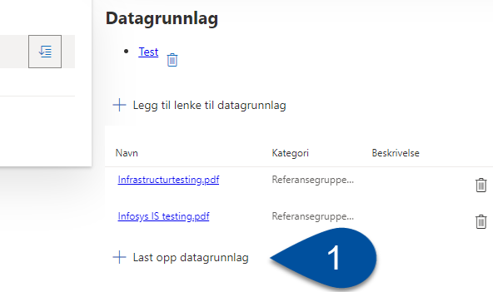
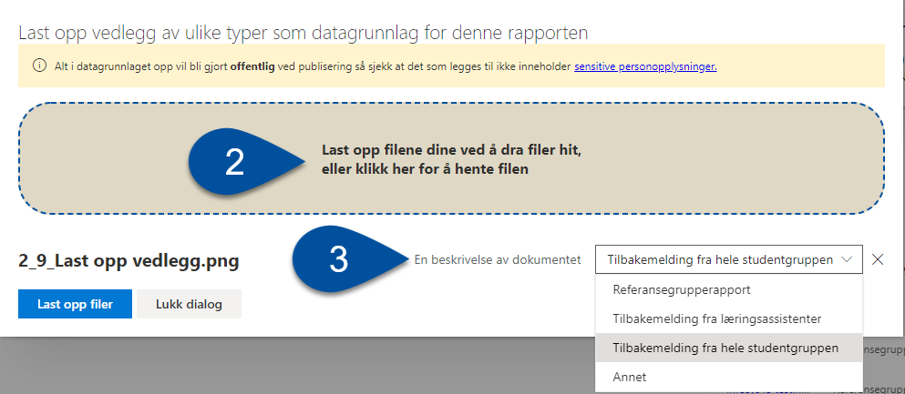
4.2 Database – Uploading Attachments
To add a file to the database as an attachment, click “Last opp datagrunnlag” [Upload database] (1).
In the dialogue box that appears, upload the file you wish to add to the database by either dragging file onto the box, or by clicking the box itself to browse the local files on your PC (2).
Before saving, make sure to select “En beskrivelse av dokumentet” [A description of the document] (3) from the dropdown menu.
Notes:
To add an item in the database as a file attachment, click “Last opp datagrunnlag” [Upload database].
In the dialogue box that appears, you can upload attachments that you wish to use by dragging files from your local file explorer into the box, or by clicking the box itself to browse the documents stored on your PC.
Before you save, select “En beskrivelse av dokumentet” [A description of the document] from the dropdown menu. There should only be one file that is described as “Referansegrupperapport” [Reference group report]. If you are unsure what to describe it as, choose “Annet” [Other].

Slide 37
4.3 Database – Student Evaluations
In most cases, the student evaluation will be carried out with reference groups and the corresponding report.
The reference group report that students have submitted in Teams will be automatically uploaded as an attachment when you publish it from there.
If you have used another form of student evaluation than reference groups, the relevant files should be uploaded as we just discussed, along with a sufficient description of the file.
Notes:
In most cases, the student evaluation will be carried out with reference groups and the corresponding report from the reference group. The reference group report that students have submitted in Teams will be automatically uploaded as an attachment when you publish it.
If you have used alternative forms of student evaluations, make sure to upload them with a suitable description.

Slide 38
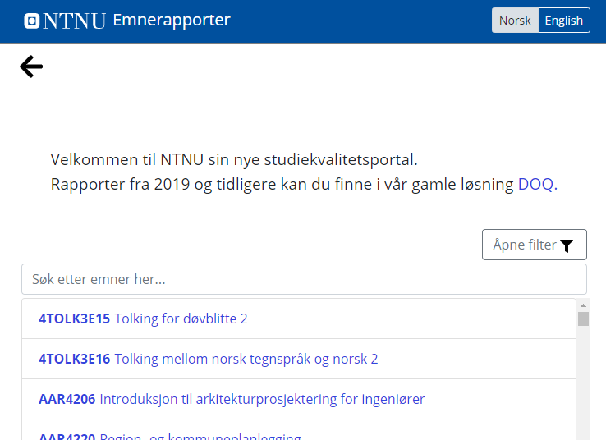
Publishing Course Reports
When you have finished the course report, click "Publiser" [Publish] at the bottom of the page.
After publishing, the report will be available in NTNU's report portal
There is a link to the portal located in “Verktøy for emneevaluering” [Tools for course evaluation] in KASPER
The repot may be un-published, if changes need to be done/more attachments need to be added
STUDIEKVALITETSPORTALEN
Notes:
When you are ready to publish the report, click the “Publiser” [Publish] button to the bottom-left.
Remember: Contributors cannot publish the report, but people you have registered as report coordinator can.
After the report has been published, it will become available in NTNU’s study quality portal. The portal can be found at innsida.ntnu.no/emnerapport (https://innsida.ntnu.no/studiekvalitetsportalen/)
Course-/report coordinators will have the ability to un-publish reports. This feature exists to allow for correcting errors, make important changes, or add additional files to the database. You un-publish the report by clicking the “Avpubliser” [Un-publish] button, which you will find in the bottom left, same place as the publish button. The course report will then be retracted. Make the necessary changes, and then publish the report again by clicking “Publiser” [Publish]. The report will be re-uploaded to the study quality portal with a new version number.

Slide 39
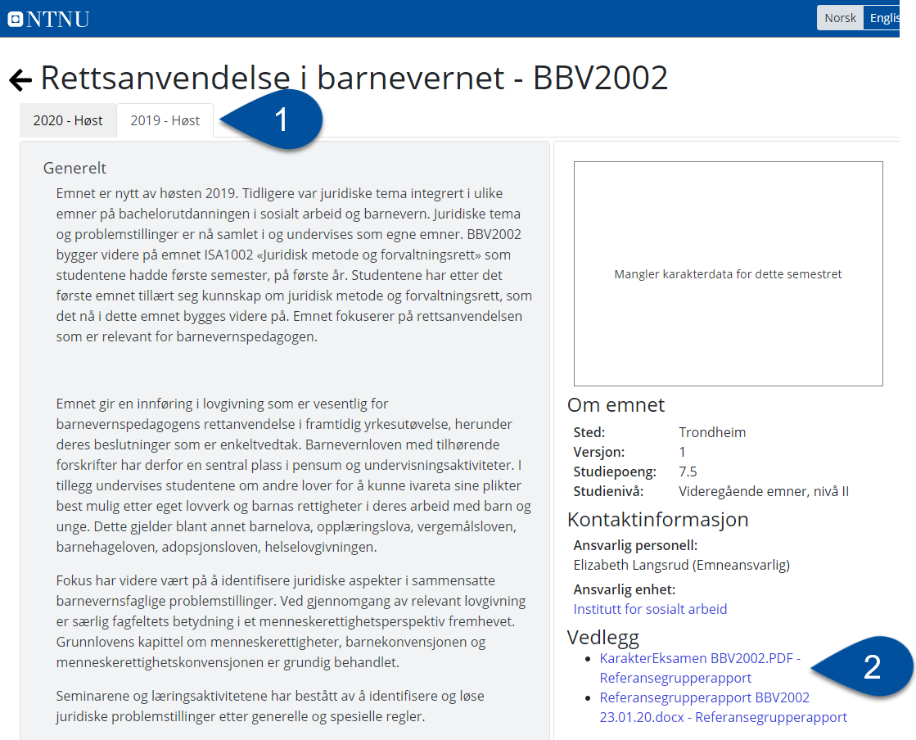
A Published Report
This is what a published report looks like
Here you can find previous reports sorted in tabs by semester (1)
Itemsadded to the database will appear here, with their descriptions (2)
A histogram showing the grade statistics will be included when possible
Notes:
A published report looks something like this. The report text proceeds from top to bottom in the same order that the text boxes were initially organized in. At the top you find tabs that are used to access course reports from earlier semesters (1).
On the right-hand side, information about the report (location, version number, number of study points, etc.) will be displayed, along with the author of the report, and any additional attachments (2)
Grade statistics will automatically be added to reports as a histogram, where it is possible. For some smaller courses, such statistics will not be publishable because of GDPR guidelines. In such instances there will be some text explaining the situation.

Slide 40
Online Course Planning
The course report that you deliver forms the basis of revisions that are carried out each year.
All changes will be carried out in the Emneplanlegging på Nett (EpN) [Online Course Planning] tool.
There is no direct connection between what happens in KASPER and what happens in EpN.
For more information about the Online Course Planning tool, you can consult the Wiki:
https://i.ntnu.no/wiki/-/wiki/English/Online+Course+Planner
Notes:
Published course reports form the basis of the revisions that are carried out each year.
Any changes that are made are implemented in the Emneplanlegging på Nett (EpN), [Online Course Planning tool]
NB: There is no direct connection between what happens in KASPER and what happens in EpN.
For more information about the Course planner, read the wiki https://i.ntnu.no/wiki/-/wiki/English/Online+Course+Planner

Slide 41
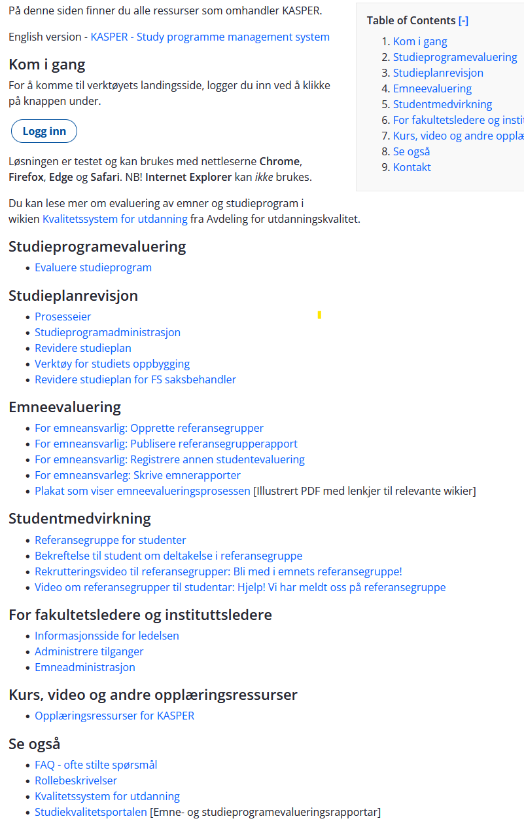
How to Get More Help
We have a main page where you will find all KASPER wikis, videos, and presentations like this one:
https://i.ntnu.no/wiki/-/wiki/English/KASPER+-+Study+programme+management+system
Speak with your institute/faculty contact. Your nearest contact can be found in the following wiki:
https://i.ntnu.no/wiki/-/wiki/Norsk/KASPER+-+Kontaktpersoner
Send us requests through NTNU Hjelp
Notes:
We have a main page where you will find all : https://i.ntnu.no/wiki/-/wiki/English/KASPER+-+Study+programme+management+system. Here you can also find other types of learning resources, such as videos, posters, and presentations like this – both in Norwegian and English.
Speak with your institute/faculty contact. Your contact can be found on the wiki entitled KASPER – kontaktpersoner: https://i.ntnu.no/wiki/-/wiki/Norsk/KASPER+-+Kontaktpersoner
These pages can easily be found by searching for the relevant keywords in Innsida.
You may also send us request through NTNU Hjelp.

Slide 42
Teaching Assistants for Digital Resources
... are here to help both students and employees
We offer courses, individual guidance, and user support for good practice.
More information can be found here: Teaching Assistants for Digital Resources*
Contact us: hjelp.ntnu.no *https://innsida.ntnu.no/wiki/-/wiki/Norsk/l%c3%a6ringsassistenter+for+digitale+ferdigheter
Notes:
Thanks for joining me today, and thanks for your attention!

