Slide 1
Information to new users

Slide 2
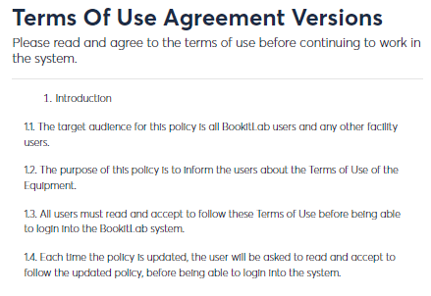
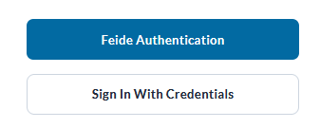
Log in
Go to: https://ecore.bookitlab.com/ntnu
Select "Feide Authentication".
Read through the "terms of use agreement versions" and accept.
NTNU and Sintef users

Slide 3
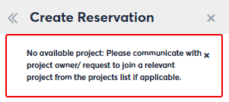
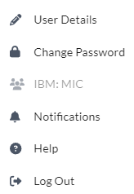
Select the core you need, and you will be redirected to this cores Dashboard.
Please update “user details” such as full name and mobile number,
if this is missing. You can also check which projects you have access to.
To make an instrument reservation/request services/order consumables/loan, you must be assigned a project. Your project leader will need to contact the project accountant (email the premade form) to assign a project to your name.
Your name
Please update your mobile number
Check your access to projects

Slide 4
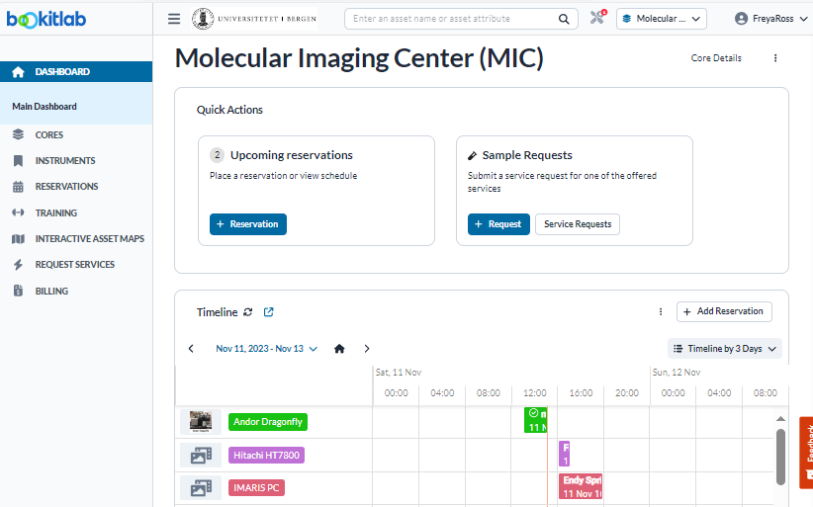
The Dashboard is core specific
Click here to change core or click on the Core menu.
You can check you reservation history, “request service” history and invoicing history here.
Different cores will decide on different widgets. This one has some quick action widgets.
Select your preferred timeline period.
Scroll down for more widgets.
In the timeline you can check for availability. Click in the calendar to create a reservation or use the “add reservation” shortcut.

Slide 5
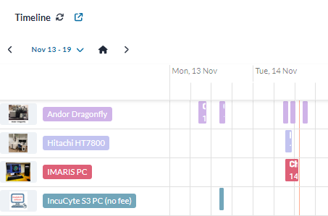
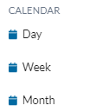
3 different ways to create an instrument reservation
You can create a reservation directly in the timeline on the Dashboard (just click and drag). You can change the timeline for a more precise view.
You can create a reservation through the RESERVATION menu. You can change between calendar and timeline and adjust the time.
You can also search for an instrument search menu and reach the calendar there.
OR
OR

Slide 6
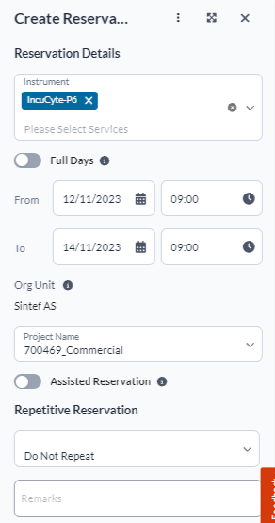
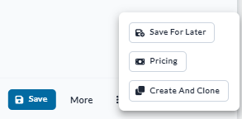
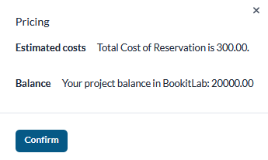
Reservation of instruments
Create a reservation by filling out the “from” and “to” and select your project from the drop down menu. If you don’t have a project, contact your project owner and project accountant (prosjektøkonom).
For pricing details, click on the three dots and select “pricing”. Estimated cost and project balance will be calculated.
If you need assistance or training in running the instrument, check “assisted reservation” (if applicable to this resource). You can also define the “staff” of choise in the drop down list (if applicable to this resource).
Click “save” to register your reservation.
If you want to know how much your reservation cost, click onto “pricing” located under the three dots.

Slide 7
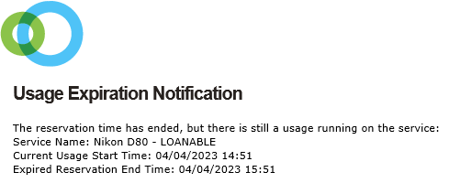
Creating a loan
Some cores will have loanable equipment.
The equipment will show up as a “loanable equipment”
Create the reservation in the calendar and pick up the object with the LOAN DESK MANAGER.
Some equipment have a fixed loan period and most of the time you will be notified when the loan is approaching the end.

Slide 8
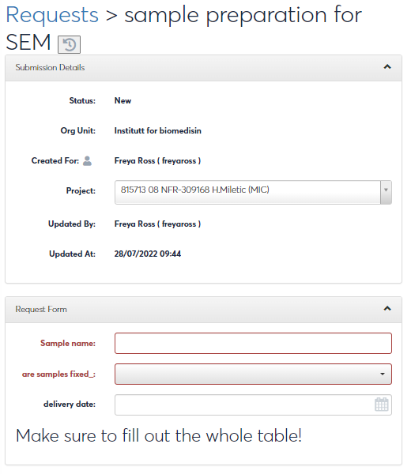
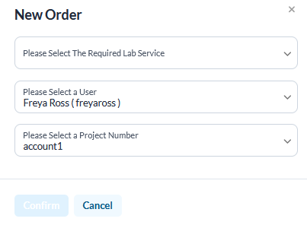
Sending Requests
Select “Requests Services” from the left main menu or through a quick action widget on the dashboard.
Make sure to have the right Core active at the top (arrow).
Press “Service Request" at the top right.
Choose from the list of available orders and fill out the form. Press "Submit/Process" at the bottom of the page.

Slide 9
Ordering Consumables
You order consumables/supplies through the request service called “Request CONSUMABLES” (for MIC) or through the CONSUMABLE menu (if applicable).
Fill out the order and indicate when you would like to pick up the items.
Select consumables under “add a consumable”.
Press SUBMIT and pick up your order.

Slide 10
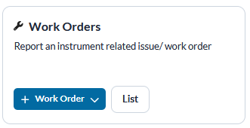
Report an issue on a system
The quickest way to report an issue is through the WORK ORDERS on the Dashboard.
You can also find the work order tab under instrument once you click on the instrument.
Select the asset related to the work order and describe the issue.
If the issue is serious, contact personnel directly!

