Slide 1
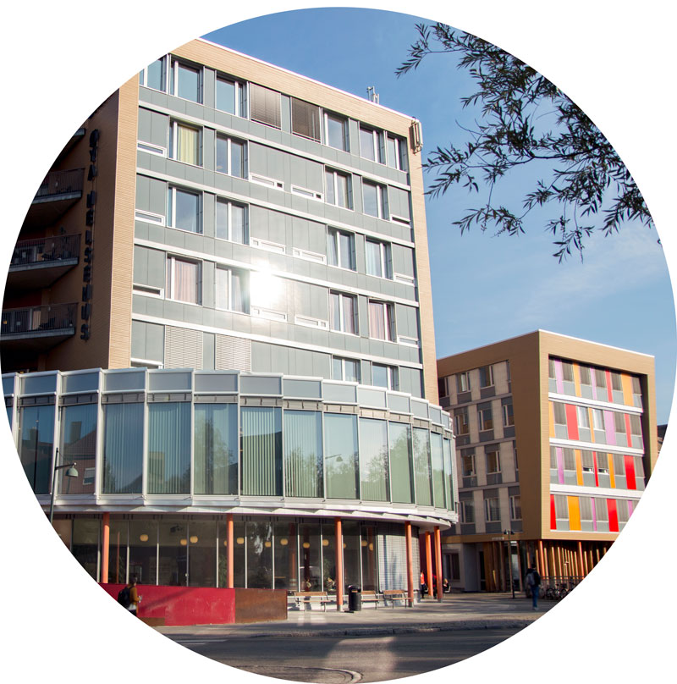
Title
Subtitle

Slide 2
Notes:
Url to the film: https://youtu.be/cf21lGxwhMk

Slide 3
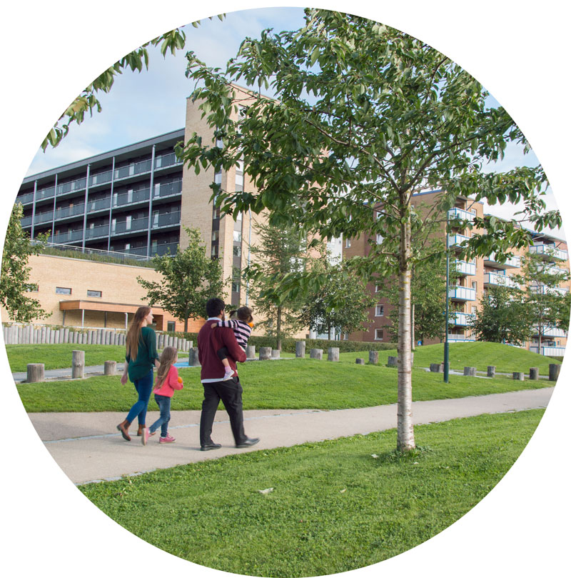
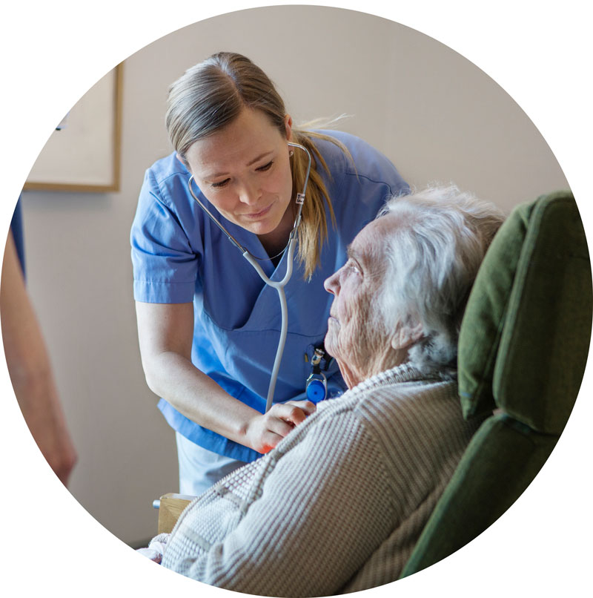
Better public health is our vision
Responsibility for education, research, innovation and communication, nationally and globally, in
Nursing
Community medicine
General medical practice
Public health
Our aim is to improve and develop health services and public health work.

Slide 4
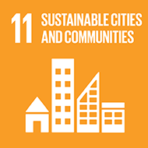
Knowledge for a better – and more fair – world, in line with the UN Sustainability Development Goals.
Notes:
From vision to action:
Trough the UN, the world has agreed on 17 sustainability development goals.
NTNU has contributed to knowledge for a better world by clearly prioritizing efforts and resources in line with the UN’s sustainability development goals.

Slide 5
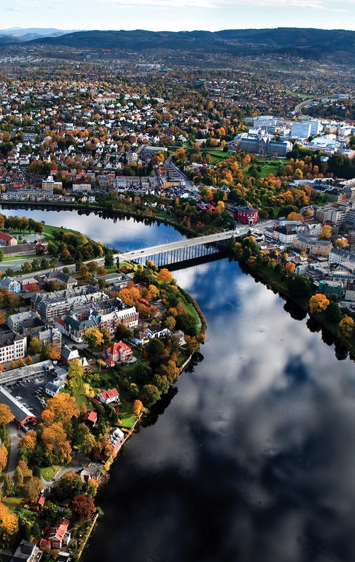
Key figures for Department of Public Health and Nursing
330 employees in Trondheim and Levanger
1500 students
80 PhD candidates, 20 doctoral degrees each year
One of eight departments at the Faculty of Medicine and Health Sciences
TRONDHEIM
LEVANGER

Slide 6
Annual activity 2020
Total: NOK 288 million
Internally funded activity: NOK 185 million
Activity based on external funding (BOA): NOK 103 million

Slide 7
Organization
Head of Department
Head of Office
Nursing and Vocational Teacher
Public Health and Community Medicine
Epidemiology and Medical Statistics
HUNT Research Centre
Advanced Nursing
General Practice and Medical Ethics
- 1 Deputy Head of Research
- 3 Deputy Heads of Education
K.G. Jebsen – Center for Genetic Epidemiology

Slide 8
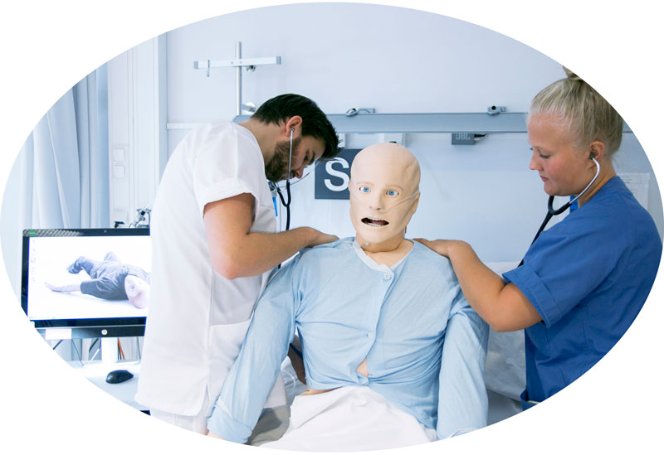
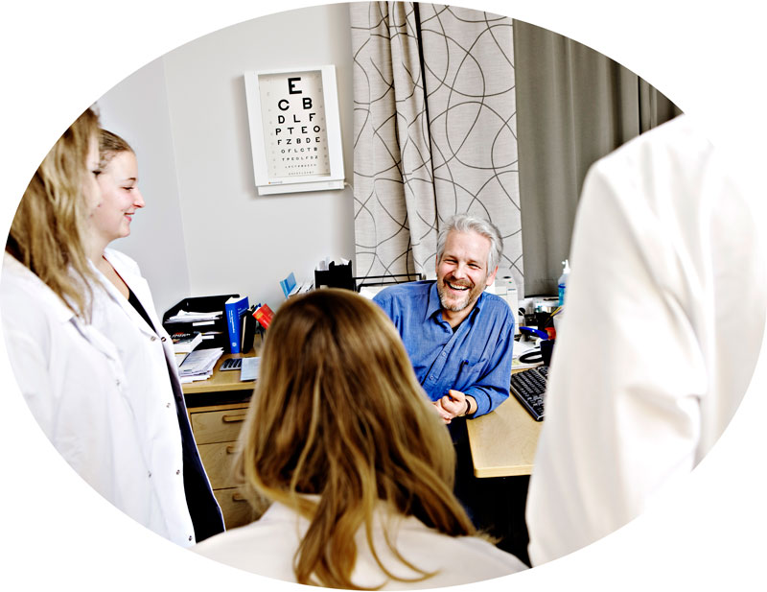
Programmes of Studies
Parts of the Professional Study in Medicine:
The Doctor-Patient Course
Thesis
Environmental and community medicine
Bachelor Programmes:
Nursing
Vocational Teacher Education
MSc Programmes:
Global Health
Public Health
Clinical Nursing
Further education:
Midwifery
Public Nursing
Advanced Clinical Nursing, Anesthesia, Paediatric, Cancer, Operating Room, Intensive Care and Older Persons’ Health
Courses
Pharmacology for ambulance workers
Contraception - for midwifes and public health nurses
Systematic examination of patients - for nurses
PhD Programmes
Health Sciences
Medicine and Health Sciences
Joint PhD-programme in Behaviour and Health
PhD courses
9 different courses
Notes:
https://www.ntnu.edu/ism/studies

Slide 9
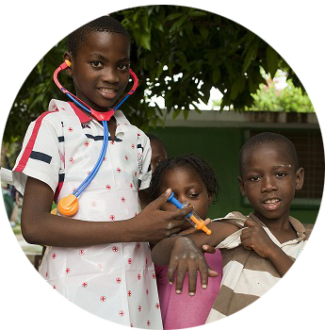
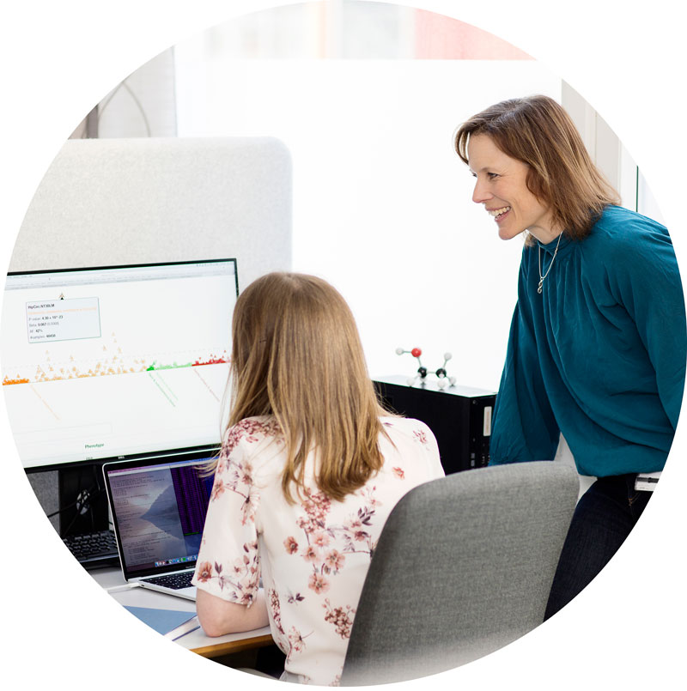
Research Areas
Wide range of research activties, from population-based studies to clinical studies
New knowledge required by the primary health services
Multidisciplinary research
Examples of research areas:
Epidemiology
The population’s use and experience of health care services and welfare programmes
Preventive actions and health promotion
Global Health
Medical Ethics
Notes:
Research Groups:
Aging and Older Persons' Health
Center for Health Promotion Research (CHPR)
Epidemiology and Medical Statistics
General Practice Research Unit
Genetic Epidemiology (K.G. Jebsen Center for Genetic Epidemiology)
Global Health Research Group
Health Services Research
Medical Ethics
Musculoskeletal Research
Patient Education and Participation (PEP)
Population-based Health Studies, Biobanking and Behavioral Epidemiology. (The HUNT Study)
Social Epidemiology, Work and Health Research
Womans Health and Reproduction

Slide 10
The HUNT Study and HUNT Research Centre
A longitudinal population health study in Norway.
One of the largest health studies ever performed.
Database with information from almost 120,000 informants.
Questionnaire data, clinical measurements and samples from a county’s inhabitants from 1984 until today.
300 national and international research projects are currently using the samples and data.
Notes:
https://www.ntnu.edu/hunt
The Trøndelag Health Study (The HUNT Study) is one of the largest health studies ever performed. It is a unique database of questionnaire data, clinical measurements and samples from a county’s inhabitants from 1984 onwards.
The HUNT Study is well-known in the county of Nord-Trøndelag, and its inhabitants have a generally positive attitude to participation and health research resulting from the study. HUNT has high participation rates, providing a good base for further health surveys in the county and an excellent research environment.
Today, HUNT Research Centre has a database with information on almost 120,000 people. Approximately 300 national and international research projects are currently using the samples and data from HUNTs collection.

Slide 11
K.G. Jebsen Center for Genetic Epidemiology
Focus on genetic variation in populations to better understand reasons for illness and health.
Improve prevention and treatment of disease.
Based on data from the HUNT study

