Slide 1

Agenda:
1. Organizational and psychososial work environment
2. Presentation of results from the work environment survey
3. Group discussion – areas to maintain and areas to improve
4. Development of actions
Notes:
Notes to management
In your welcome address it is recommended to place the work environment as an element in the strategy process of the unit. The survey is a development tool, and agreed measures will be part of the unit’s Action Plan.
Be personal. This work is important for you as unit manager. The survey will give you an overview of the work environment situation at the unit.
Be specific. We spend time on the follow-up process with the aim to develop good framework conditions for the employees and for the work which your unit is responsible for.
Be local. This is about the daily work, values and culture of our unit. Matters outside the control of the unit, should be taken note of by the manager and appropriately followed-up.
What is on the agenda and what is not
The survey puts the organizational and psychososial work environment on the agenda
Physical work environment is primarily dealt with in other processes, however, it can be relevant to bring it up relating to how physical conditions influence the effective work of employees and units.
The survey does not examine occurrences of bullying and harassment. As the survey is anonymous, it cannot identify where or how such occurences are taking place. All work places in Norway shall have systems to handle bullying and harassment. Explain how this is handled at your institution.

Slide 2
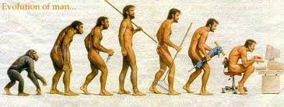


Organizational and psychososial work environment
Working tasks
- interaction between the person and the tasks
Social relations
- interaction between colleagues and with the manager
Organizational framework
- interaction between the person and the structural context
Notes:
Notes to management
Use this slide to develop a joint understanding of what we mean by organizational and psychosocial work environment. It is relevant to develop measures/actions in all these areas.
The survey includes indicators in all three categories – working tasks, social relations and organizational framework. In the follow-up process you may discuss the indicators of the survey (see bullet-points below) and other matters which are important for the work environment at your unit.
Working tasks – interaction between person and tasks (organization and contents of the tasks):
Autonomy
Competence demands
Leadership support
Support for teaching and research
Social support from supervisor
Social relations - interaction between persons (what we most often think of as psychososial work environment) (includes social support, collaboration, roles, and communication):
Collaboration
Conflict
Competitive work environment
Relation to management (confidence, support, trust, control, contact, supervision, mutual respect)
Recognition
Organizational framework – interaction between person and structural context (physical environment, institutional guidelines, organizational culture):
Responsibility
Goal clarity
Improvement culture
Management above own unit
Resources

Slide 3

The survey shed light on both demands and resources:
Individual resources
+ autonomy
+ support from supervisor
+ competence demands
Job commitment
- workaholism
- work-family conflict
+ meaning of work
+ engagement
Colleague resources
+ collaboration
+ social support
krav
Job demands
- role conflict
- role overload
- Interpersonal conflict
Organizational resources
+ goal clarity
+ trust in management
Notes:
Bakgrunnsnotat til leder
Arbeidsmiljøundersøkelsen bygger på jobbkrav-ressursmodellen (JD-R) som brukes mye i arbeidsmiljø- og organisasjonsutviklingsarbeid. Her er modellen illustrert med en vekt. Tanken er at det må være en rimelig balanse mellom krav og ressurser for at vi skal ha et helsefremmende arbeidsmiljø. Blir det for stor ubalanse mellom krav og ressurser vil det oppleves stressende. Hva som i arbeidshverdagen oppleves som krav og ressurser vil variere fra person til person. Når kravene er store, er det ekstra viktig å styrke ressursene rundt de ansatte. Ressursene kan da fungere som en «buffer» eller «moderator» mot stress. Det er en grunn til at arbeidsmiljøundersøkelsen legger så stor vekt på å kartlegge ressursene i arbeidsmiljøet. Når vi skaper gode rammer for arbeidet, bidrar det både til et helsefremmende arbeidsmiljø og god måloppnåelse. Det er bra både for ansatte og for virksomheten.
Arbeidsmiljøundersøkelsen omfatter fem temaområder. Figuren viser eksempler på hvilke tema undersøkelsen tar opp på hvert område. Temaene er beskrevet nærmere i notatfeltene til resultatpresentasjonen (stolpediagrammene).
Arbeidsmiljøundersøkelsen er godt egnet til å jobbe forebyggende med utvikling av et helsefremmende arbeidsmiljø i samsvar med Arbeidsmiljøloven. Dersom undersøkelsen gir indikasjoner på uforsvarlige arbeidsforhold, har leder en lovpålagt undersøkelsesplikt og aktivitetsplikt. HR/HMS-avdeling og Bedriftshelsetjeneste kan gi råd og lederstøtte i slike tilfeller.

Slide 4
What is demanding in your job situation??
What contributes to your job engagement?
Notes:
Bakgrunnsnotat til leder
Målet for arbeidet med det organisatoriske og psykososiale arbeidsmiljøet er at vi skal utvikle et helsefremmende arbeidsmiljø preget av jobbengasjement, god arbeidsflyt og måloppnåelse.
Forslag til individuell oppgave (brukes som oppvarming og påkopling til tema)
Diskuter to og to (ca 5 minutter). Noter 2-3 ting som dere kjenner «utløser jobbengasjement» eller som «er krevende» (alternativt «gir energi/tapper for energi», «hemmer/fremmer»).
Innhent noen eksempler fra deltakerne på hva som utløser jobbengasjement og hva som oppleves som krevende i jobben.
Prosessleder kan gjerne knytte eksemplene til de fem temaområdene i arbeidsmiljøundersøkelsen:
individuelle ressurser i oppgaveutførelsen
kollegaressurser
organisatoriske ressurser
jobbkrav
jobbtilknytning
Oppfordre alle til å ta med seg sine refleksjoner inn i gruppeprosessen når vi skal diskutere hva det er viktig å ta vare på og å forbedre i arbeidsmiljøet.

Slide 5

Participation in the survey:
Nivå 1-L
64,8% of the 3341 employees that were invited to participate at 03.03.2017 responded.
Response rates:
  Gender: female 68,0%, men 61,0%
  Job categories: Academics: 61,3%, Ph.d.-candidates: 52,5%, Techn/adm: 71,5%, Leaders: 84,9%
  Position size: 50-99% position: 53,3%, 100% position: 65,9%
Nivå 3: svarprosent
Nivå 4: svarprosent
Egen enhet -L
Number of responses 2017: Response rate 2017:
Number of responses 2014: Response rate 2014:
Notes:
Those who has not completed are removed from the data.
Those who has not answered more than one index are removed from the data.
Intro to the next slide:
A column represent the mean of the responses for each index.
The items are coded such that a high value indicate a positive result. This imply that some items are reversed. In the cases with reversal this is indicated with a ®.
It is on standard deviation in each direction. This is a indication about variation from the mean and tell something about how much diversification it s in the data.
Large standard deviation – large diversification – the respondents are not giving a clear message.
Little standard deviation – little diversification – the respondents give a clear message.
3 is in the middle of the response alternatives. The results must be seen together with the context at the unit in present. It is only the people in the unit who can decide if the results are satisfactory.
There will always be room for improvements.

Slide 6
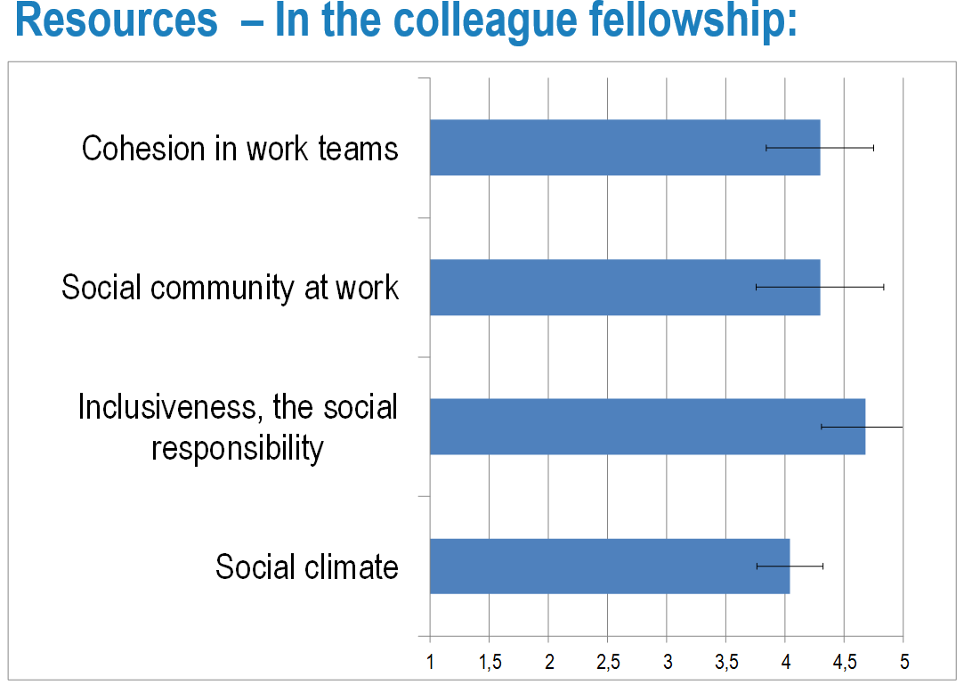
How the results of each thematic area is presented
Note what you think is:
important to maintain
necessary to improve
Scale from «strongly agree» (1) to «strongly agree» (5)
The distribution of responses is represented by a standard deviation from the average
Notes:
Before you go through the results (in plenary or individually)
The next slides shows in more detail the results within the five thematic areas of the survey. In addition, three are 3 slides on working hours, employee review, and health.
It is recommended to note what areas you think are the most important to maintain and to improve. This will be helpful in the later group process.
The bar charts shows the average response on each of the 28 topics (indicators) of the survey
The index results on each topic is based on the average response on 3-15 statements.
It was possible to choose five alternative responses to each statement from «strongly disagree» (1) to «strongly agree» (5).
All responses are coded to make 5 the most positive response. If the result is 3, this means that the respondents on average have responded «neither/nor» (respondents may also choose 3 to indicate “either/or” or “not relevant”).
The distribution of responses is represented by a standard deviation from the average
It is one standard deviation in each direction from the average score. This is an indication of variation from the mean and tell something about how much diversification there is in the data.
Large standard deviation = large diversification. The respondents are not giving a clear message.
Little standard deviation = little diversification. The respondents give a clear message.

Slide 7
Resources – The individual`s task completion:
Notes:
Task completion ambiguity, capture to what extent the employees them selves can, or have to, determine when their tasks are completed.
I determine when my work assignments are completed
I know when a task is completed
It is up to me to assess when I have completed a work assignment
Empowering leadership, capture to what extent the employees experience the leadership as empowering.
My immediate superior encourages me to participate in important decisions
My immediate superior encourages me to speak up when I have a different opinion
My immediate superior contributes to the development of my skills
Recognition, capture to what extent the employees experience to be recognized, a high score indicate that the respondents to a large extent experience to be recognized.
My work is recognized and appreciated by my unit management?
I am respected by my unit management
I am treated fairly by my unit management
Social support from supervisor, a high score indicate that the respondents to a large extent experience that they receive social support from their supervisor.
My immediate superior listens to me when I have problems at work
My immediate superior gives me the help and support I ned from her/him
My immediate superior talks with me about how well I carry out my work
Competency demands, captures the sense that work tasks demand learning of new knowledge, and that the nature of work requires continuous training.
I am expected to continually develop my competence
The nature of my work means I continually have to develop and think in new ways
I feel pressure to continually learn new things in order to manage my work tasks
Contents of the indexes:
Job autonomy, measures the extent of autonomy and influence over how the work is carried out.
I have a sufficient degree of influence in my work
I can make my own decisions on how to organize my work
There is room for me to take my own initiatives at work
I manage my work situation in the direction I want.

Slide 8
Resources – In the colleague fellowship:
Notes:
Cohesion in work teams: High score indicate that the respondents experience a good cohesion between colleagues at their unit.
At our unit we stand together in trying to reach our performance goals
I’m happy with my unit’s level of task commitment
This unit gives me ample opportunities to improve my personal performance
Social community at work: High score indicate that the respondents experience that there is a good social community at their unit.
There is a good atmosphere between me and my colleagues
There is a good sense of fellowship between the colleagues at my unit
I feel that I am a part of a community at my unit
Inclusiveness, the social responsibility: High score indicate that the respondents experience that inclusiveness and social responsibility is taken care of at their unit.
Men and women are treated as equals at in my unit
In my unit, there is room for employees of a different etnic background or religion
In my unit, there is room for older employees
In my unit, there is room for employees with various illnesses or disabilities
Social climate: This index are also presented with means for the single items. This is done because the statements represent a lot of difference in the climate issues
The climate in my unit is encouraging and supportive
The climate in my unit is distrustful and suspicious ®
The climate in my unit is relaxed and comfortable

Slide 9
The social climate in your work unit is…
Notes:
Item number one and five are not part of the scale on the previous slide
The climate in my unit is competitive
The climate in my unit is encouraging and supportive
The climate in my unit is distrustful and suspicious
The climate in my unit is relaxed and comfortable
The climate in my unit is rigid and rule-based

Slide 10
Resources – In the organizational unit:
Notes:
Innovation, the score is high if the respondent`s experience that there are a innovative climate at their unit.
My unit is constantly evolving to meet the employees` needs
In my unit, no one listens to new suggestions and ideas ®
My unit is flexible and constantly adapts to new ideas
My unit is open-minded and adapts to changes
My unit strives to retain status quo rather than to change ®
Resources research and teaching, the score is high if the respondent`s experience that there are sufficient resources.
I get the administrative support I need for planning and implementation of teaching and examinations
I get the administrative support I need for my research
I get the technical support I need for my research
I get the support I need for internationalisation of my research
Fairness of the supervisor, the score is high if the respondent`s experience that the supervisor is fair.
My immediate superior distributes work assignments fairly
My immediate superior treats the employees fairly
My immediate superior treats the employees impartially
Trust regarding management, own unit, the score is high if the respondent`s experience that they can trust the management at their unit.
My unit management trusts the employees to do their work well
I can trust the information from my unit management
My unit management withhold important information from the employees ®
It is possible for the employees at my unit to express their views
Reliability unit management, the score is high if the respondent`s experience that the management at their unit is reliable.
I can expect my unit management to treat me in a consistent and predictable way
My unit management is always reliable
My unit management is open and honest with me
I am confident that I can trust my unit management
I have complete confidence in my unit management
Reliability in next administrative level, the score is high if the respondent`s experience that the next administrative level is reliable.
I can expect the management of the next administrative level to treat me in a consistent and predictable way
The management of the next administrative level is always reliable
The management of the next administrative level is open and honest with me
I am confident that I can trust the management of the next administrative level
I have complete confidence in the management of the next administrative level
Goal clarity, the four items measures to which purpose of one`s work tasks is clear.
What is expected of me at work is clearly expressed
I have a clear understanding of which tasks constitute my job
I feel that the objectives of my job are diffuse and unclear ®

Slide 11
Support – research and teaching:
Notes:
There is no form of coding in this slide. A little column shows that respondents to a little extent experience in ex support for teaching and examinations.
These questions regards only academic staff. It was possible to answer not applicable.

Slide 12
Demands – in the individual`s work situation:
Notes:
Absence of dysfunctional support, capture if the employees in different positions experience dysfunctional support, high score indicate that the employees not have such experience when the items are reversed.
People in my unit sometimes help me in a difficult situation, but combines this with reproaches ®
People in my unit sometimes help me in a difficult situation, but support me reluctantly ®
People in my unit sometimes help me in a difficult situation, but expect everlasting gratitude ®
People in my unit sometimes help me in a difficult situation, but do not support in a way that is matter-of-factly ®
People in my unit sometimes help me in a difficult situation, but do so with a reproachful tone or gaze ®
People in my unit sometimes help me in a difficult situation, but indicate that I should have dealt with the problem myself ®
Absence of interpersonal conflicts, the scale measures the extent to which work is negatively affected by conflicts between employees. The scale is reversed which imply that a high score indicate that the respondents not experience such conflicts.
My work is hampered by power struggles and territorial thinking in my unit ®
In my unit, intrigues impair the work climate ®
In my unit, there is a great deal of tension due to prestige and conflicts ®
Absence of role conflicts, one can experience that there is conflicts between own roles, that different people expect different from you, or that it is conlict between your own and others expectations. The scale is reversed which imply that a high score indicate that the respondents not experience such role conflicts.
I have to do things that I feel should be done differently ®
I am often given assignments without adequate resources to complete them ®
I frequently receive incompatible requests from two or more people ®
My job involves tasks that are in conflict with my personal values ®
Absence of role overload, measure the feeling of having too much to do in too little time. Item nr 2 and 3 are reversed which imply that a high score indicate that the respondents not experience role overload.
I have enough time to do what is expected of me at work
It happens quite often that I have to work under heavy time pressure ®
I frequently have too much to do at work ®
Absence of illegitimate tasks, capture if the employees in different positions experience to have illegitimate tasks, high score indicate that the employees not have such experience when the items are reversed.
I must carry out work which I think should be done by someone else ®
I must carry out work which I feel demands more of me than is reasonable ®
I must carry out work that put me into awkward positions ®
I must to carry out work that I think it is unfair I should do ®

Slide 13
Commitment to the work
Notes:
Engagement, captures the respondents experience of having
engagement in their work. The scale measure three aspects of
engagement: vigour, dedication and absorption.
At my work, I feel bursting with energy
At my job, I feel strong and vigorous
When I get up in the morning, I feel like going to work
I am enthusiastic about my job
My job inspires me
I am proud of the work that I do
I feel happy when I am working intensely
I am immersed in my work
I get carried away when I’m working
Work-home-facilitation, captures whether the respondents experience that the work situation have a positive influence to the home-situation.
The things I do at work help me deal with personal and practical issues at home
The things I do at work make me a more interesting person at home
The skills I use at work are useful for things I have to do at home
Absence of work-home-conflict, the scale is reversed in the presentation. A high score indicate that the respondents not experience that there is a work-home-conflict.
My job reduces the effort I can give to activities at home ®
Stress at work makes me irritable at home ®
My job makes me feel too tired to do the things that need attention at home ®
Job worries or problems distract me when I am at home ®
Commitment to the workplace, a high score indicate that the respondents have a positive commitment to their workplace.
I am happy to tell others about my work place
I would recommend a close friend to apply for a position at my workplace
I feel that my workplace is of great importance to me
Absence of workaholism, the scale is reversed, a high score indicate that the respondents not experience that they might work excessively or that they feel a compulsively urge to work.
I seem to be in a hurry and racing against the clock (R)
I find myself continuing to work after my co-workers have called it quits (R)
I stay busy and keep many irons in the fire (R)
I spend more time working than on socializing with friends, on hobbies, or on leisure activities (R)
I find myself doing two or three things at one time such as eating lunch and writing a memo, while talking on the telephone (R)
It is important to me to work hard even when I do not enjoy what I am doing (R)
I feel that there’s something inside me that drives me to work hard (R)
I feel obliged to work hard, even when it’s not enjoyable (R)
I feel guilty when I take time off work (R)
It is hard for me to relax when I’m not working (R)
Meaning of work, captures the respondents experience of having a meaningful work.
My work is meaningful
I feel that the work I do is important
I feel motivated and involved in my work

Slide 14
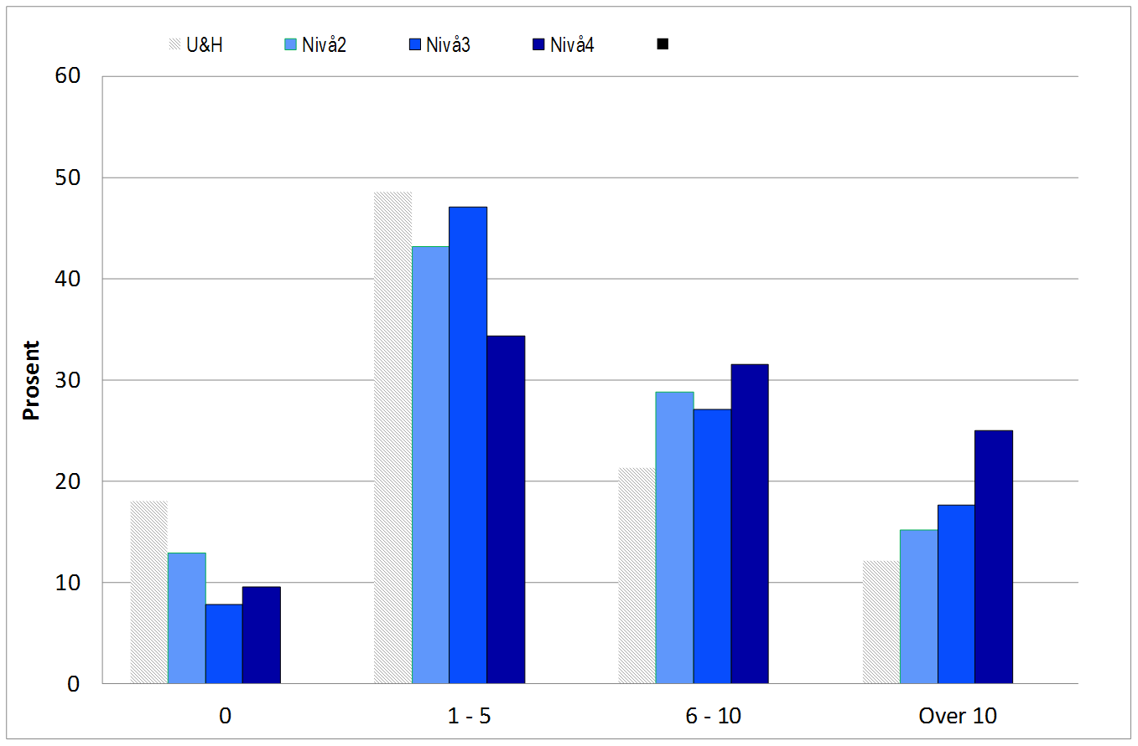
“How many hours beyond the agreed working hours do you usually work per week?”

Slide 15
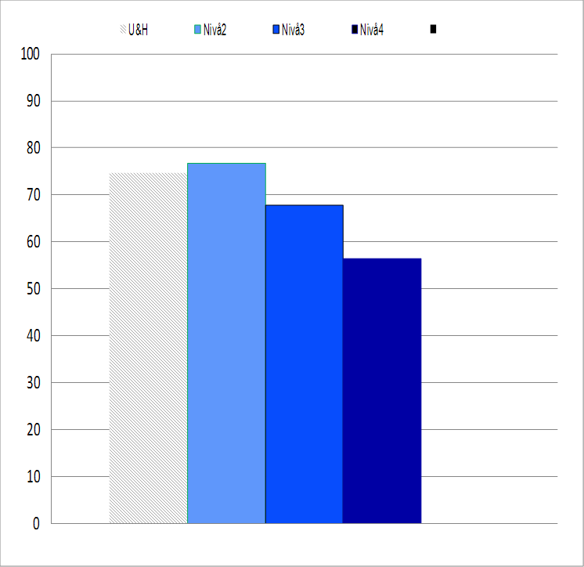
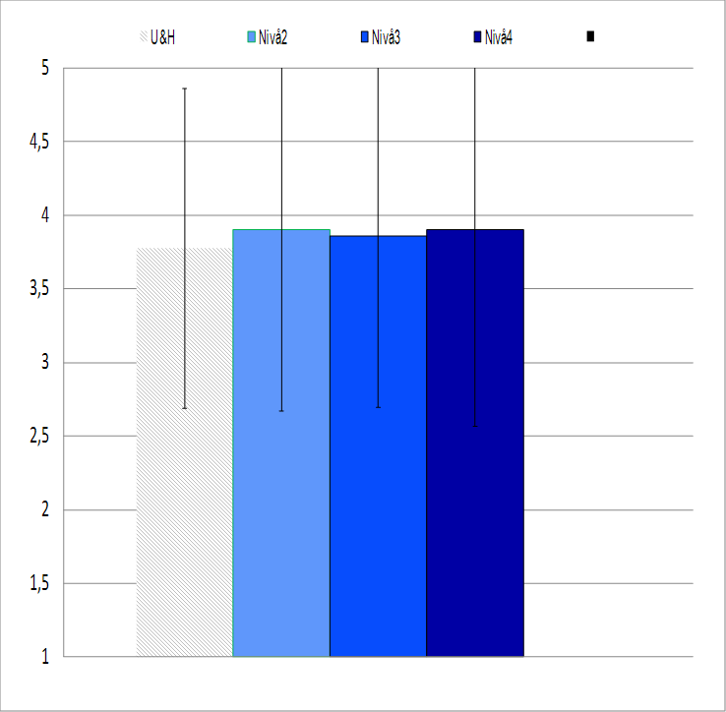
Employee review
Have you had an employee review during the last 24 months?
Percent replying «yes»
Mean experienced utility value of the employee review
Notes:
On the scale from 1 – 5, how do you feel about the employee review(s) you have had during the last 24 months?
1 = A waste of time
5 = Very positive

Slide 16
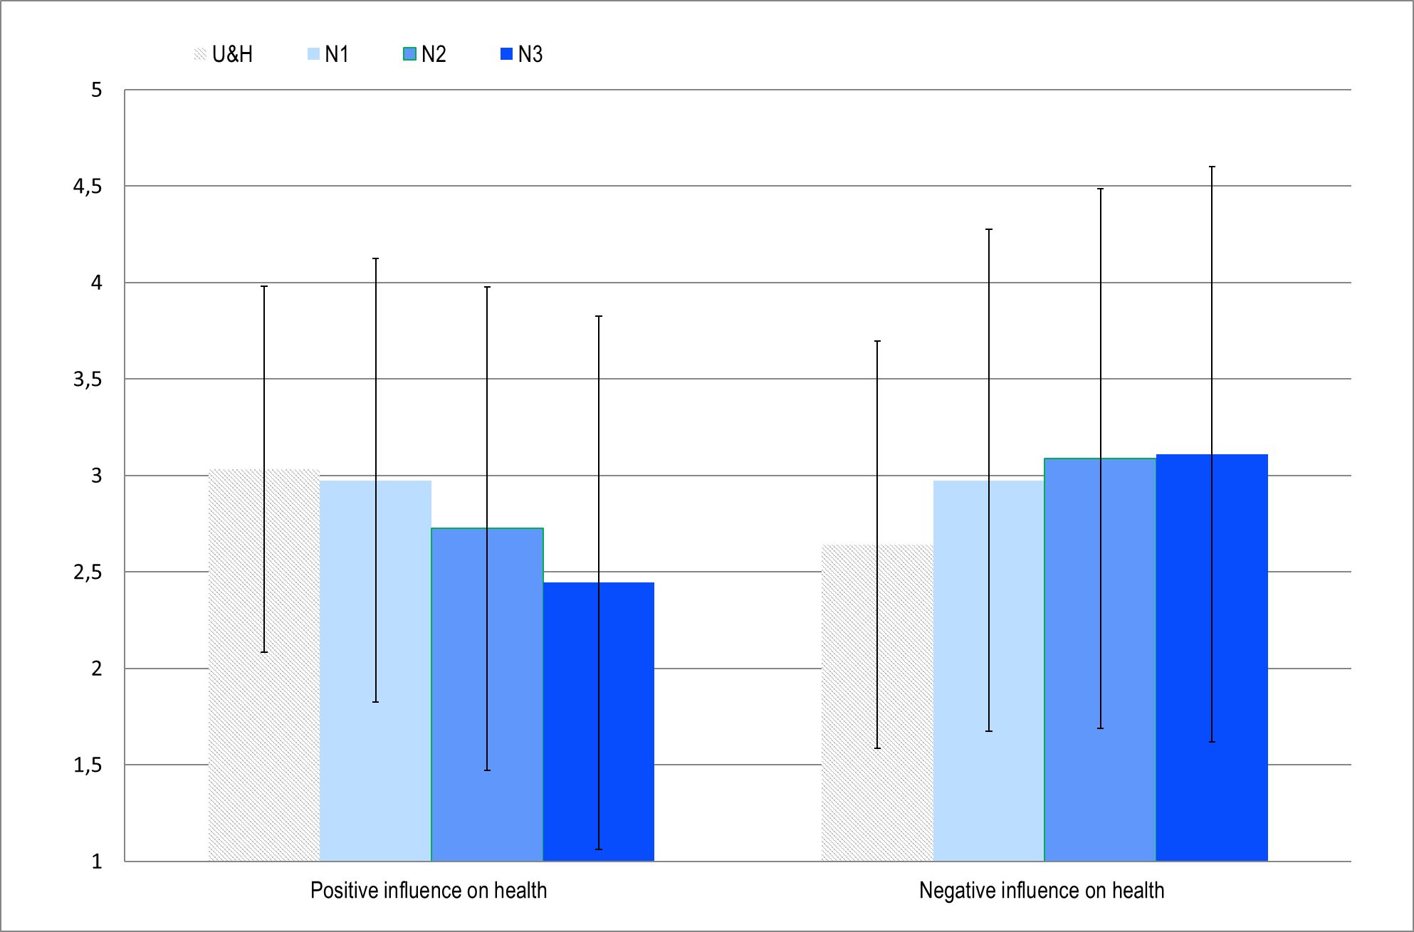
Mean of experienced influence from work
on own health:
Notes:
My work has a negative influence on my health
My work has a positive influence on my health
(1 = Strongly disagree, 5 = Strongly agree)

Slide 17
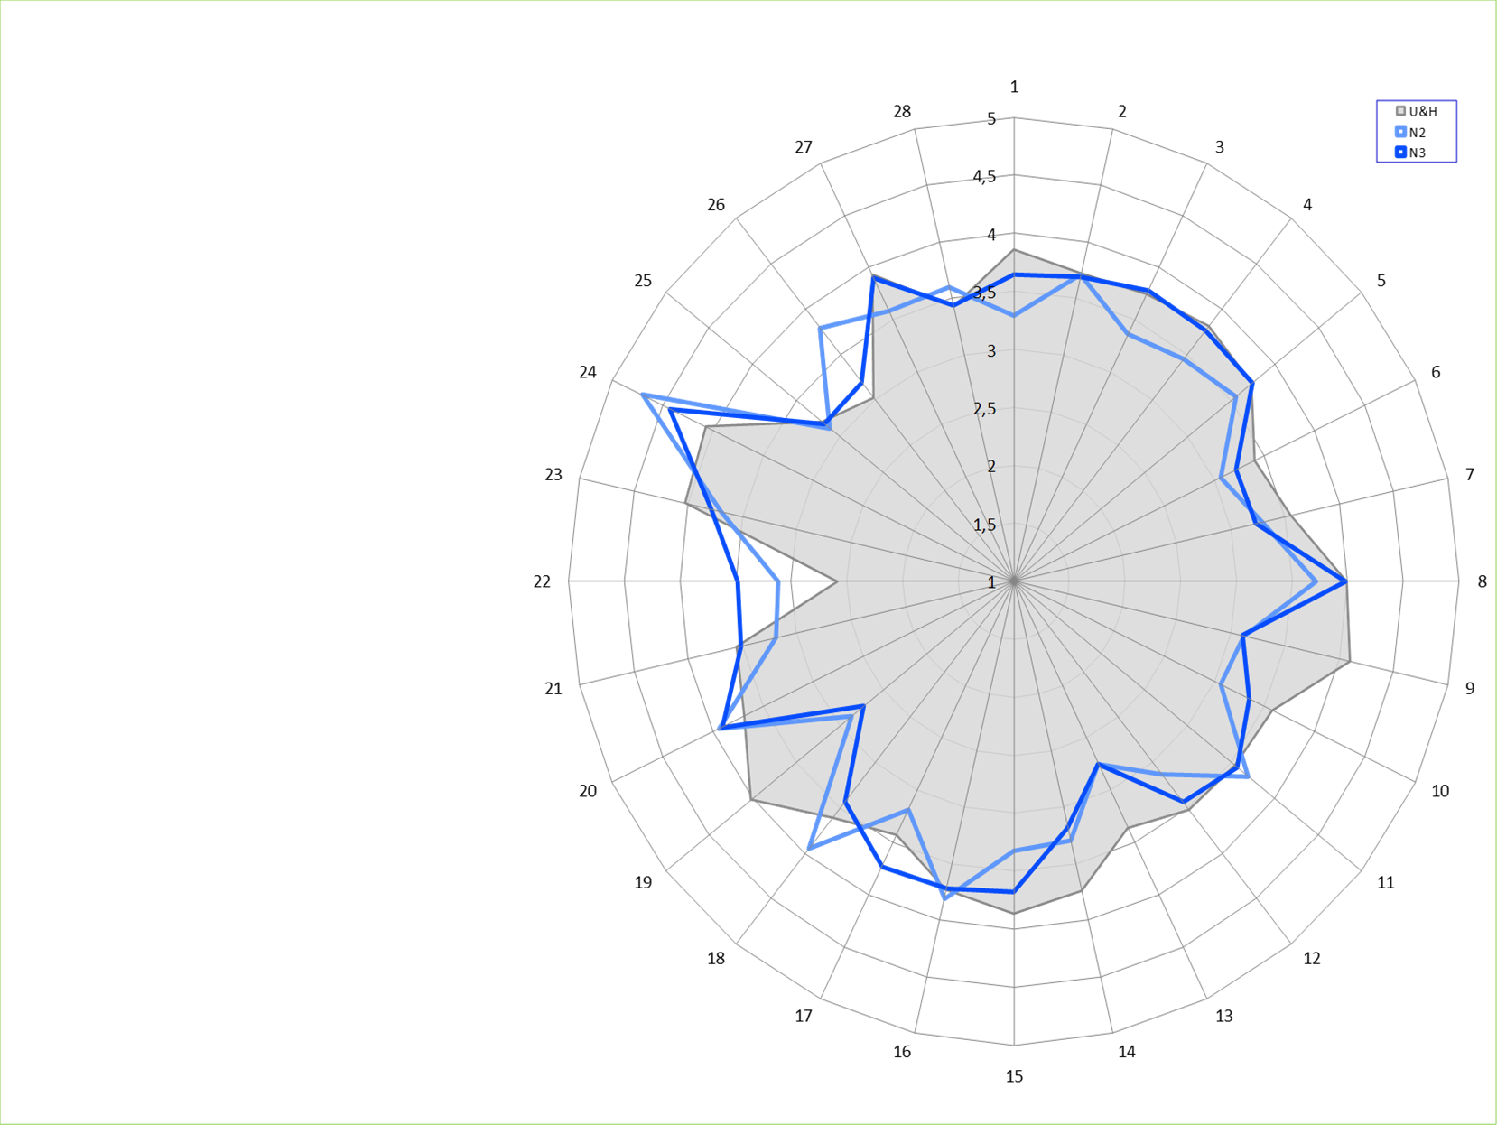





The unit's response to the survey
1: Job autonomy
2: Task completion ambiguity
3: Empowering leadership
4: Recognition
5: Social support from supervisor
6: Competency demands
28: Absence of workaholism
27: Commitment
26: Absence of Work-family-conflict
25: Work-home-facilitation
24: Engagement
23: Meaning of work
7: Cohesion in work teams
8: Social community at work
9: Inclusiveness/ social responsibility
10: Social climate
22: Absence of role overload
21: Absence of role conflicts
20: Abs interpersonal conflicts
19: Abs dysfunctional social support
18: Absence illegitimate tasks
11: Goal clarity
12: Innovation
13: Support research/teaching
14: Fairness of the supervisor
15: Trust/own management
16: Reliability / own management
17: Reliability / next adm level

Slide 18
Group process
Dialogue
Nothing is right or wrong
Explore each others’ perspectives and standpoint
Obtain a common understanding of what you want to achieve
Local focus
Concentrate on the things you can do something about
The unit manager takes note of other matters
Notes:
Notes to management
The framing of the follow-up process is important. The facilitation of the good group processes shall contribute to a common understanding of the situation and the sharing of ideas on how you may further develop the work environment of the unit. If possible, each group should not exceed 8 persons. You may set up groups in advance or let the participants decide which group they want to join. The choice depends on the follow-up actions you have in mind (unit-level, group-level, or employee category). It is also possible to do both, but it will then require more time than a standard 3 hour session. If you have more time, it is possible to have mixed groups in group process 1 (areas to maintain and improve) and have sub-groups in group process 2 (actions).
Use dialogue as a framework for discussion
When you discuss work environment and relational matters, a debate mood where the aim is to win an argument, should be avoided. There is no right answer on these matters as all people are different with different needs and experiences of the work environment.
Encourage participants to use dialogue as the form of communication.
Stimulate all everyone to participate (we have an obligation to contribute to the development of our work environment according to the Work Environment Act), and ensure that everyone behave constructively and respectfully.
Have a local focus
Take an active role (focus on development and own influence), do not delve into the role of the victim (everything was better before…).
Distinguish between what you can do something about and what you cannot influence at the unit.
Focus on what you can do something about. Then you will see that the room of manoeuvre is wider and that you may have more influence on the situation than you initially thought, for instance if you make better use of the resources you have (human resources and the way work is organized).
Other matters of significance to your work environment should be noted by management, sorted out and brought to the attention of the right management level or process in the organization. This is not specific to the follow-up process of the work environment survey, but should be part of the regular development process of the organization.

Slide 19
Group process from results to actions
Group process in two phases:
Work out areas to maintain and areas to improve
Work out and prioritize actions
results
actions
Notes:
Notes to management
The group process towards actions should be done in two phases
The time you have at your disposal, the number of participants, and the framework you set for the discussion, have an impact on wheather it is possible to go through everything in one meeting or if you need to split it up in two meeting. It is also possible to agree that a smaller group is given the task to come up with actions based on the areas to maintain/improve. Employees should in that case be given the opportunity to give feedback on the proposed actions at a later meeting.

Slide 20
Group process 1
– areas to maintain and improve
Discuss the five thematic areas of the work environment survey:
What do you think is the most important to maintain?
What is it necessary to improve?
Which areas shall we work on?
Choose 4 areas which you think are the most important to work on.
(2 areas to maintain and 2 areas to improve)
Notes:
Notes to management
This part of the group process can for instance be organized in this way:
Each table present their four areas. Depending on the number of participants, it is possible to either sum up on the board or in a power-point presentation. If many different areas comes up, it is possible to select four areas by allowing participants to place 2 sticky dots on one or more areas. Start with areas to maintain, then areas to improve.
Another alternative is to let each table write 3 topics on 3 post-its. You can then either use the spiderweb diagram or the picture of the balance (JD-R) and place the post-its on the diagram/picture. Group together similar post-its. If the post-it does not fit the topics of the diagram/picture, just place it in the centre or on the side. If there are many different topics, participants may prioritize with the help of stickly dots.

Slide 21

Group process 2 – actions for areas to maintain
Discuss various measures which can contribute to preserving or developing the two areas you selected to maintain
(put in concrete terms as many actions as possible)
Questions to help «unwrap» appropriate actions:
Why is this important?
What should not be changed or renounced?
How can we do even better?
Notes:
Notes to management
Here are some more questions you may use if it is difficult to turn your ideas into specific actions.
What should we not change/terminate because it is one of the most important factors in order for you to enjoy work?
What do we have to do in order to maintain the most important things to maintain?
What works well?
Why does it work well?
How can we ensure that it will keep on working well?
How can it be further developed?
Try to find SMART actions:
Specific (as concrete as possible)
Measurable (not a must, but convenient when the effectiveness of actions are evaluated)
Acceptance (common understanding of challenges and actions)
Relevance (actions matches identified challenges)
Time limited (annual action plan)

Slide 22

Group process 2 – actions for improvement
Discuss various measures which can contribute to the improvement/development of the two improvement areas selected
(put in concrete terms as many as possible)
Questions to help «set the standard»:
How does it look like when we have succeeded?
What are we doing then?
Notes:
Notes to management
Here are some more questions you may use if it is difficult to turn your ideas into specific actions:
Solution orientation:
How does it look like when it works? Describe.
How do you work then?
What concrete action do to you take?
GAP-analysis:
Where are we going?
Where do we stand?
How do we get there?

Slide 23

Group process 2 – prioritize actions
Which concrete actions will you prioritize to implement in 2018?
Prioritize 3 actions for areas
to maintain
Prioritize 3 actions for
improvement
Notes:
Notes to management
This exercise is done at each table:
Each table write down 6 actions (max) on a flip-over sheet.
The group quickly presents their actions, combine similar actions!
All participants are given 6 sticky dots (in two colours) and place their votes on actions for areas to maintain and actions for improvement. The votes can be distributed or placed on one action of each kind.
Give participants 10 minutes to place their sticky dots.
Count sticky dots and select the 3 actions with the most votes to maintain and the 3 actions with the most votes to improvement. List the selected actions on the action plan (next slide).

Slide 24
Work Environment Survey 2017 – action plan
Date:…… Name of unit:…………………………………………………(place on the work environment file of the unit)
Concrete actions relating to areas to maintain and to improve | Responsible | Deadline
Notes:
Notes to management
If time allows, you may challenge the groups to appoint a responsible person for the implementation of each action point, as well as to set a deadline. By experience it is usually necessary to take up such matters again, but a preliminary brainstorming can be fruitful.
End the meeting by thanking everyone for their contribution and communicate that this is the start of a development process of the work environment at the unit.
After the meeting, the follow-up actions include:
Finalize description of actions and implement them
Continuous evaluation of the effectiveness of actions and adjustment of actions if needed
Reporting to next management level according to institutional guidelines
Say something about when the participants can expect further information about the development and implementation process at the unit.

