Slide 1
General meeting IDI Trondheim on co-location with focus on employee areas
23.01.2019

Slide 2
Agenda
Presentation of main status and plans (John Krogstie)
Timeframe and milestones
Overall background for co-location
Framework conditions for use and adaptation of new areas
Use of new and existing areas
Who should sit where? Principles and process.
IDI's project organization
Communication ahead
Questions of general interest can be asked along the way
Possible to ask more detailed questions after presentation
Representatives from the co-location project centrally, as well as from the faculty and department

Slide 3
Timeframe and milestones
The move of IDI from Kalvskinnet must be no later than 1.12.2019. (Teaching ends November 22, exam period starts November 25)
Plan for adaptations of workplaces in the IT building south wing is decided on 30.4.2019.
Learning area plan ready for 14.6.2019.
Final implementation is decided on 14.6.2019.
Rebuilding and adaptations in IT building south wing completed 15.9.2019.

Slide 4
Overall setting
The Rector has decided that the technology studies at Kalvskinnet will be co-located with the technology studies at Gløshaugen
Overall goals for co-location of IDI Gløshaugen and IDI Kalvskinnet:
Gather the academic community at IDI Trondheim one place to achieve a greater degree of collaboration across the different environments within
Teaching
Research
to improve how we do this

Slide 5
What can we achieve through co-location?
Utilize each other's strengths.
The different communities have different strengths, some examples:
Kalvskinnet
Team-based education
Follow-up of student cohort - stronger class feeling
Broad experience within EVU that is important for a new strategy for this field
Gløshaugen
Implementation of large courses
Long experience in obtaining research funding both nationally and internationally
Publishing

Slide 6
Advantages of co-location
Robustness, many subject areas where we have teaching activities both at Gløshaugen and at Kalvskinnet (and Gjøvik)
Programming
Algorithms and data structures
Databases
Software Engineering
Operating systems
Computer-aided collaborative work…..
Simplifies collaboration in new research initiatives across units
XR+ – Extended reality
IT for Health and Welfare
IT Education and learning

Slide 7
Overall regulations for the co-location project based on the Rector's decision of 22.10.2018
23 sqm gross per workplace (calculated from the total floor space)
Fixed places where it is considered necessary to perform the work
Must ensure flexibility for the use of offices over time
Will not be own office for everyone
Applies to both new buildings and remodeling as well as new premises we receive (IT-south 2.floor)
The area standard applies to everyone at NTNU

Slide 8
Budget for changing employee areas and labs
5-7 MNOK total cost, including labs.
Contributions from the faculty and department to improve solutions will be assessed in the overall framework of the entire NTNU's co-location

Slide 9
New and existing premises
Architectural assessment: capacity of 48 fixed workplaces in IT-Syd 2nd floor (21 sqm BTA workplace)
At least 6 sqm per workplace (workplace regulations)
23 sq.m. BTA provides 44 workplaces in IT-south 2. floor
Not allowed to redesign learning areas to workplaces
Growth in student numbers at IDI and IE
Changes in the IT building in relation to growth and possible changes of offices
2019 will be a year we tidy, for example clear / compress stock to accommodate some more small meeting rooms

Slide 10
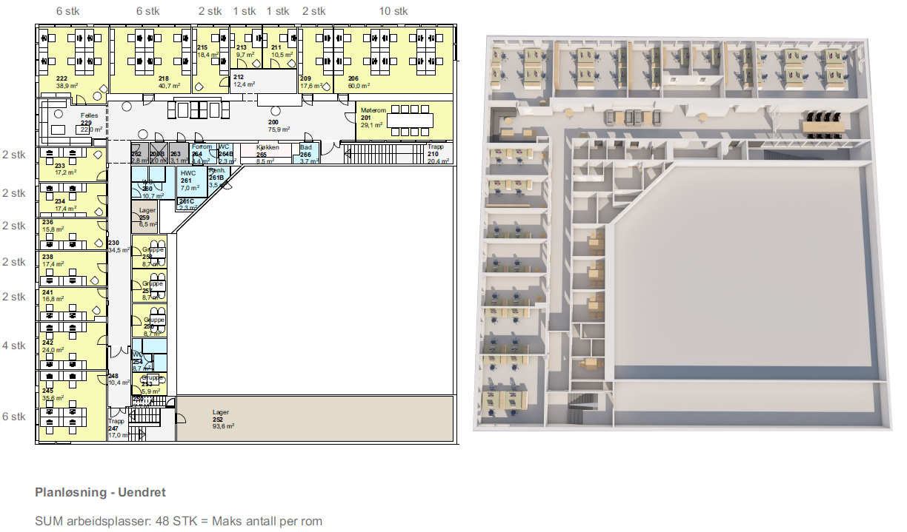
IT-syd 2.floor sketch

Slide 11
3 different scenarios we investigate
AIT in IT south 2.floor
About half of the temporary employees (PhD / Postdoc) in IT-south 2.floor (reshuffle offices in IT-building that makes room for AIT there)
Another unit in IT-south 2.floor (reshuffle offices in IT-building that makes room for AIT there)

Slide 12
Who is going where?
Assessment is done by the department in collaboration with the faculty
Everyone must be prepared to change offices
The process is further run by IDI's project organization in cooperation with the central co-location project
The goal is improved collaboration, as well as good working conditions to achieve this
Co-determination is ensured through employee representatives and structured meeting points between the employer and the unions (LOSAM)
Participation is taken care of directly by the departments' managers and employees, where the employees themselves contribute to the design of the decisions that affect the work situation
Use representative in internal project organization (overview later in the presentation)
Different participation arenas during the process
Seminar at Oppdal, other meetings during the winter / spring
Participation means that everyone should be heard, but not all inputs can be taken into account

Slide 13
Principles for the desired use of rooms that we consider in the different scenarios in relation to employee offices: Not all wishes can be met
Permanent employees to the greatest possible extent in their own offices. Some are going to have to share office (there is sharing of offices on all Campi at present)
Teachers in the same unit should be able to sit close to each other
Support for collaboration and integration (possible to place people working in the same areas close to each other)
The subject units should be in the same building body (IT-south and IT-building is considered here as the same building body)
The department wants to be at as few different places as possible (e, g, an area for employees and one student area in reasonable proximity (5-7 min walk))
PhD / Postdoc (3-4 years of engagement) should be able to sit near the supervisor
PhD / Postdoc can sit in rooms where 2-5 share office (fixed space)
More short-term guests can sit in the common area (on IDI exemplified by the VIP room) with no fixed space
Subject-specific laboratories should be in close proximity to where the professionals using these have offices

Slide 14
Roles / functions in operational subproject group and support functions at faculty and SAMLOK for implementation of subproject on IDI
Institutt
Fakultet
SAMLOK
Jan Håvard Ryen – fra 2/1
Delprosjektleder
Jan Håvard Ryen – fra 2/1
Koordinering byggeprosess
Cathrine Haugen Grønvik
Bistand organisasjonsprosess
Nina Kotte
Bistand kommunikasjon
Kari Skarholt
Bistand gjennomføring org.utvikling
Morten Grande
Delprosjektleder byggeprosjekt
Jan Håvard Ryen
Koordinering kommunikasjon
Monica Storvik
Koordinering Flytteprosess
Terje Brekke/Vegard Kildal
Bistand prosjekt/prosjektstøtte
Linn Rasch Aune
Organisasjonsutvikling/Kommunikasjon
Randi Tiller Ansvarlig flytteprosess
Morten Antonsen
Koordinering organisasjonsprosess
John Krogstie
Ansvarlig leder og overordnet ansvarlig
Eva Helene Haanæs
Arkitekt
Eva Lotte Johansen NTNU Eiendom

Slide 15
IDI's project organization
Monica Storvik <monica.storvik@ntnu.no>; AIT
Magnus Själander <magnus.sjalander@ntnu.no>; Computing
Mads Nygård <mads.nygaard@ntnu.no>; DART
Babak Amin Farshchian <babak.farshchian@ntnu.no>; ISSE
Birgit Sørgård <birgitss@ntnu.no>; HMS, adm. ansatte
Alf Høiseth <alfh@ntnu.no> – teknisk gruppe
Bart Iver van Blokland <bart.van.blokland@ntnu.no>; Temporary emplyees
Stein Meisingseth <stein.meisingseth@ntnu.no>; Verneombud Kalvskinnet
Randi Holvik <randi.holvik@ntnu.no>; (1.1 Nytt verneombud Gløs)
Åsmund Haugse <aasmuha@stud.ntnu.no>; Studentrepresentant Gløshaugen
Hallvard Sælthun <hallvsa@stud.ntnu.no>; Studentrepresentant Kalvskinnet
Morten Antonsen <morten.antonsen@ntnu.no> – HR focus on organizational development
Your main contact in the process ahead is the representative of your unit / group

Slide 16
Communication ahead
Sharepoint directory already in use updates continuously https://studntnu.sharepoint.com/:f:/s/TeamSite/4195/EqOWA6VSuZRNlywR4UyenGYBcrmPD64VSIwF3J4nBxHWNA?e=xWzVxt
On important decisions, it is notified on Innsida
Important that the representatives in the project organization contribute to information out to the unit, as well as ensure participation

Slide 17
Further questions ?

